Slide 1
LO: Non-Linear Graphs
(Rates of Change)

Slide 2

What is the gradient?
r
s
Gradient $=\frac{r}{s}$

Slide 3

What is the gradient?
2
1
Gradient $=\frac{2}{1}=2$

Slide 4

What is the gradient?
8
4
Gradient $=\frac{8}{4}=2$

Slide 5

What is the gradient?
1
2
Gradient $=\frac{1}{2}=0.5$

Slide 6
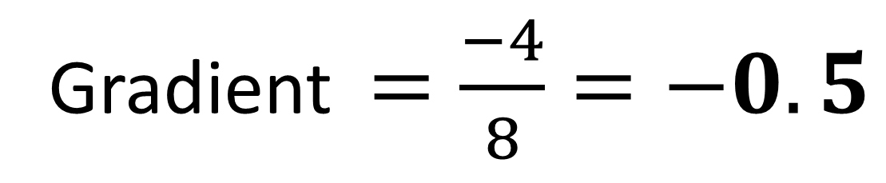
What is the gradient?
-4
8
Gradient $=\frac{−4}{8}=−0.5$

Slide 7

Do cars travel at constant speeds?
Sometimes

Slide 8
What word would you use to describe the rate of change of velocity and time?
Acceleration

Slide 9
What word would you use to describe the rate of change of distance and time?
Velocity or Speed

Slide 10
The velocity time graphs shows the journey of car.
Velocity
Time
What is strange about this graph?
They are all linear lines

Slide 11
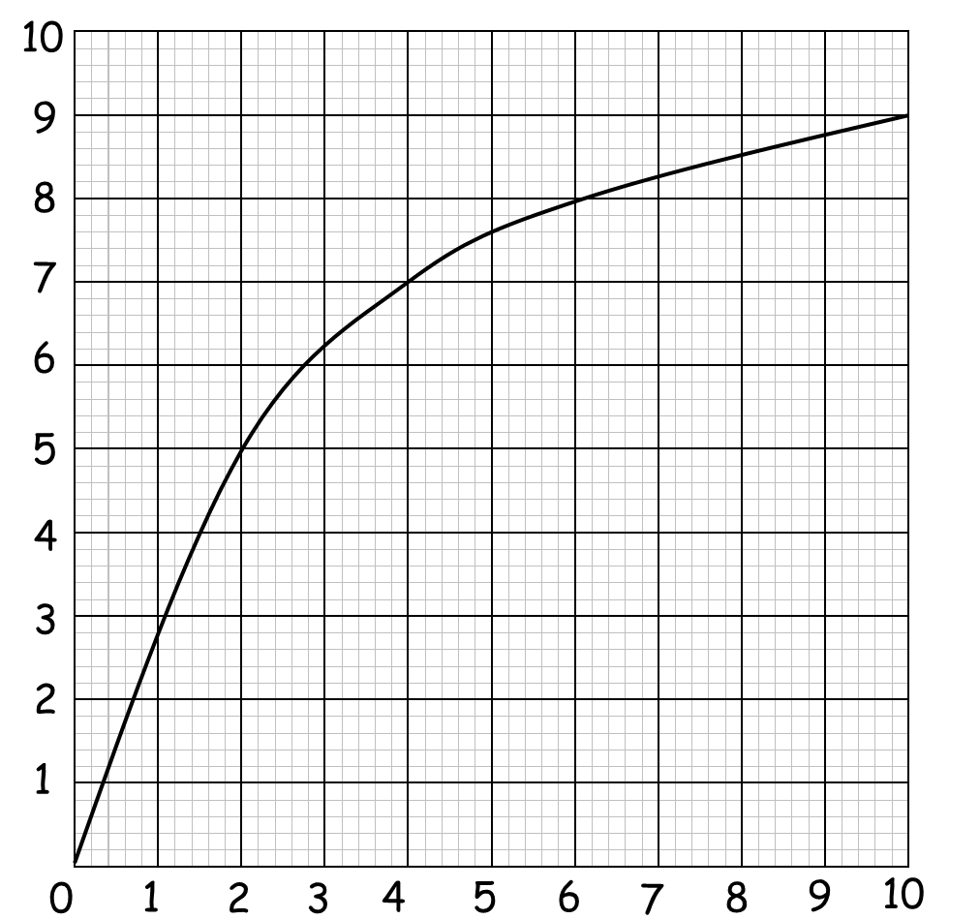
Changing Acceleration.
Velocity (m/s)
Changing acceleration will be seen as a curved graph.
Time (Seconds)

Slide 12
Measuring Acceleration.
Velocity (m/s)
Find the gradient of
a tangent at the time you want to know the acceleration.
Time (Seconds)

Slide 13
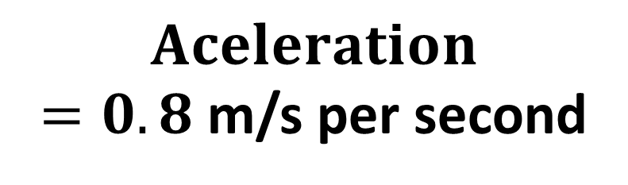
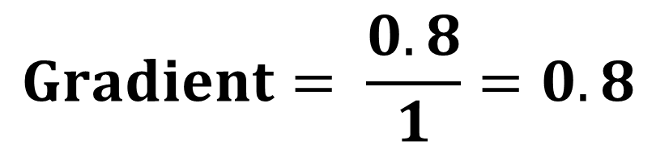
0.8
What is the acceleration of the car at 4 seconds?
1
Velocity (m/s)
$$Gradient= \frac{0.8}{1}=0.8$$
$$Aceleration$$
$=0.8$ m/s per second
Time (Seconds)

Slide 14
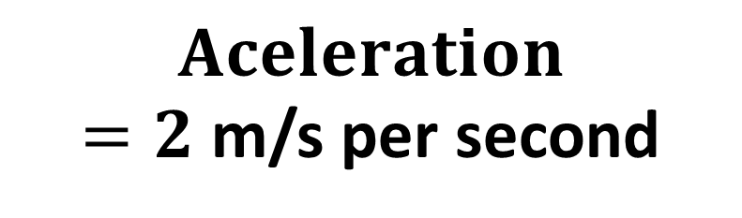
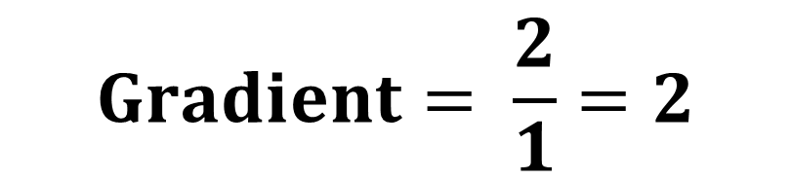
What is the acceleration of the car at 2 seconds?
2
Velocity (m/s)
1
$$Gradient= \frac{2}{1}=2$$
$$Aceleration$$
$=2$ m/s per second
Time (Seconds)

Slide 15
Accelerating
or Decelerating?
5 m/s per second
Accelerating

Slide 16
Accelerating
or Decelerating?
0.5 m/s per second
Accelerating

Slide 17
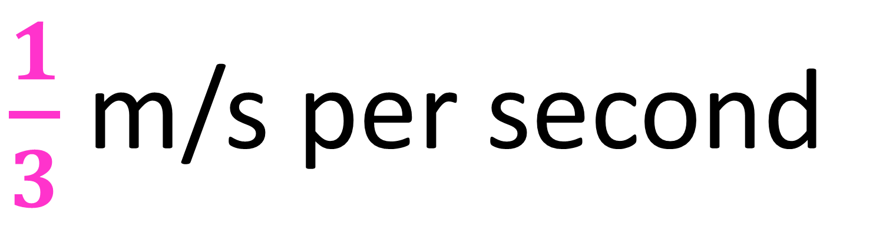
Accelerating
or Decelerating?
$\frac{1}{3}$ m/s per second
Accelerating

Slide 18

Accelerating
or Decelerating?
$−5$ m/s per second
Decelerating

Slide 19
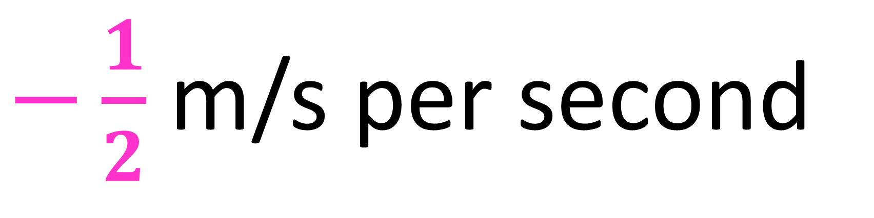
Accelerating
or Decelerating?
$−\frac{1}{2}$ m/s per second
Decelerating

Slide 20
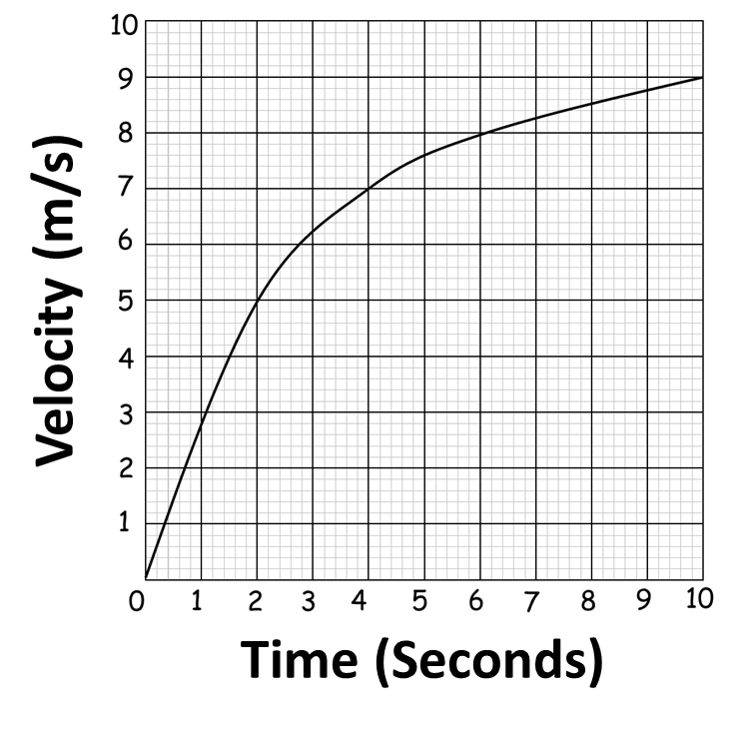
Accelerating
or Decelerating?
Accelerating

Slide 21
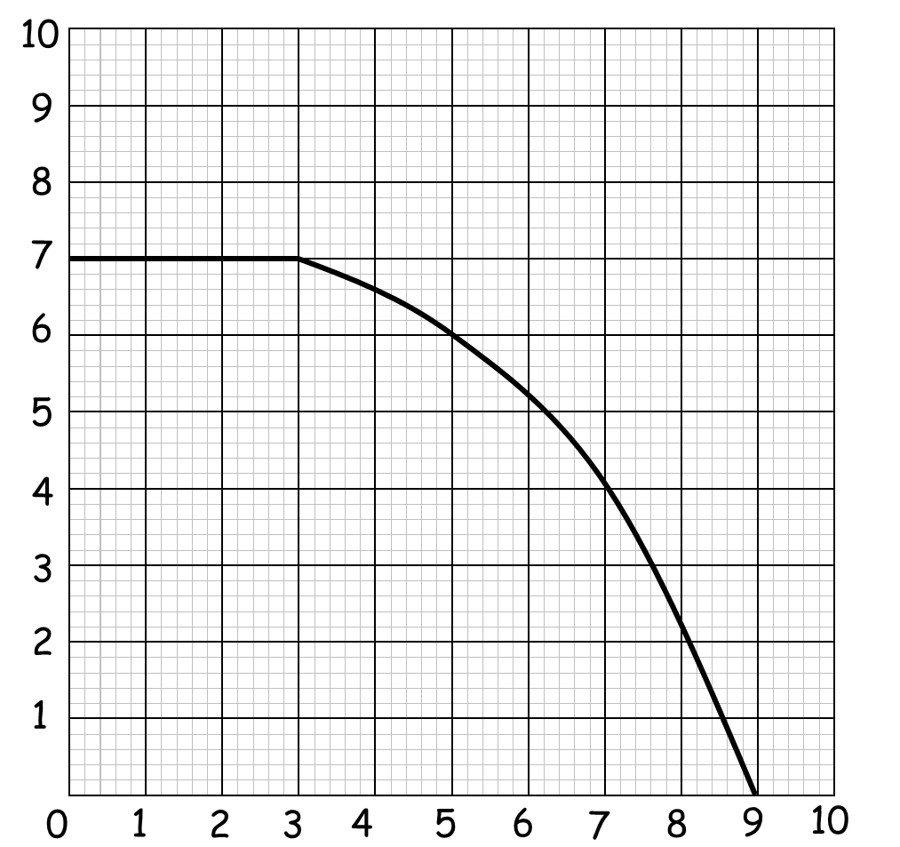
Accelerating
or Decelerating?
Decelerating
Velocity (m/s)
Time (Seconds)

Slide 22
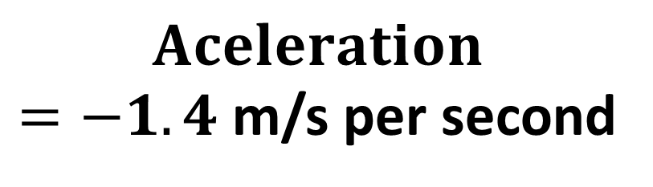
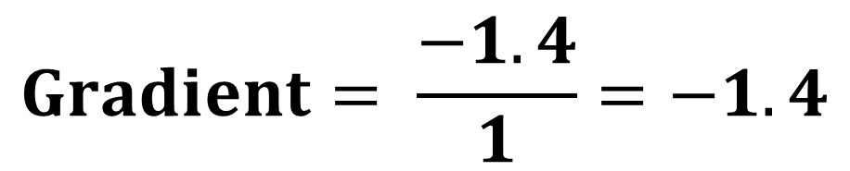
What is the deceleration of the car at 7 seconds?
Distance (m/s)
1
$$Gradient= \frac{−1.4}{1}=−1.4$$
-1.4
$$Aceleration$$
$=−1.4$ m/s per second
Time (Seconds)

Slide 23
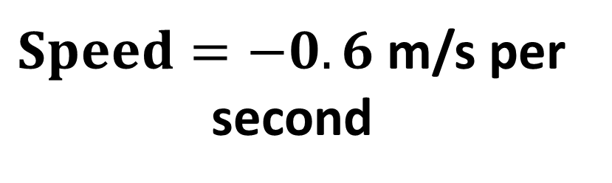
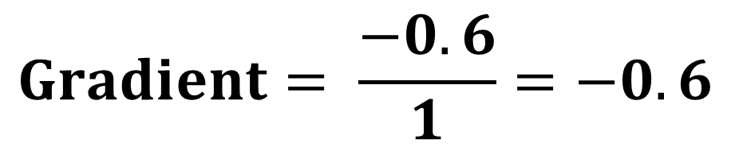
What is the speed
of the car at 7 seconds?
1
-0.6
Distance (m/s)
$$Gradient= \frac{−0.6}{1}=−0.6$$
$Speed=−0.6$ m/s per second
Time (Seconds)

Slide 24
Acceleration over a period of time.
Identify the two times
then draw a straight line.
Then find the
gradient of the line.
Velocity (m/s)
Time (Seconds)

Slide 25
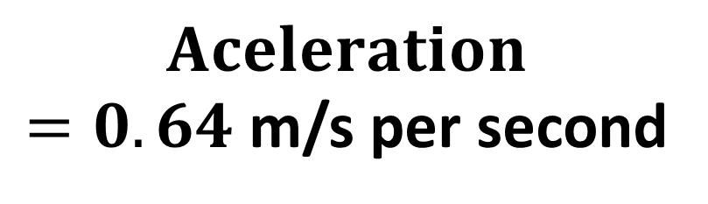

What is the acceleration between
2 and 7 seconds?
3.2
Velocity (m/s)
5
$$Gradient= \frac{3.2}{5}=0.64$$
$$Aceleration$$
$=0.64$ m/s per second
Time (Seconds)

