Slide 1

Intermediate Challenge 2
GOLD

Slide 2
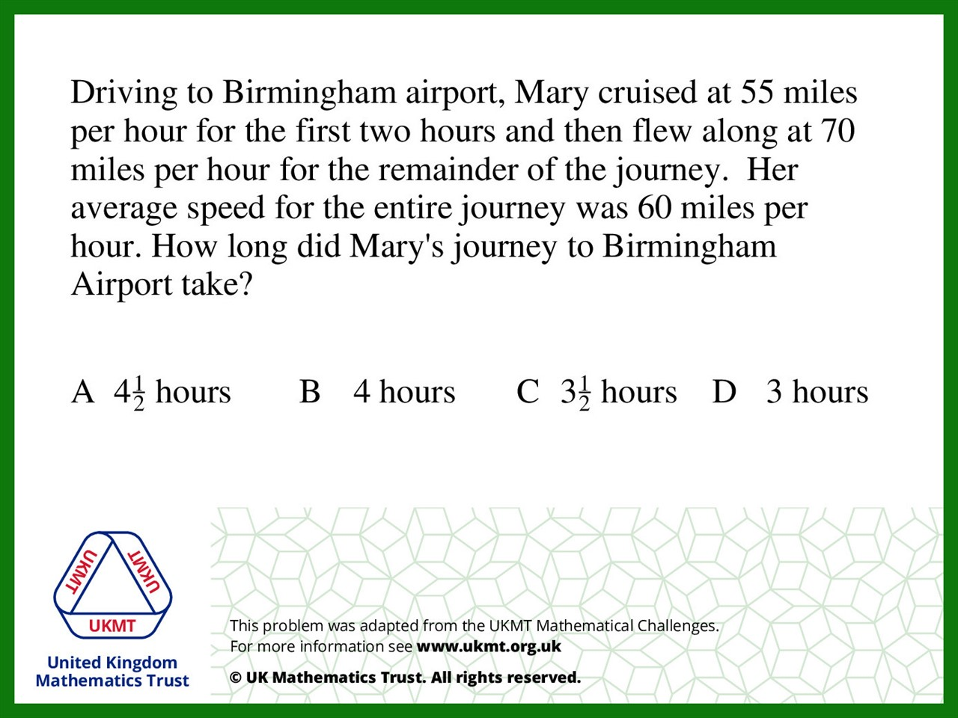
Q1.
55 x 2 =110
110 + 70 = 180
180 ÷ 3 = 60

Slide 3
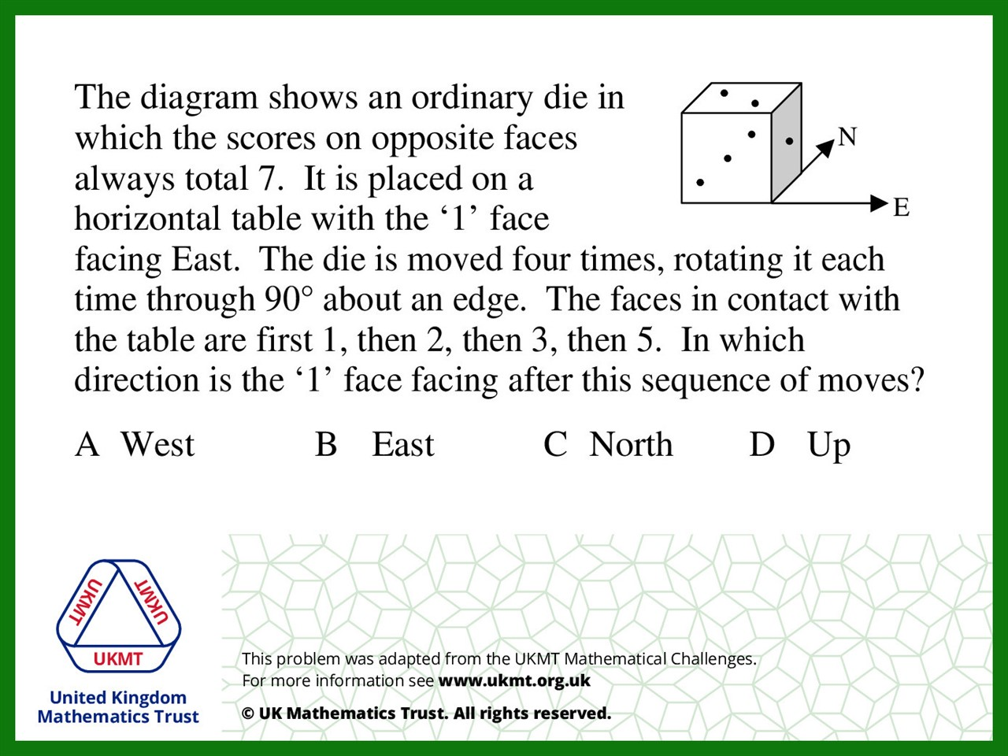
Q2.
1 = Right side moves bottom
2 = Right side moves bottom
3 = Front moves bottom
5 = Back moves bottom 1 facing West

Slide 4
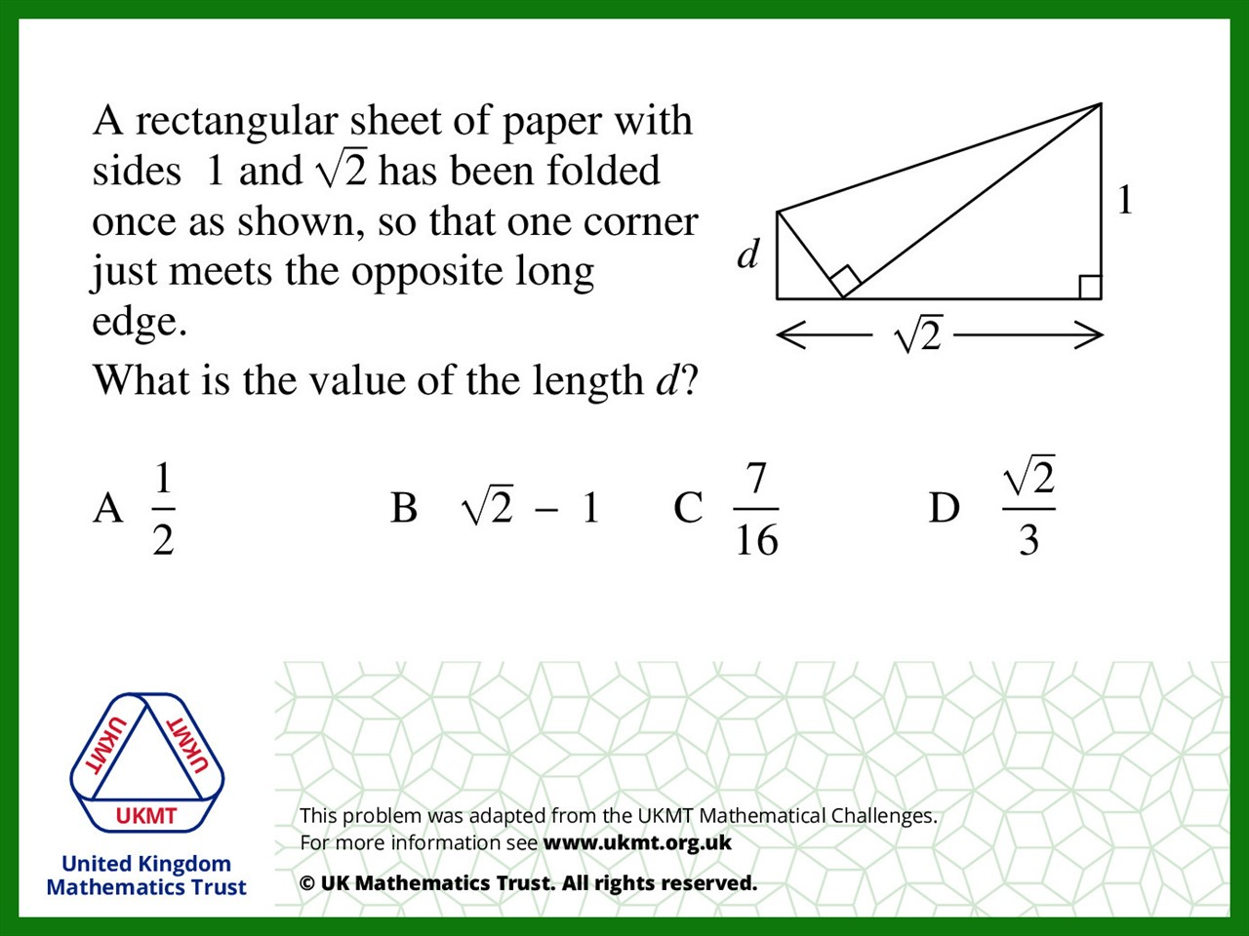
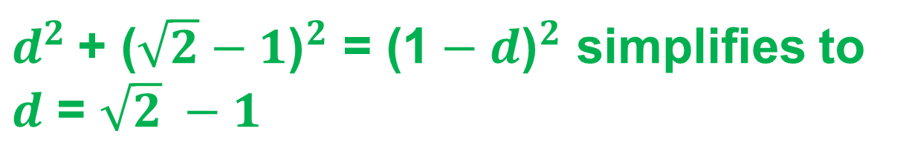
Q3.
$d^{2}$+ ${\text{(}\sqrt{2}−1\text{)}}^{2}$ = ${\text{(1}−d\text{)}}^{2}$ simplifies to
$d$ = $\sqrt{2} −1$

Slide 5
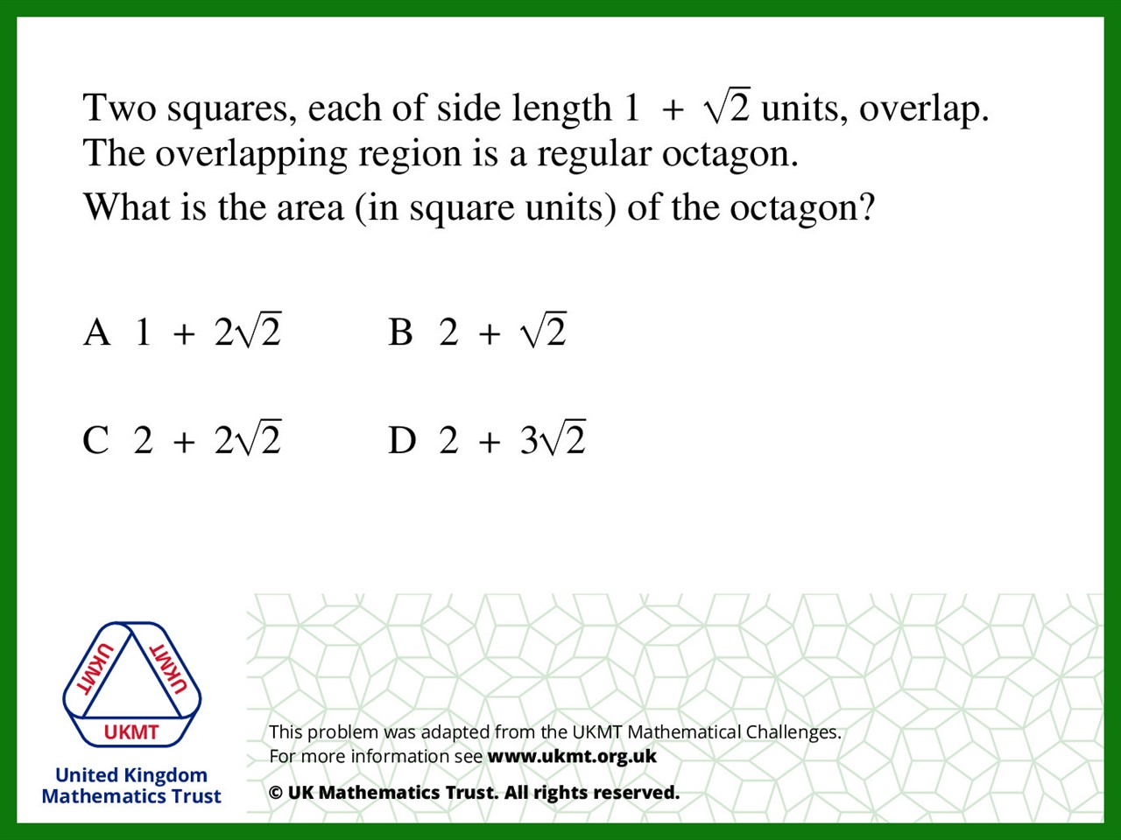
Q4.

Slide 6
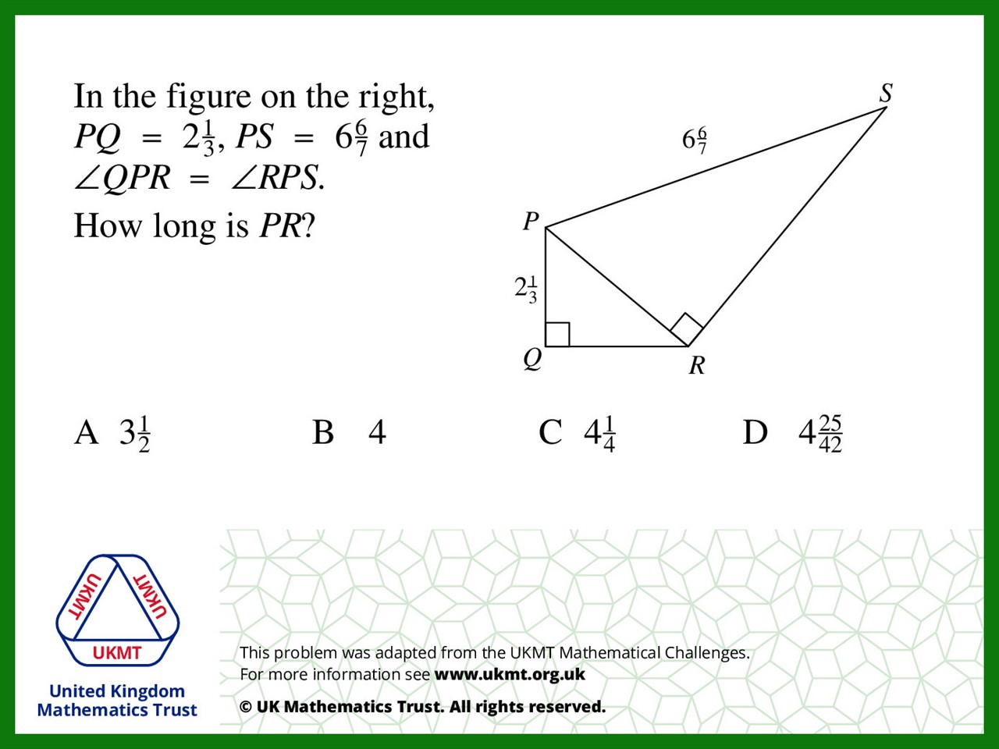

Q5.
They are similar triangles
Scale factor = $\frac{12}{7}$
Then do PS divided by scale factor to find PR

