Slide 1
What shape am I?
I have 6 faces.
I have 8 vertices.
I have 12 edges.
My faces are all the same shape.
I am a cube!
?

Slide 2

What shape am I?
I have 1 curved face.
I have 2 circular faces.
I have 0 vertices.
I am a cylinder!
?

Slide 3
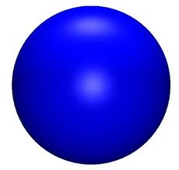
What shape am I?
I have 1 curved face.
I have 0 vertices.
I have 0 edges.
I am a sphere!
?

Slide 4
What shape am I?
I have 6 faces.
I have 8 vertices.
4 of my faces are rectangles.
I have 12 edges.
I am a cuboid!
?

Slide 5
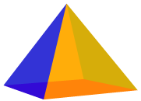
What shape am I?
I have 5 faces.
I have 5 vertices.
I have 8 edges.
I am a triangular pyramid!
?

Slide 6
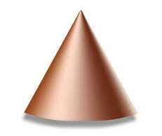
What shape am I?
I have 1 curved face.
I have 1 circular face.
I have 1 vertex.
I am a cone!
?

