Slide 1
Exponentials and Logs
Non-Linear Data
Chapter 14
(Part 9 of 9)

Slide 2
Graphs of Exponential Data
In Science and Economics,
experimental data often has
exponential growth.
e.g. bacteria grow/decay,
rabbit populations,
energy produced by earthquakes,
twitter followers over time, etc.

Slide 3
What type of line is the best fit for this graph?
Population of Rabbits
Exponential Curve of best fit
2000
Year
1970
1980
1990

Slide 4
Regression
The process of finding parameters in a model, that best fits the data,
is known as regression.

Slide 5
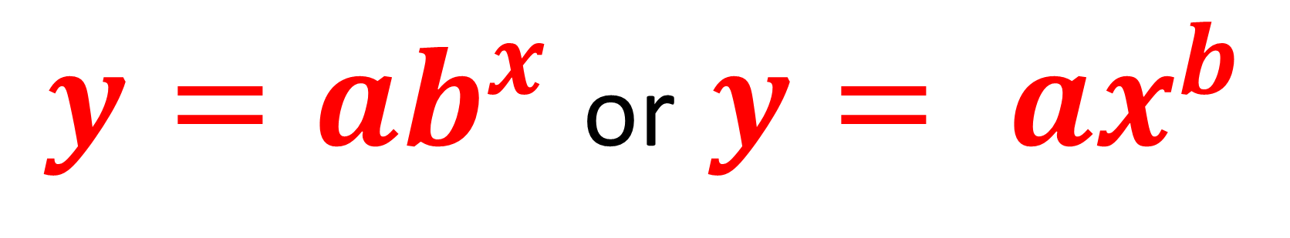
For exponential graphs
there are two possible
general equations
${y=ab}^{x}$or $y= {ax}^{b}$

Slide 6
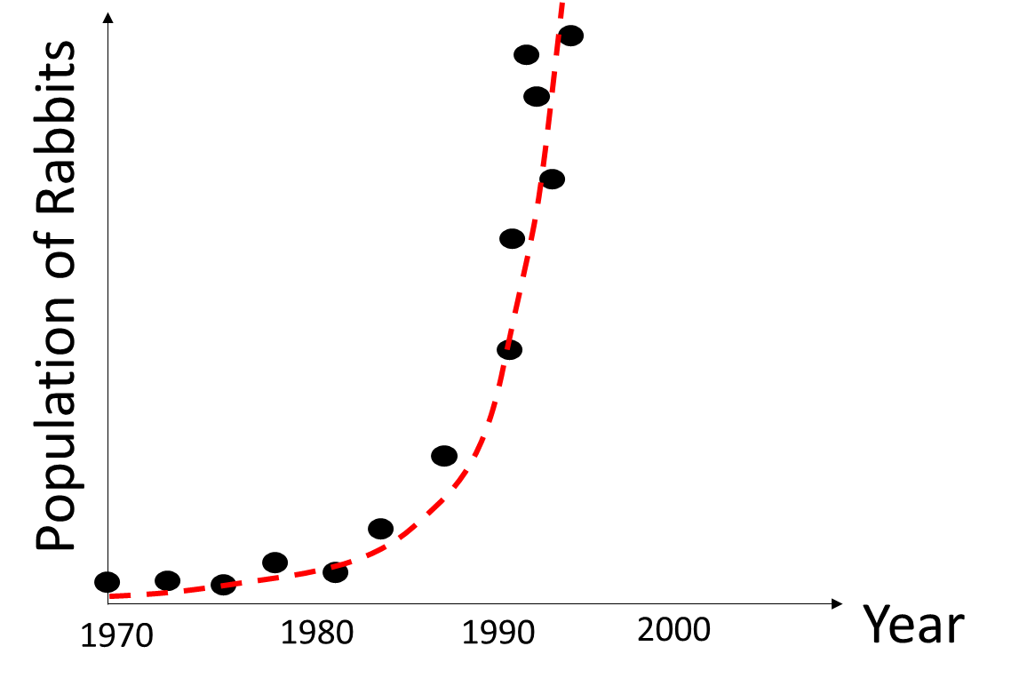
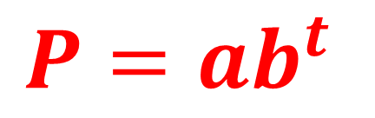
As the data is non-linear it is hard
to draw an ‘exponential curve of best fit’.
$${P=ab}^{t}$$
If the data had a linear trend, then this would be easy!

Slide 7
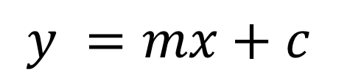
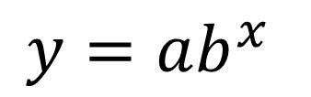

Exponential Model $(y=ab^{x})$ → Linear Model
P
$$y=ab^{x}$$
Log P
$$y =mx+c$$
Population
Log Population
(x , log y)
(x , log y)
(x , y)
(x , y)
30
Years
Years
0
10
20
0
10
20
30

Slide 8
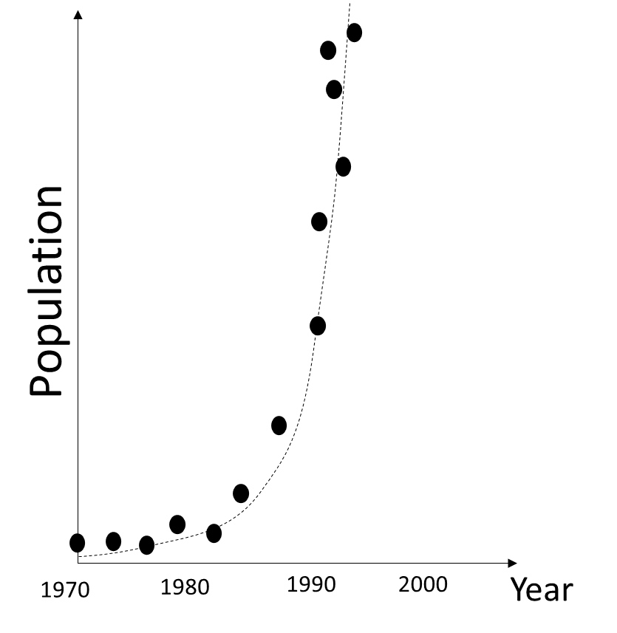
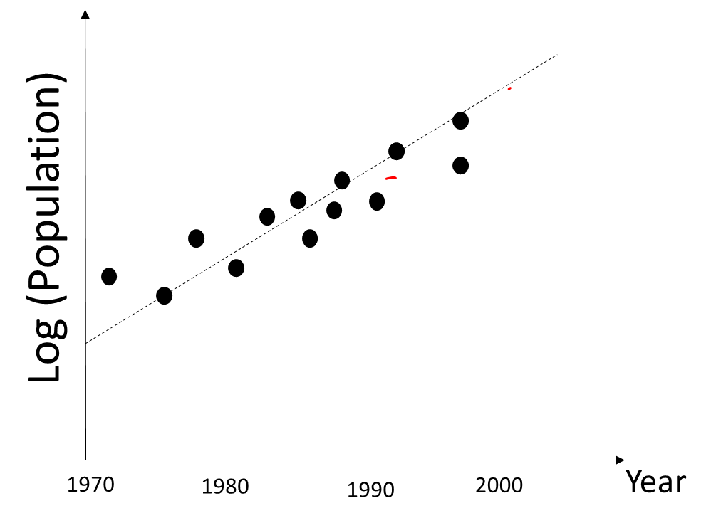
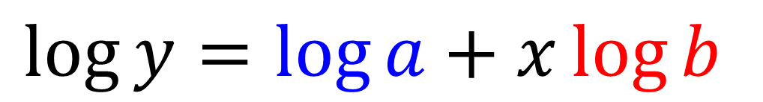
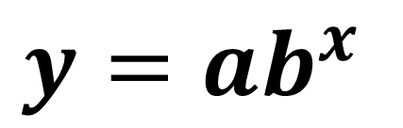
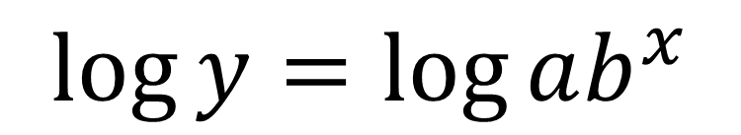
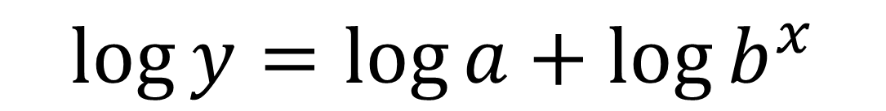

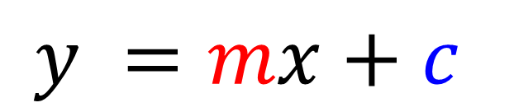

Exponential Model $(y=ab^{x})$ → Linear Model
$$y=ab^{x}$$
$$y=ab^{x}$$
$$\log{y}=\log{ab^{x}}$$
$$\log{y}=\log{a+\log{b^{x}}}$$
$$y =mx+c$$
$$\log{y}=\log{a}+x\log{b}$$
$$y =mx+c$$

Slide 9
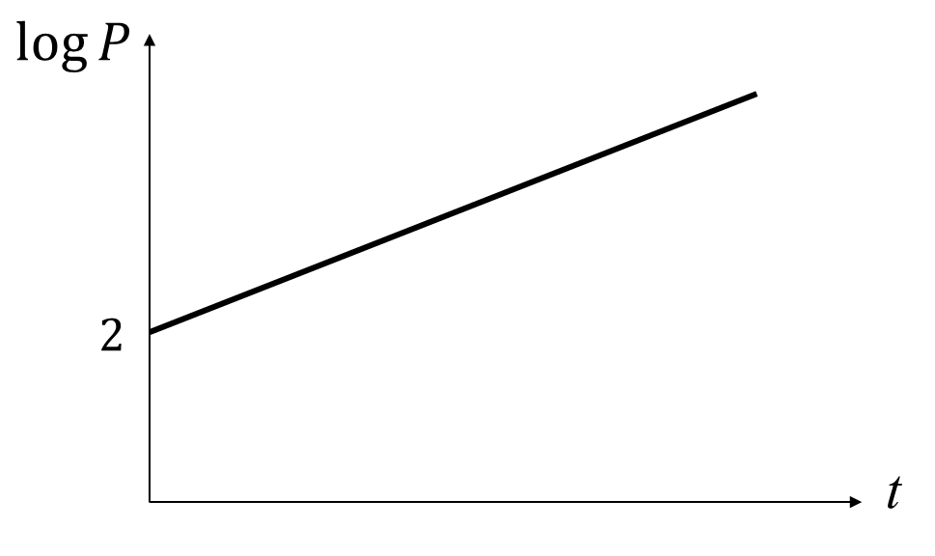
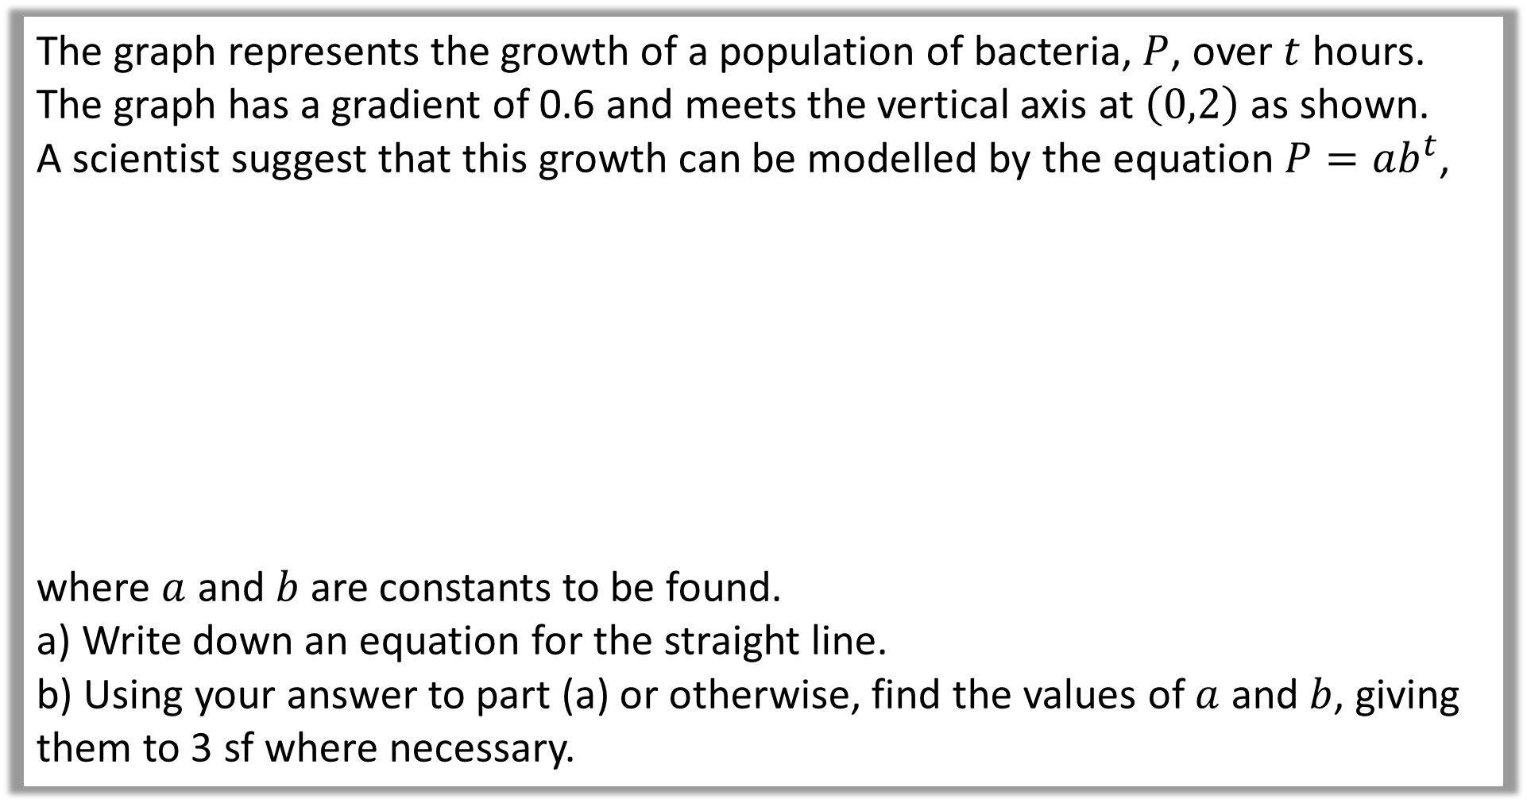
The graph represents the growth of a population of bacteria, $P$, over $t$ hours.
The graph has a gradient of 0.6 and meets the vertical axis at $\left(0,2\right)$ as shown.
A scientist suggest that this growth can be modelled by the equation $P=ab^{t}$,
where $a$ and $b$ are constants to be found.
a) Write down an equation for the straight line.
b) Using your answer to part (a) or otherwise, find the values of $a$ and $b$, giving them to 3 sf where necessary.

Slide 10
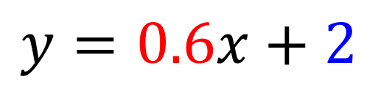
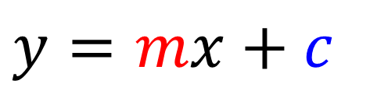

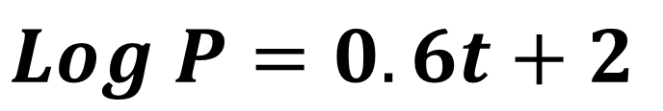

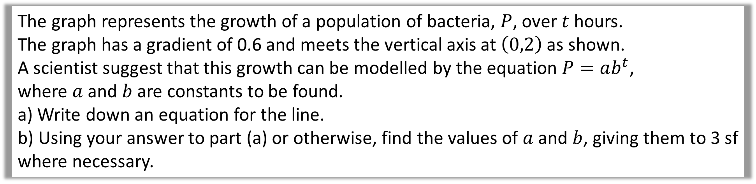
The graph represents the growth of a population of bacteria, $P$, over $t$ hours.
The graph has a gradient of 0.6 and meets the vertical axis at $\left(0,2\right)$ as shown.
A scientist suggest that this growth can be modelled by the equation $P=ab^{t}$,
where $a$ and $b$ are constants to be found.
a) Write down an equation for the line.
b) Using your answer to part (a) or otherwise, find the values of $a$ and $b$, giving them to 3 sf where necessary.
$$\log{P}$$
$$y=mx+c$$
a)
$$y=0.6x+2$$
$$Log P=0.6t+2$$
$$2$$
t

Slide 11











The graph represents the growth of a population of bacteria, $P$, over $t$ hours.
The graph has a gradient of 0.6 and meets the vertical axis at $\left(0,2\right)$ as shown.
A scientist suggest that this growth can be modelled by the equation $P=ab^{t}$,
where $a$ and $b$ are constants to be found.
a) Write down an equation for the line.
b) Using your answer to part (a) or otherwise, find the values of $a$ and $b$, giving them to 3 sf where necessary.
b)
$$\log{P}$$
$$P=ab^{t}$$
$$log P=0.6t+2$$
$$\log{P}=\log{a}+t\log{b}$$
$$\log{b=0.6}$$
$$\log{a=2}$$
$$2$$
$$b{={10}^{0.6}}$$
$$a{={10}^{2}}$$
t
$$b{=3.98}$$
$$a{=100}$$

Slide 12
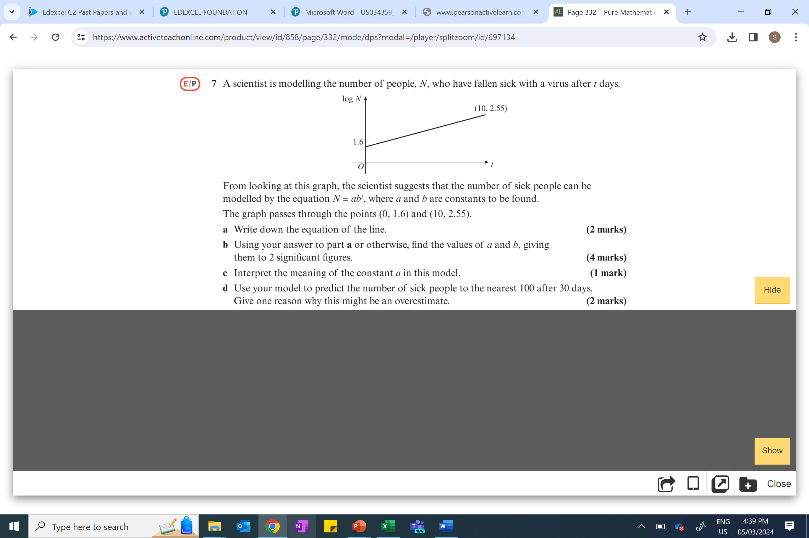

Slide 13
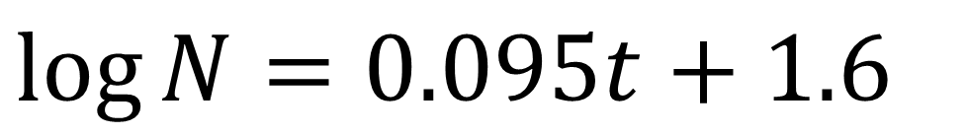
$$\log{N}=0.095t+1.6$$

Slide 14
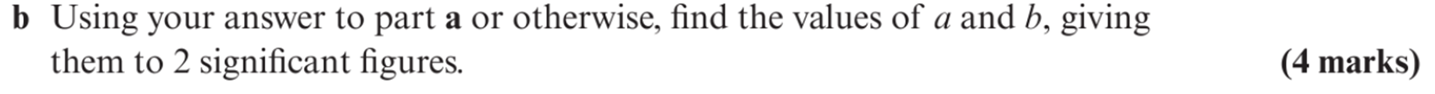









$$\log{N}=0.095t+1.6$$
$$\log{b=0.095}$$
$$\log{a=1.6}$$
$$N=ab^{t}$$
$$b{={10}^{0.095}}$$
$$a{={10}^{1.6}}$$
$$\log{N}=\log{a}+t\log{b}$$
$$b{=1.2}$$
$$a{=40}$$

Slide 15
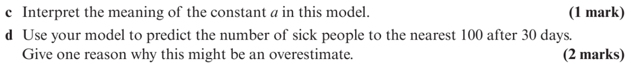
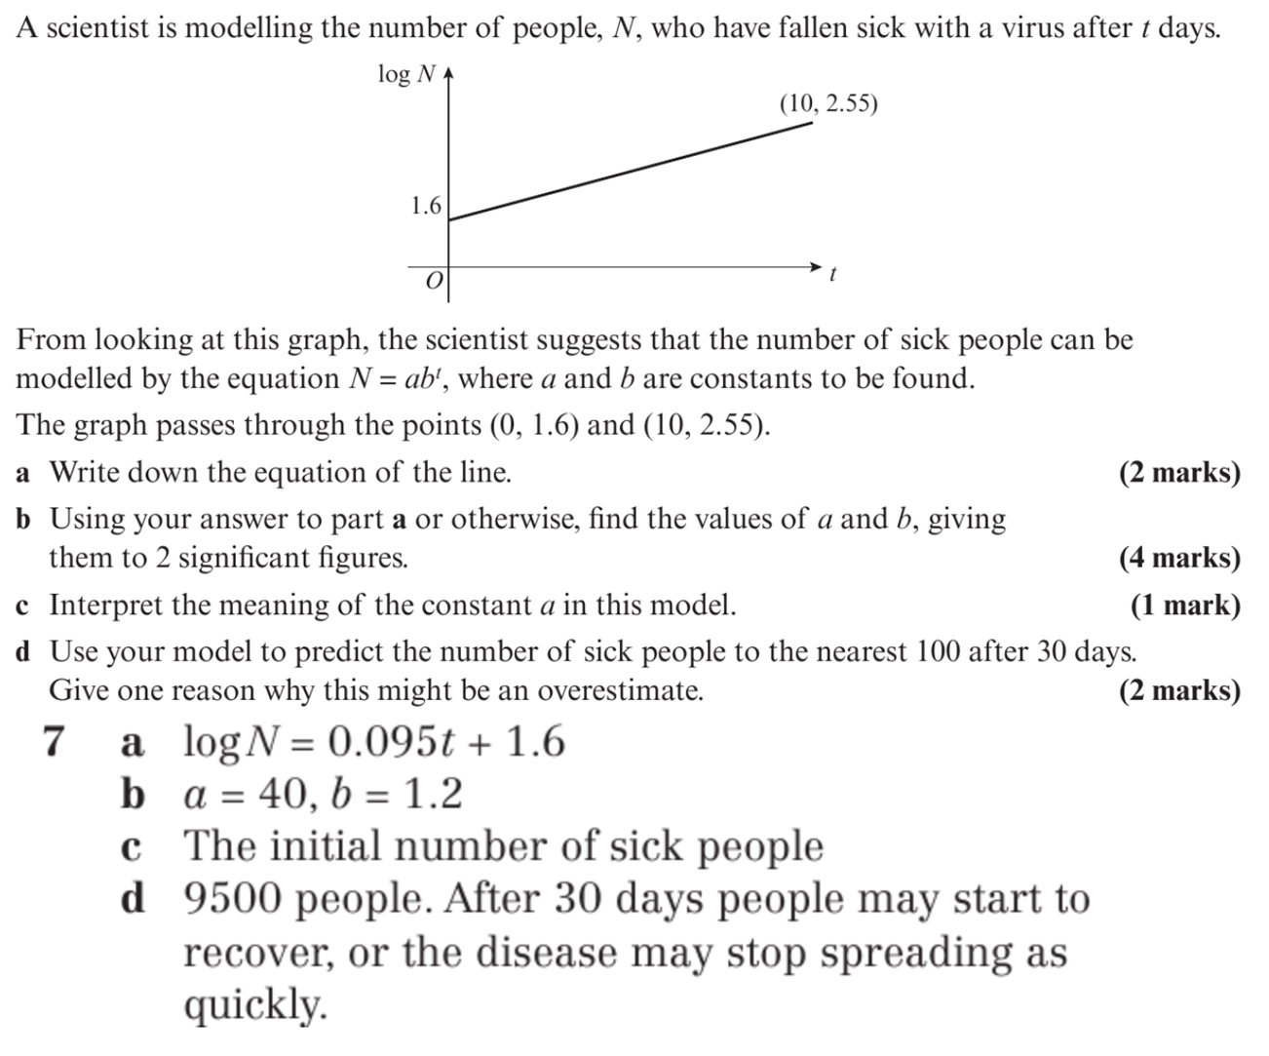
$$\log{N}=0.095t+1.6$$

Slide 16
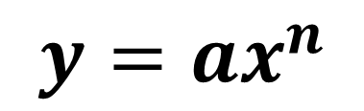

Exponential Model $(y=ax^{n})$ → Linear Model
P
$$y=ax^{n}$$
Log P
Population
Log Population
(log x , log y)
(log x , log y)
(x , y)
(x , y)
0
10
20
30
Time
0
10
20
30
Log Time

Slide 17
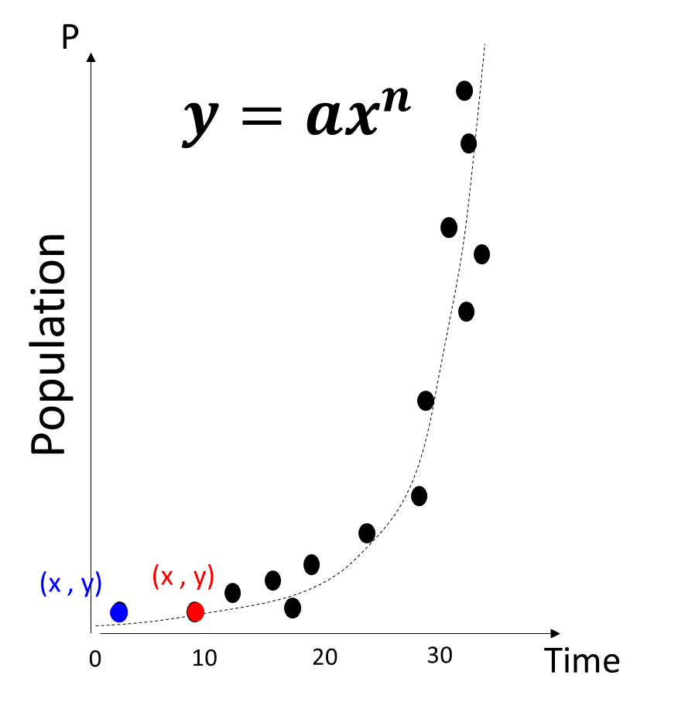
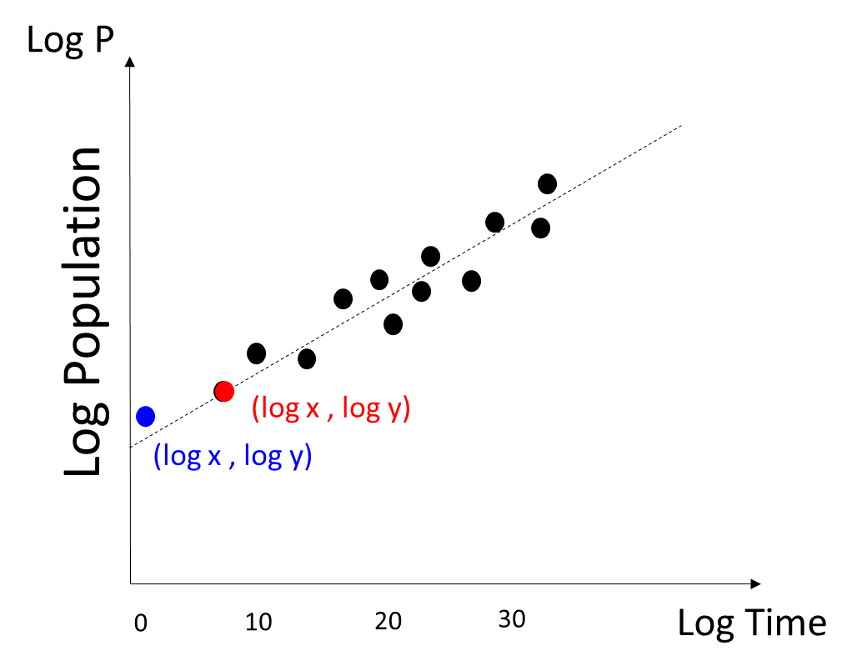
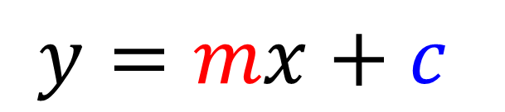
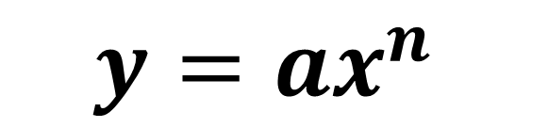
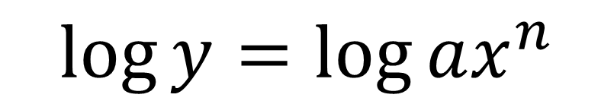
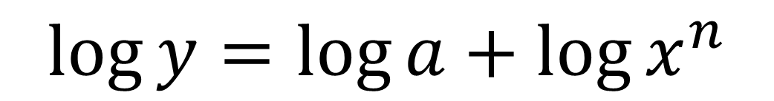

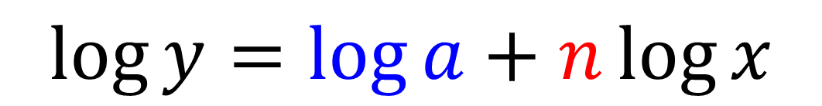
Exponential Model $(y=ax^{n})$ → Linear Model
$$y=ax^{n}$$
$$\log{y}=\log{ax^{n}}$$
$$\log{y}=\log{a+\log{x^{n}}}$$
$$y =mx+c$$
$$\log{y}=\log{a}+n\log{x}$$
$$y=mx+c$$

Slide 18
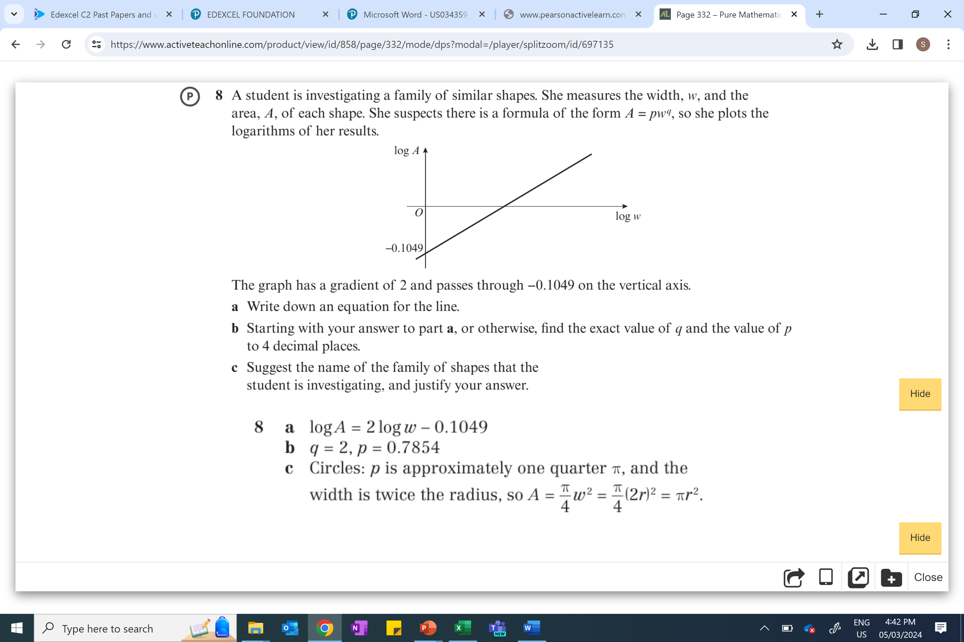

Slide 19
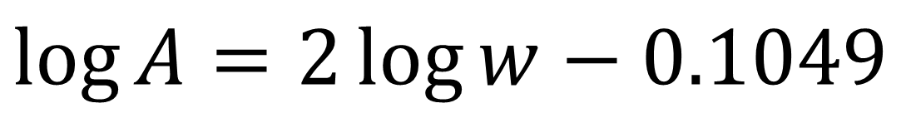
$$\log{A}=2\log{w}−0.1049$$

Slide 20
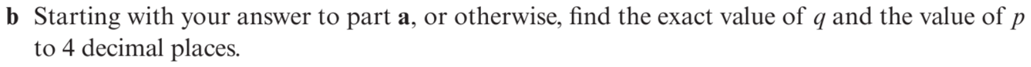









$$\log{A}=2\log{w}−0.1049$$
$$\log{b=0.095}$$
$$\log{a=1.6}$$
$$\log{p=−0.1049}$$
$$q{=2}$$
$$A=pw^{q}$$
$$p{={10}^{−0.1049}}$$
$$\log{A}=\log{p}+q\log{w}$$
$$p{=0.7854}$$

