Slide 1
Representation of Data
Histograms
Chapter 3
(Part 3 of 3)

Slide 2
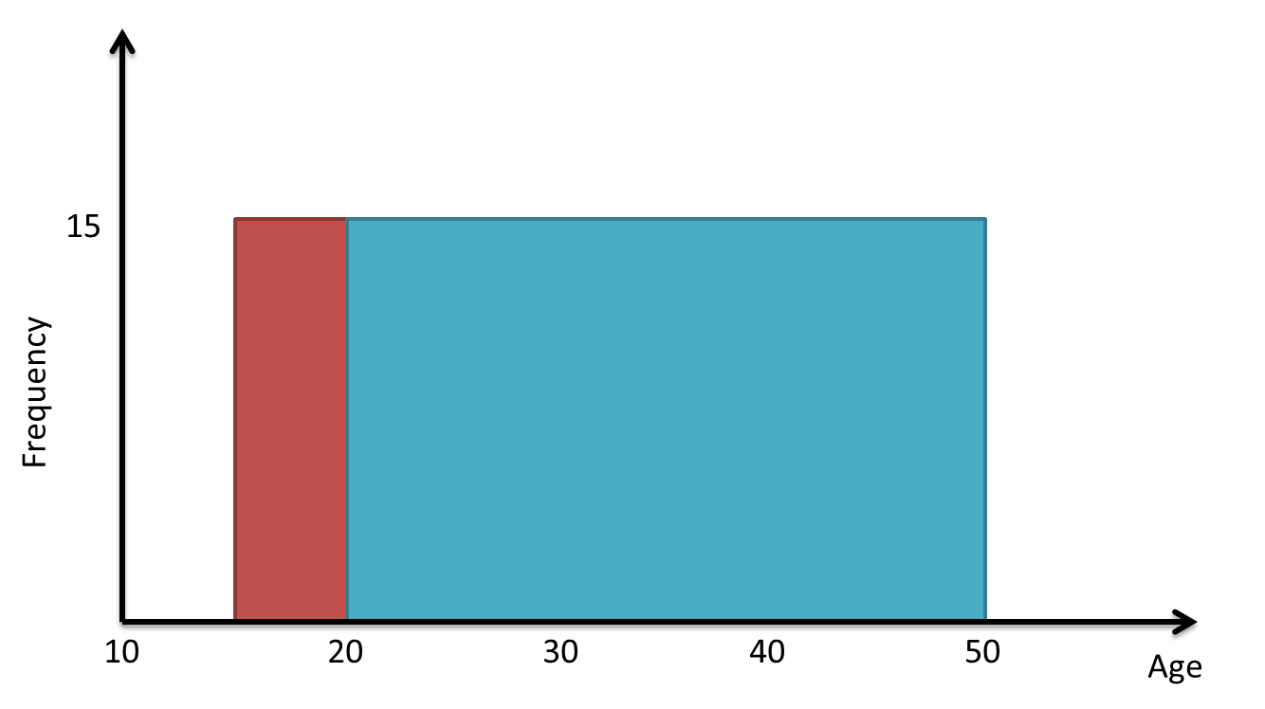
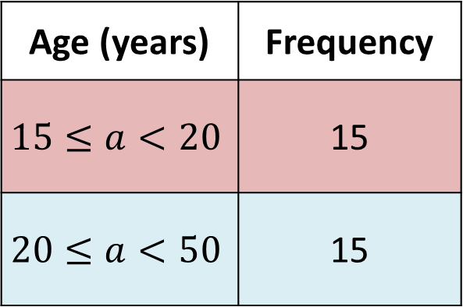
Bar Charts vs Histograms
Age (years) | Frequency
$$15≤a<20$$ | 15
$$20≤a<50$$ | 15
The 15 people in the second group are more spread out in age, but this graph seems to suggest that people’s ages are spread out uniformly between 15 and 50.

Slide 3
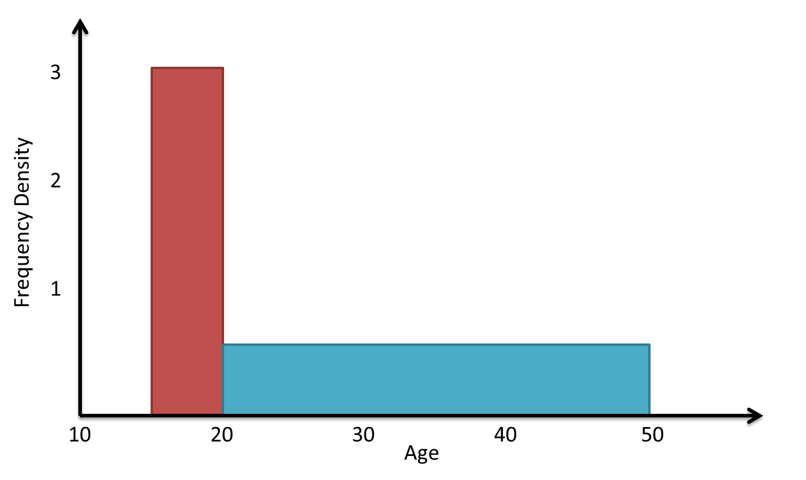
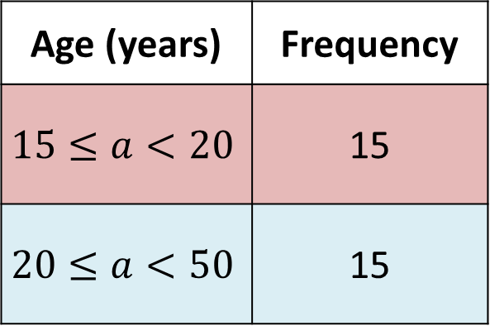
Bar Charts vs Histograms
Age (years) | Frequency
$$15≤a<20$$ | 15
$$20≤a<50$$ | 15
Histogram; it allows us to display the ‘concentration’ (i.e. density) of people per unit value.

Slide 4
Bar Charts
Histograms
For discrete data.
Frequency given by height of bars.
For continuous data.
Bars can be uneven intervals.
Frequency given by area of bars.
No gaps between bars.
Frequency
Frequency Density
6 7 8 9
Shoe Size
1.0m 1.2m 1.4m 1.6m 1.8m
Height

Slide 5
Histograms Calculations
Area
= Length x Width
Frequency
Frequency Density
Frequency
= Frequency Density x Class Width
Class Width

Slide 6
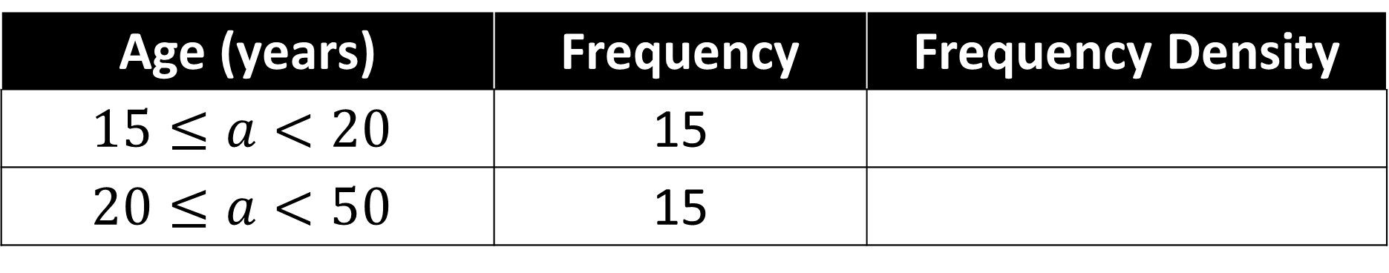
Age (years) | Frequency | Frequency Density
$$15≤a<20$$ | 15
$$20≤a<50$$ | 15
15 ÷ 5 = 3
15 ÷ 30 = 0.5
3
2
1
Frequency Density
Age
10 15 20 30 40 50

Slide 7
Age (years) | Frequency | Frequency Density
$$15≤a<20$$ | 15
$$20≤a<50$$ | 15
15 ÷ 5 = 3
15 ÷ 30 = 0.5
3
2
1
Frequency Density
Age
10 15 20 30 40 50

Slide 8
Weight (w kg) | Frequency | Frequency Density
10 < w ≤ 15 | 15
15 < w ≤ 30 | 30
30 < w ≤ 40 |  | 4
 | 20 | 5
3
2
40
40 < w ≤ 44
5
4
3
2
1
Frequency Density
10 20 30 40 50
Height (m)

Slide 9
Histograms – Rounded Data
Histograms – Rounded Data
Watch out for when the data has been rounded to the nearest whole number.
Height (to the nearest cm) | Frequency
10 – 15
16 – 30
31 – 40
Frequency Density
9.5 – 15.5
18
3
15.5 – 30.5
30
2
30.5 – 40.5
12
4
5
4
3
2
1
Frequency Density
10 15 20 30 40
Height (m)

Slide 10
Histograms - Scalers
Unlike at GCSE,
the area of a bar is not
necessarily equal to the frequency;
there are just proportional.

Slide 11
Histograms - Scalers
So when you are given predawn histogram you need to check
to see if the TOTAL AREA is
equal to the TOTAL FREQUENCY.

Slide 12
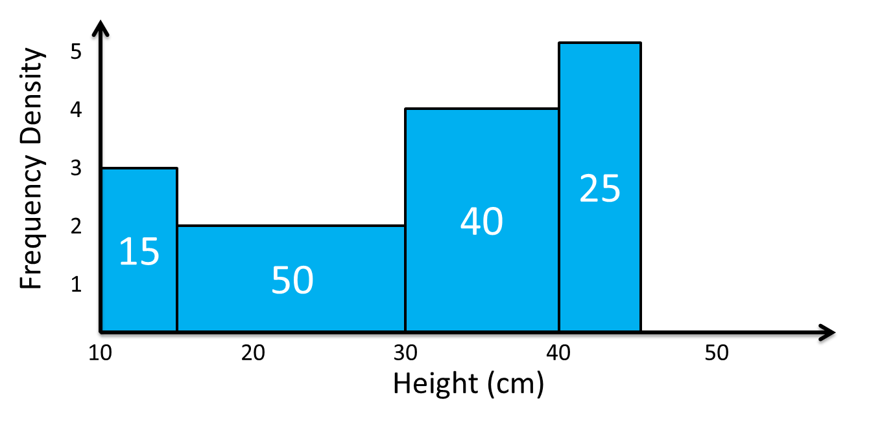
55 plants heights were measured.
The following histogram represents their heights.
Total Frequency = 55
Total Area ≠ Total Frequency
Total Area = 110
Therefore, a scaler has been used.
Scaler
= 110 ÷ 55
= 2
30

Slide 13
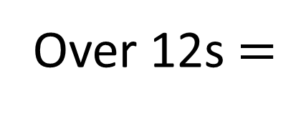
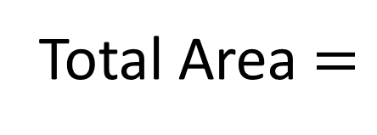
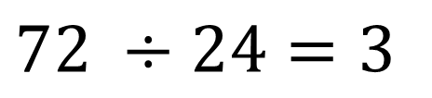
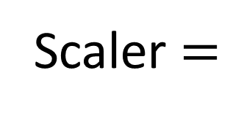
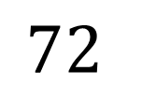
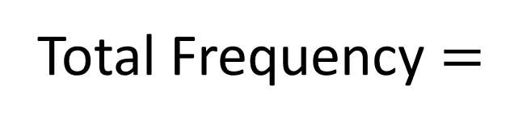
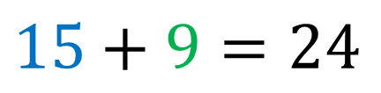
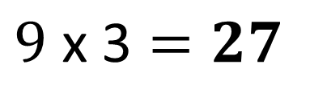
There were 72 runners in a 100m race.
The following histogram represents their times.
Determine the number of runners with times above 12s.
Total Area $=$
$$15+9=24$$
5
4
3
2
1
0
Total Frequency $=$
$$72$$
Frequency Density
Scaler $=$
$$72 ÷24=3$$
Over 12s $=$
$$9 \text{x}\text{ 3}=27$$
9
12
18
Time (s)

Slide 14
Weight (to nearest kg) | Area | Frequency
1-2
3-6
7-9
The histograms show the weight of 39 babies.
Find each frequency.
2 x 2 = 4
4 x 1.5 = 6
3 x 1 = 3
4 x 3 = 12
6 x 3 = 18
3 x 3 = 9
Scaler = 39 ÷ 13 = 3
2
1
0
Frequency Density
Weight
1 2 3 4 5 6 7 8 9 10

Slide 15
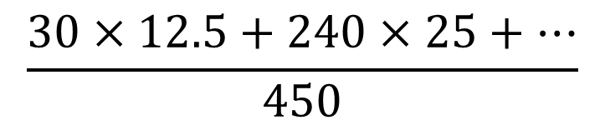

(on your printed sheet)
Estimate the value of the mean speed of the cars in the sample.
Use histogram to construct sum of speeds.
$$\frac{30×12.5+240×25+…}{450}$$
$$=28.8$$

Slide 16
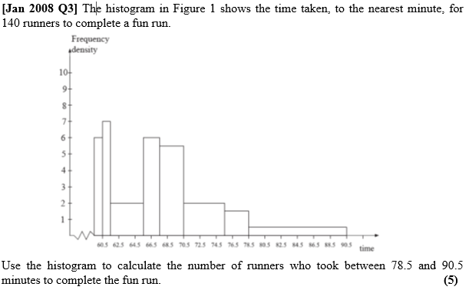

Slide 17
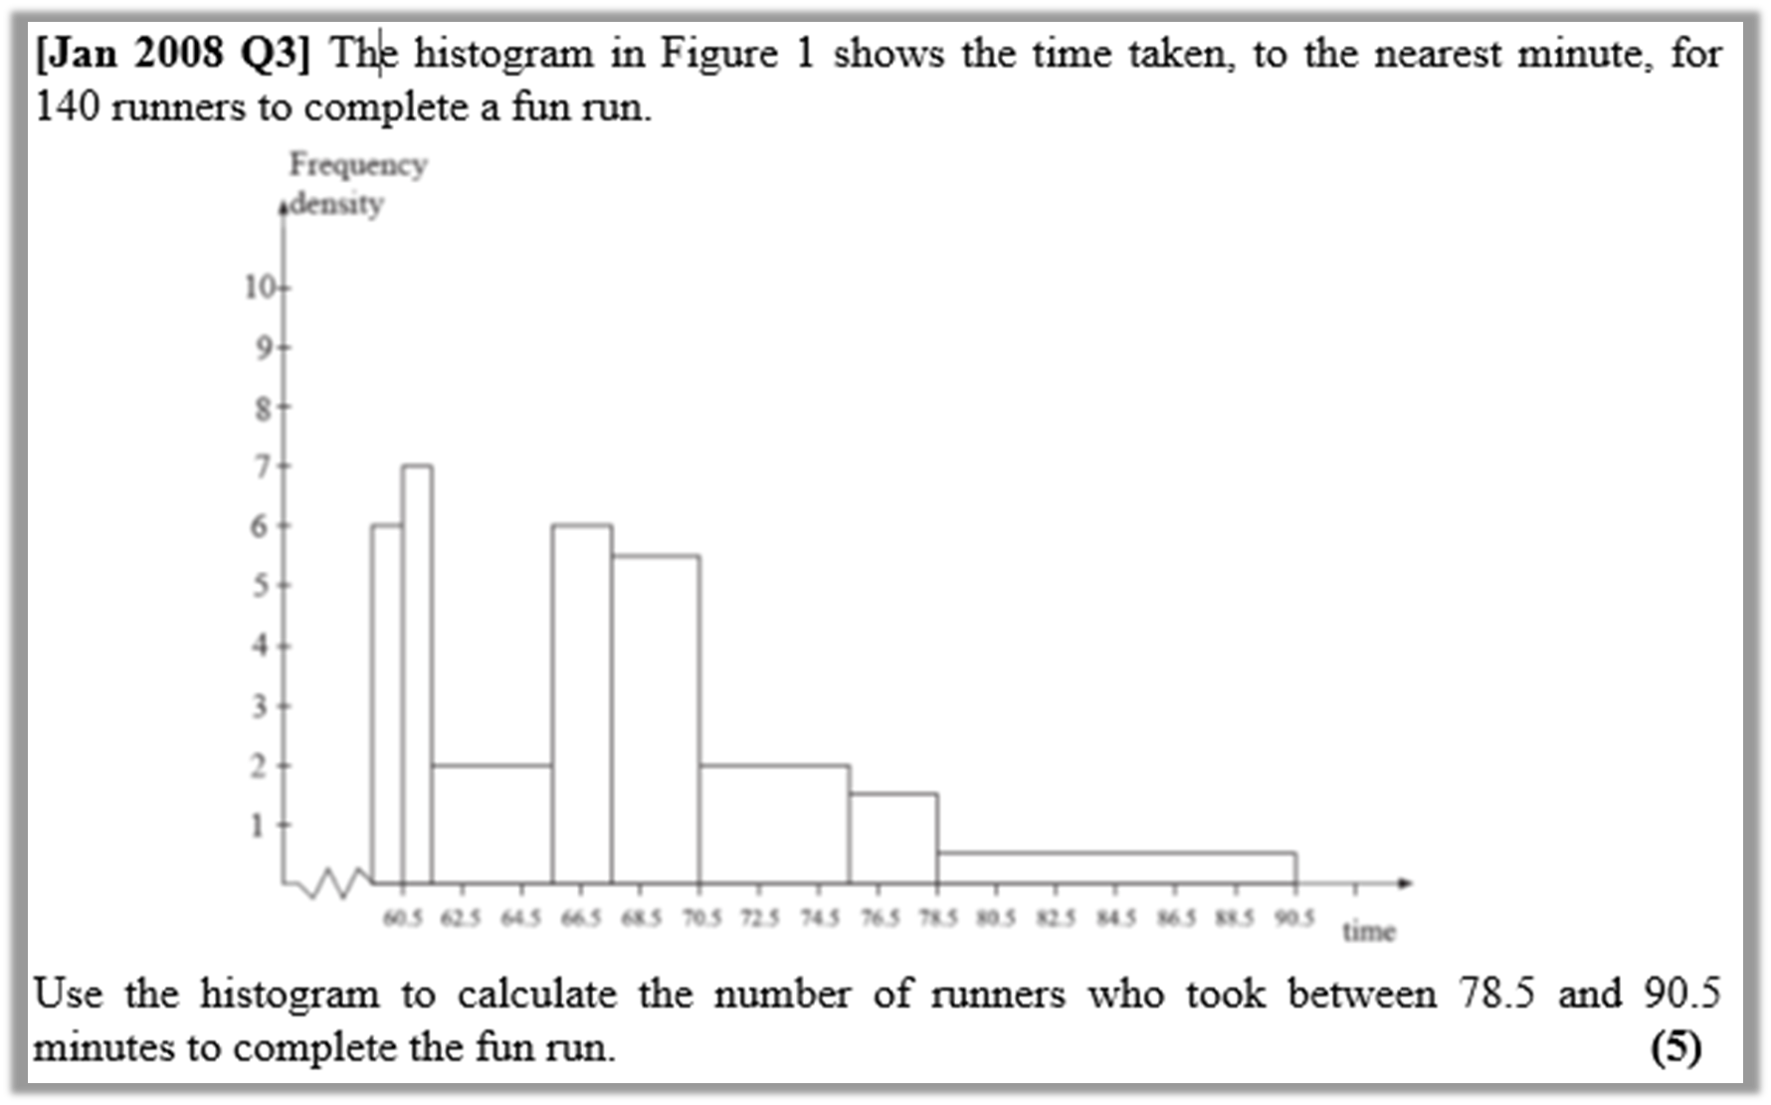
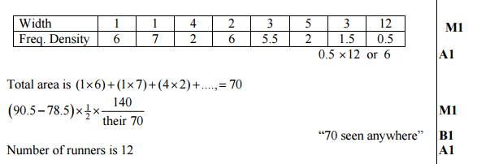
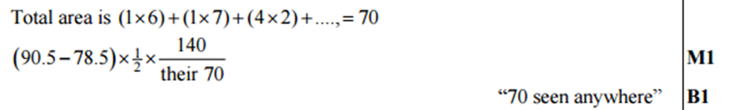

Slide 18
Frequency Polygon
Frequency polygon can be drawn from a histogram by using
the midpoint of each interval
and joining them with a straight line.

