Slide 1
FM: Factor Theorem

Slide 2
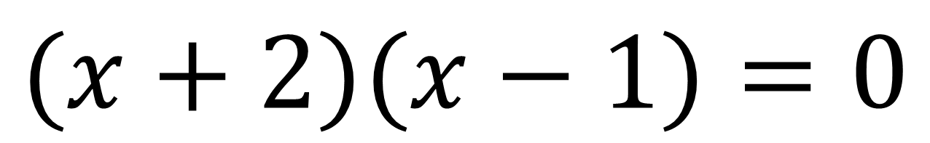
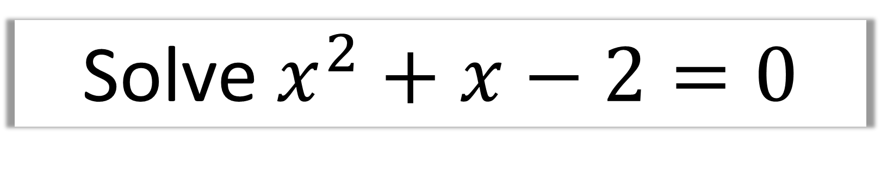
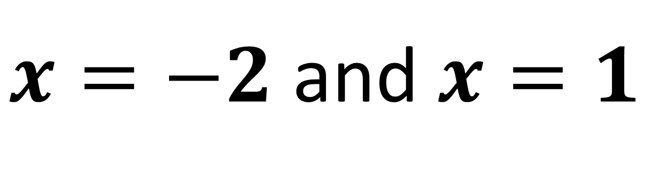
Solve $x^{2}+x−2=0$
$(x+2)(x−1)=0$
$x=−2$ and $x=1$

Slide 3
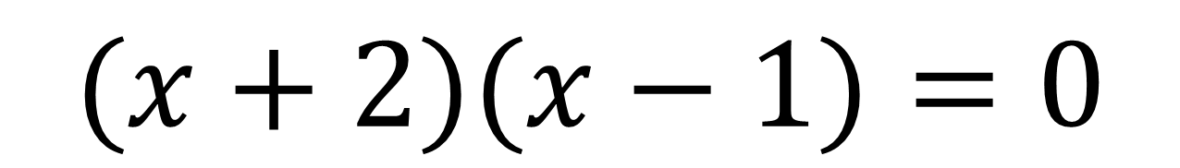
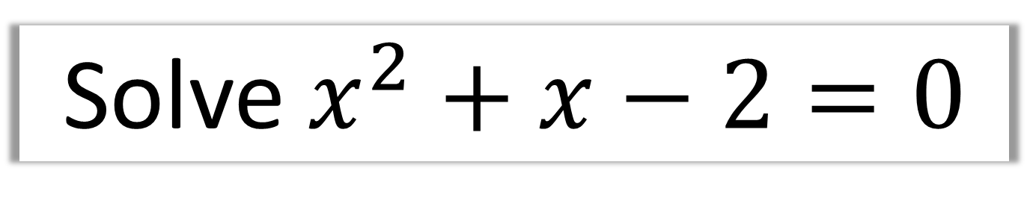

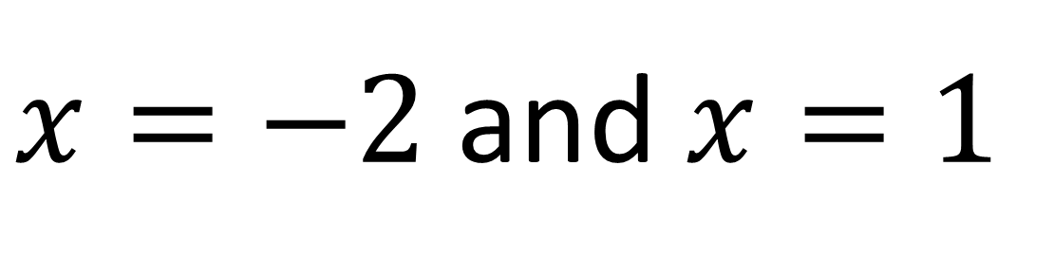
Solve $x^{2}+x−2=0$
$(x+2)(x−1)=0$
$x=−2$ and $x=1$
How is $\left(x+2\right)$ related to $x^{2}+x−2$?
It is a factor.

Slide 4

Solve $x^{2}+x−2=0$
$(x+2)(x−1)=0$
$x=−2$ and $x=1$
How is $\left(x−1\right)$ related to $x^{2}+x−2$?
It is a factor.

Slide 5
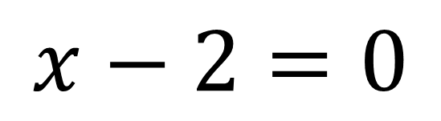
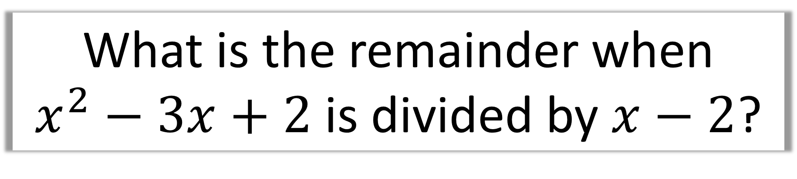
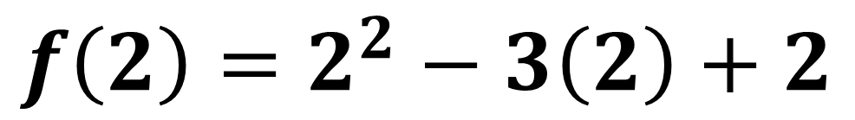
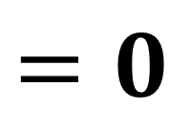
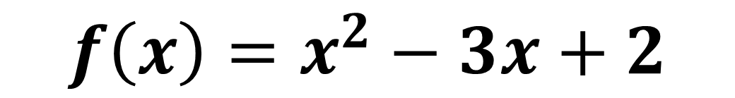
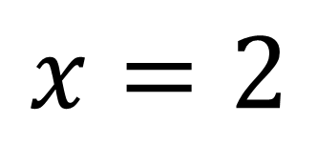
What is the remainder when
$x^{2}−3x+2$ is divided by $x−2$?
$$x−2=0$$
$$f\left(x\right)=x^{2}−3x+2$$
$$x=2$$
$$f\left(2\right)=2^{2}−3\left(2\right)+2$$
$$=0$$
Therefore, the reminder is 0

Slide 6
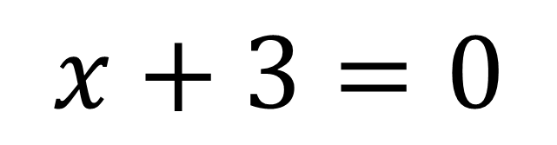
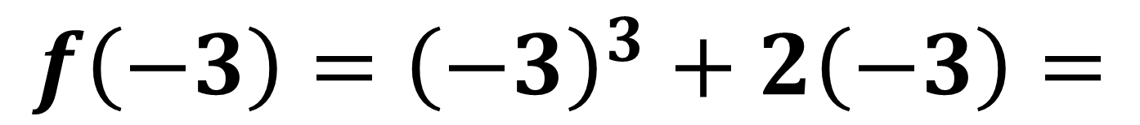
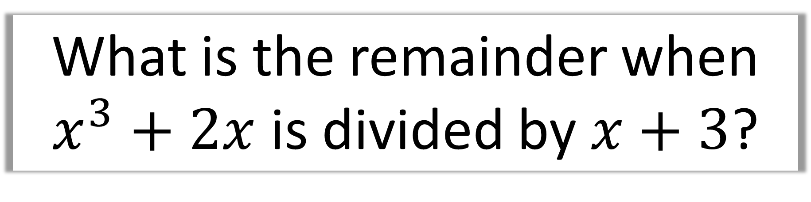
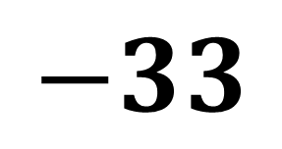
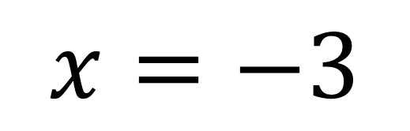
What is the remainder when
$x^{3}+2x$ is divided by $x+3$?
$$x+3=0$$
$$x=−3$$
$$f\left(−3\right)={\left(−3\right)}^{3}+2\left(−3\right)=$$
$$−33$$

Slide 7
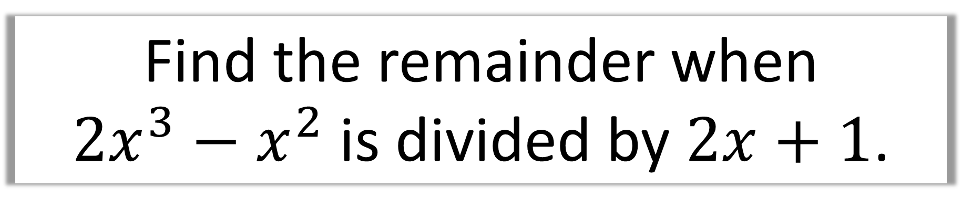
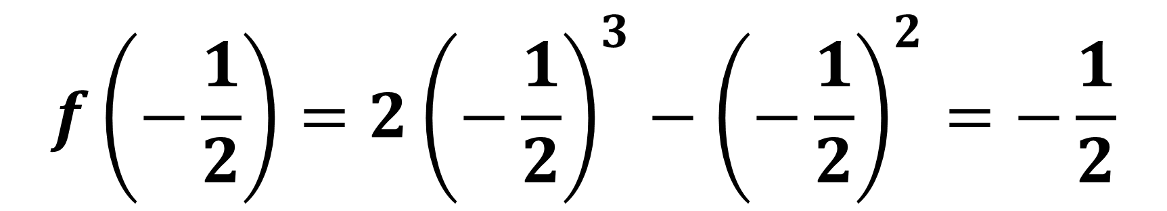
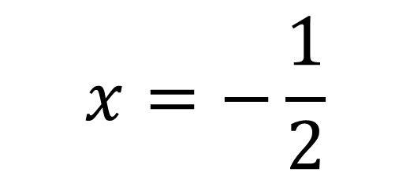
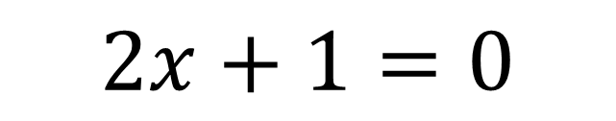
Find the remainder when
$2x^{3}−x^{2}$ is divided by $2x+1$.
$$2x+1=0$$
$$x=−\frac{1}{2}$$
$$f\left(−\frac{1}{2}\right)=2{\left(−\frac{1}{2}\right)}^{3}−{\left(−\frac{1}{2}\right)}^{2}=−\frac{1}{2}$$

Slide 8
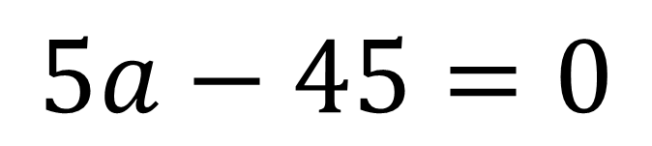
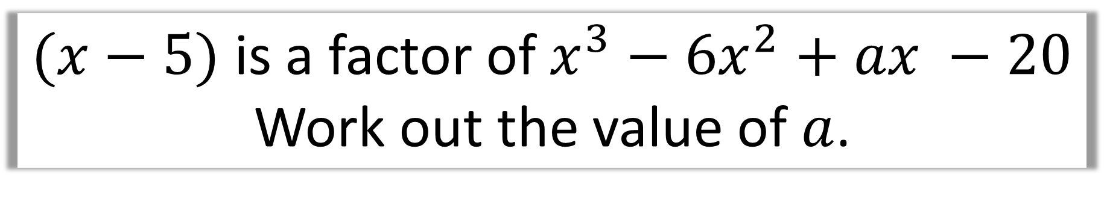
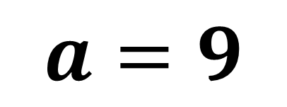
$(x−5)$ is a factor of $x^{3}−{6x}^{2}+ax −20$ Work out the value of $a$.
$$f\left(5\right)=5^{3}−6\left(5^{2}\right)+5a−20=0$$
$$5a−45=0$$
$$a=9$$

Slide 9
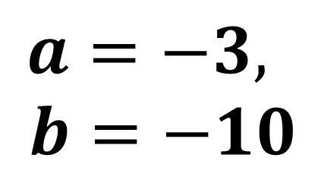
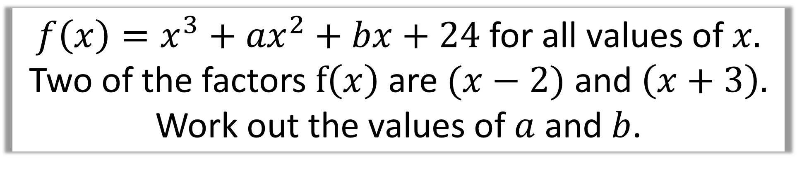
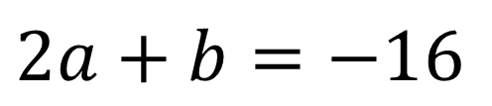
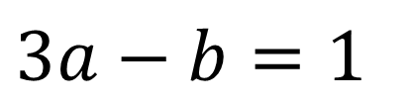
$f\left(x\right)=x^{3}+{ax}^{2}+bx+24$ for all values of $x.$ Two of the factors $f\left(x\right)$ are $(x−2)$ and $\left(x+3\right).$ Work out the values of $a$ and $b$.
$$f\left(2\right)=8+4a+2b+24=0$$
$$2a+b=−16$$
$$f\left(−3\right)=−27+9a−3b+24=0$$
$$a=−3,$$
$$b=−10$$
$$3a−b=1$$

Slide 10
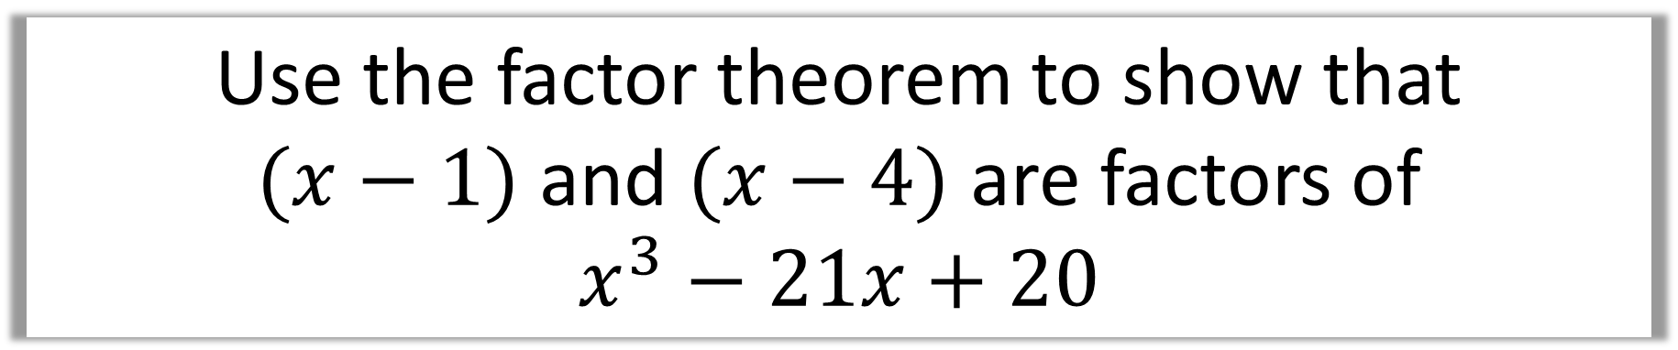
Use the factor theorem to show that
$(x−1)$ and $(x−4)$ are factors of
$$x^{3}−21x+20$$
$$f\left(1\right)=1^{3}−21+20=0$$
$$f\left(4\right)=4^{3}−21\left(4\right)+20=0$$
Both have a remainder of 0, therefore are factors.

Slide 11
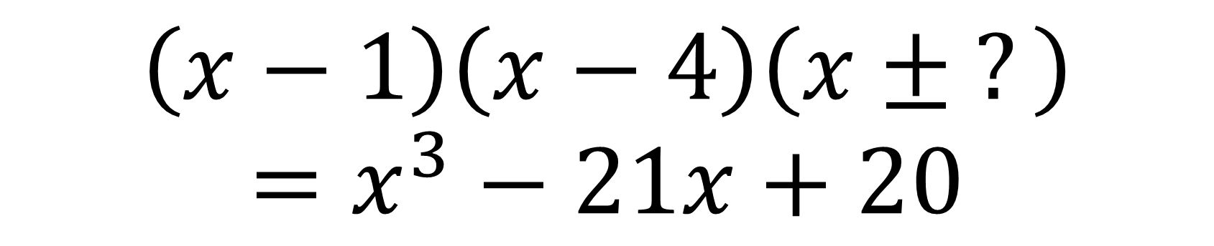
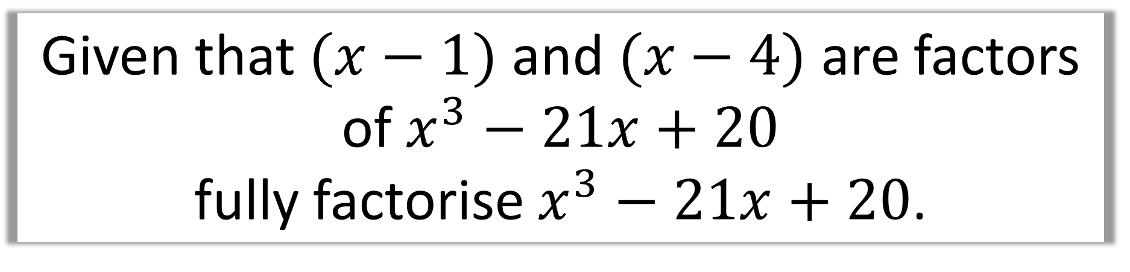
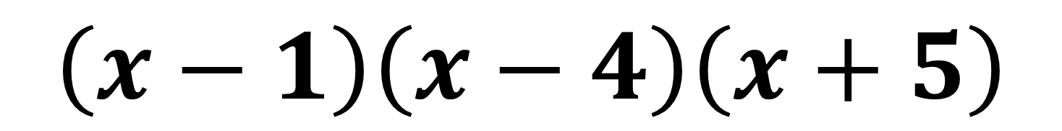
Given that $(x−1)$ and $(x−4)$ are factors
of $x^{3}−21x+20$
fully factorise $x^{3}−21x+20$.
$$\left(x−1\right)\left(x−4\right)\left(x ± ?\right)=x^{3}−21x+20$$
$$\left(x−1\right)\left(x−4\right)\left(x+5\right)$$

Slide 12
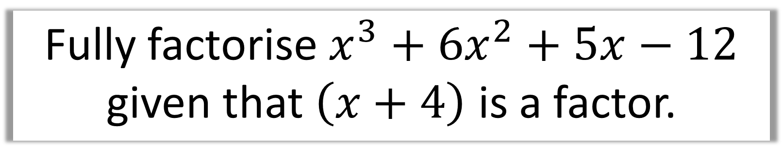
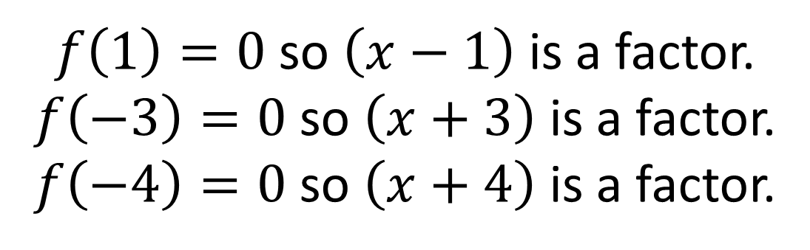

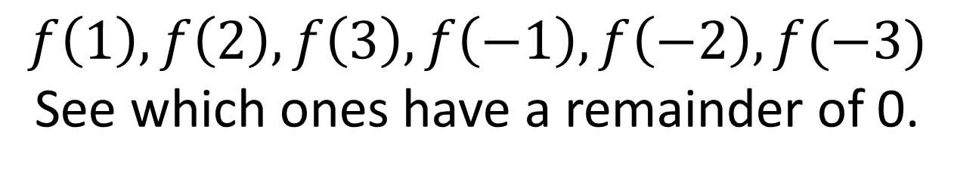
Fully factorise $x^{3}+6x^{2}+5x−12$
given that $\left(x+4\right)$ is a factor.
Hint: What could be the factors of $−12?$
$f\left(1\right), f\left(2\right), f\left(3\right), f\left(−1\right), f\left(−2\right), f(−3)$
See which ones have a remainder of 0.
$f\left(1\right)=0$ so $\left(x−1\right)$ is a factor.
$f\left(−3\right)=0$ so $\left(x+3\right)$ is a factor.
$f\left(−4\right)=0$ so $\left(x+4\right)$ is a factor.
$$x^{3}+6x^{2}+5x−12=\left(x−1\right)\left(x+3\right)\left(x+4\right)$$

Slide 13
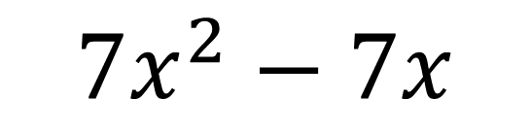
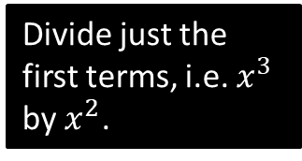
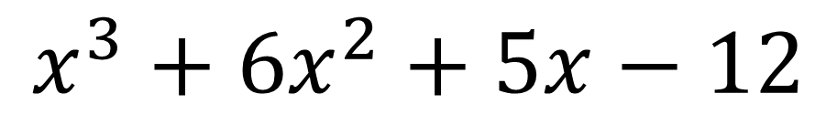
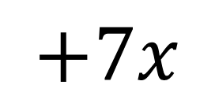

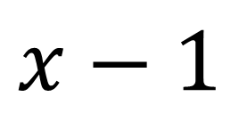
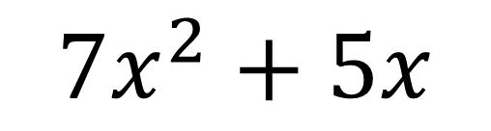
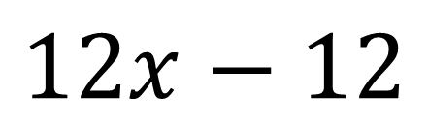
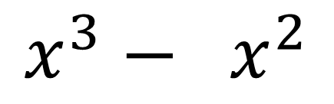
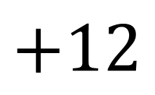
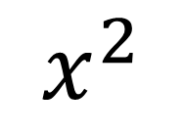
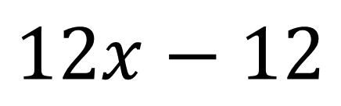
$$x^{2}$$
$$+7x$$
$$+12$$
$$x−1$$
$$x^{3}+6x^{2}+5x−12$$
$$x^{3}− x^{2}$$
Divide just the first terms, i.e. $x^{3}$ by $x^{2}$.
$$7x^{2}+5x$$
$$7x^{2}−7x$$
$$12x−12$$
$$12x−12$$
$$0$$

Slide 14
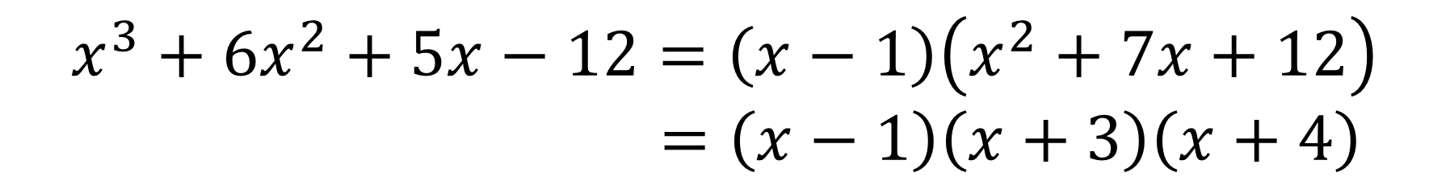
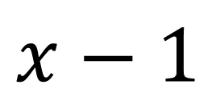
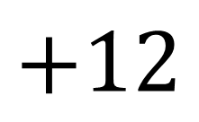

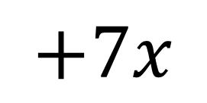


Fully factorise $x^{3}+6x^{2}+5x−12$
$$x^{2}$$
$$+7x$$
$$+12$$
$$x−1$$
$$x^{3}+6x^{2}+5x−12$$
$$x^{3}+6x^{2}+5x−12=\left(x−1\right)\left(x^{2}+7x+12\right) \\ =\left(x−1\right)\left(x+3\right)\left(x+4\right)$$

Slide 15












How many times does $x$ go into $6x^{3}$?
Now repeat! How many times does $x$ go into $−2x^{2}$?
6$x$²
– 2$x$
+ 3
$x$ + 5
6$x$³ + 28$x$² – 7$x$ + 15
6$x$³ + 30$x$²
Subtract and carry down next term.
Multiply $6x^{2}$ by $(x+5)$. The first term should match with above.
– 2$x$² – 7$x$
– 2$x$² – 10$x$
3$x$ + 15
3$x$ + 15
This is the remainder.
0

Slide 16











Find the remainder when $3x^{3}−2x+4$ is divided by $x−1$.
3$x$²
+ 3$x$
$$+1$$
$x$ - 1
3$x$³ + 0$x$² – 2$x$ + 4
3$x$³ – 3$x$²
$3x^{2}−2x$
$$3x^{2}−3x$$
$$x+4$$
$$x−1$$
$$5$$
The remainder is 5.

Slide 17






Solve the following:
$$x^{3}−x^{2}−4x+4=0$$
$$x=−2,2,1$$
$$x^{3}−x^{2}−14x+24=0$$
$$x=−4, 3, 2$$
$$x^{3}+5x^{2}+6x=0$$
$$x=0, −2, −3$$

