Slide 1
LO: Identical
and Equal

Slide 2
=
What does this symbol mean?
Equal To

Slide 3
True or False
x + y = y + x
True

Slide 4
True or False
x – y = y - x
False

Slide 5
True or False
xy = yx
True

Slide 6
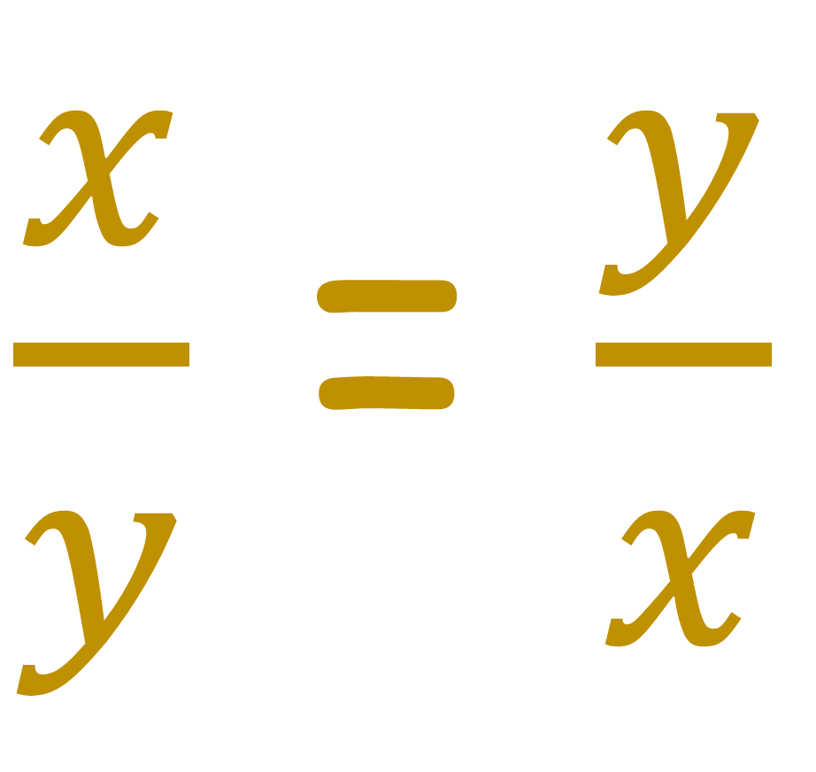
True or False
$\frac{x}{y}$ = $\frac{y}{x}$
False

Slide 7
≡
What does this symbol mean?
Identical To

Slide 8
This is called an
Equation
3x = 2x + 5
Both sides are equal for
certain of values x.

Slide 9
True or False if x = 1
7x = 2x + 5
True
True or False if x = 3
7x = 2x + 5
False

Slide 10
This is called an
Identity
3x ≡ 2x + x
Both sides are equal for
ALL values of x.

Slide 11
True or False if x = 5
3x ≡ 2x + x
True
True or False if x = 3
3x ≡ 2x + x
True

Slide 12
Identical or Equal?
5x = 4x + 1
=

Slide 13
Identical or Equal?
5x = 4x + x
≡

Slide 14
Identical or Equal?
=
4x + 1 = 4(x + 1)

Slide 15
Identical or Equal?
≡
4x + 4 = 4(x + 1)

Slide 16
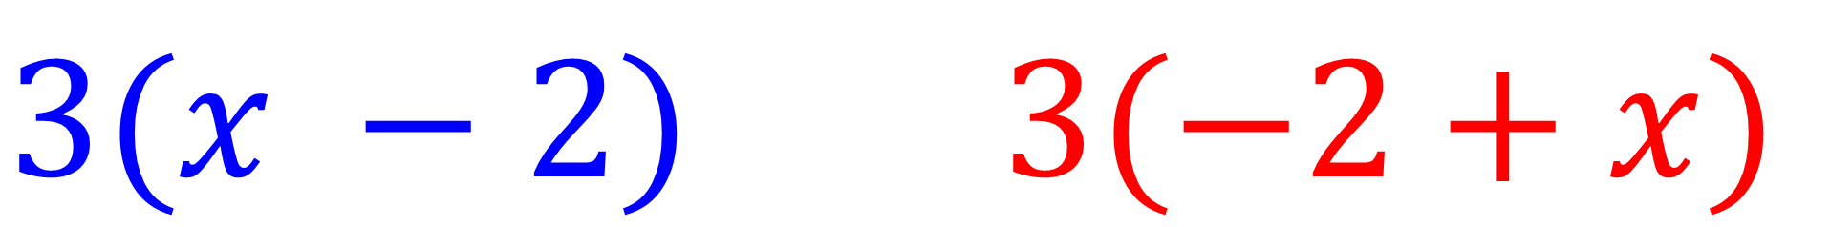
Identical or Equal?
≡
$$3(x −2) 3(−2+x)$$

Slide 17
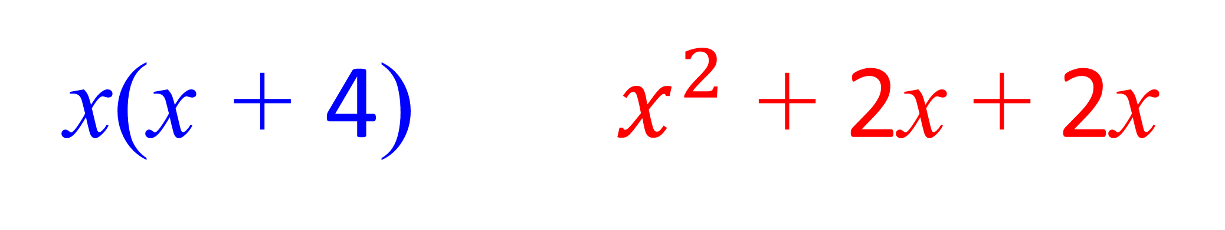
Identical or Equal?
≡
x(x + 4) $x^{2}$ + 2x + 2x

