Slide 1
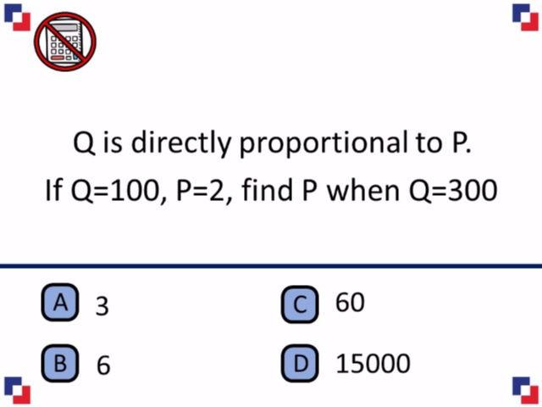
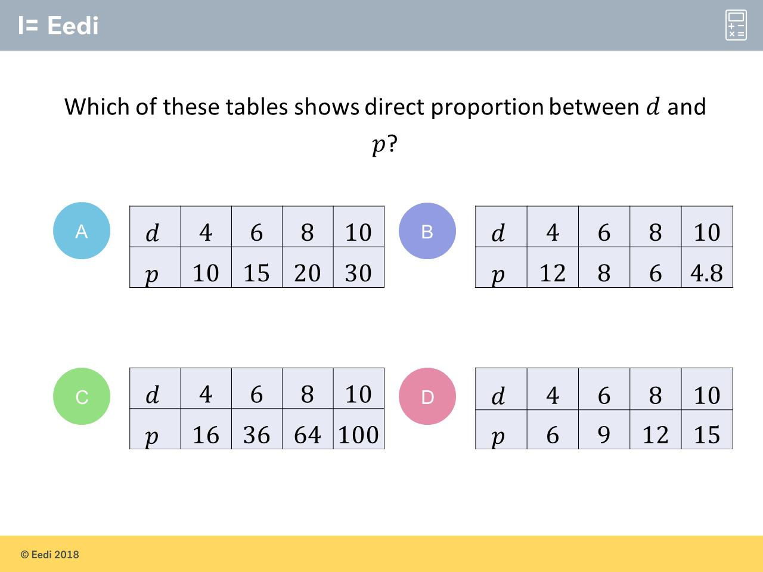
Worst answered question?
Most common wrong answer?

Slide 2
ANSWERS

Slide 3
Worst answered question?

Slide 4
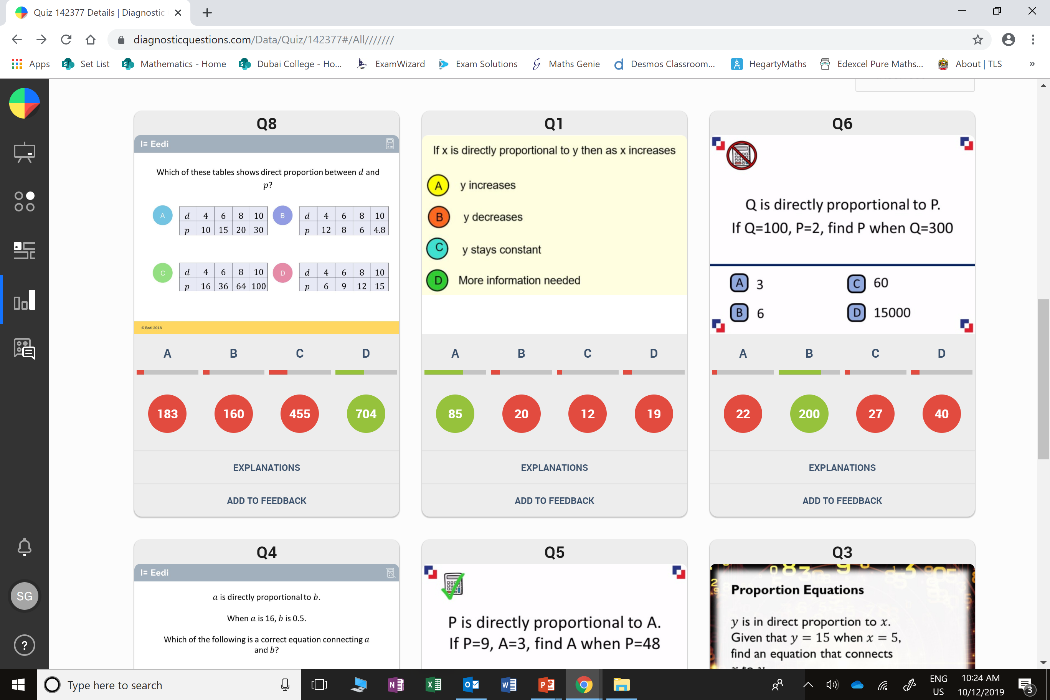
C
They are all squared which is not a common multiplier.

Slide 5
D
They multiplied by 50 instead of dividing.

