Slide 1
Measure of Location and Spread
Mean, Median
and Interpolation
Chapter 2
(Part 1 of 4)

Slide 2
What is a Measure of Location?
Measures of location are
single values which describe
a position in a data set.
Such as mode, median, mean and quartiles.

Slide 3
What is a Measure of Spread?
Measures of spread are to do with
how data is spread out.
Such as range, interquartile range and standard deviation.

Slide 4
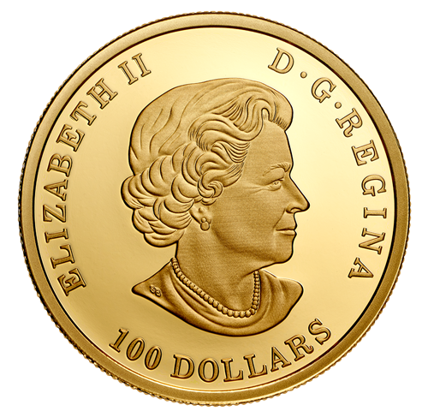
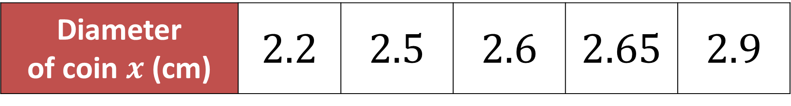
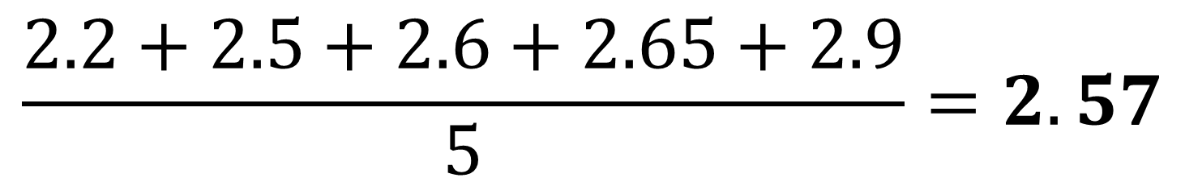
Mean from Raw Data
Diameter of coin $x$ (cm) | $$2.2$$ | $$2.5$$ | $$2.6$$ | $$2.65$$ | $$2.9$$
Calculate the mean diameter of the coin.
$$\frac{2.2+2.5+2.6+2.65+2.9}{5}=2.57$$

Slide 5
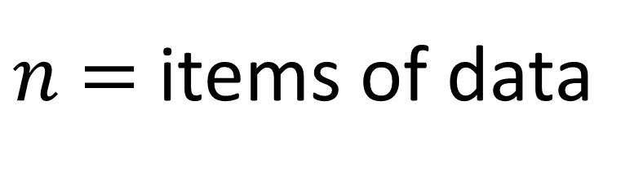
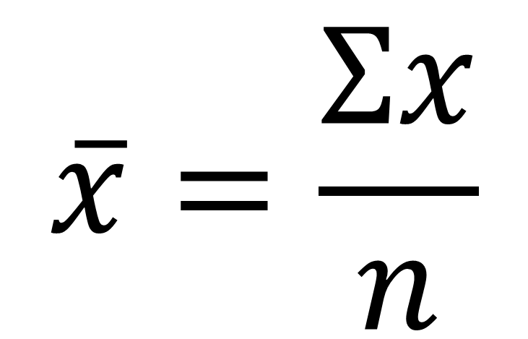

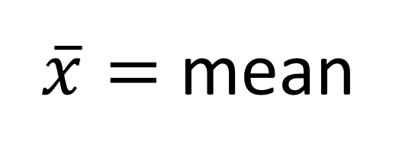
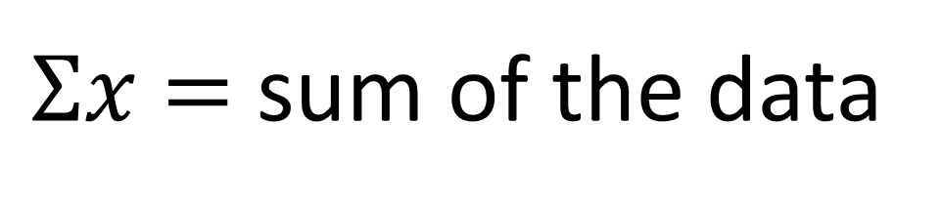
Diameter of coin $x$ (cm) | $$2.2$$ | $$2.5$$ | $$2.6$$ | $$2.65$$ | $$2.9$$
$$\overline{x}=\frac{Σx}{n}$$
$\overline{x}=$ mean
$Σx$ $=$ sum of the data
$n$ $=$ items of data

Slide 6

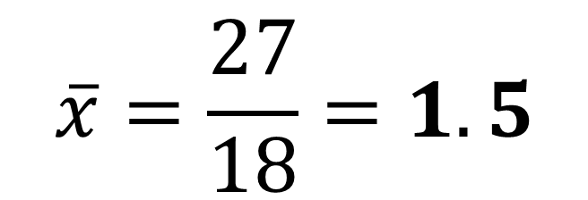
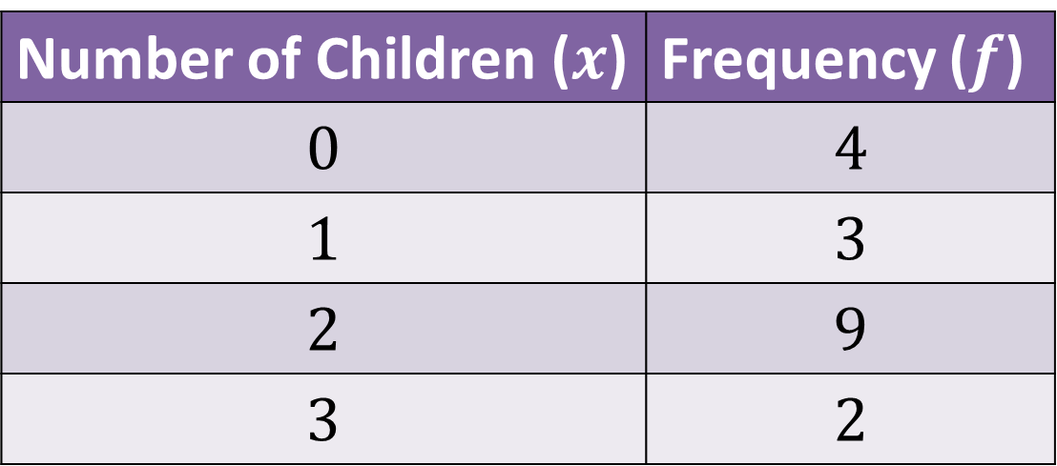
Mean from Frequency Tables
Number of Children ($x$) | Frequency ($f$)
$$0$$ | $$4$$
$$1$$ | $$3$$
$$2$$ | $$9$$
$$3$$ | $$2$$
0
3
18
6
Calculate the mean number of children in a family.
$$\overline{x}=\frac{27}{18}=1.5$$

Slide 7

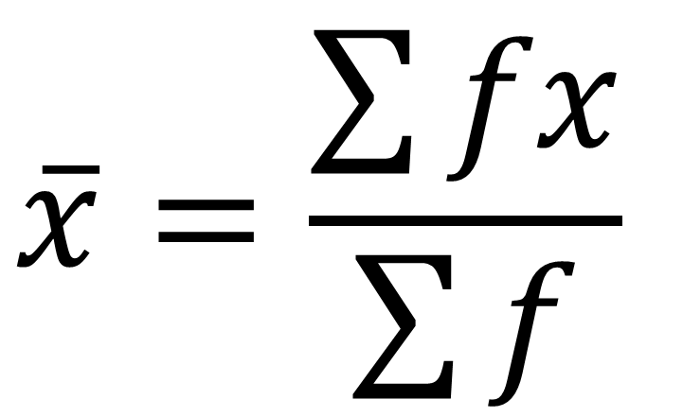
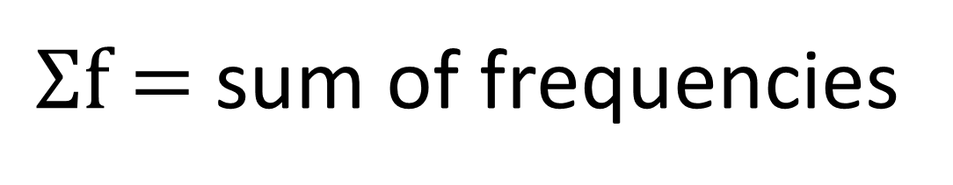

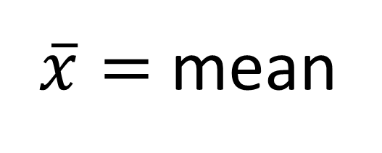
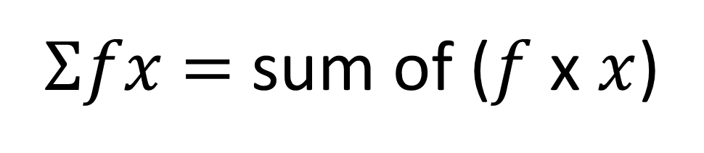
Number of Children ($x$) | Frequency ($f$)
$$0$$ | $$4$$
$$1$$ | $$3$$
$$2$$ | $$9$$
$$3$$ | $$2$$
$$\overline{x}=\frac{\sum{fx}}{\sum{f}}$$
$\overline{x}=$ mean
$Σfx$ $=$ sum of ($f$ x $x$)
$Σf$ $=$ sum of frequencies

Slide 8

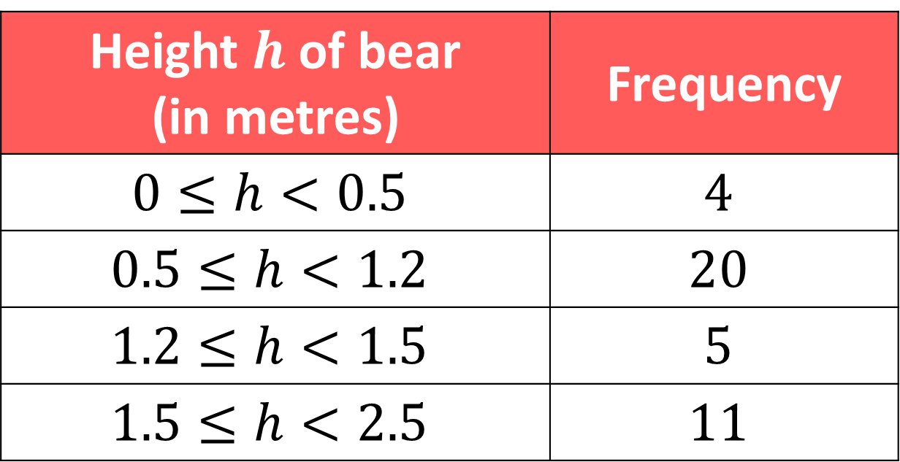
Mean from Group Frequency Tables
Height $h$ of bear (in metres) | Frequency
$$0≤h<0.5$$ | $$4$$
$$0.5≤h<1.2$$ | $$20$$
$$1.2≤h<1.5$$ | $$5$$
$$1.5≤h<2.5$$ | $$11$$
What is the height of the shortest bear?
0.25m - use the midpoint to estimate the height.

Slide 9
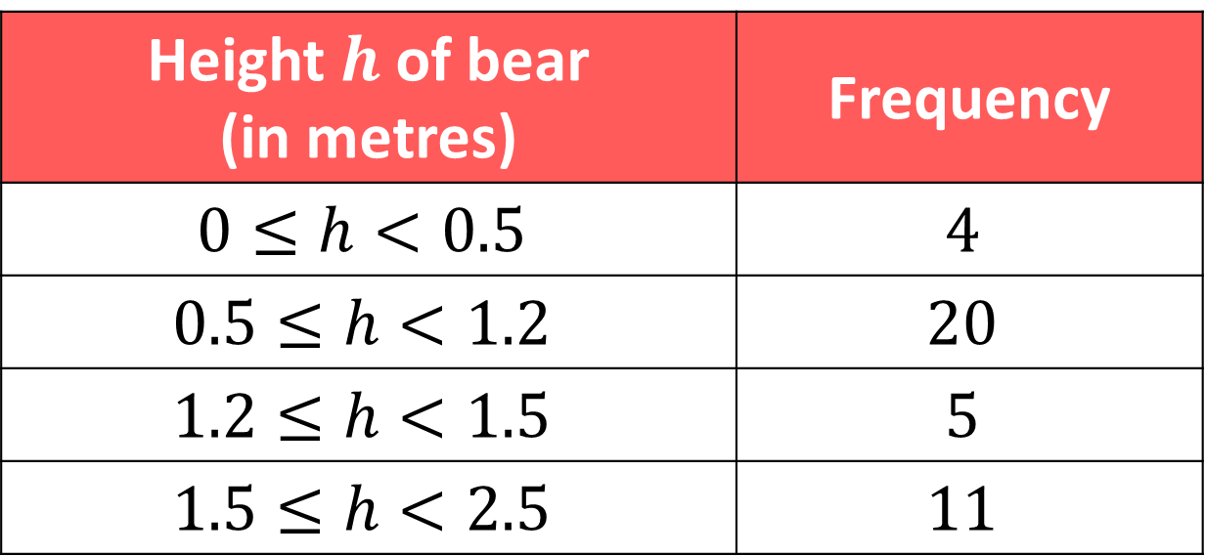
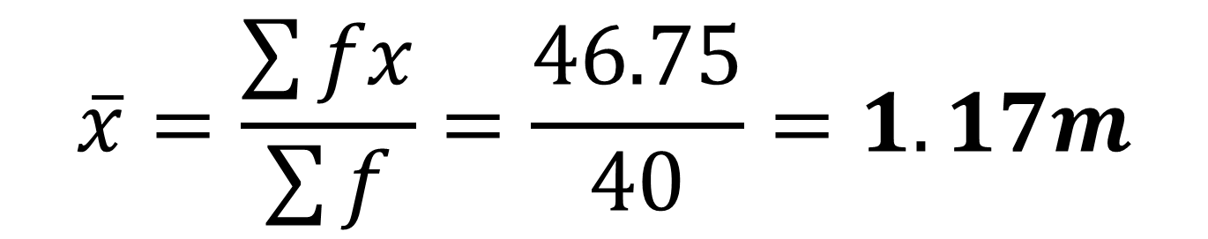
Height $h$ of bear (in metres) | Frequency
$$0≤h<0.5$$ | $$4$$
$$0.5≤h<1.2$$ | $$20$$
$$1.2≤h<1.5$$ | $$5$$
$$1.5≤h<2.5$$ | $$11$$
1
17
6.75
22
Estimate the mean height of a bear.
$$\overline{x}=\frac{\sum{fx}}{\sum{f}}=\frac{46.75}{40}=1.17m$$

Slide 10
Mean - Combined
Set A
5, 5, 5, 5, 5, 5, 5, 5, 5, 5,
5, 5, 5, 5, 5, 5, 5, 5, 5, 5,
Mean = 5
Set B
6, 6, 6, 6, 6
Mean = 6
Is the combined mean of both sets 5.5?

Slide 11
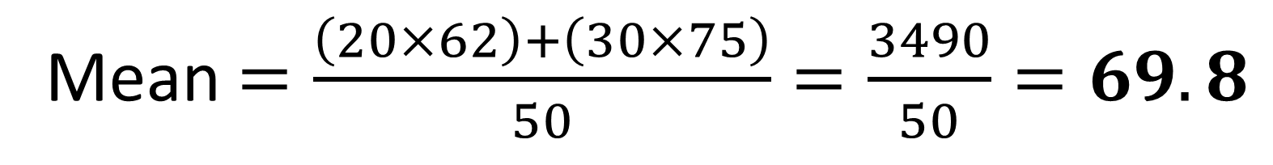
The mean maths score of 20 pupils in class A is 62.
The mean maths score of 30 pupils in class B is 75.
What is the overall mean of all the pupils’ marks.
b) The teacher realises they mismarked one student’s paper;
he should have received 100 instead of 95.
Explain the effect on the mean and median.
Mean $=\frac{\left(20×62\right)+\left(30×75\right)}{50}=\frac{3490}{50}=69.8$
The revised score will increase the mean but leave the median unaffected.

Slide 12
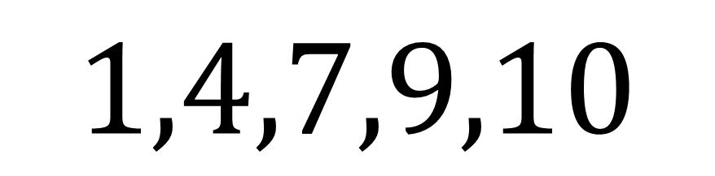
Median from Listed Data
$$1,4,7,9,10$$
What is the median?
Median = 7

Slide 13
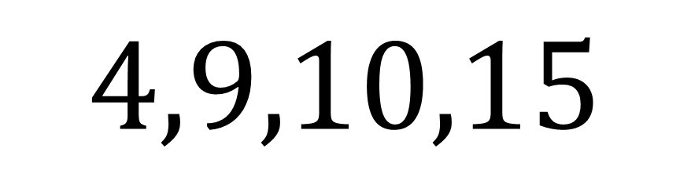
Median from Listed Data
$$4,9,10,15$$
What is the median?
Median = 9.5

Slide 14
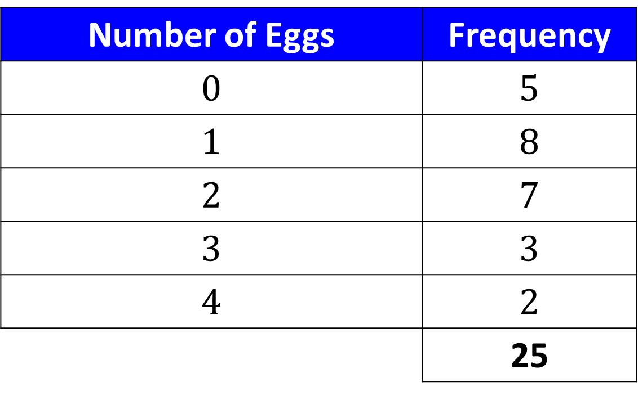

Median from a Frequency Table
Number of Eggs | Frequency
$$0$$ | $$5$$
$$1$$ | $$8$$
$$2$$ | $$7$$
$$3$$ | $$3$$
$$4$$ | $$2$$
 | 25
13th value
What is the median number of eggs?
$$1$$

Slide 15

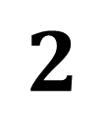
Median from a Frequency Table
Number of Eggs | Frequency
$$0$$ | $$5$$
$$1$$ | $$8$$
$$2$$ | $$12$$
$$3$$ | $$3$$
$$4$$ | $$2$$
 | 30
15th/16th value
What is the median number of eggs?
$$2$$

Slide 16

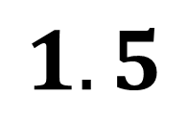
Median from a Frequency Table
Number of Eggs | Frequency
$$0$$ | $$5$$
$$1$$ | $$10$$
$$2$$ | $$10$$
$$3$$ | $$3$$
$$4$$ | $$2$$
 | 30
15th/16th value
What is the median number of eggs?
$$1.5$$

Slide 17
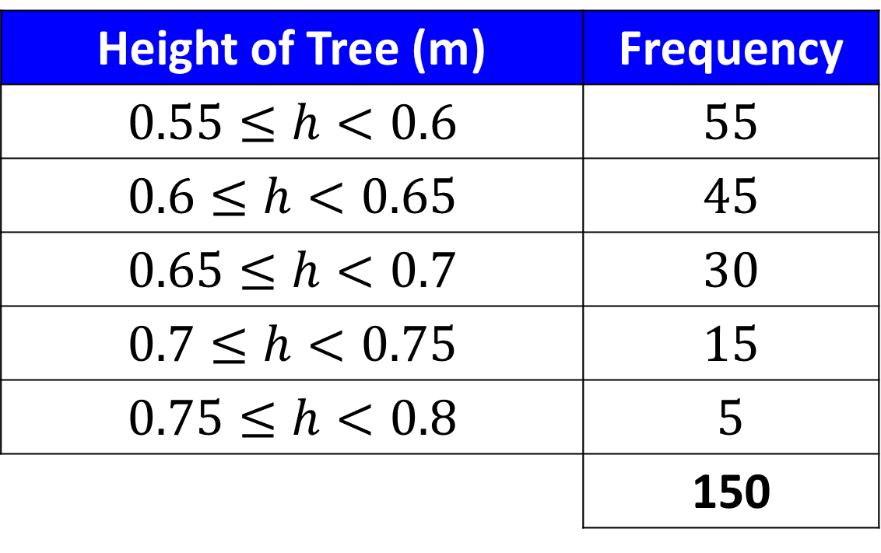
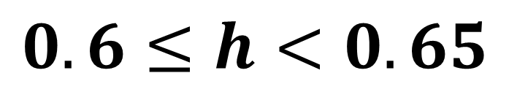
Median from a Group Frequency Table
Height of Tree (m) | Frequency
$$0.55≤h<0.6$$ | $$55$$
$$0.6≤h<0.65$$ | $$45$$
$$0.65≤h<0.7$$ | $$30$$
$$0.7≤h<0.75$$ | $$15$$
$$0.75≤h<0.8$$ | $$5$$
 | 150
75th/76th value
What is the median group?
$$0.6≤h<0.65$$

Slide 18
Median - Linear Interpolation
Interpolation allows you to find
an estimate for the median
rather than just a group interval.

Slide 19
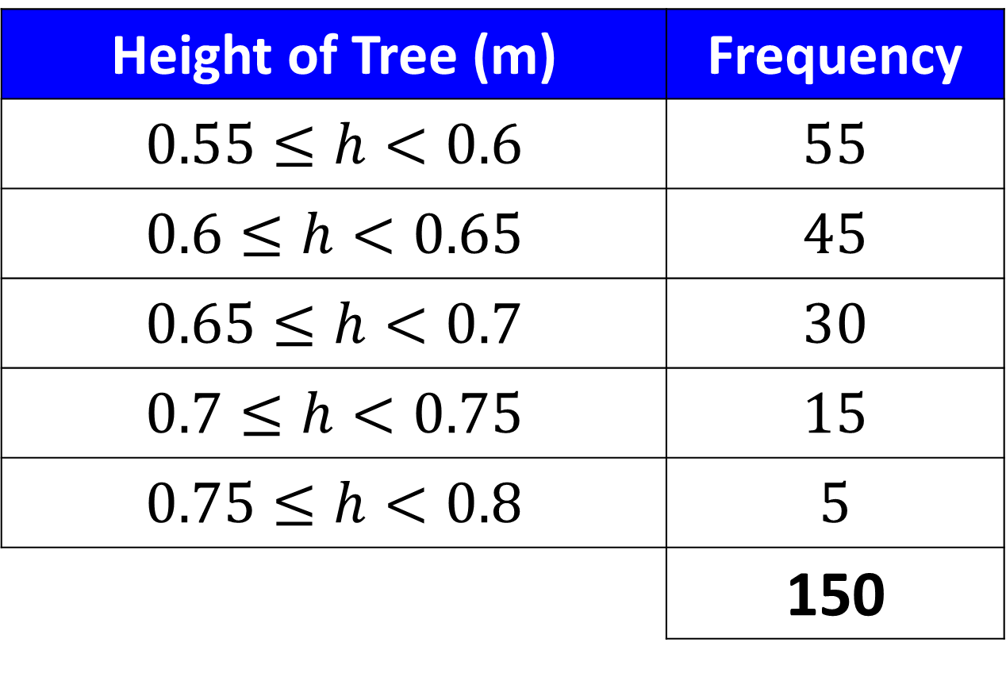
Height of Tree (m) | Frequency
$$0.55≤h<0.6$$ | $$55$$
$$0.6≤h<0.65$$ | $$45$$
$$0.65≤h<0.7$$ | $$30$$
$$0.7≤h<0.75$$ | $$15$$
$$0.75≤h<0.8$$ | $$5$$
 | 150
Find an estimate for the median height.

Slide 20
Median - Linear Interpolation
Find the fraction into the frequency,
then go the same fraction
into the class interval.

Slide 21
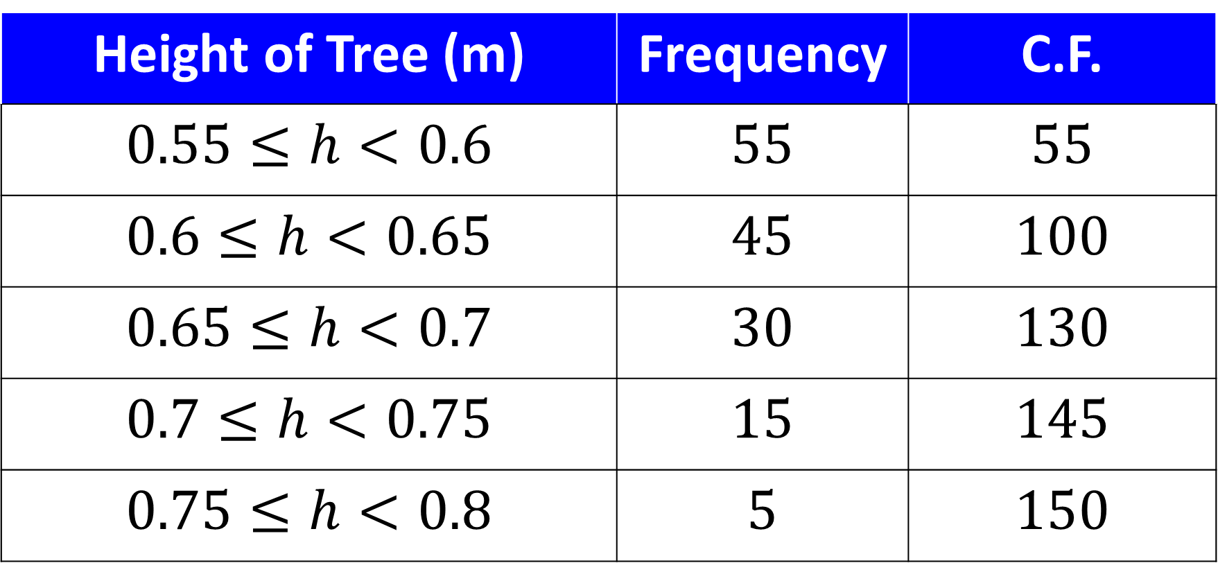
Find an estimate for the median weight.
Height of Tree (m) | Frequency | C.F.
$$0.55≤h<0.6$$ | $$55$$ | $$55$$
$$0.6≤h<0.65$$ | $$45$$ | $$100$$
$$0.65≤h<0.7$$ | $$30$$ | $$130$$
$$0.7≤h<0.75$$ | $$15$$ | $$145$$
$$0.75≤h<0.8$$ | $$5$$ | $$150$$

Slide 22
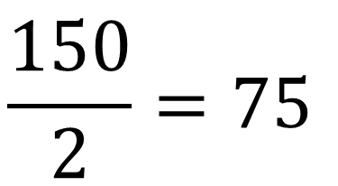
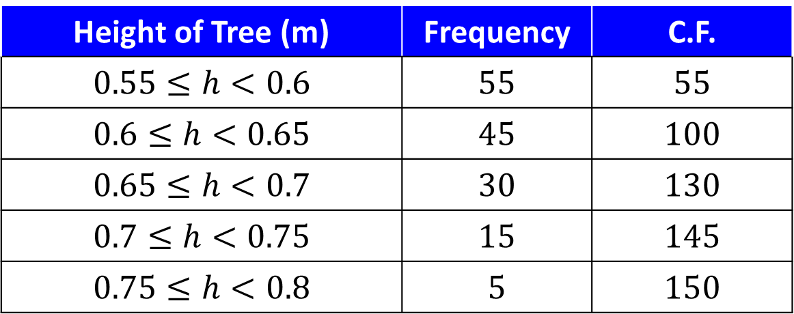
Height of Tree (m) | Frequency | C.F.
$$0.55≤h<0.6$$ | $$55$$ | $$55$$
$$0.6≤h<0.65$$ | $$45$$ | $$100$$
$$0.65≤h<0.7$$ | $$30$$ | $$130$$
$$0.7≤h<0.75$$ | $$15$$ | $$145$$
$$0.75≤h<0.8$$ | $$5$$ | $$150$$
$$\frac{150}{2}=75$$
75th item
55
100
0.6
0.65
Estimated Median

Slide 23
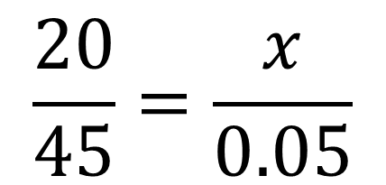
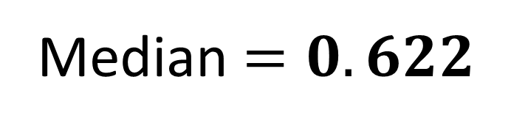
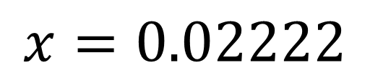
Height of Tree (m) | Frequency | C.F.
$$0.55≤h<0.6$$ | $$55$$ | $$55$$
$$0.6≤h<0.65$$ | $$45$$ | $$100$$
$$0.65≤h<0.7$$ | $$30$$ | $$130$$
$$0.7≤h<0.75$$ | $$15$$ | $$145$$
$$0.75≤h<0.8$$ | $$5$$ | $$150$$
75th item
75th item
45
$$\frac{20}{45}=\frac{x}{0.05}$$
55
100
20
$$x=0.02222$$
0.6
0.65
x
0.05
Median $=0.622$
Estimated Median

Slide 24
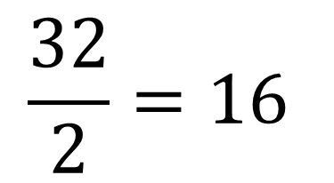
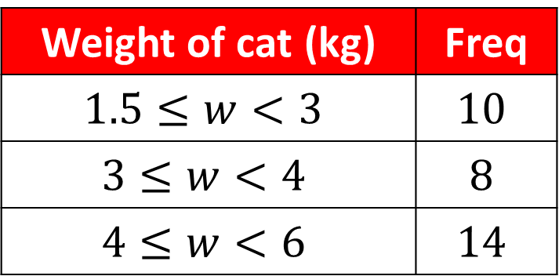
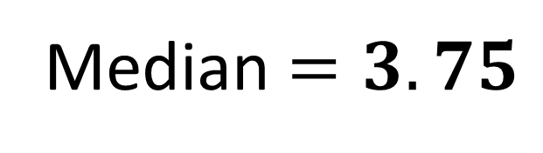
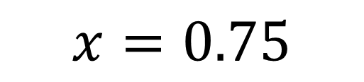
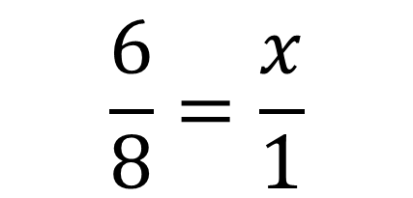
Find an estimate for the median weight.
Weight of cat (kg) | Freq
$$1.5≤w<3$$ | $$10$$
$$3≤w<4$$ | $$8$$
$$4≤w<6$$ | $$14$$
$$\frac{32}{2}=16$$
16th item
8
$$\frac{6}{8}=\frac{x}{1}$$
10
18
6
3
4
x
$$x=0.75$$
1
Median $=3.75$
Estimated Median

Slide 25

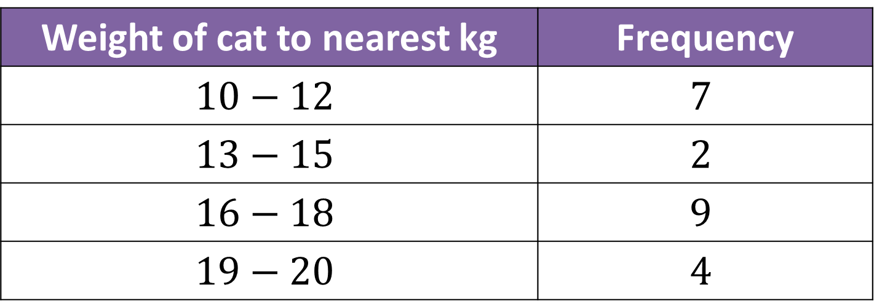
Watch Out!
What’s different about the intervals here?
Weight of cat to nearest kg | Frequency
$$10−12$$ | $$7$$
$$13−15$$ | $$2$$
$$16−18$$ | $$9$$
$$19−20$$ | $$4$$
There are GAPS between intervals.

Slide 26
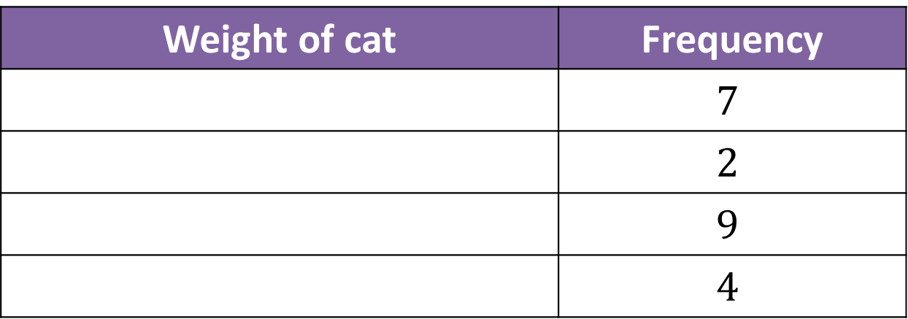
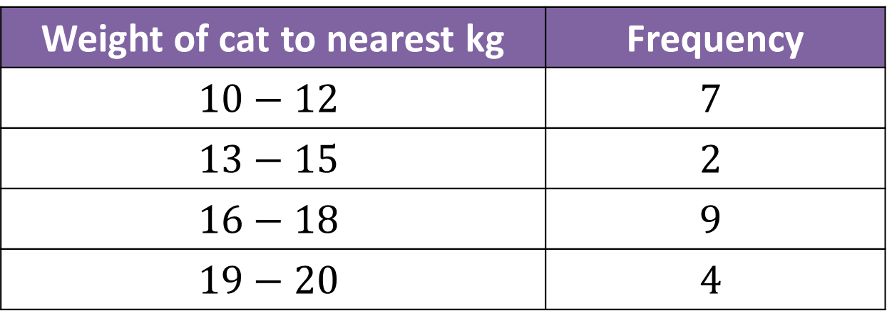
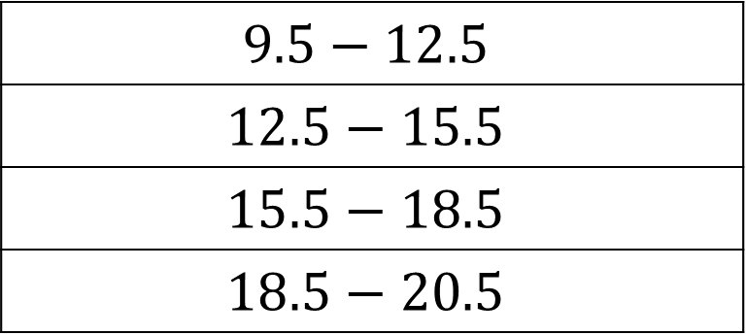
Weight of cat to nearest kg | Frequency
$$10−12$$ | $$7$$
$$13−15$$ | $$2$$
$$16−18$$ | $$9$$
$$19−20$$ | $$4$$
What do the intervals actually represent?
Weight of cat | Frequency
 | $$7$$
 | $$2$$
 | $$9$$
 | $$4$$
$$9.5−12.5$$
$$12.5−15.5$$
$$15.5−18.5$$
$$18.5−20.5$$

Slide 27
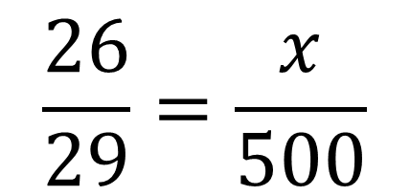
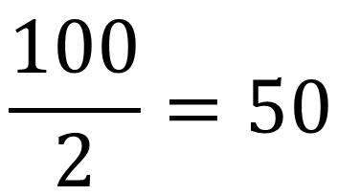
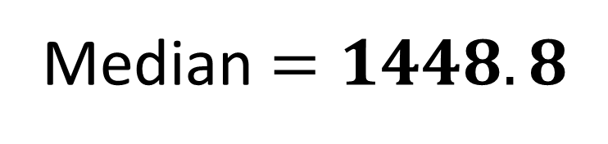
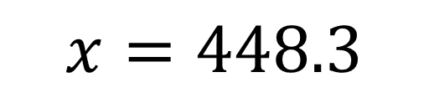
Find an estimate for the median age.
Age of relic (years) | Frequency
0 – 1000 | 24
1001 – 1500 | 29
1501 – 1700 | 12
1701 – 2000 | 35
0 – 1000.5
1000.5 – 1500.5
1500.5 – 1700.5
1700.5 – 2000.5
$$\frac{100}{2}=50$$
50th item
29
$$\frac{26}{29}=\frac{x}{500}$$
24
53
26
1000.5
1500.5
x
$$x=448.3$$
500
Median $=1448.8$
Estimated Median
Notes:
There’s a slip to print out here.

Slide 28
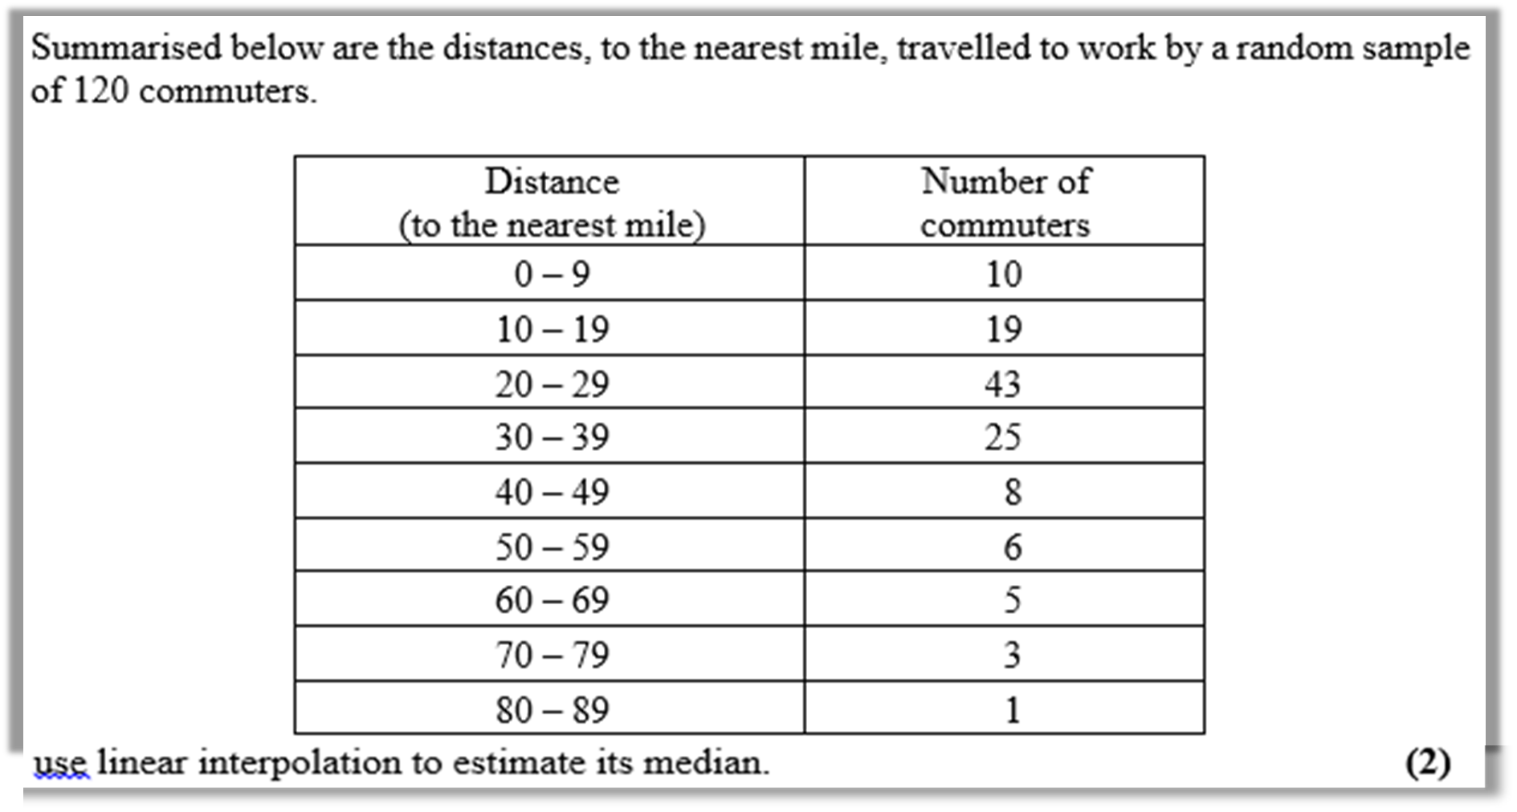

Slide 29
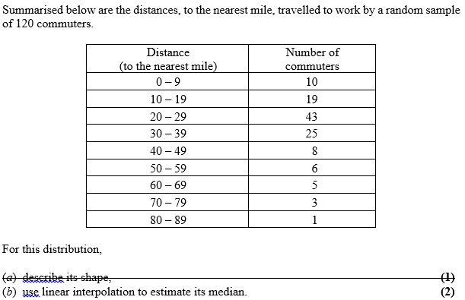
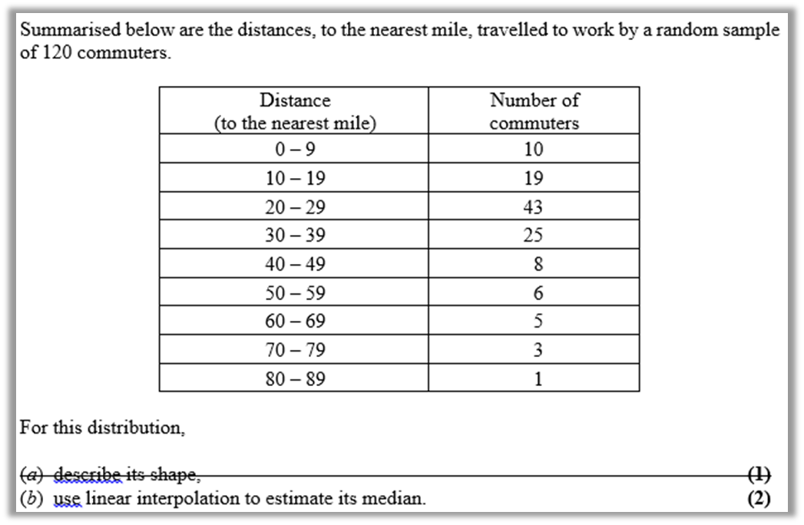
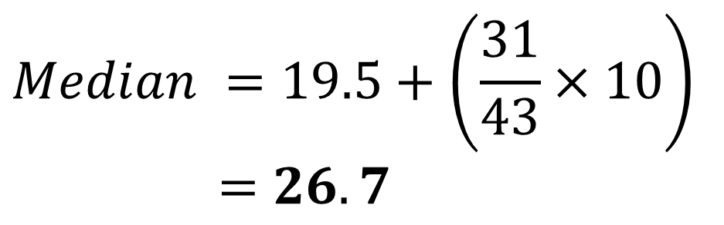
Cumulative
Frequency
10
29
72
97
105
111
116
119
120
29
60
72
$$Median =19.5+\left(\frac{31}{43}×10\right)$$
$$=26.7$$
19.5 miles
Median
29.5 miles

