Slide 1
FM: Identity Matrix

Slide 2
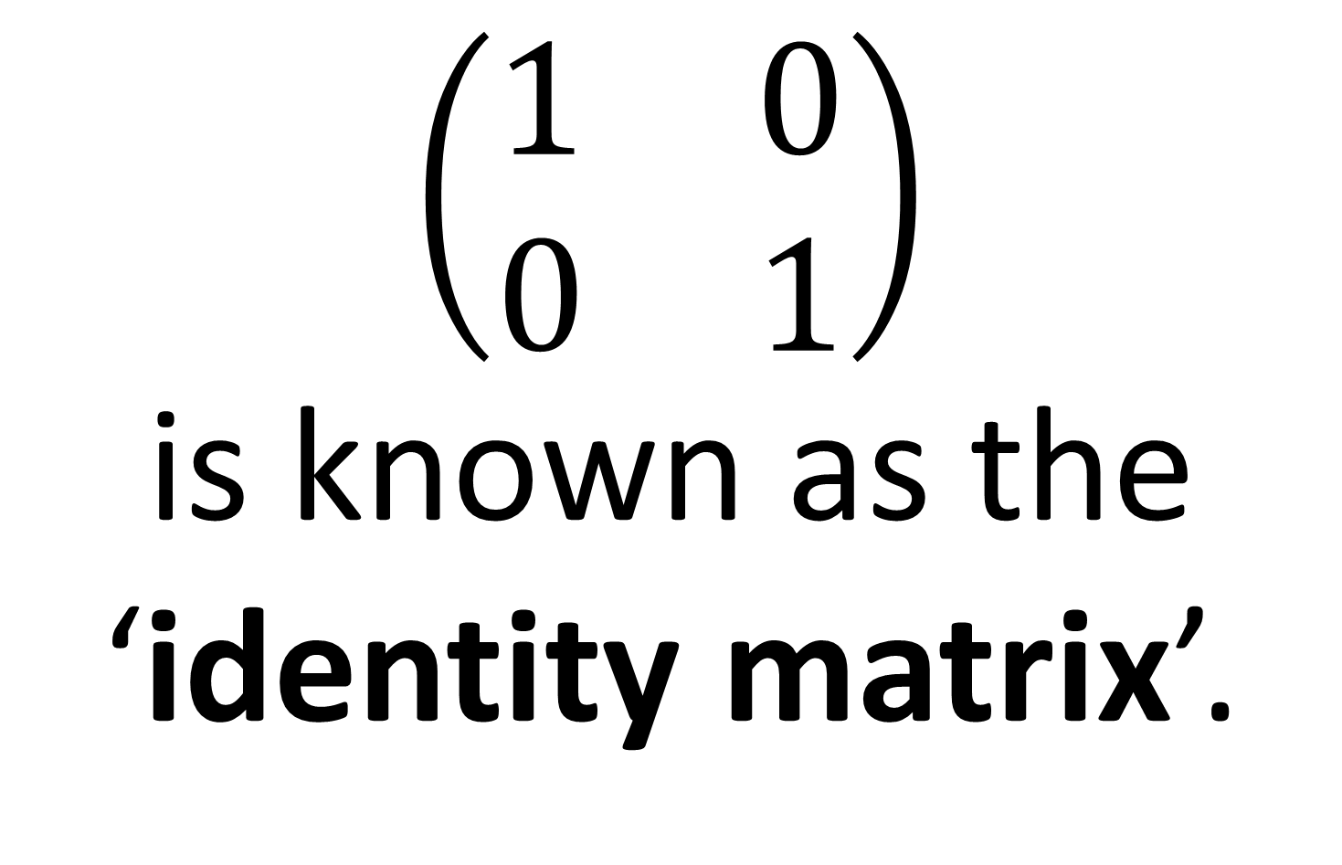
Identity Matrix
$\left(\begin{matrix}1 & 0 \\ 0 & 1\end{matrix}\right)$
is known as the
‘identity matrix’.

Slide 3
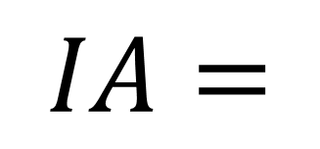
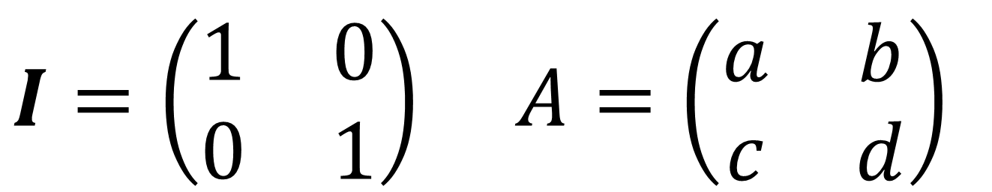
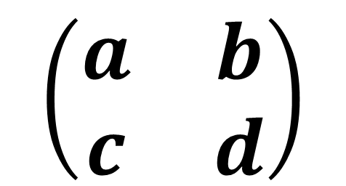
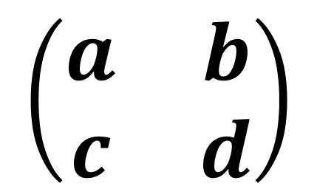
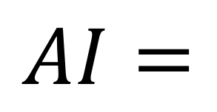
$I=\left(\begin{matrix}1 & 0 \\ 0 & 1\end{matrix}\right)$ $A=\left(\begin{matrix}a & b \\ c & d\end{matrix}\right)$
$$\left(\begin{matrix}a & b \\ c & d\end{matrix}\right)$$
$$IA=$$
$$\left(\begin{matrix}a & b \\ c & d\end{matrix}\right)$$
$$AI=$$

Slide 4
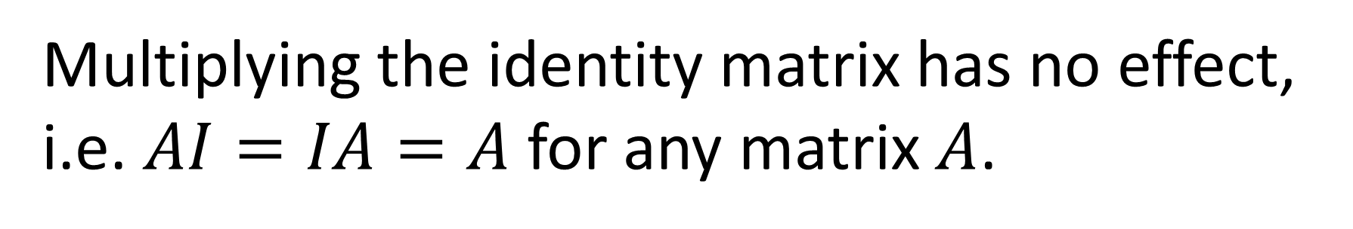
Identity Matrix
Multiplying the identity matrix has no effect,
i.e. $AI=IA=A$ for any matrix $A$.
It may seem pointless to have such a matrix,
but it’ll have more importance when you consider matrices as ‘transformations’ later.

Slide 5

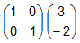
=

Slide 6
