Slide 1
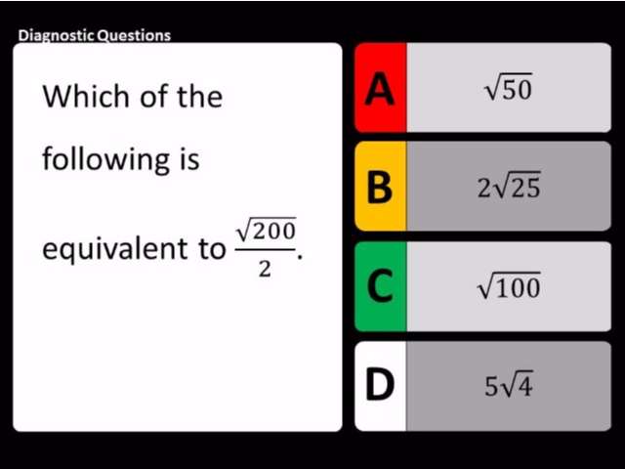
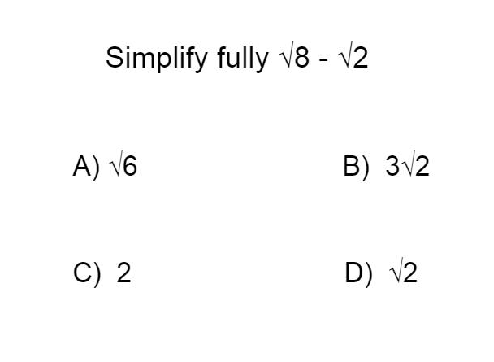
Worst answered question?
Most common wrong answer?

Slide 2
ANSWERS

Slide 3
Worst answered question?

Slide 4

C
They simply divided 200 by 2 and did not use any surd laws.

Slide 5
A
They simply did 8 subtract from 2 and did not use any surd laws.

