Slide 1
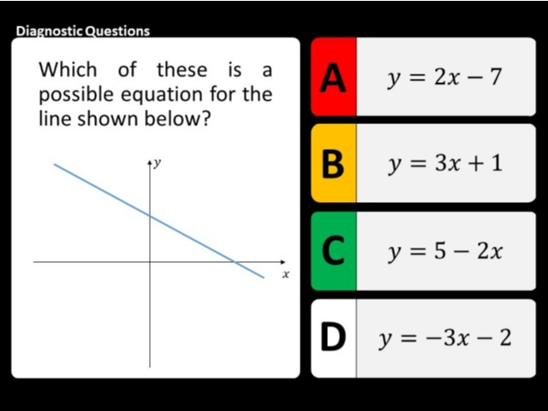
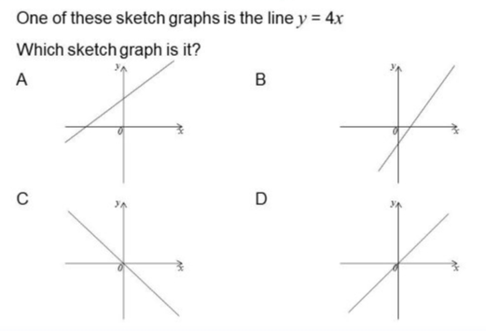
Worst answered question?
Most common wrong answer?

Slide 2
ANSWERS

Slide 3
Worst answered question?

Slide 4
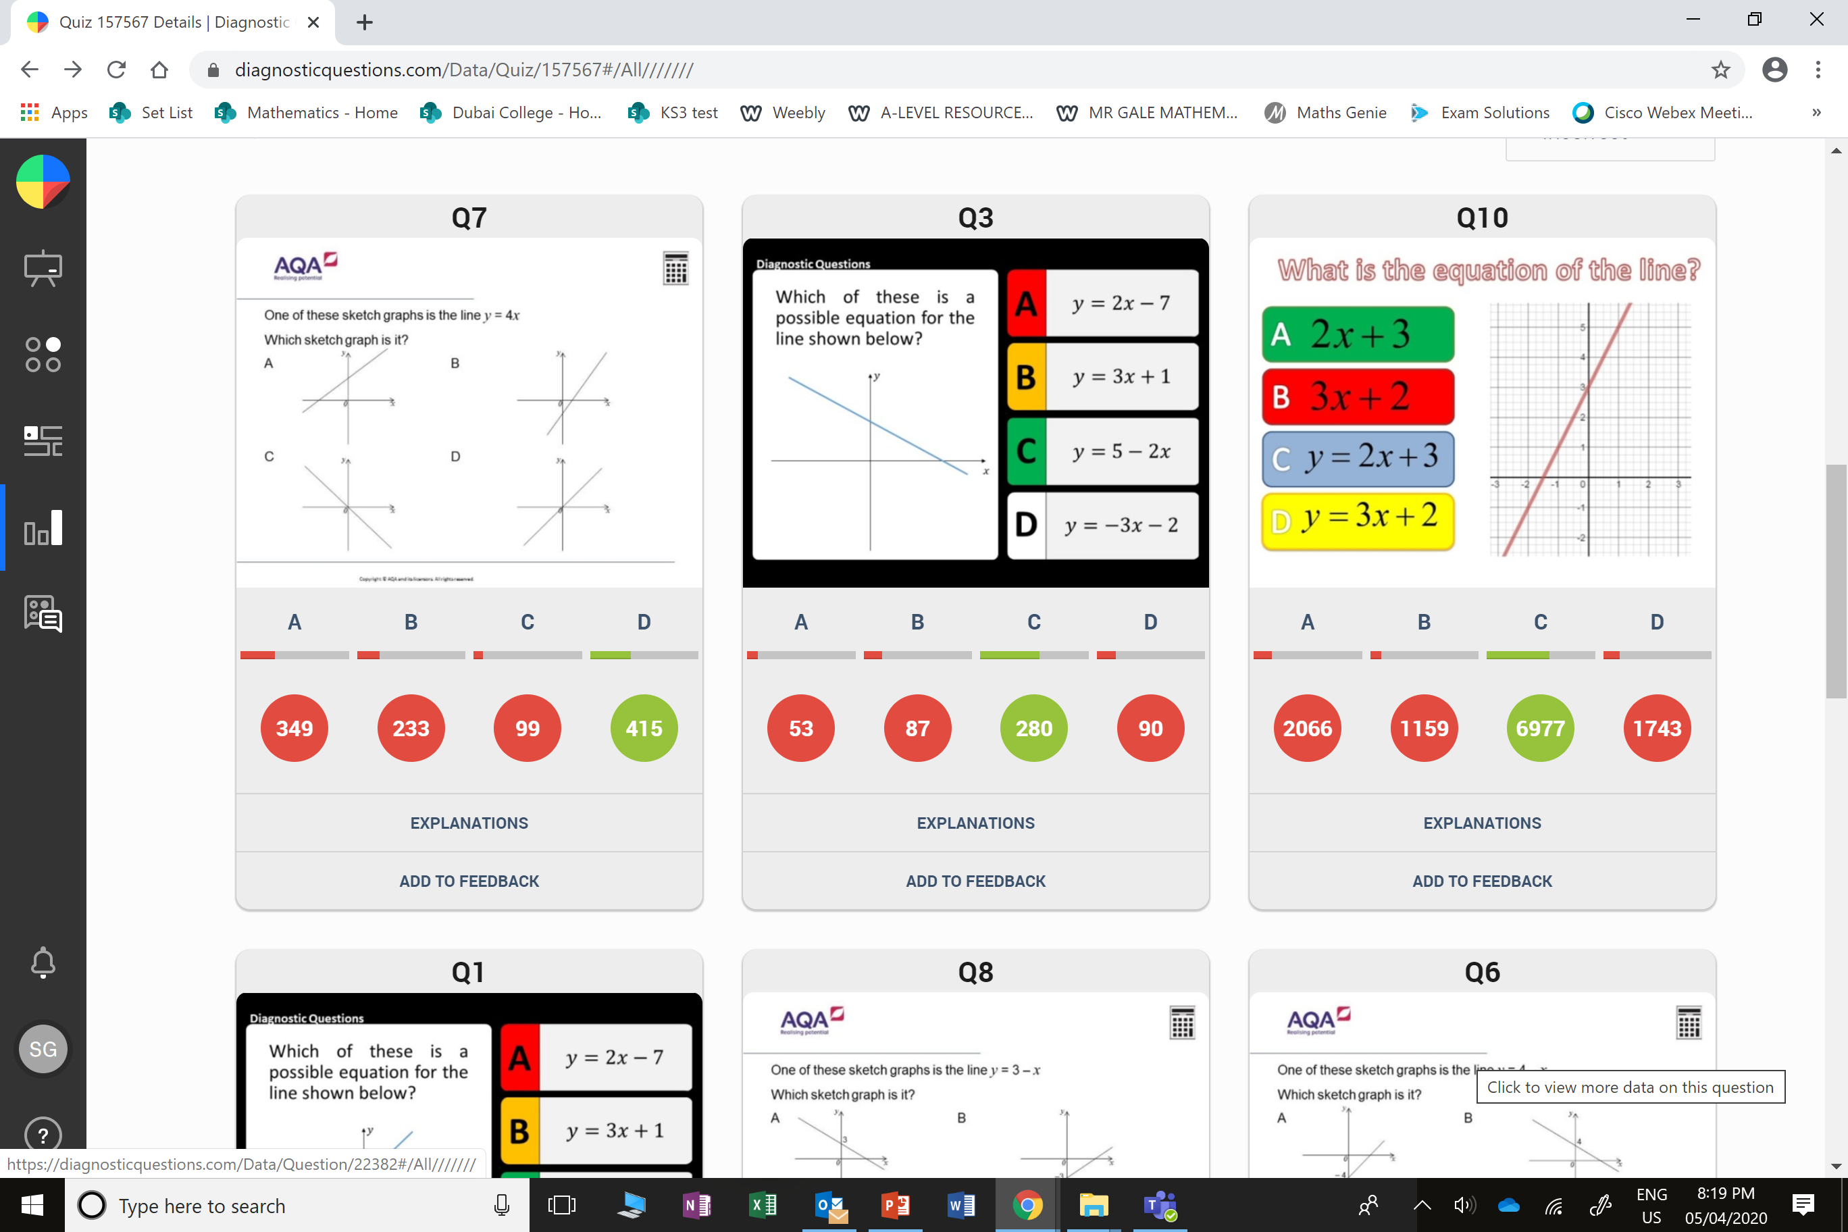
D
They didn’t recognize that the 2 was a minus 2.

Slide 5
A
They thought the
4 was the
y intercept
and not the gradient.

