Slide 1
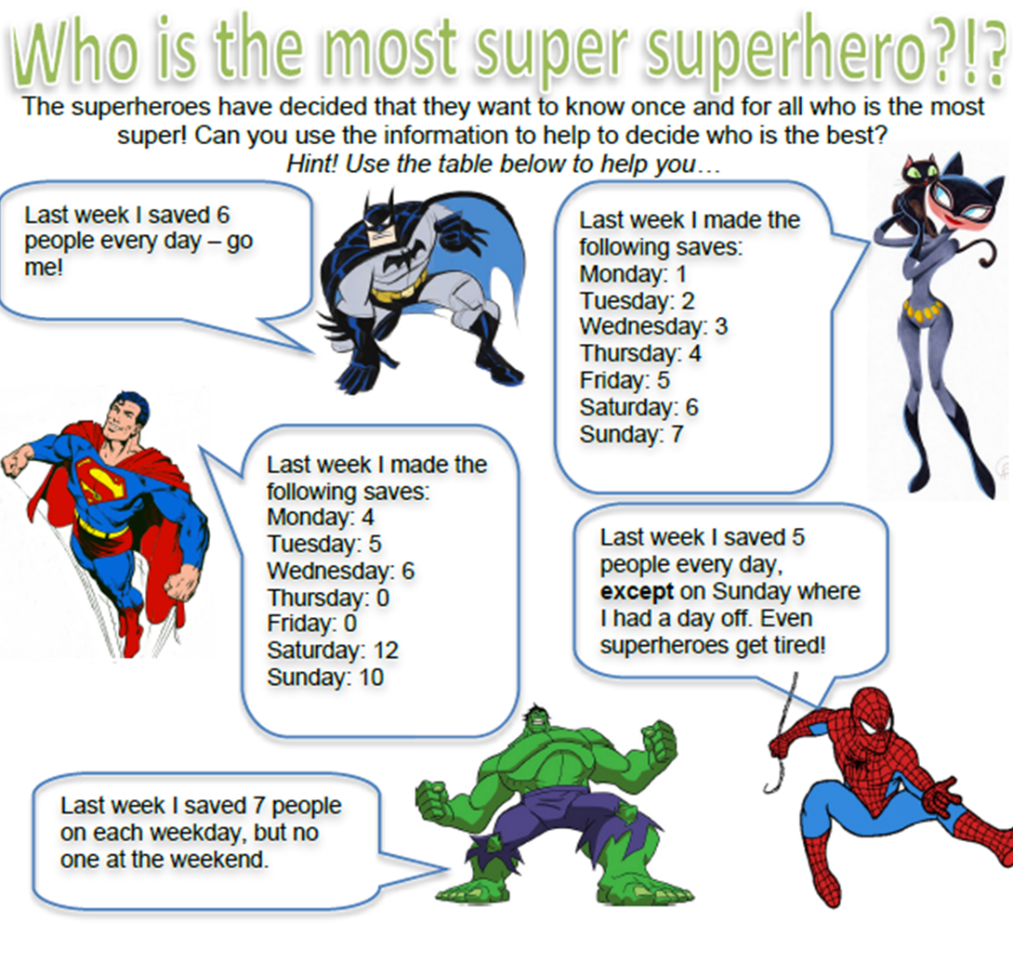
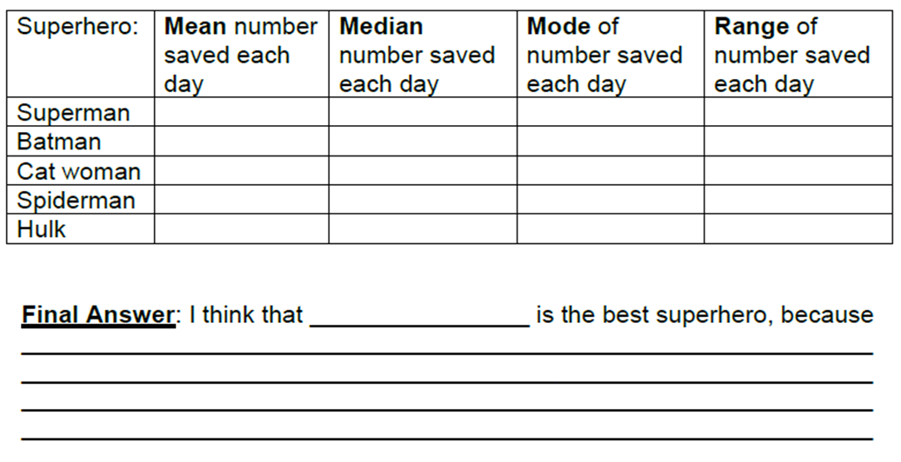

Slide 2
ANSWERS

Slide 3
5.3 | 5 | 0 | 12
6 | 6 | 6 | 0
4 | 4 | No Mode | 6
4.3 | 5 | 5 | 5
5 | 7 | 7 | 7

