Slide 1
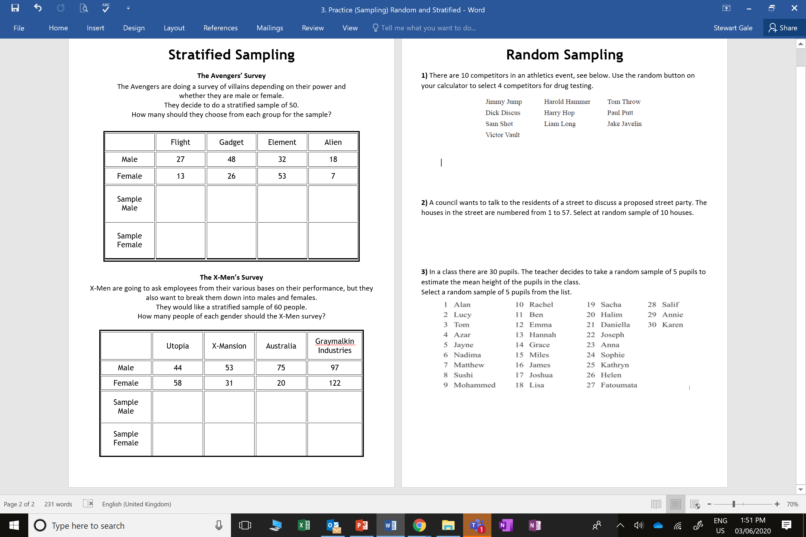

Slide 2
ANSWERS

Slide 3








$\frac{27}{224}$ x 50 = 6.03
$\frac{48}{224}$ x 50 = 10.71
$\frac{32}{224}$ x 50 = 7.1
$\frac{18}{224}$ x 50 = 4.01
6
11
7
4
$\frac{13}{224}$ x 50 = 2.9
$\frac{26}{224}$ x 50 = 5.8
$\frac{53}{224}$ x 50 = 11.8
$\frac{7}{224}$ x 50 = 1.56
3
6
11
2

Slide 4








$\frac{44}{500}$ x 60 = 5.28
$\frac{53}{500}$ x 60 = 6.36
$\frac{75}{500}$ x 60 = 9
$\frac{97}{500}$ x 60 = 11.64
5
6
9
12
$\frac{58}{500}$ x 60 = 6.96
$\frac{31}{500}$ x 60 = 3.72
$\frac{20}{500}$ x 60 = 2.4
$\frac{122}{500}$ x 60 = 14.64
7
4
2
15

