Slide 1
Projectiles
Components
Chapter 6
(Part 2 of 3)

Slide 2




Vertical and Horizontal Components
$20$ ms⁻¹
$$20\sin{70°}$$
$$70°$$
$$20\cos{70°}$$

Slide 3







Vertical and Horizontal Components
$$20\cos{70°}$$
$$20\cos{70°}$$
$$20\cos{70°}$$
$20$ ms⁻¹
$$20\sin{70°}$$
$$70°$$
$$20\cos{70°}$$

Slide 4
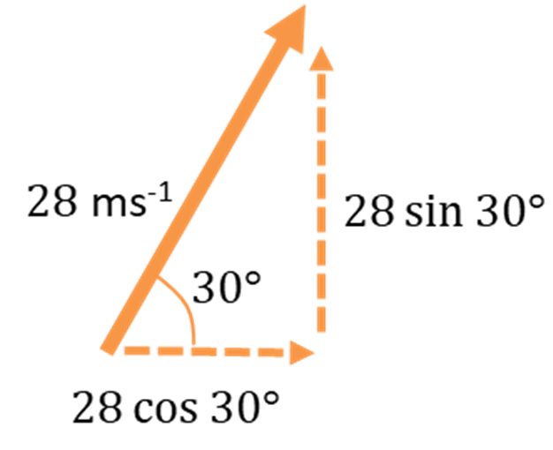

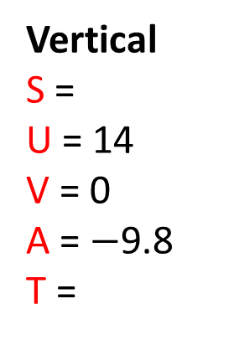

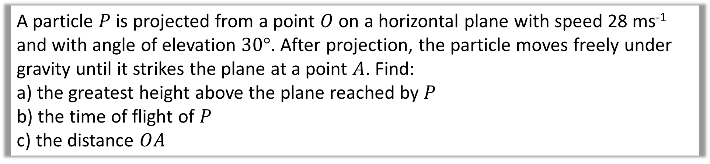



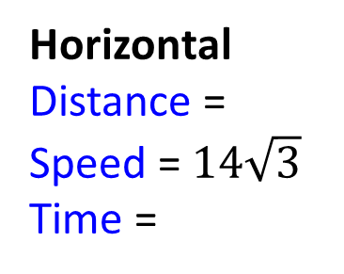

A particle $P$ is projected from a point $O$ on a horizontal plane with speed 28 ms⁻¹ and with angle of elevation $30°$. After projection, the particle moves freely under gravity until it strikes the plane at a point $A$. Find:
a) the greatest height above the plane reached by $P$
b) the time of flight of 𝑃
c) the distance $OA$
Vertical
S =
U = 14
V = 0
A = $−$9.8
T =
a)
$$Resolve Vertial$$
$$v^{2}=u^{2}+2as$$
$$=14$$
$$0={14}^{2}+2×\left(−9.8\right)×s$$
Horizontal
Distance =
Speed = $14\sqrt{3}$
Time =
$$s=10$$
$$=14\sqrt{3}$$
Greatest height is 10m

Slide 5
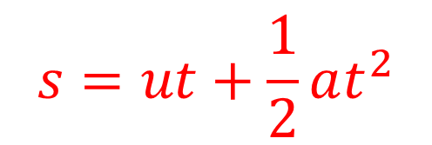
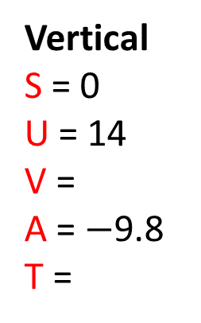




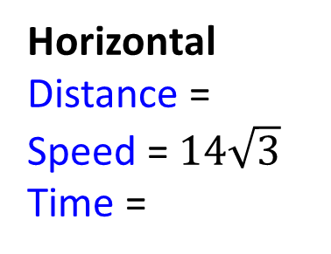

A particle $P$ is projected from a point $O$ on a horizontal plane with speed 28 ms⁻¹ and with angle of elevation $30°$. After projection, the particle moves freely under gravity until it strikes the plane at a point $A$. Find:
a) the greatest height above the plane reached by $P$
b) the time of flight of 𝑃
c) the distance $OA$
Vertical
S = 0
U = 14
V =
A = $−$9.8
T =
b)
$$Resolve Vertial$$
$$s=ut+\frac{1}{2}at^{2}$$
$$=14$$
$$0=14t−4.9t^{2}$$
Horizontal
Distance =
Speed = $14\sqrt{3}$
Time =
$$t=2.857$$
$$=14\sqrt{3}$$

Slide 6

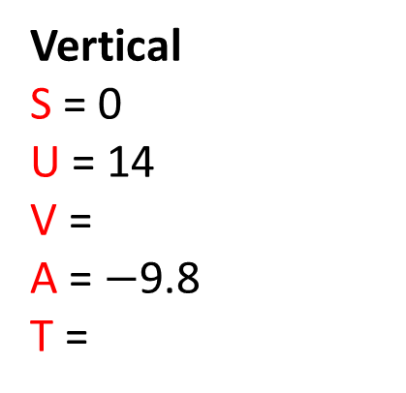


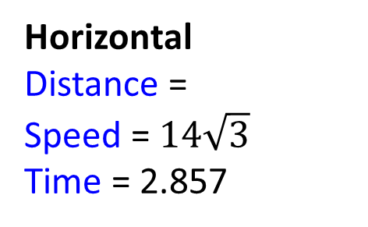

A particle $P$ is projected from a point $O$ on a horizontal plane with speed 28 ms⁻¹ and with angle of elevation $30°$. After projection, the particle moves freely under gravity until it strikes the plane at a point $A$. Find:
a) the greatest height above the plane reached by $P$
b) the time of flight of 𝑃
c) the distance $OA$
Vertical
S = 0
U = 14
V =
A = $−$9.8
T =
c)
$$Resolve Horizontial$$
Distance $=$ Speed x Time
$$=14$$
$$=28\cos{30°}×2.857$$
Horizontal
Distance =
Speed = $14\sqrt{3}$
Time = 2.857
$$=69.28$$
$$=14\sqrt{3}$$

Slide 7


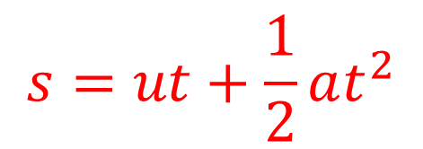

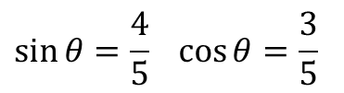


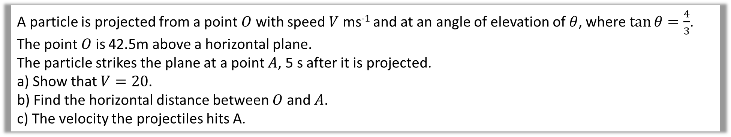
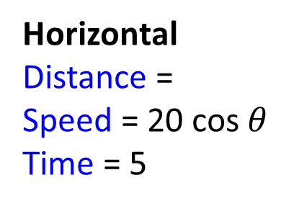



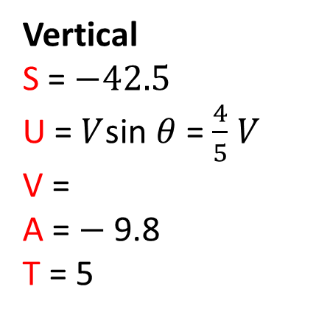




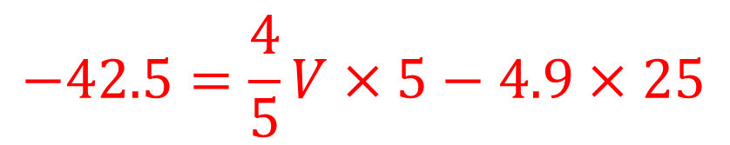
A particle is projected from a point $O$ with speed $V$ ms⁻¹ and at an angle of elevation of $θ$, where $\tan{θ=\frac{4}{3}}$. The point $O$ is 42.5m above a horizontal plane.
The particle strikes the plane at a point $A$, 5 s after it is projected.
a) Show that $V=20$.
b) Find the horizontal distance between $O$ and $A$.
c) The velocity the projectiles hits A.
$$5$$
$$\sin{θ}=\frac{4}{5} \cos{θ}=\frac{3}{5}$$
$$4$$
$$θ$$
$$3$$
a)
Vertical
S = $−42.5$
U = $V$sin $θ$ = $\frac{4}{5}$ $V$
V =
A = $−$9.8
T = 5
$$Resolve Vertial$$
$V$ ms⁻²
$$s=ut+\frac{1}{2}at^{2}$$
$$θ$$
$$O$$
$$−42.5=\frac{4}{5}V×5−4.9×25$$
$$42.5m$$
Horizontal
Distance =
Speed = 20 cos $θ$
Time = 5
$$V=20$$
$$A$$
$$t=5$$

Slide 8







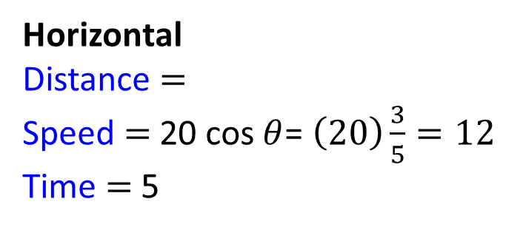


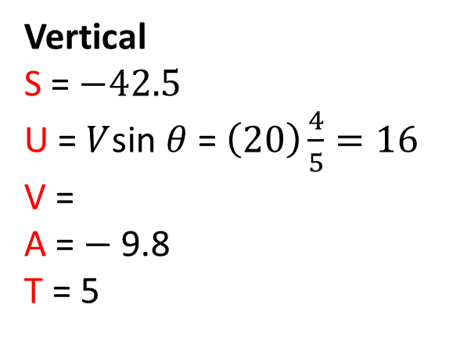
A particle is projected from a point $O$ with speed $V$ ms⁻¹ and at an angle of elevation of $θ$, where $\tan{θ=\frac{4}{3}}$. The point $O$ is 42.5m above a horizontal plane.
The particle strikes the plane at a point $A$, 5 s after it is projected.
a) Show that $V=20$.
b) Find the horizontal distance between $O$ and $A$.
c) The velocity the projectiles hits A.
$$5$$
$$\sin{θ}=\frac{4}{5} \cos{θ}=\frac{3}{5}$$
$$4$$
$$θ$$
$$3$$
b)
Vertical
S = $−42.5$
U = $V$sin $θ$ = $\left(20\right)\frac{4}{5}=16$
V =
A = $−$9.8
T = 5
$$Resolve Horizontial$$
$V$ ms⁻²
$$θ$$
$$OA=12×5$$
$$O$$
$$=60m$$
$$42.5m$$
Horizontal
Distance $=$
Speed $=$ 20 cos $θ$= $\left(20\right)\frac{3}{5}=12$
Time $=$ 5
$$A$$
$$t=5$$

Slide 9
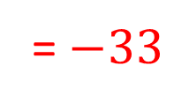
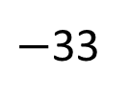




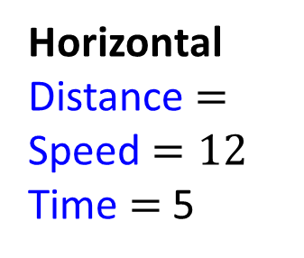
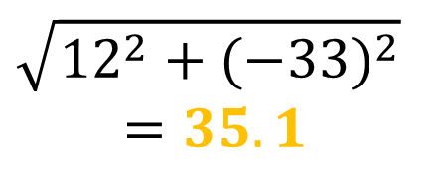
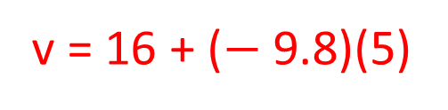
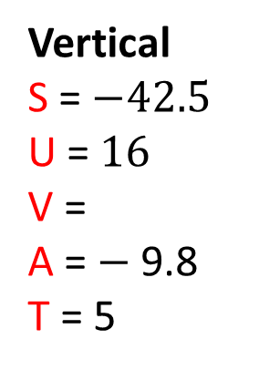

A particle is projected from a point $O$ with speed $V$ ms⁻¹ and at an angle of elevation of $θ$, where $\tan{θ=\frac{4}{3}}$. The point $O$ is 42.5m above a horizontal plane.
The particle strikes the plane at a point $A$, 5 s after it is projected.
a) Show that $V=20$.
b) Find the horizontial distance between $O$ and $A$.
c) The velocity the projectiles hits A.
$$5$$
$$\sin{θ}=\frac{4}{5} \cos{θ}=\frac{3}{5}$$
$$4$$
$$θ$$
$$3$$
c)
Vertical
S = $−42.5$
U = $16$
V =
A = $−$9.8
T = 5
$Horizontial Velocity$ at A
12
$V$ ms⁻²
$$θ$$
$Vertical Velocity$ at A
$$O$$
v = u + at
v = 16 + ($−$9.8)(5)
= $−33$
$$42.5m$$
Horizontal
Distance $=$
Speed $=12$
Time $=$ 5
$Resultant Velocity$ at A
12
$$\sqrt{{12}^{2}+{(−33)}^{2}}$$
$$=35.1$$
$$A$$
$$A$$
$−$33
$$t=5$$

Slide 10
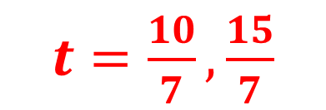


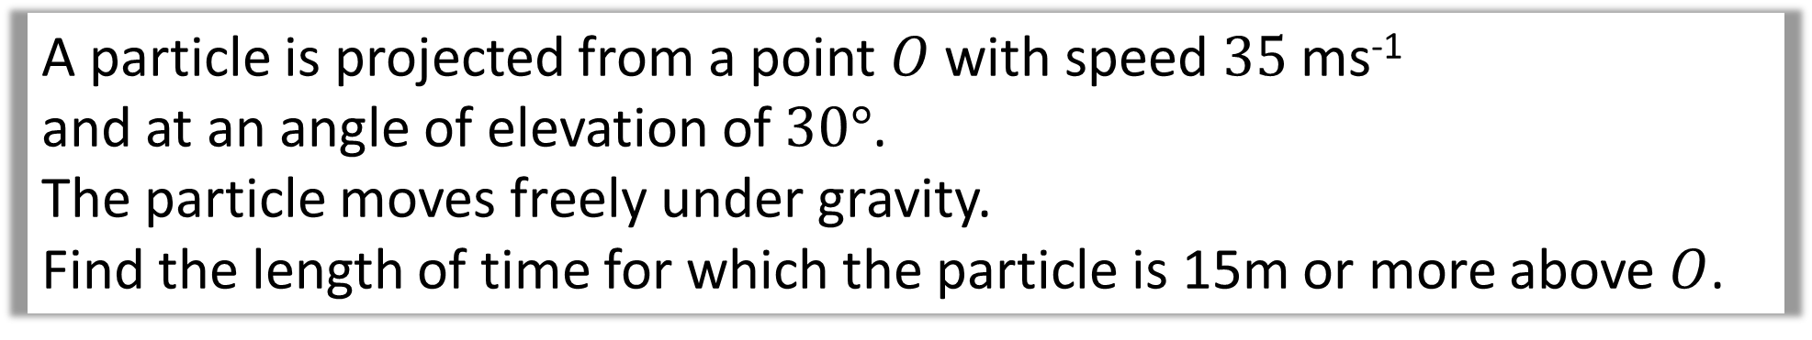
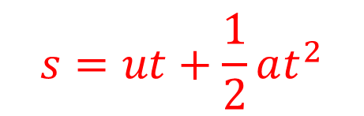

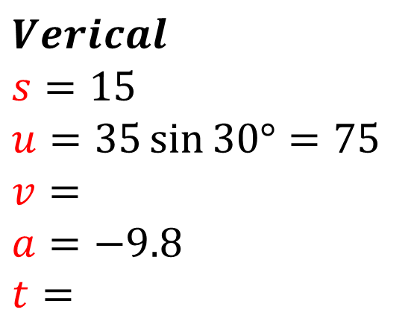

A particle is projected from a point $O$ with speed $35$ ms⁻¹
and at an angle of elevation of $30°$.
The particle moves freely under gravity.
Find the length of time for which the particle is 15m or more above $O$.
The key is to find the two times at which the particle is 15m above ground.
The time above 15m will then be the difference between these times.
$$Verical$$
$$s=15$$
$$u=35\sin{30°=75}$$
$$v=$$
$$a=−9.8$$
$t=$
$$Resolve Horizontial$$
$$s=ut+\frac{1}{2}at^{2}$$
$$15=17.5t −4.9t^{2}$$
Time above 15m
$$4.9t^{2}−17.5 t+15=0$$
$\frac{15}{7}−\frac{10}{7}=0.71$sec
$t=\frac{10}{7},\frac{15}{7}$

Slide 11
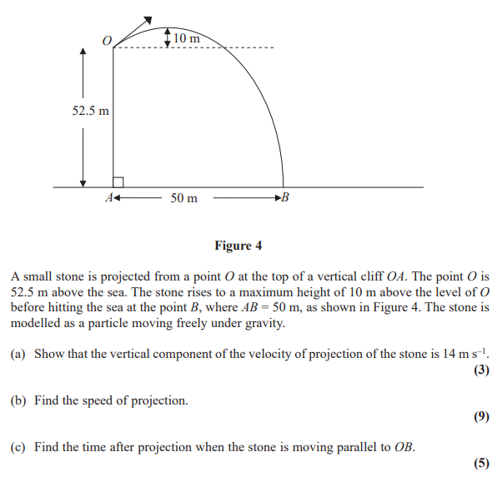

Slide 12
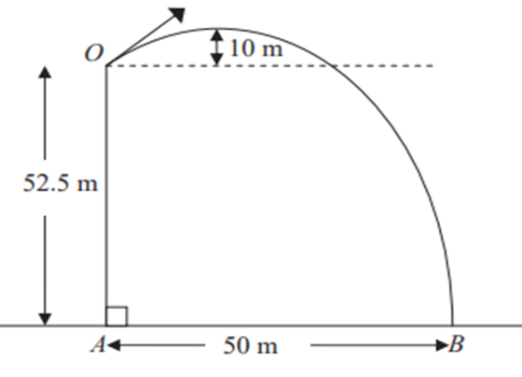
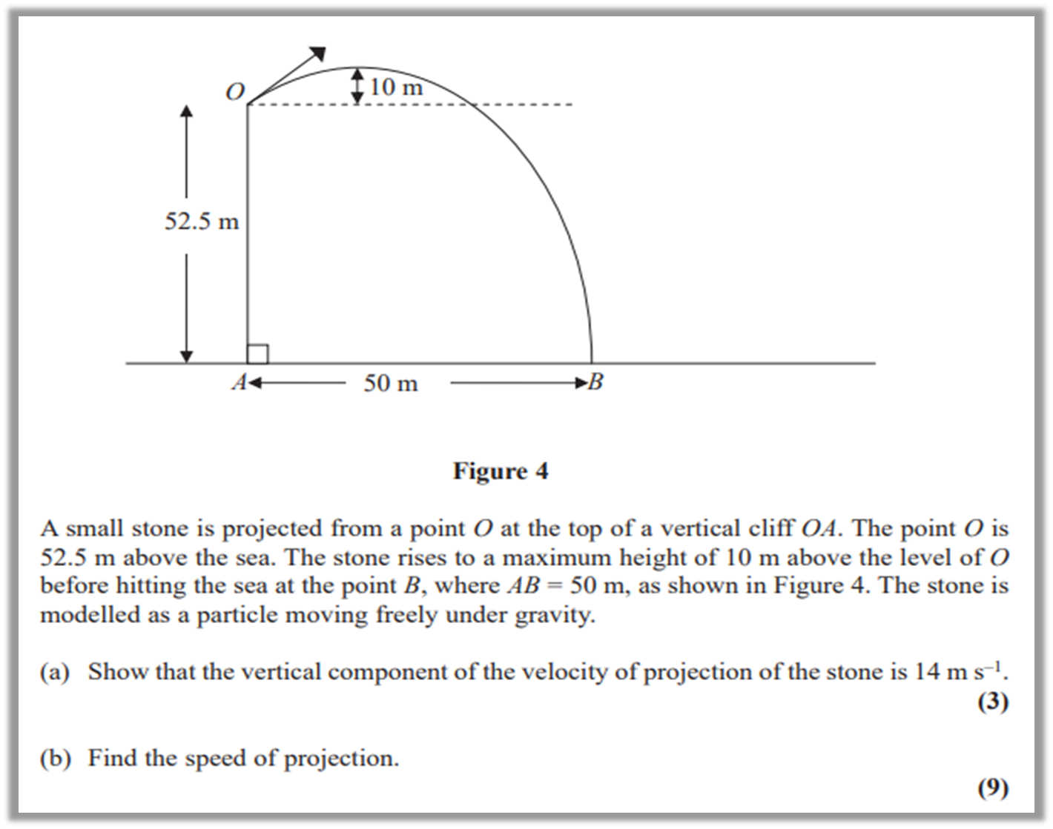



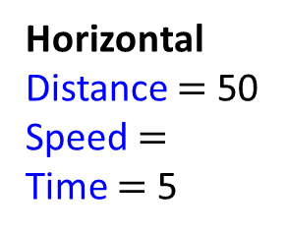

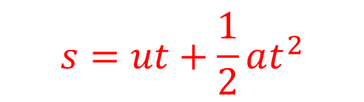


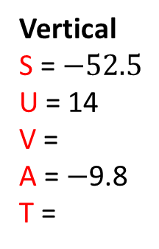


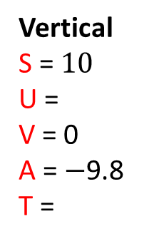
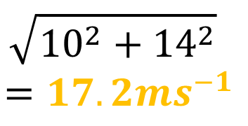

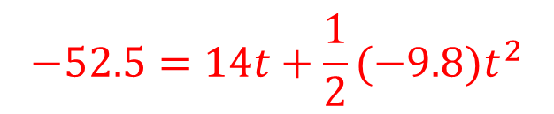

Vertical
S = $10$
U =
V = 0
A = $−$9.8
T =
$$v^{2}=u^{2}+2as$$
$$0^{2}=u^{2}+2(−9.8)(10)$$
$$u=14$$
$$s=ut+\frac{1}{2}at^{2}$$
Vertical
S = $−52.5$
U = 14
V =
A = $−$9.8
T =
$$−52.5=14t+\frac{1}{2}(−9.8)t^{2}$$
$Resultant Velocity$ at O
$$49t^{2}−140t−525=0$$
$$\sqrt{{10}^{2}+{14}^{2}}$$
$$=17.2{ms}^{−1}$$
$$t=5$$
$$14$$
Horizontal
Distance $=$ 50
Speed $=$
Time $=$ 5
$50= 5u$
$$O$$
10
$u=10$

