Slide 1
LO: Transforming
Graphs

Slide 2
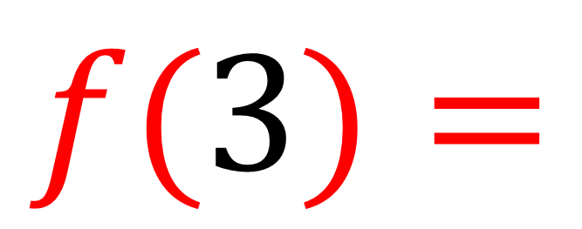
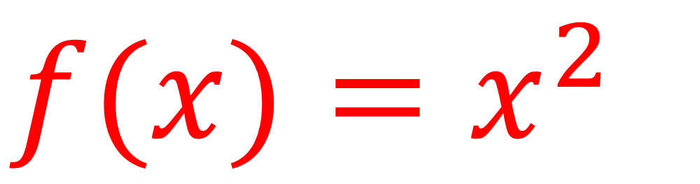
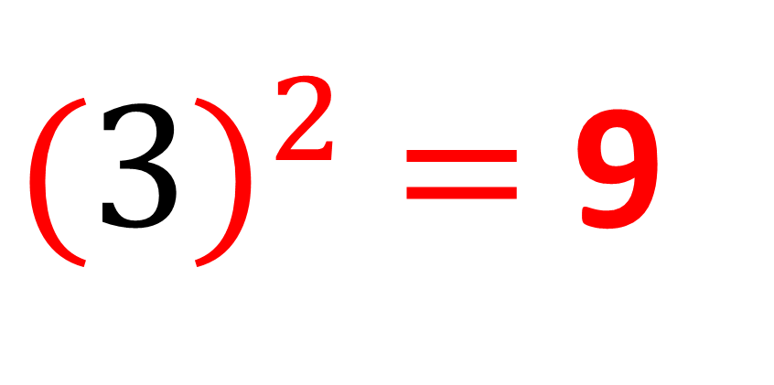
$f(x)=x^{2}$
$$f(3)=$$
${(3)}^{2}$ $=$ 9

Slide 3
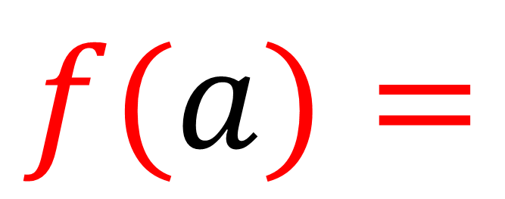
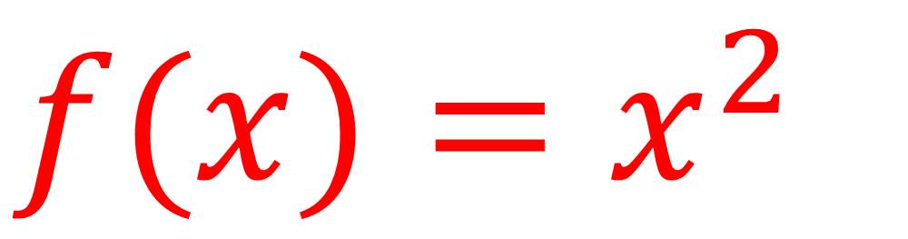
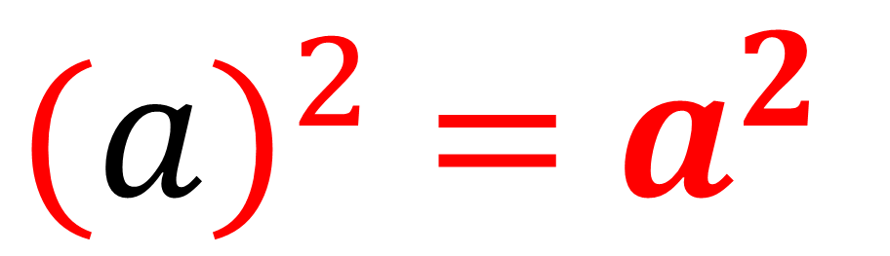
$f(x)=x^{2}$
$$f(a)=$$
${(a)}^{2}$ $=$ $a^{2}$

Slide 4
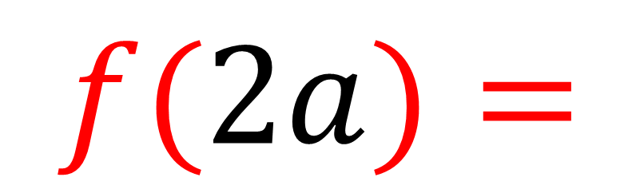
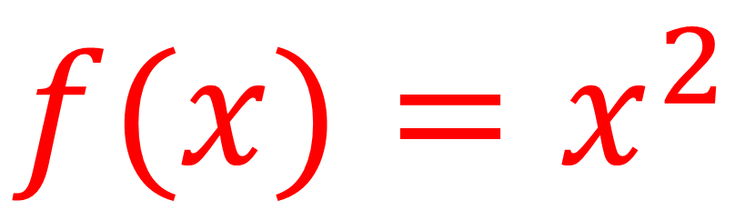
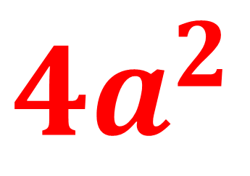
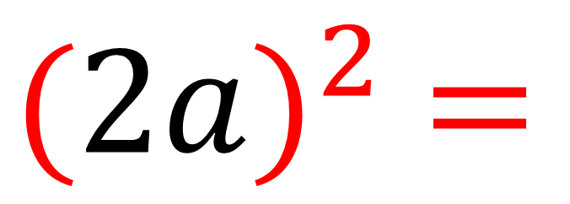
$f(x)=x^{2}$
$$f(2a)=$$
${(2a)}^{2}$ $=$
${4a}^{2}$

Slide 5
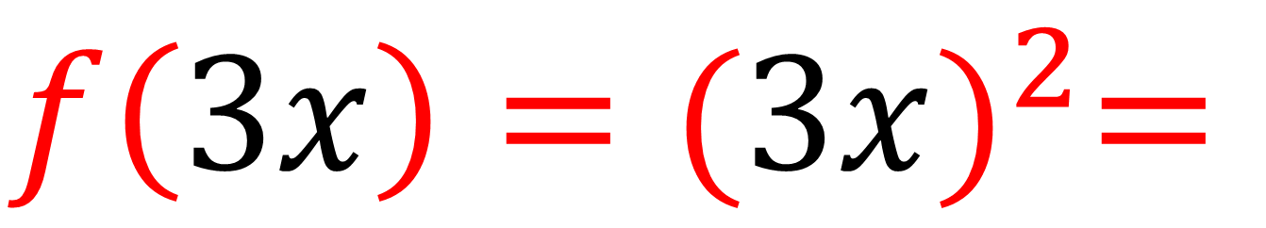
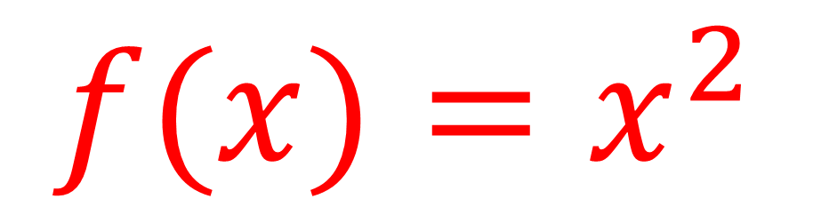
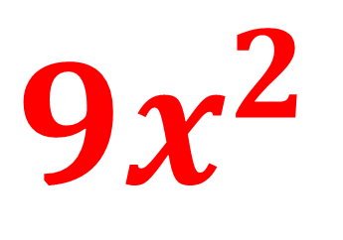
$f(x)=x^{2}$
$$f\left(3x\right)={(3x)}^{2}=$$
${9x}^{2}$

Slide 6
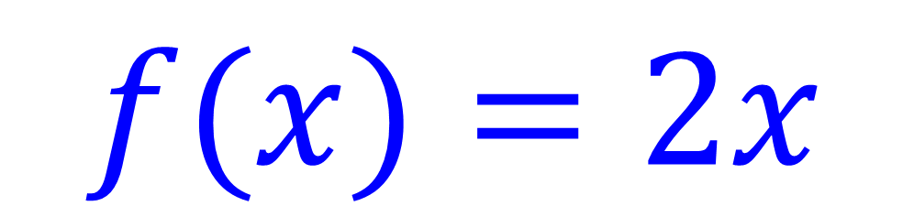
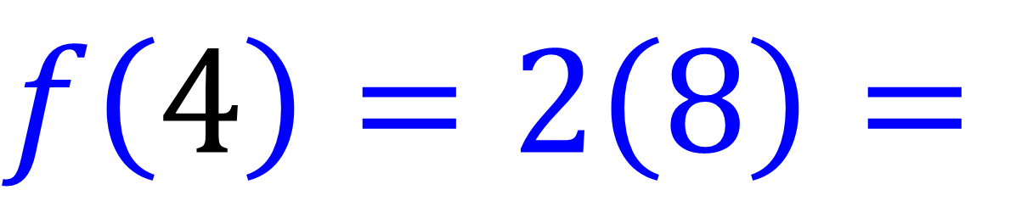
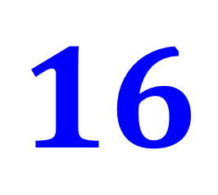
$f(x)=2x$
$$f\left(4\right)=2\left(8\right)=$$
$$16$$

Slide 7

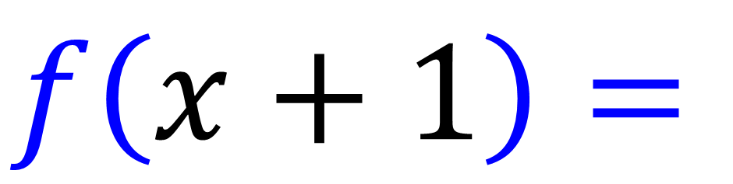
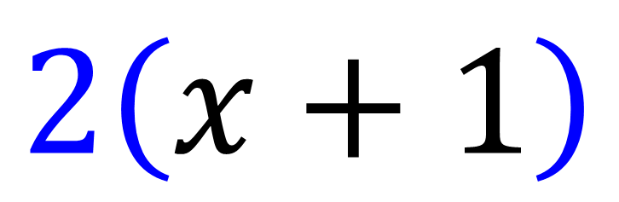
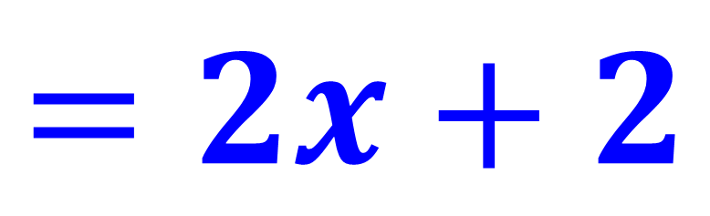
$f(x)=2x$
$$f\left(x+1\right)=$$
$$2\left(x+1\right)$$
$$=2x+2$$

Slide 8
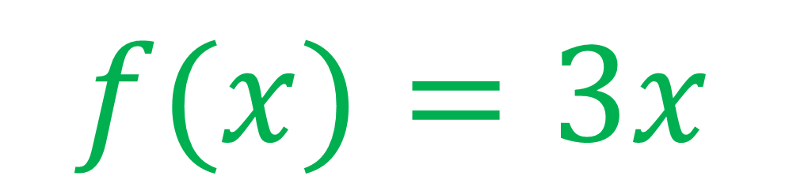
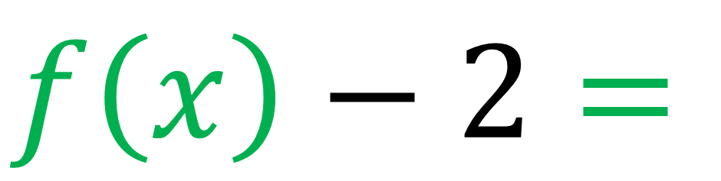
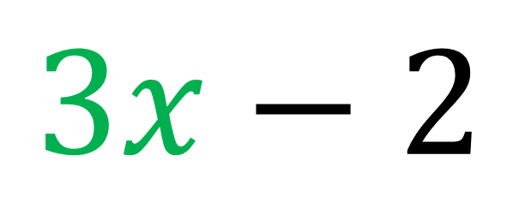
$f(x)=3x$
$$f\left(x\right)−2=$$
$$3x−2$$

Slide 9
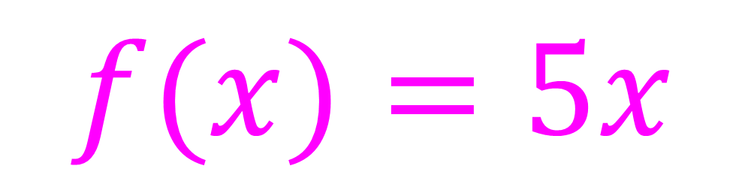

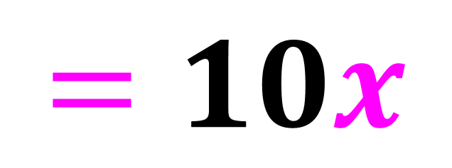
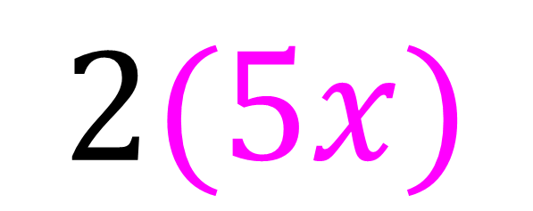
$f(x)=5x$
$$2f\left(x\right)=$$
$$2(5x)$$
$$=10x$$

Slide 10



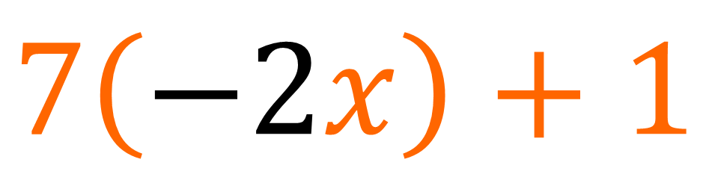
$f\left(x\right)=7x+1$
$$f\left(−2x\right)=$$
$$7\left(−2x\right)+1$$
$$=−14x+1$$

Slide 11
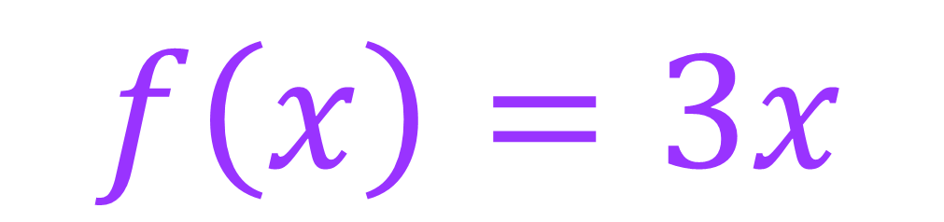
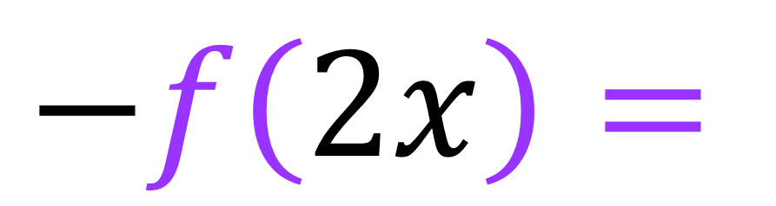
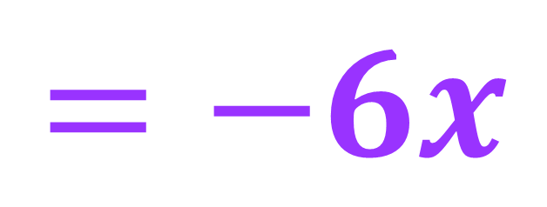
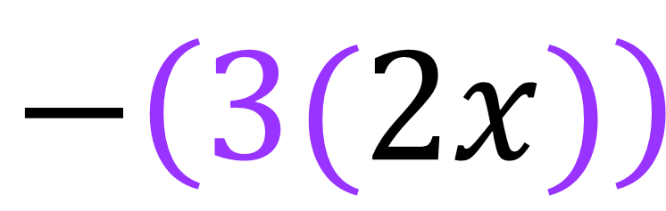
$f\left(x\right)=3x$
$$−f\left(2x\right)=$$
$$−\left(3(2x)\right)$$
$$=−6x$$

Slide 12
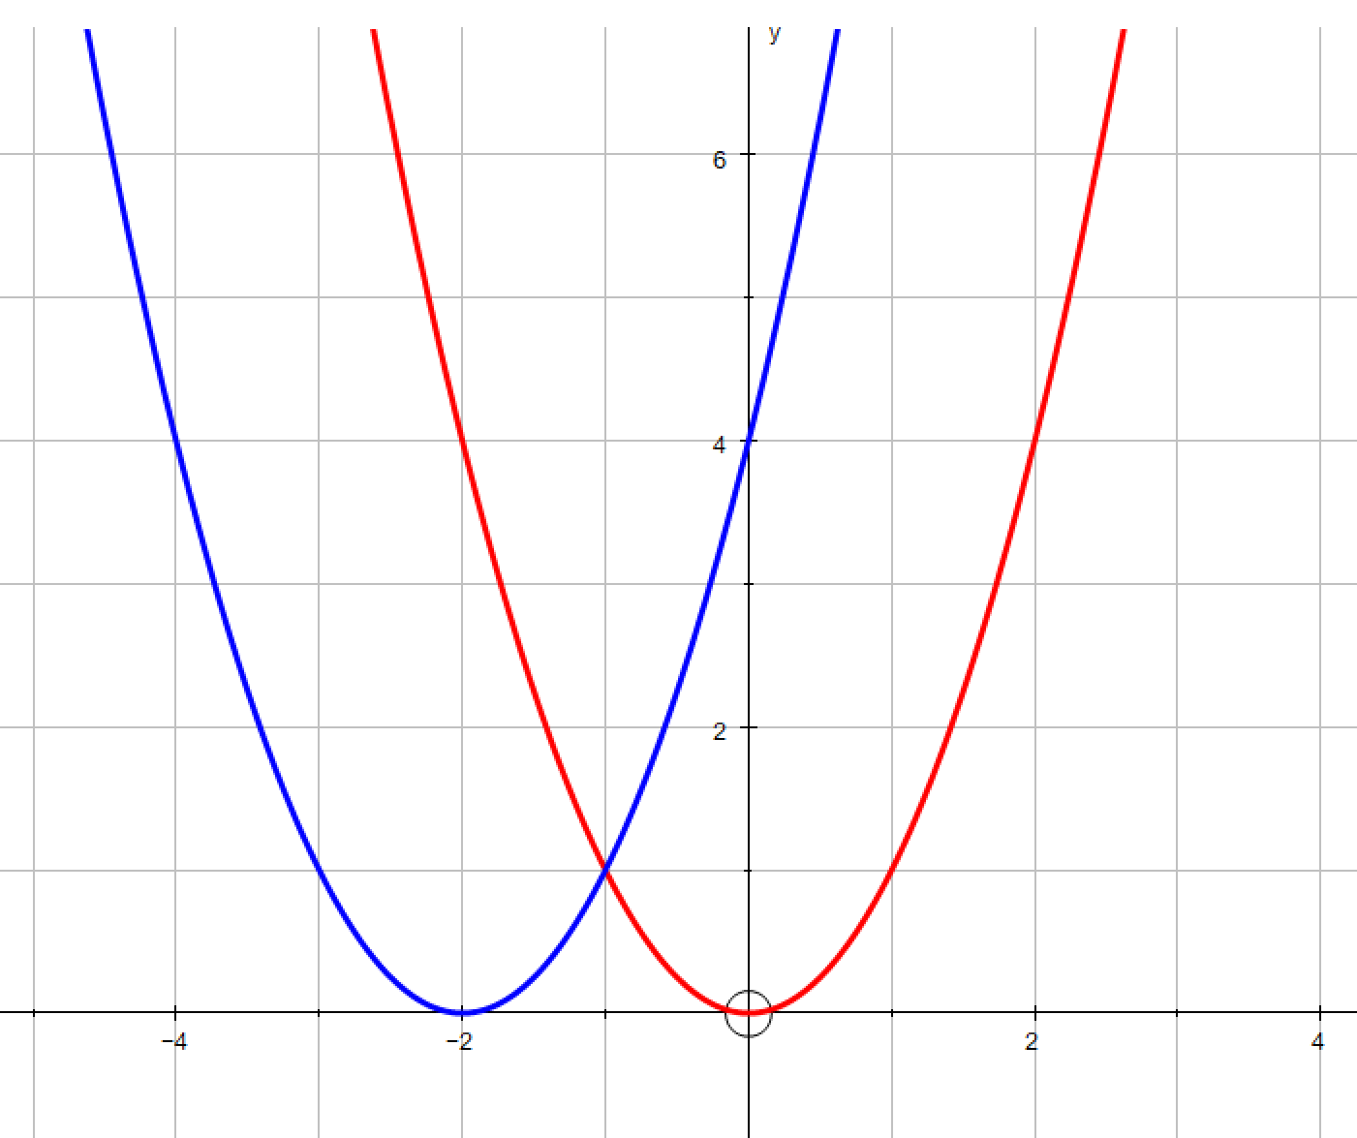
The red curve is the starting position.
What is the transformation to blue?
A. Shift Up
B. Shift Down
C. Shift Left
D. Shift Right
E. Reflect in x axis
F. Reflect in y axis
G. Stretch in x axis
H. Stretch in y axis

Slide 13
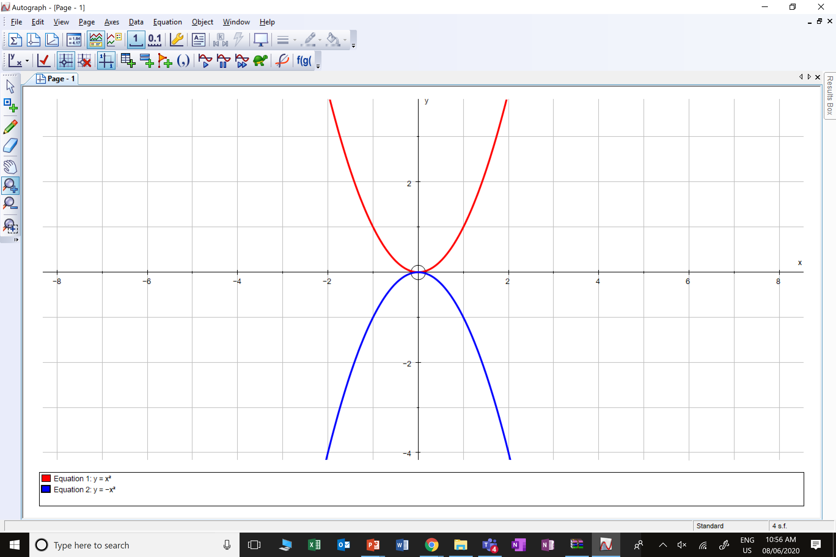
The red curve is the starting position.
What is the transformation to blue?
A. Shift Up
B. Shift Down
C. Shift Left
D. Shift Right
E. Reflect in x axis
F. Reflect in y axis
G. Stretch in x axis
H. Stretch in y axis

Slide 14
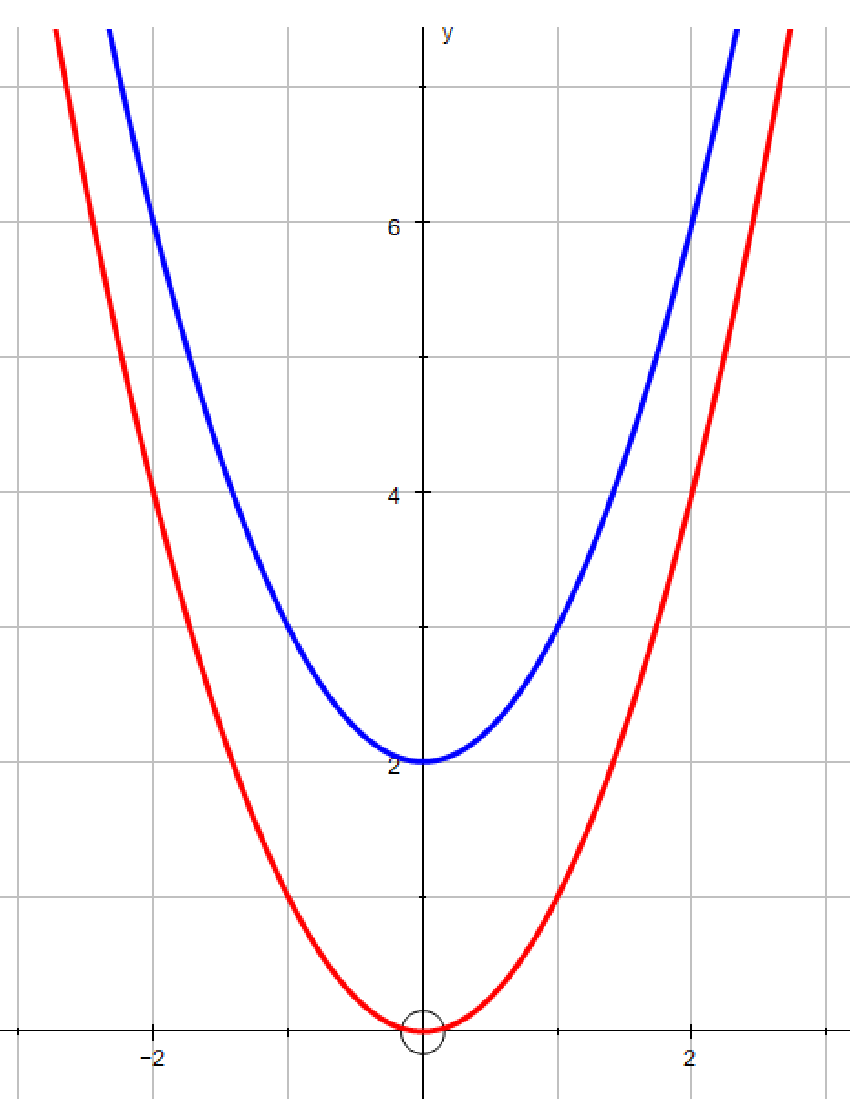
The red curve is the starting position.
What is the transformation to blue?
A. Shift Up
B. Shift Down
C. Shift Left
D. Shift Right
E. Reflect in x axis
F. Reflect in y axis
G. Stretch in x axis
H. Stretch in y axis

Slide 15
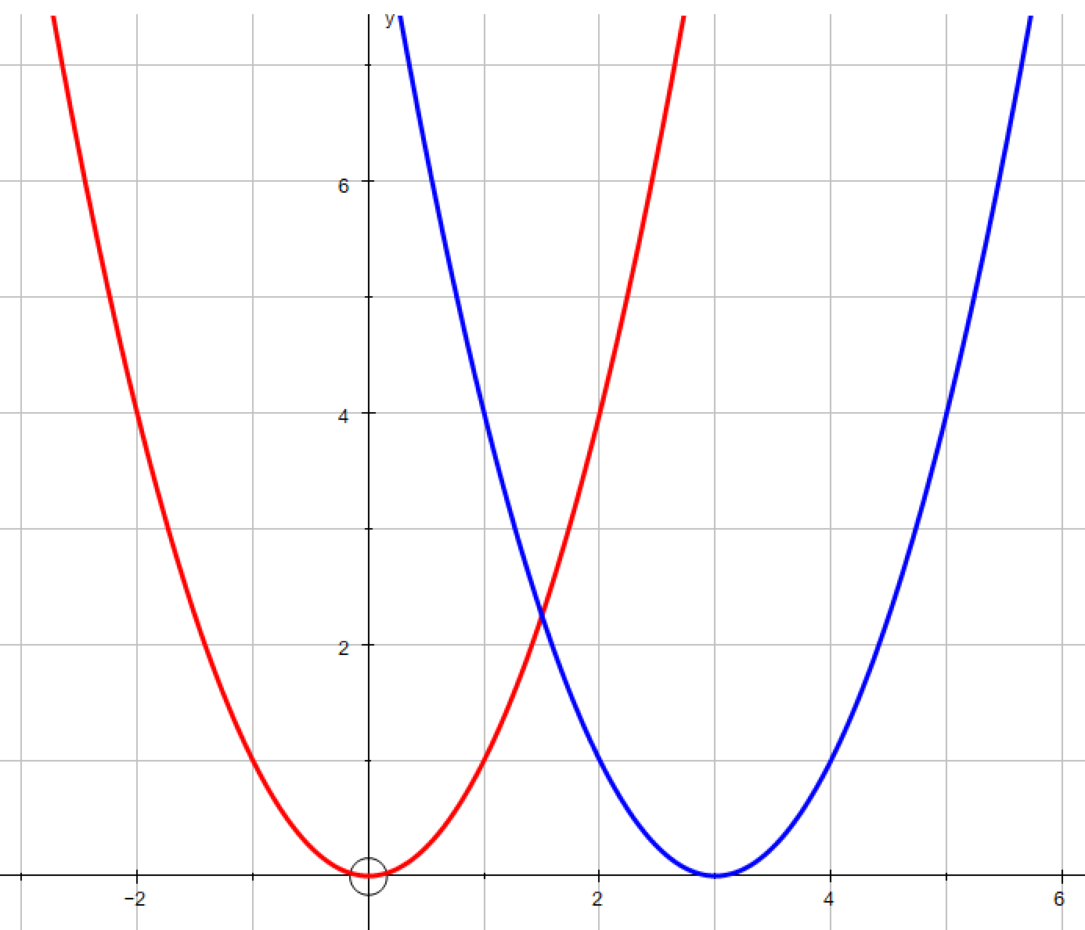
The red curve is the starting position.
What is the transformation to blue?
A. Shift Up
B. Shift Down
C. Shift Left
D. Shift Right
E. Reflect in x axis
F. Reflect in y axis
G. Stretch in x axis
H. Stretch in y axis

Slide 16
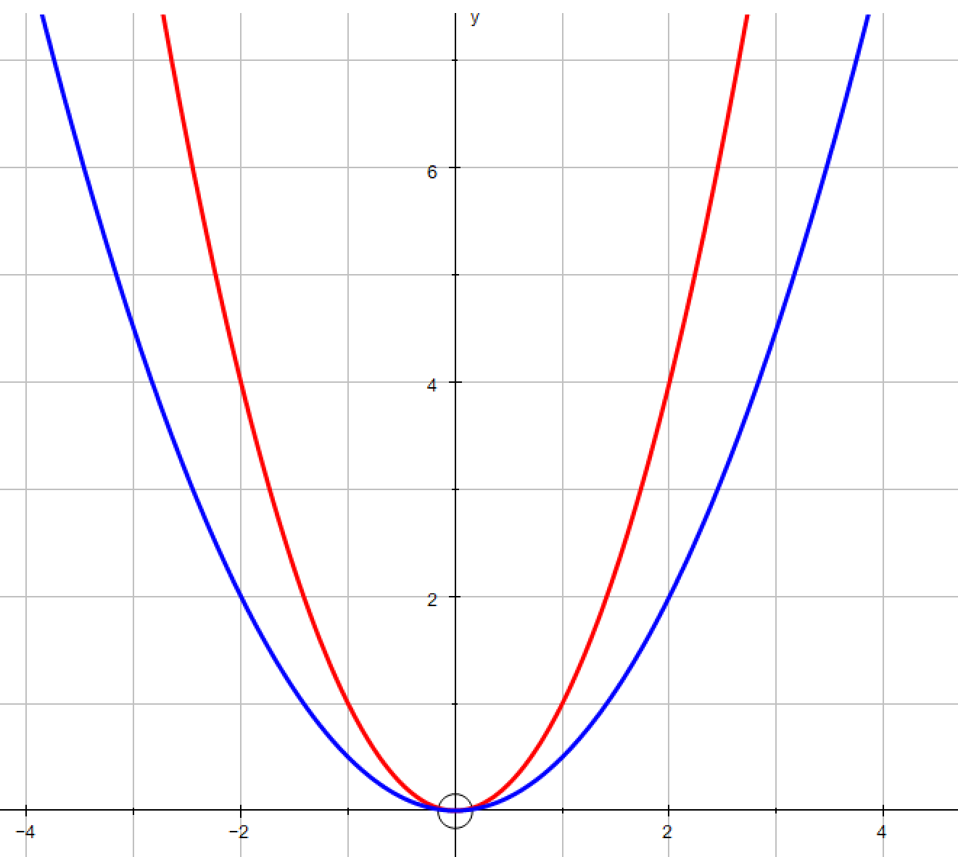
The red curve is the starting position.
What is the transformation to blue?
A. Shift Up
B. Shift Down
C. Shift Left
D. Shift Right
E. Reflect in x axis
F. Reflect in y axis
G. Stretch in x axis
H. Stretch in y axis

Slide 17
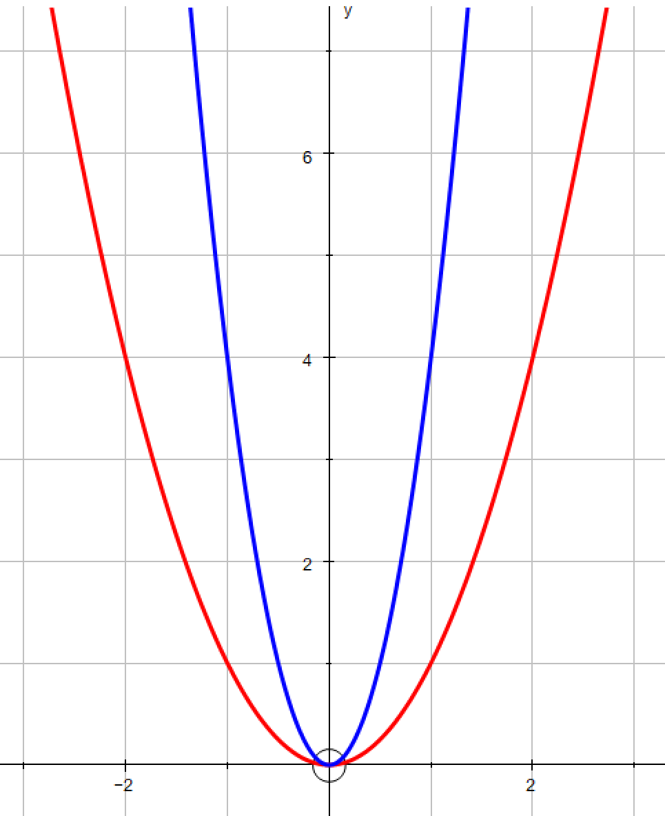
The red curve is the starting position.
What is the transformation to blue?
A. Shift Up
B. Shift Down
C. Shift Left
D. Shift Right
E. Reflect in x axis
F. Reflect in y axis
G. Stretch in x axis
H. Stretch in y axis

Slide 18
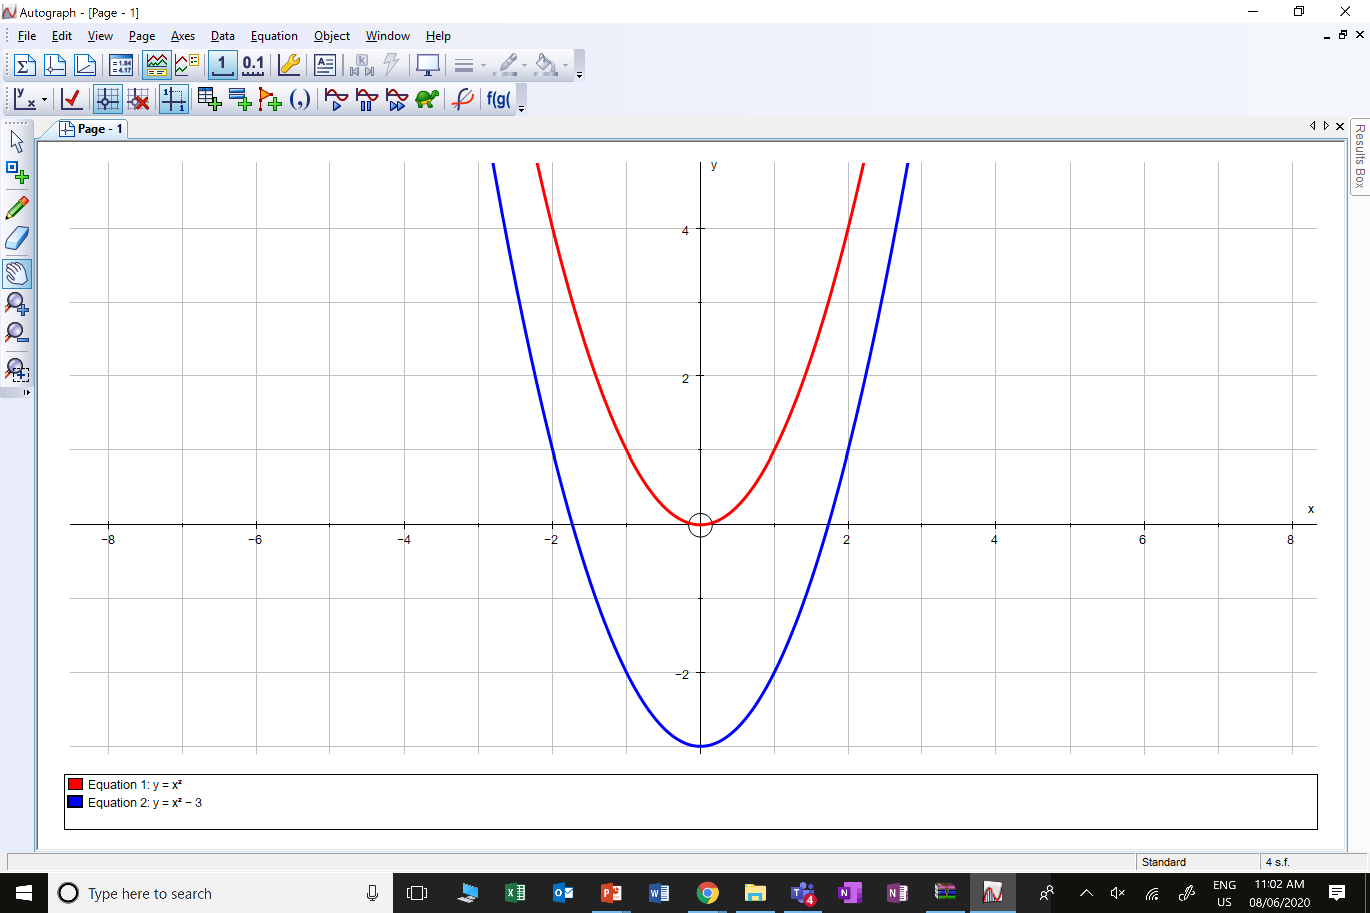
The red curve is the starting position.
What is the transformation to blue?
A. Shift Up
B. Shift Down
C. Shift Left
D. Shift Right
E. Reflect in x axis
F. Reflect in y axis
G. Stretch in x axis
H. Stretch in y axis

Slide 19
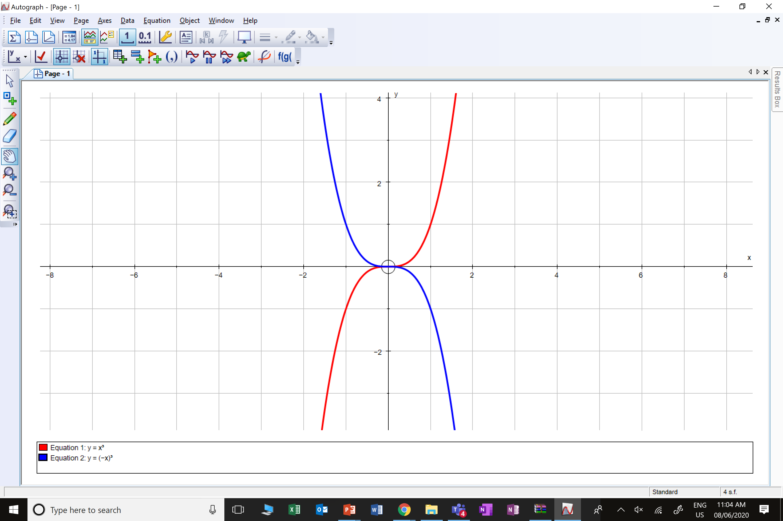
The red curve is the starting position.
What is the transformation to blue?
A. Shift Up
B. Shift Down
C. Shift Left
D. Shift Right
E. Reflect in x axis
F. Reflect in y axis
G. Stretch in x axis
H. Stretch in y axis

Slide 20
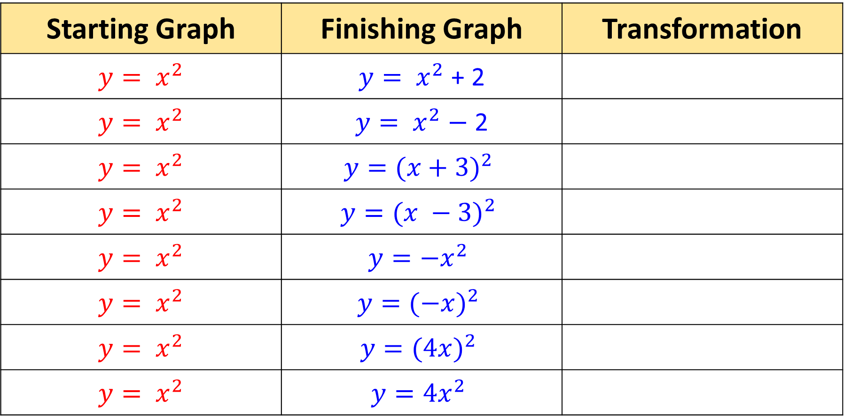
Use ‘Graphing Calculator – Desmos’ to identify the transformations
Starting Graph | Finishing Graph | Transformation
$${y= x}^{2}$$ | ${y= x}^{2}$ + 2
$${y= x}^{2}$$ | ${y= x}^{2}$ $−$ 2
$${y= x}^{2}$$ | $${y=(x+3)}^{2}$$
$${y= x}^{2}$$ | $${y=(x −3)}^{2}$$
$${y= x}^{2}$$ | $${y=−x}^{2}$$
$${y= x}^{2}$$ | $${y=(−x)}^{2}$$
$${y= x}^{2}$$ | $${y=(4x)}^{2}$$
$${y= x}^{2}$$ | $${y=4x}^{2}$$
Shift Up
Shift Down
Shift Left
Shift Right
Reflect in x axis
Reflect in y axis
Horizontal stretch
Vertical stretch

Slide 21
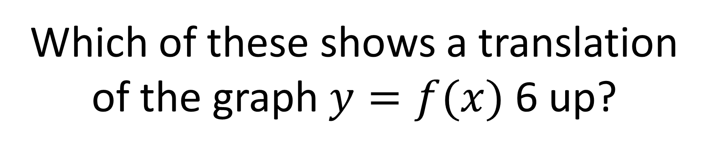
Which of these shows a translation
of the graph $y=f(x)$ 6 up?
A
B
C
D

Slide 22
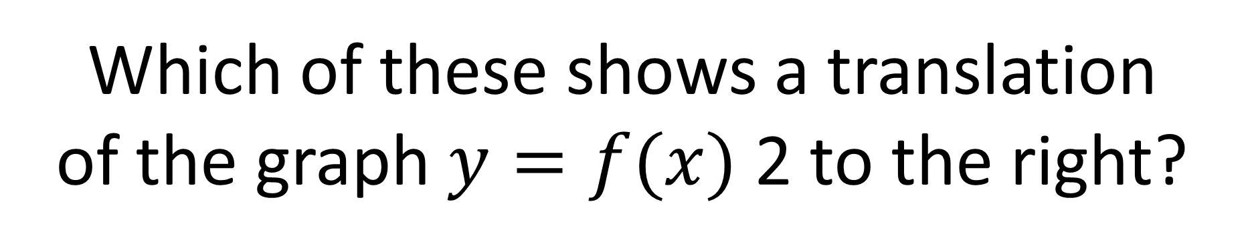
Which of these shows a translation
of the graph $y=f(x)$ 2 to the right?
A
B
C
D

Slide 23
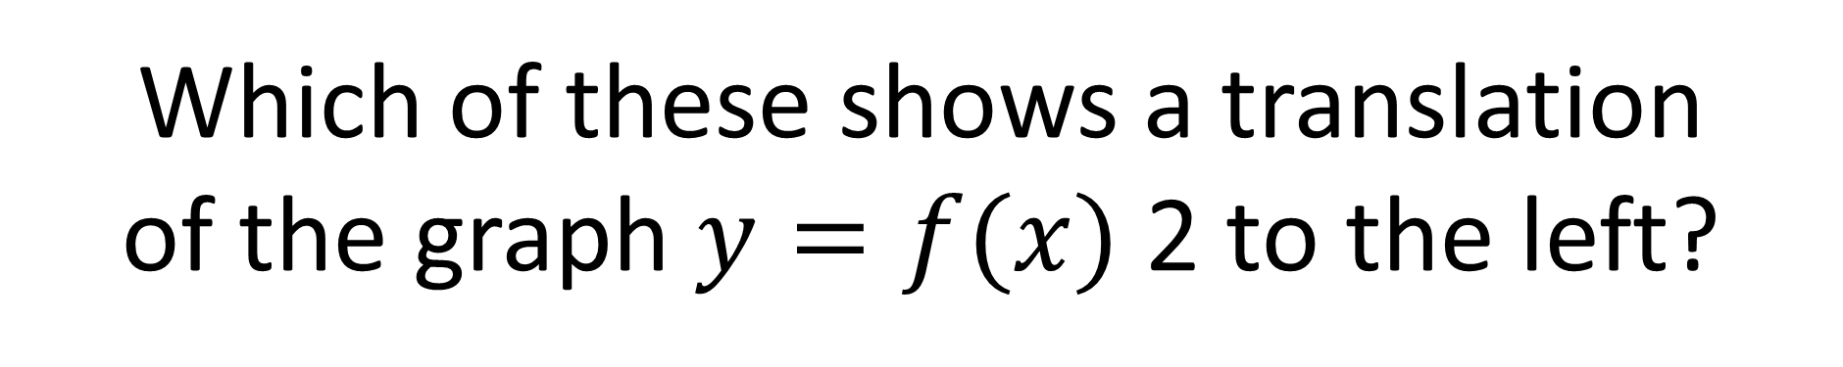
Which of these shows a translation
of the graph $y=f(x)$ 2 to the left?
A
B
C
D

Slide 24
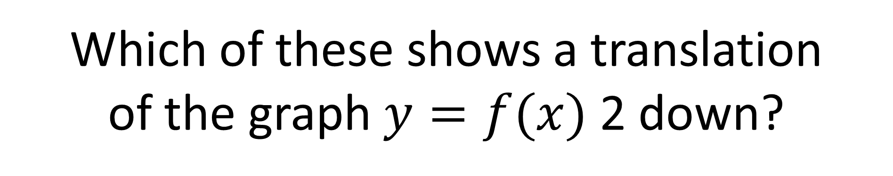
Which of these shows a translation
of the graph $y=f(x)$ 2 down?
A
B
C
D

Slide 25
What will happen to the point (3,2) under the transformation f(x) + 5?
A
(3,7)
B
(7,3)
C
(3,5)
D
(5,2)

Slide 26
What will happen to the point (3, 2) under the transformation f(x) – 8?
A
(3,-8)
B
(-8,3)
C
(3,-6)
D
(-5,2)

Slide 27
What will happen to the point (3, 2) under the transformation f(x + 1)?
A
(3,1)
B
(1,2)
C
(2,2)
D
(3,3)

Slide 28
What will happen to the point (3, 2) under the transformation f(x – 4) ?
A
(-1,2)
B
(7,2)
C
(3,-4)
D
(-4,2)

Slide 29
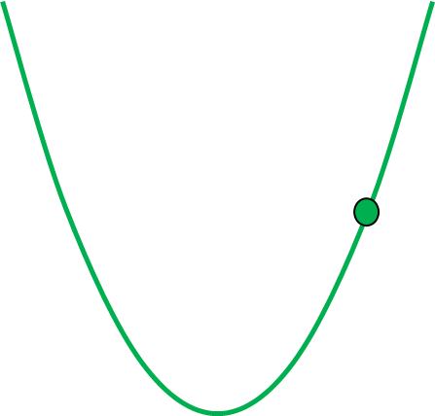
y
f(x)
8
7
6
5
f(x) + 1
4
(2,4)
3
2
1
x
What is the new
co-ordinate?
(2,5)

Slide 30
f(x)
(2,4)
f(x) – 3
What is the new
co-ordinate?
(2,1)

Slide 31
f(x)
f(x + 2)
(2,4)
What is the new
co-ordinate?
(0,4)

Slide 32
f(x)
(2,4)
f(x - 2)
What is the new
co-ordinate?
(4,4)

Slide 33
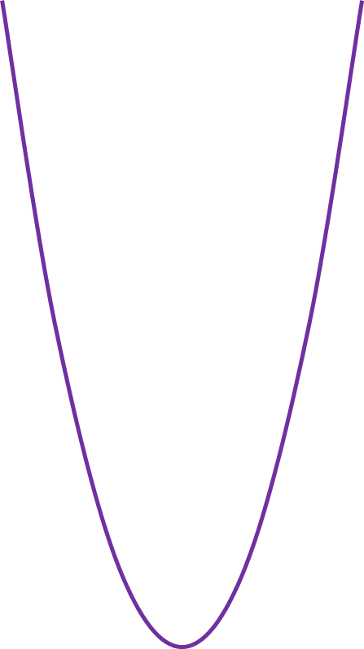
f(x)
2f(x)
(2,4)
What is the new
co-ordinate?
(2,8)

Slide 34
f(x)
f(2x)²
(2,4)
What is the new
co-ordinate?
(1,4)

Slide 35
f(x)
(2,4)
f(-x)
What is the new
co-ordinate?
(2,-4)

Slide 36
f(x)
(2,4)
-f(x)
What is the new
co-ordinate?
(-2,4)

Slide 37
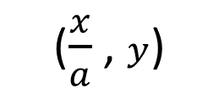
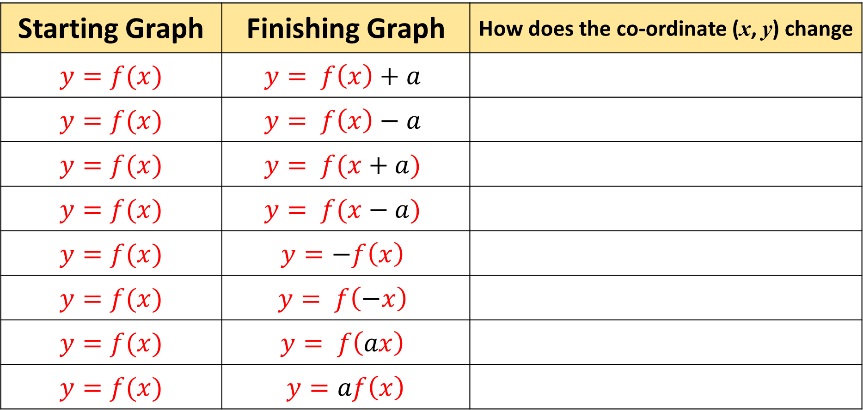
Identify how the transformation changes the co-ordinate.
Starting Graph | Finishing Graph | How does the co-ordinate (x, y) change
$$y=f(x)$$ | $$y= f\left(x\right)+a$$
$$y=f(x)$$ | $$y= f\left(x\right)−a$$
$$y=f(x)$$ | $$y= f(x+a)$$
$$y=f(x)$$ | $$y= f(x−a)$$
$$y=f(x)$$ | $$y=−f\left(x\right)$$
$$y=f(x)$$ | $$y= f\left(−x\right)$$
$$y=f(x)$$ | $$y= f\left(ax\right)$$
$$y=f(x)$$ | $$y=af\left(x\right)$$
(x, y + a)
(x, y – a)
(x – a , y)
(x + a , y)
(x, – y)
(– x, y)
($\frac{x}{a}$ , $y$)
(x , ay)

Slide 38
y
f(x) + 1 +
f(x) + a
(x,y)
x
What is the co-ordinate of the green point?
(x , y + a)

Slide 39
y
f(x)
f(x) – a
(x,y)
What is the co-ordinate of the green point?
x
(x , y - a)

Slide 40
y
f(x) 1
f(x + a)
(x,y)
x
What is the co-ordinate of the purple point?
(x - a , y)

Slide 41
y
f(x)
f(x - a)
(x,y)
What is the co-ordinate of the purple point?
x
(x + a , y)

Slide 42
y
f(x)
(x,y)
af(x)
x
What is the co-ordinate of the purple point?
(x , ay)

Slide 43
y
f(x)
(x,y)
f(-ax)
x
What is the co-ordinate of the grey point?
(x , -ay)

Slide 44
y
f(x)
-af(x)
(x,y)
What is the co-ordinate of the green point?
x
(-ax , y)

Slide 45
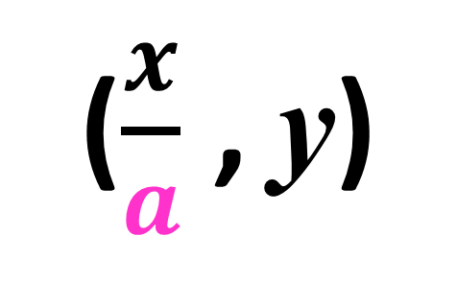
y
f(x)
f(ax)
(x,y)
What is the co-ordinate of the pink point?
x
($\frac{x}{a}$ , y)

Slide 46
Using function notation, write out:
Translating 12 units down
f(x) – 12

Slide 47
Using function notation, write out:
Translating 5 units left
f(x + 5)

Slide 48
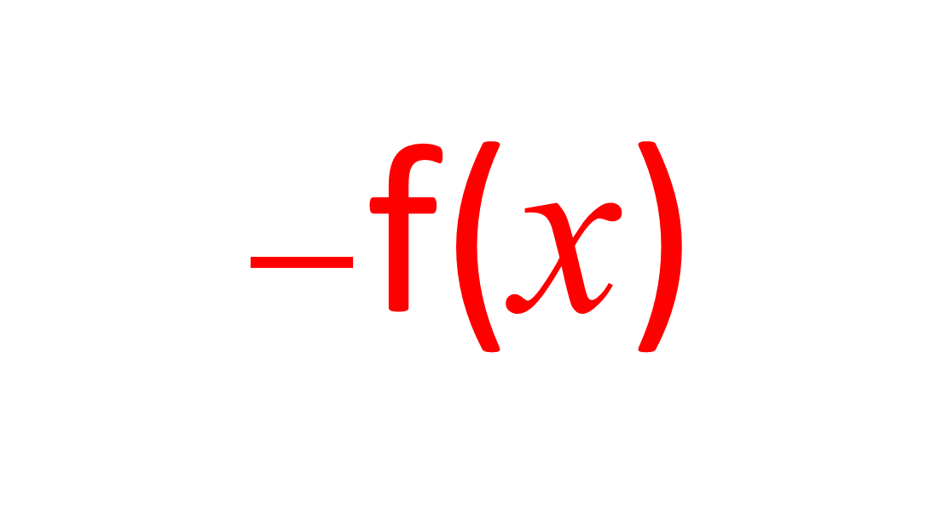
Using function notation, write out:
Reflex in the x axis
$−$f(x)

Slide 49
Using function notation, write out:
Stretch in y axis
af(x)

Slide 50
Using function notation, write out:
Translating 8 units up
f(x) + 8

Slide 51
Using function notation, write out:
Translating 7 units right
f(x – 7)

Slide 52
Using function notation, write out:
Reflex in the y axis
f(– x)

Slide 53
Using function notation, write out:
Stretch in x axis
f(ax)

