Slide 1
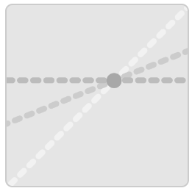
Introduction to Reciprocal graphs
Activity: Click on the Icon
Students work through the 25 slides to explore reciprocal graphs.

