Slide 1
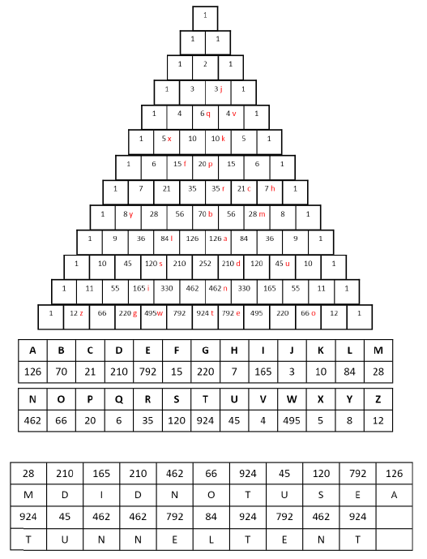

Slide 2
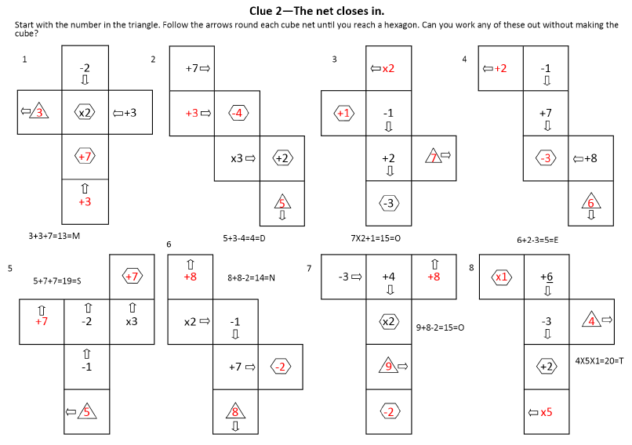

Slide 3
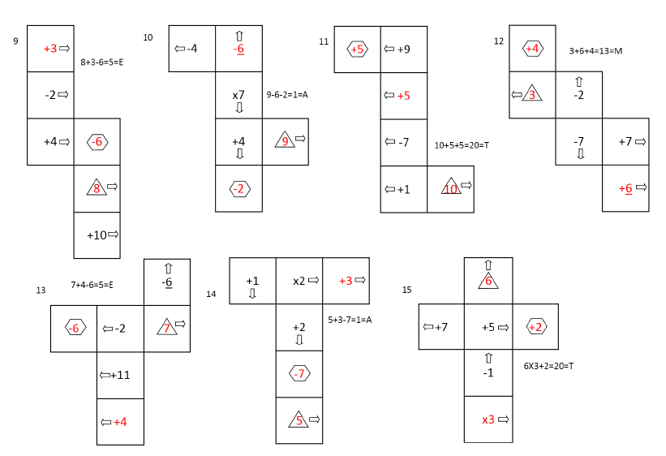

Slide 4
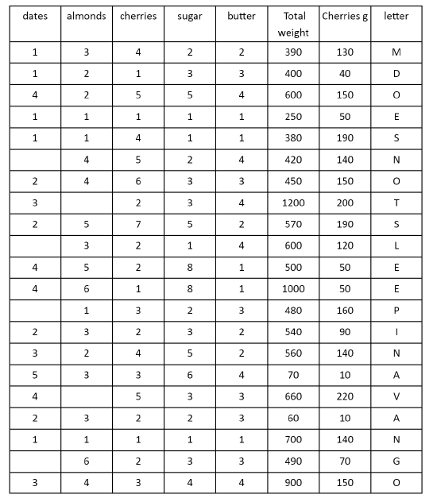

Slide 5
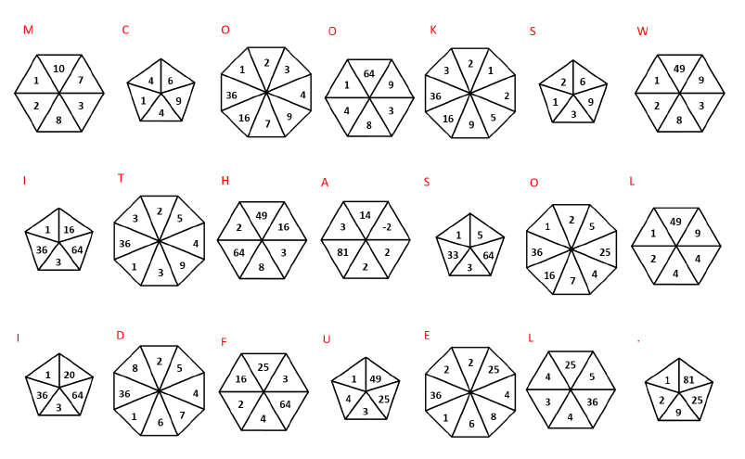

Slide 6
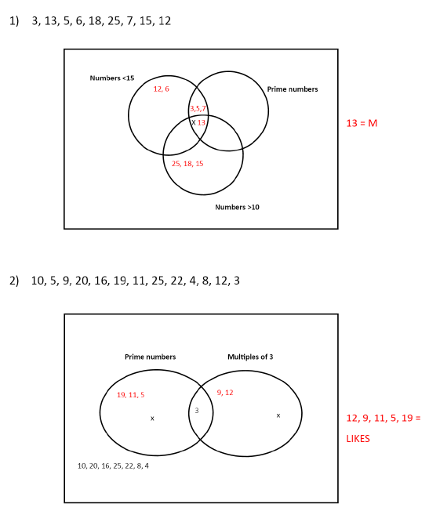
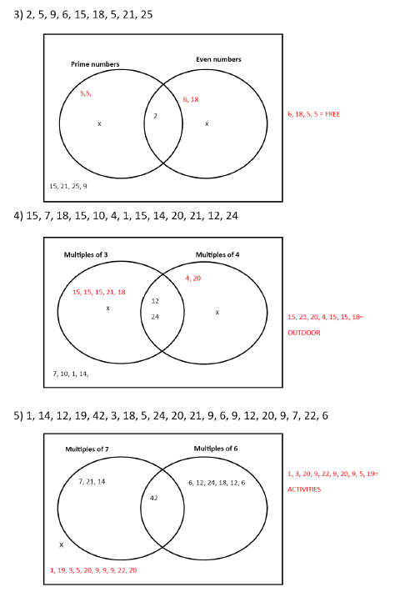

Slide 7
Murder at the Campsite!
Clue 1
M did not use a tunnel tent
Clue 2
M does not eat meat
Clue 3
M does not sleep in a vango
Clue 4
M cooks with a solid fuel
Clue 5
M likes free outdoor activities
M is……
Jeremy Sugden

