Slide 1
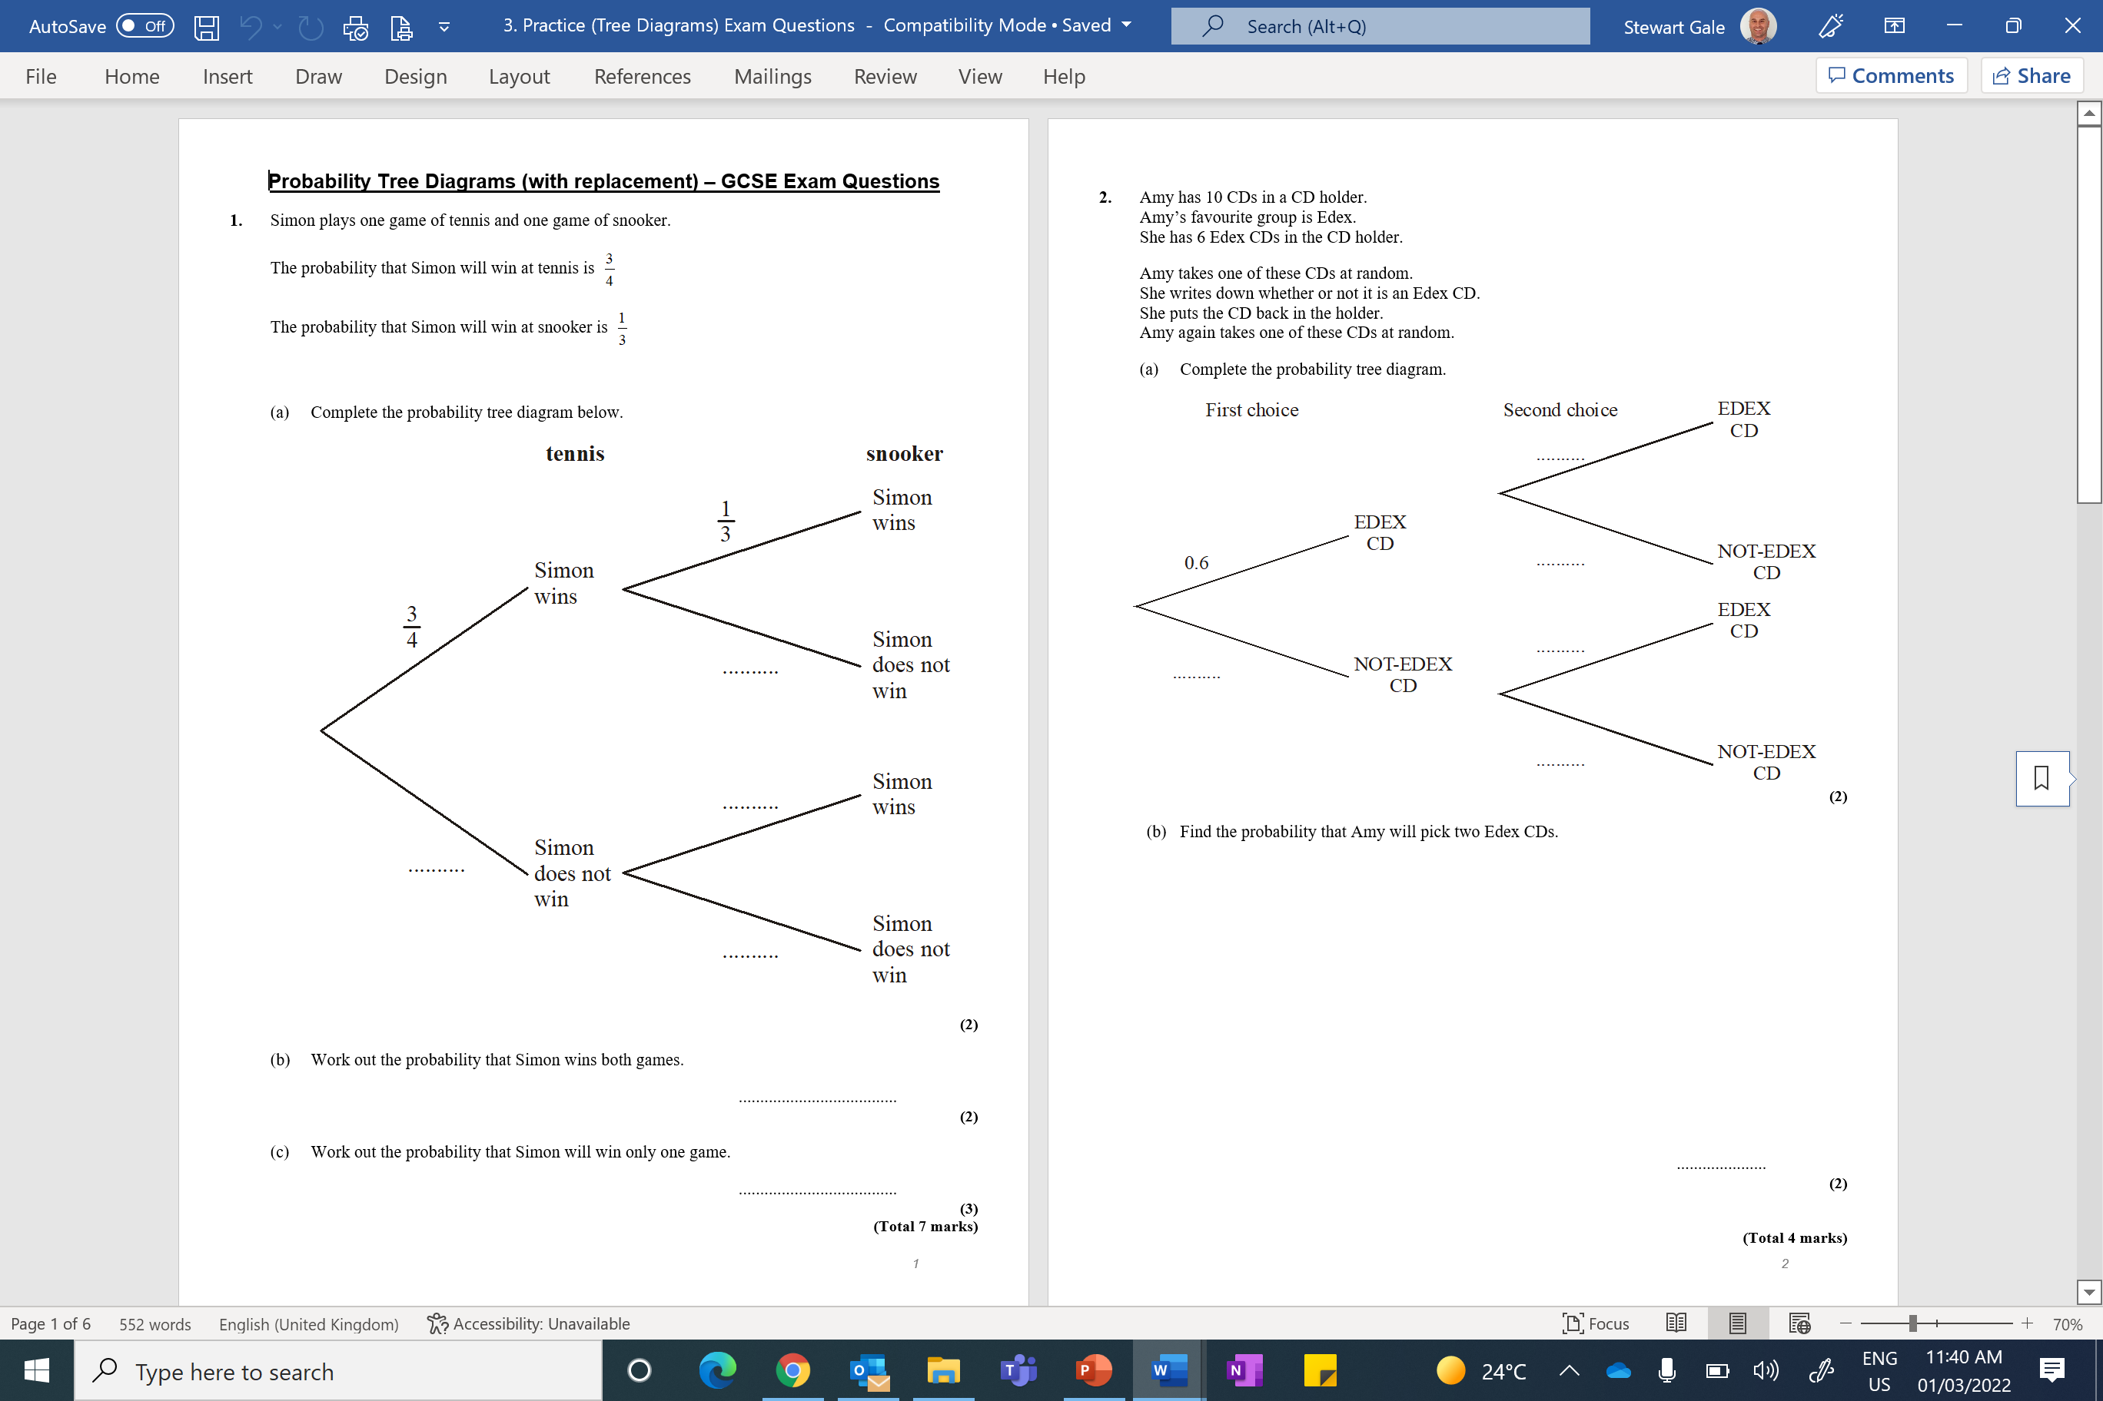

Slide 2
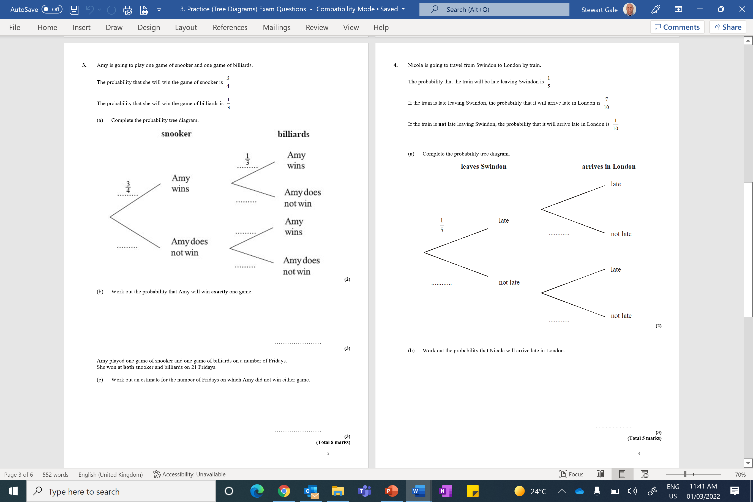

Slide 3
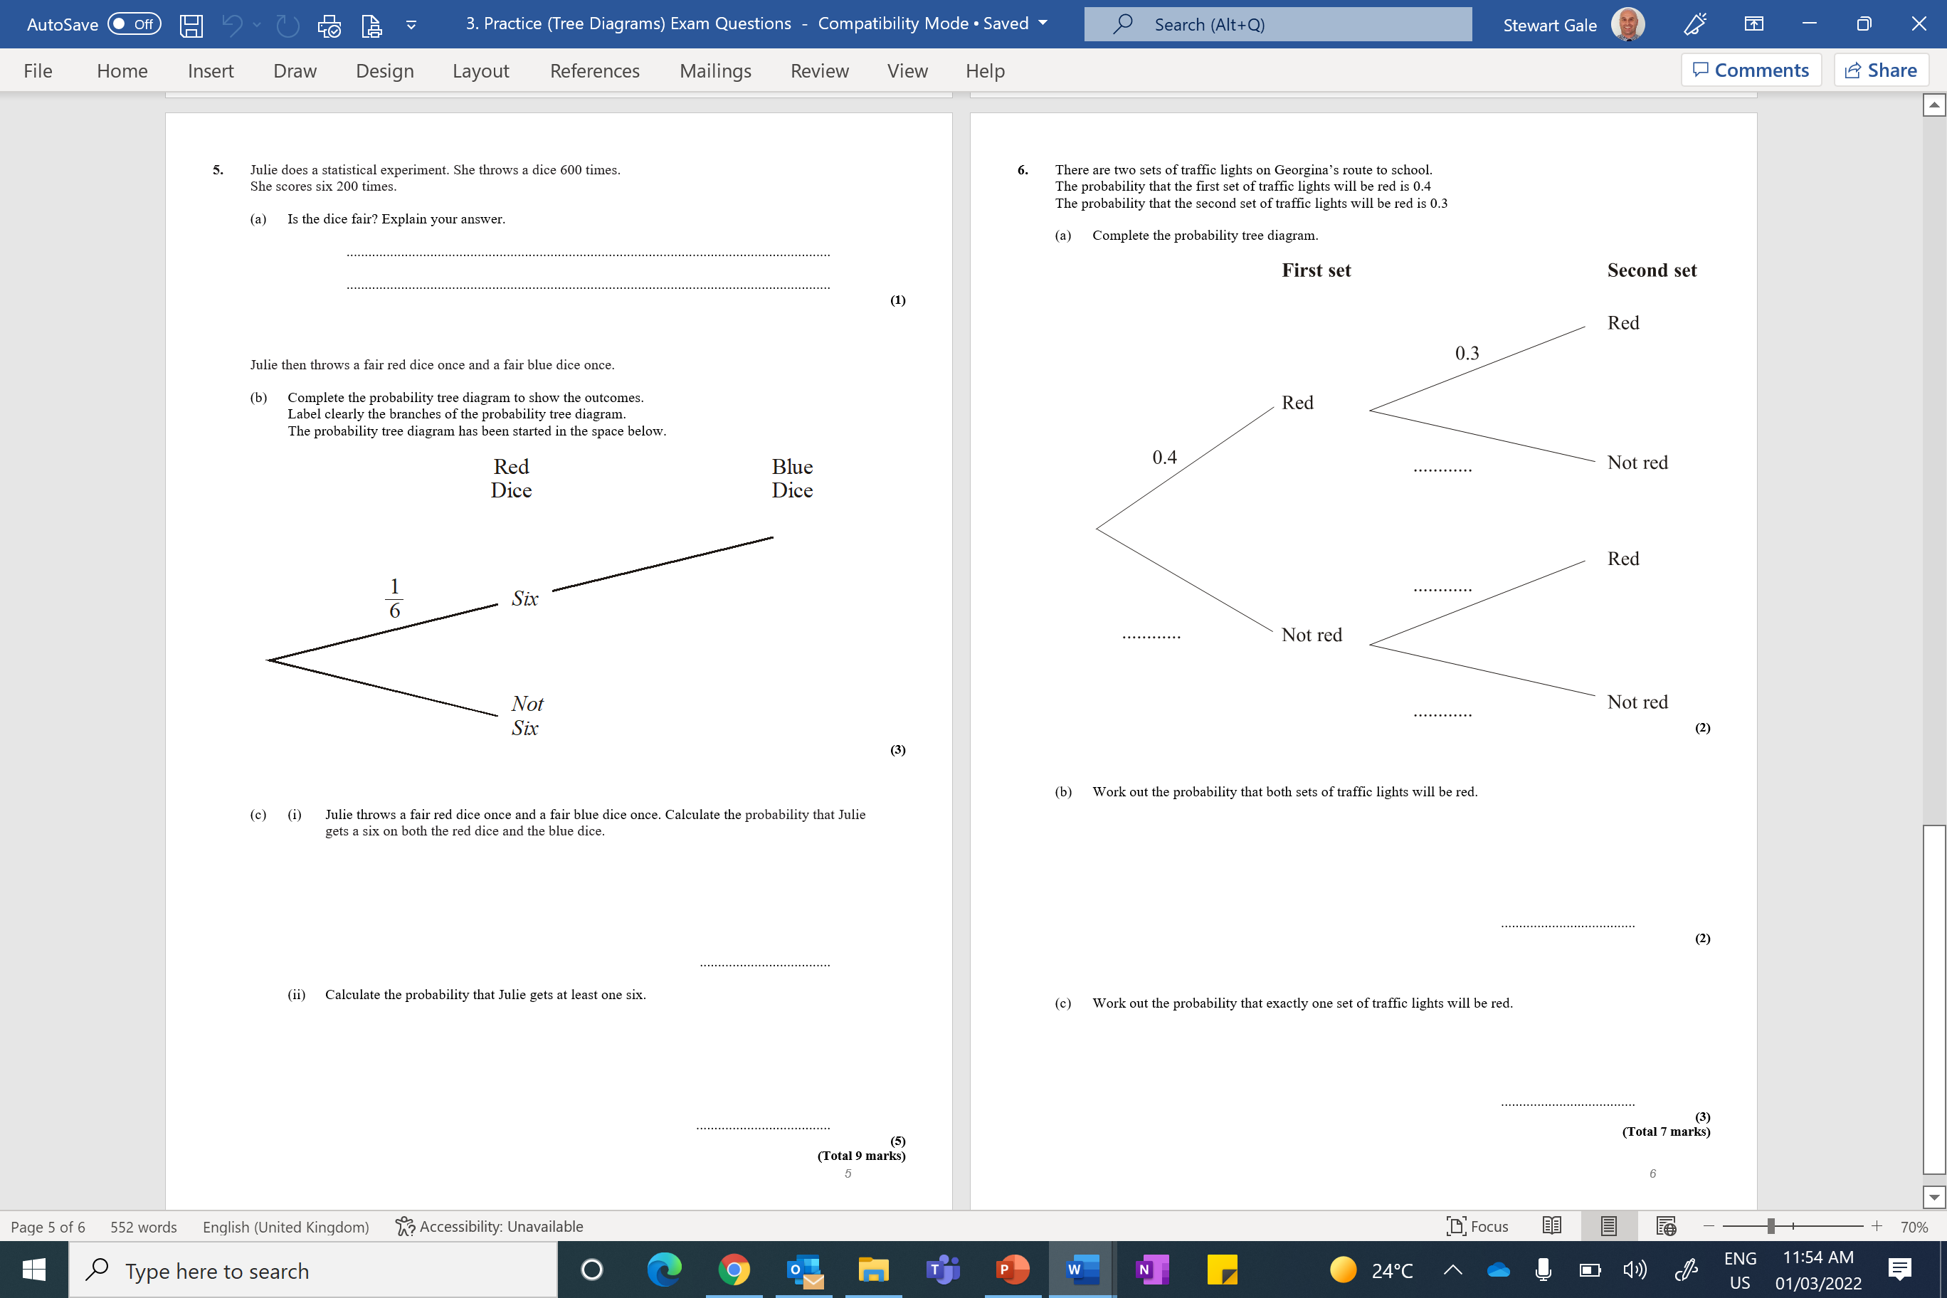

Slide 4
ANSWERS

Slide 5

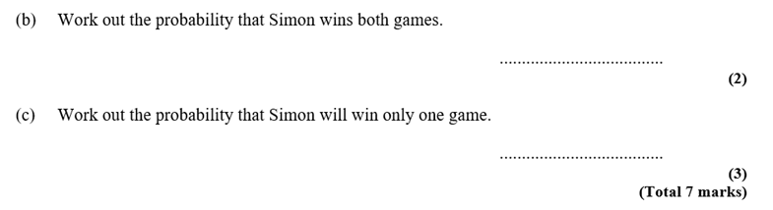

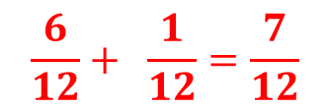








$$\frac{3}{12}$$
$$\frac{6}{12}+ \frac{1}{12}=\frac{7}{12}$$
$$\frac{3}{12}$$
$$\frac{2}{3}$$
$$\frac{6}{12}$$
$$\frac{1}{3}$$
$$\frac{1}{12}$$
$$\frac{1}{4}$$
$$\frac{2}{3}$$
$$\frac{2}{12}$$

Slide 6
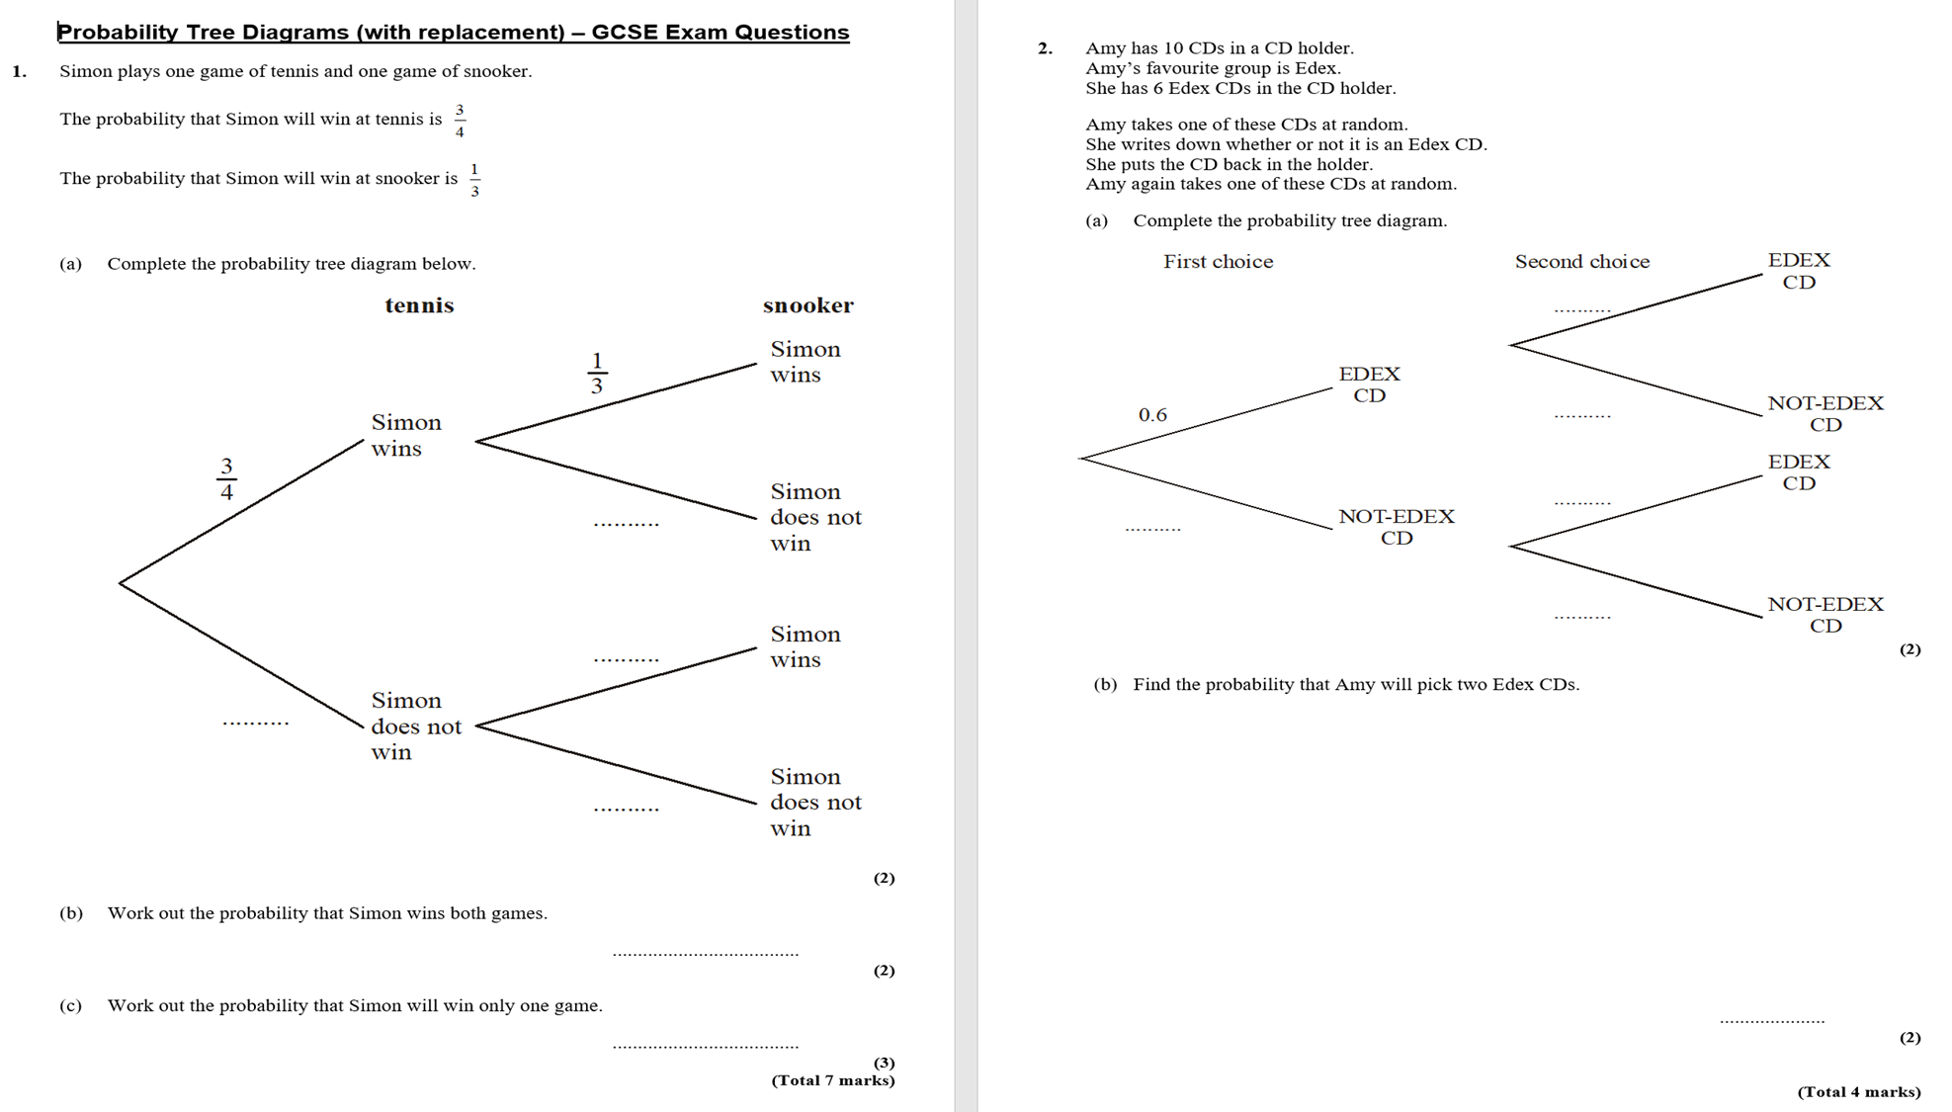





0.6 x 0.6 = 0.36
$$0.6$$
$$0.4$$
$$0.6$$
$$0.4$$
$$0.4$$

Slide 7
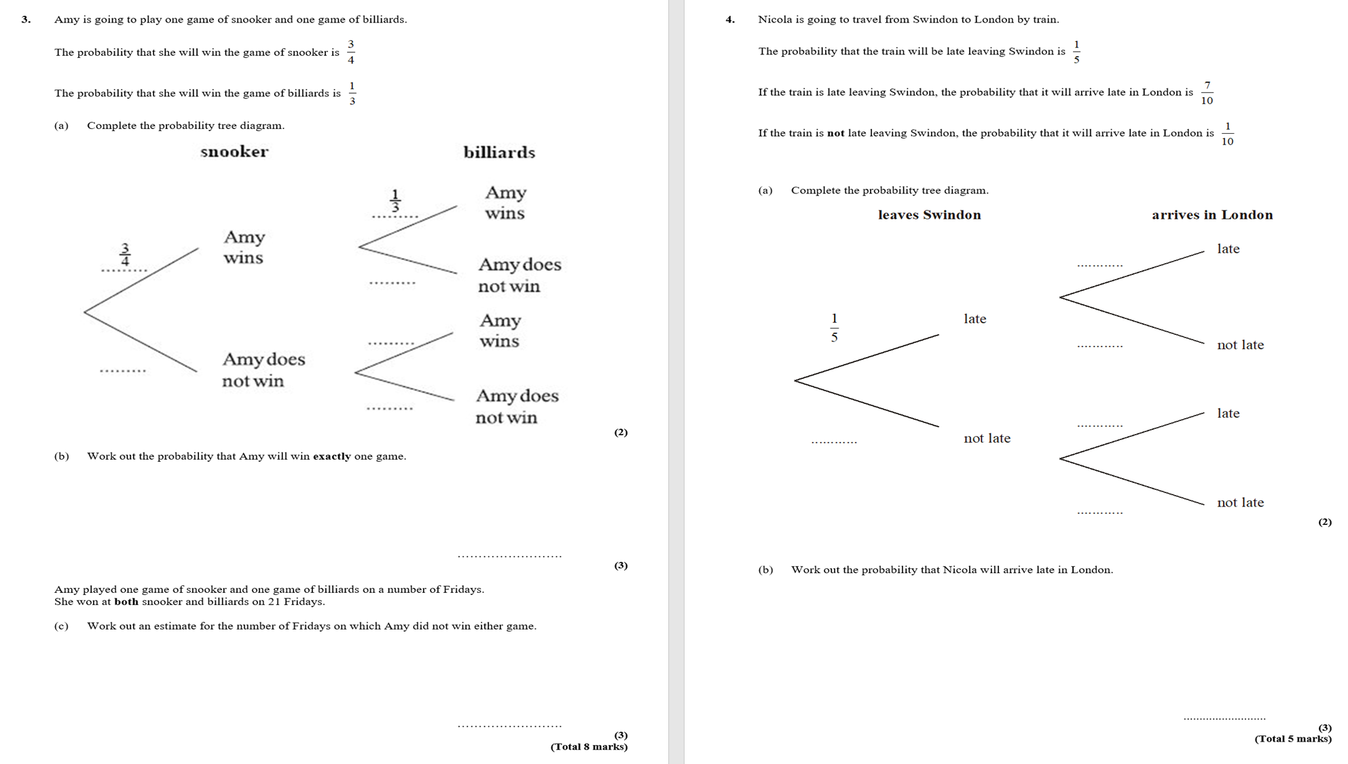
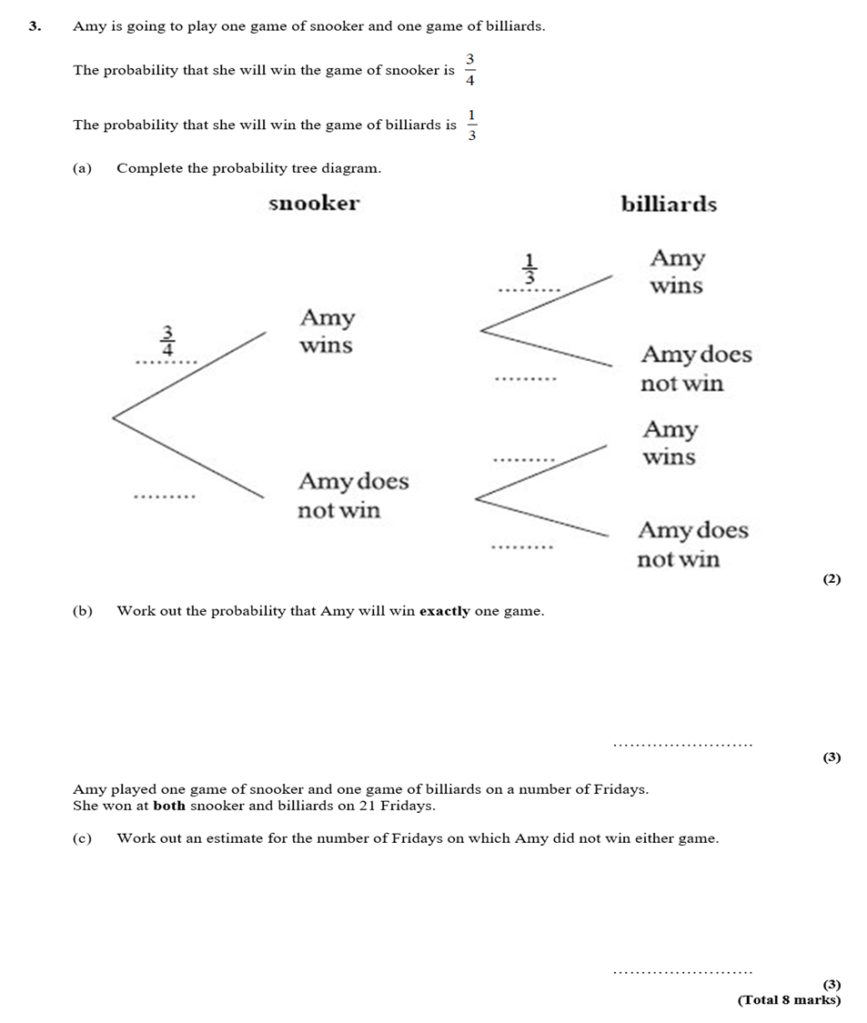
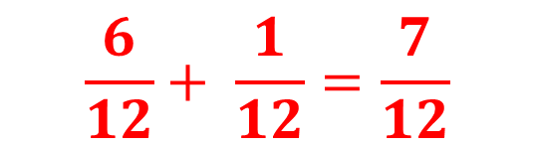



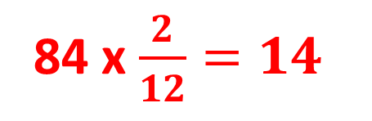

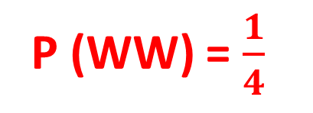
$$\frac{6}{12}+ \frac{1}{12}=\frac{7}{12}$$
$$\frac{2}{3}$$
$$\frac{1}{3}$$
P (WW) = $\frac{1}{4}$
$$\frac{1}{4}$$
$$\frac{2}{3}$$
21 x 4 = 84 fridays
84 x $\frac{2}{12}=14$

Slide 8
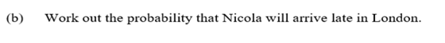





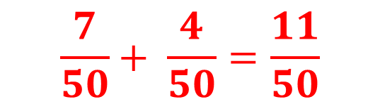
$$\frac{7}{50}+ \frac{4}{50}=\frac{11}{50}$$
$$\frac{7}{10}$$
$$\frac{3}{10}$$
$$\frac{1}{10}$$
$$\frac{4}{5}$$
$$\frac{9}{10}$$

Slide 9
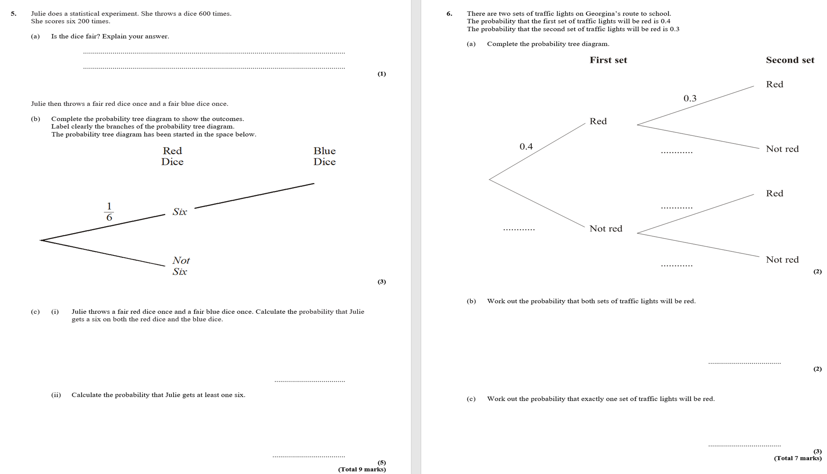
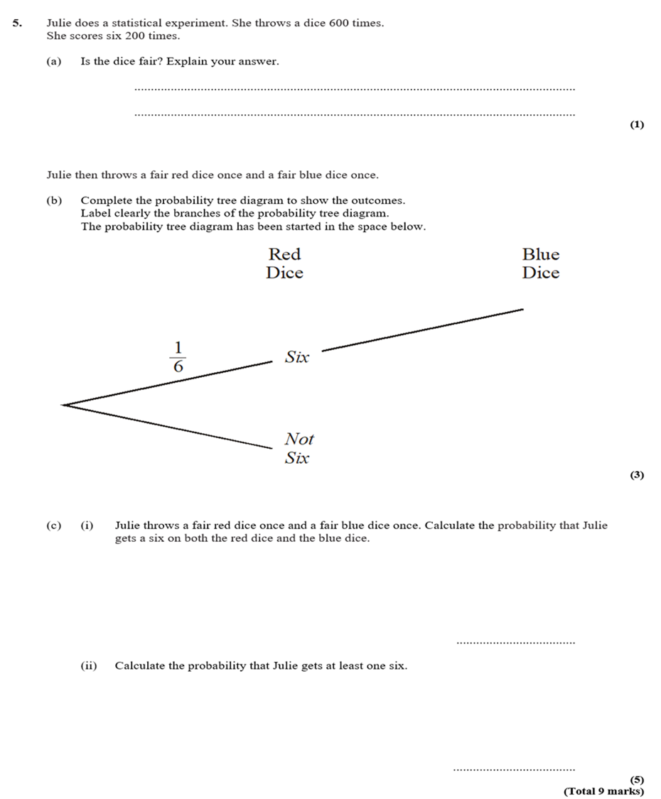




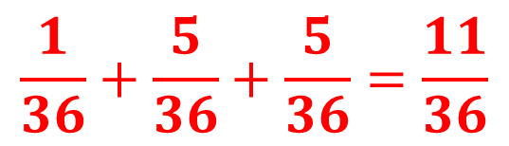

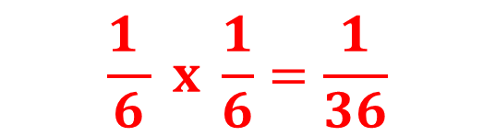
If you throw 600 times you would expect 100 times to get a 6. No, it is not a fair dice.
$$\frac{1 }{6} x \frac{1}{6}=\frac{1}{36}$$
$$\frac{1}{36}+\frac{5}{36}+\frac{5}{36}=\frac{11}{36}$$
$$\frac{1}{6}$$
Six
$$\frac{5}{6}$$
Not Six
$$\frac{1}{6}$$
Six
$$\frac{5}{6}$$
$$\frac{5}{6}$$
Not Six

Slide 10
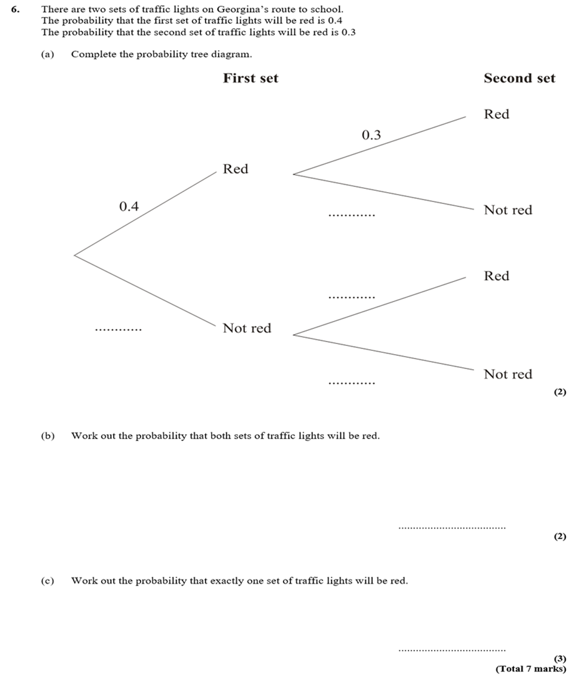
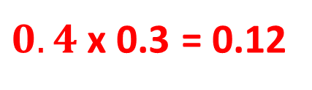




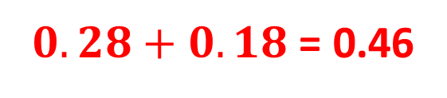
$0.4$ x 0.3 = 0.12
$$0.7$$
$0.28+0.18$ = 0.46
$$0.3$$
$$0.6$$
$$0.7$$

