Slide 1

Diagnostic Assessment .Delta 2
Unit 5
Translations
Reflections
Rotational Symmetry
Rotations
Enlargement
Combined Transformations
Enlargement of
Area and Volume

Slide 2
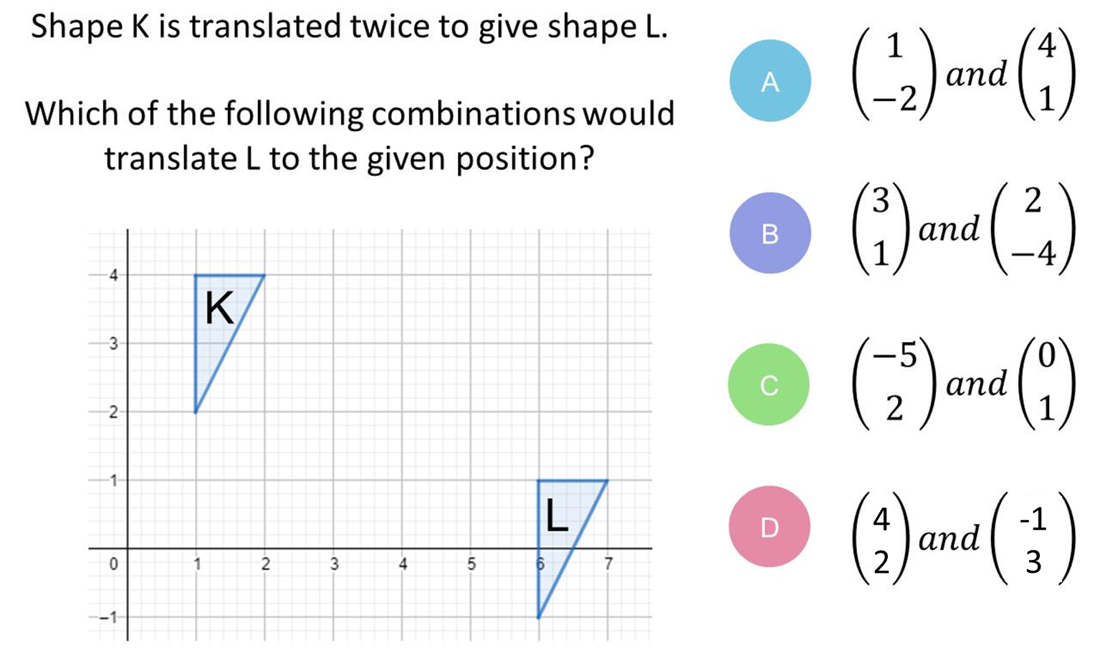
Question 1 – Translations

Slide 3

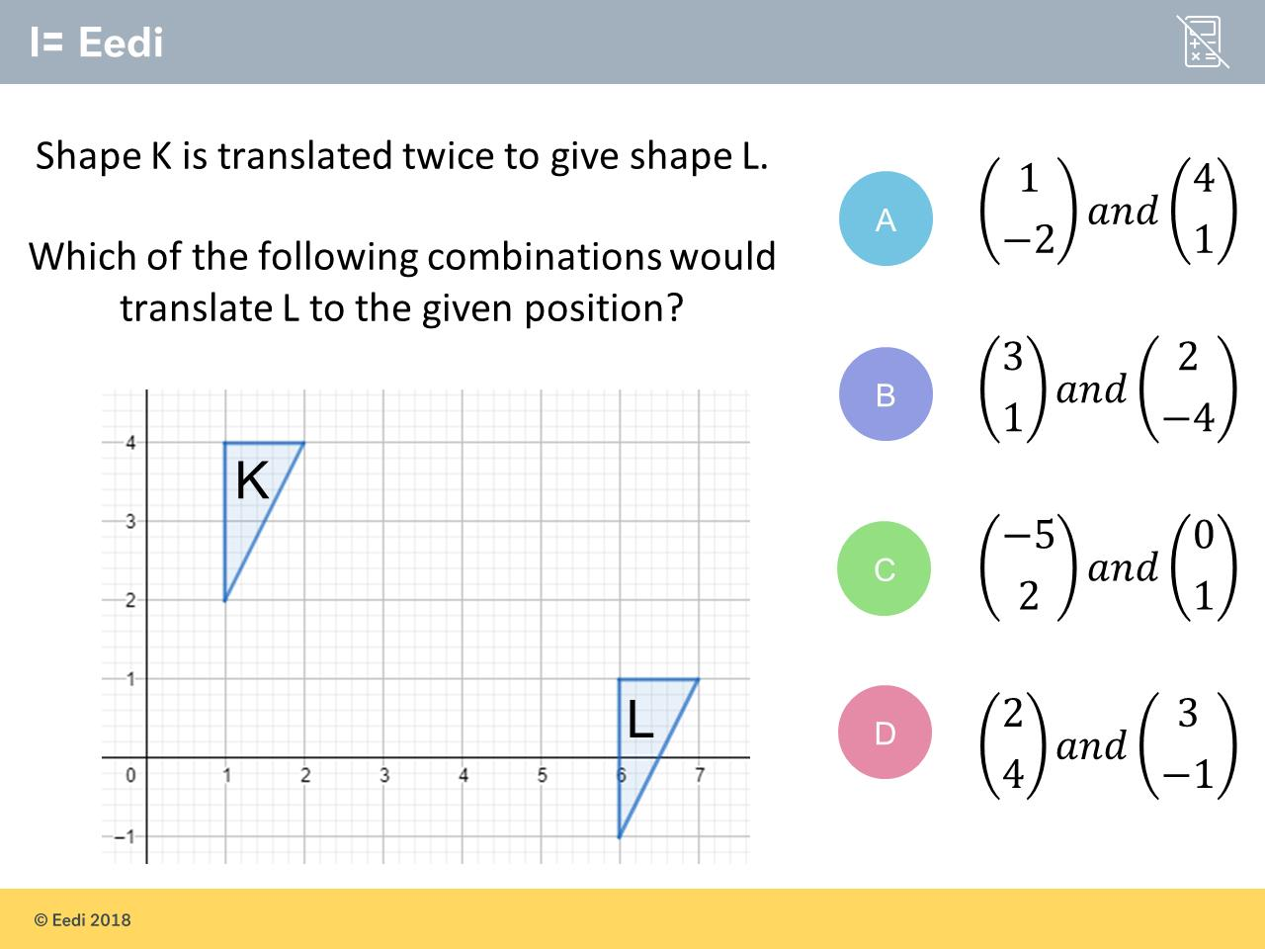
Answer 1 – Translations
CORRECT ANSWER | CORRECT EXPLANATION
B | 5 right and 3 down is correct.
COMMON MISTAKES | WHAT MIGHT BE YOUR MISTAKE
A | Student has done 5 right and 1 down.
C | Student has found a correct combination to go from L to K rather than K to L.
D | Student has done 3 right and 5 down instead of 5 right 3 down.

Slide 4
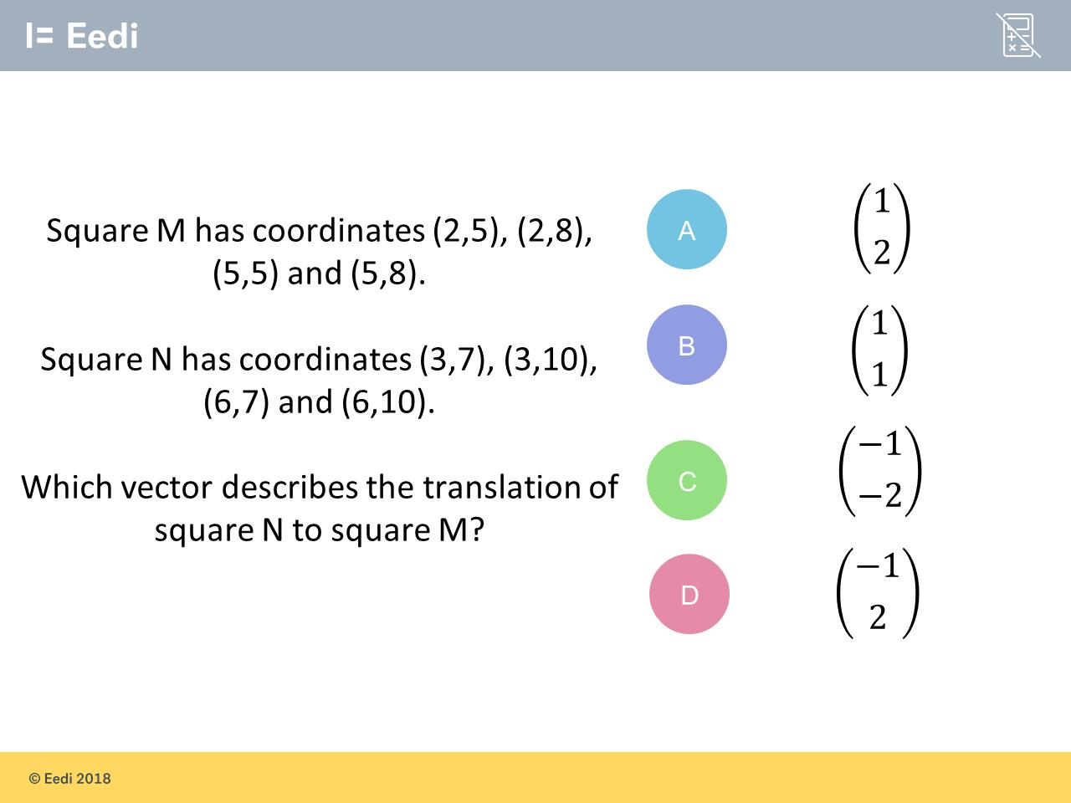
Question 2 – Translations

Slide 5
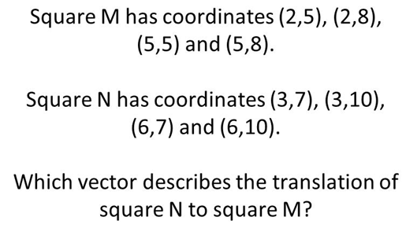
Answer 2 – Translations
CORRECT ANSWER | CORRECT EXPLANATION
C | A correct rotation from this centre would actually move every vertex one square left
COMMON MISTAKES | WHAT MIGHT BE YOUR MISTAKE
A | The student has not read the question correctly and has described square M to square N.
B | The student may find the difference between the x-coordinates and assume that the change is simply 1 right and 1 up
D | The student has found the difference between the coordinates but incorrectly identified directions.

Slide 6
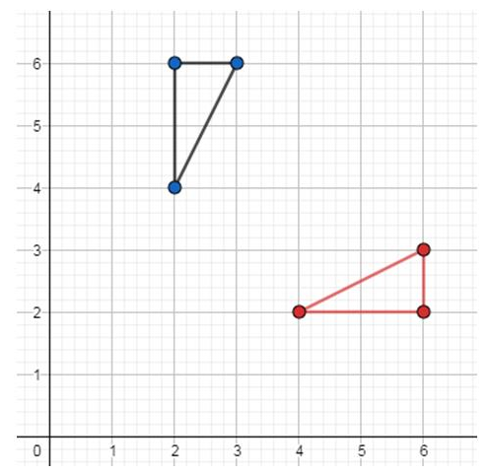
Question 3 – Reflections
Describe the transformation that maps the blue triangle
onto the red triangle?

Slide 7
Answer 3 – Reflections
Describe the transformation that maps the blue triangle
onto the red triangle?
CORRECT ANSWER | CORRECT EXPLANATION
Reflection y = x | The mirror line is a diagonal line whereby all of the x-coordinates are equal to the y-coordinates. The name of this line is y=x.
COMMON MISTAKES | WHAT MIGHT BE YOUR MISTAKE
Rotation 90˚ CW (2,2) | Student has incorrectly recognised this to be a rotation and identified the correct direction/distance/turning point but the orientation is incorrect
y = x | Student has missed out key terminology by not saying reflection
Reflection y = -x | Student has incorrectly named the mirror line

Slide 8
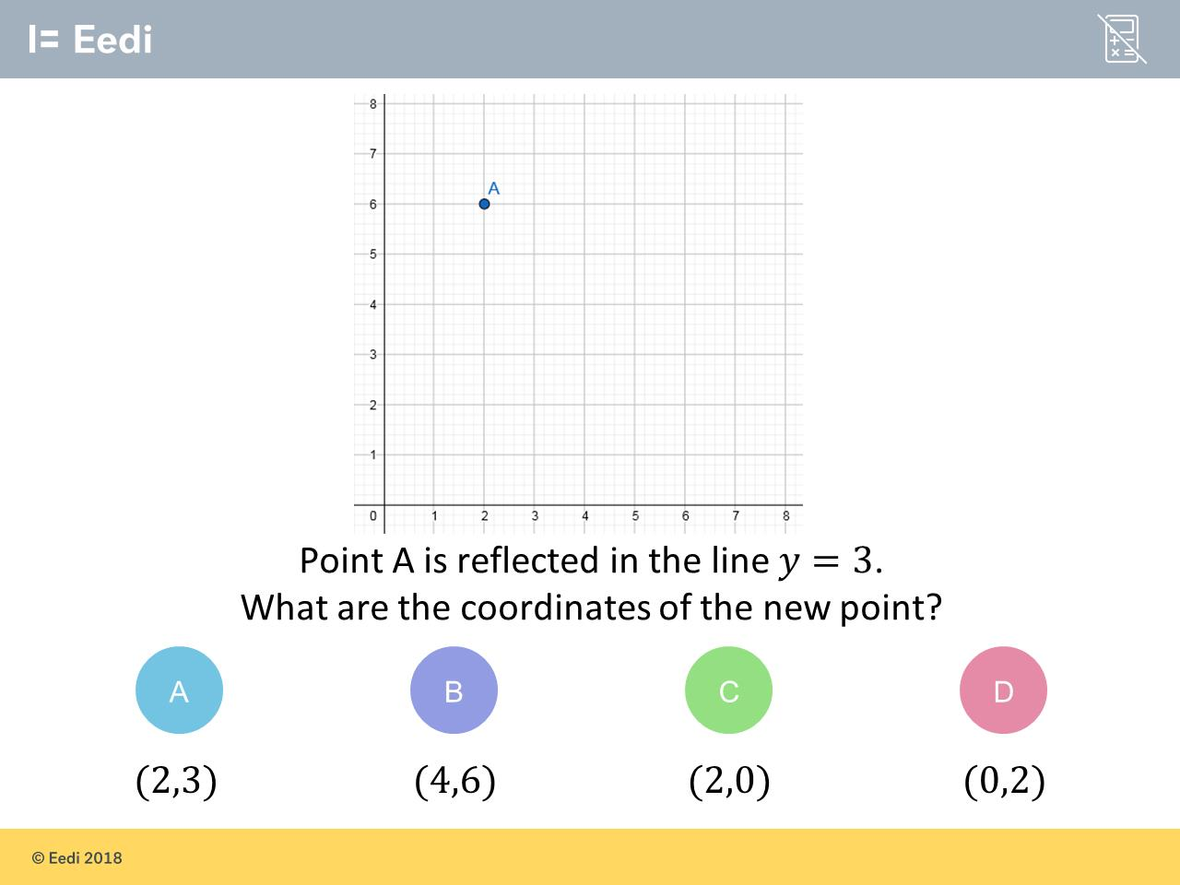
Question 4 – Reflections

Slide 9
Answer 4 – Reflections
CORRECT ANSWER | CORRECT EXPLANATION
(2,0) | y = 3 is a horizontal line. The point is 3 squares above the line. If you reflect the point it transforms 3 squares below the line to the point (2, 0)
COMMON MISTAKES | WHAT MIGHT BE YOUR MISTAKE
(2,3) | The student may think that the y-coordinate must be 3
(4,6) | The student has reflected in x=3
(0,2) | The student has found the correct answer but has incorrectly written the coordinates the wrong around

Slide 10
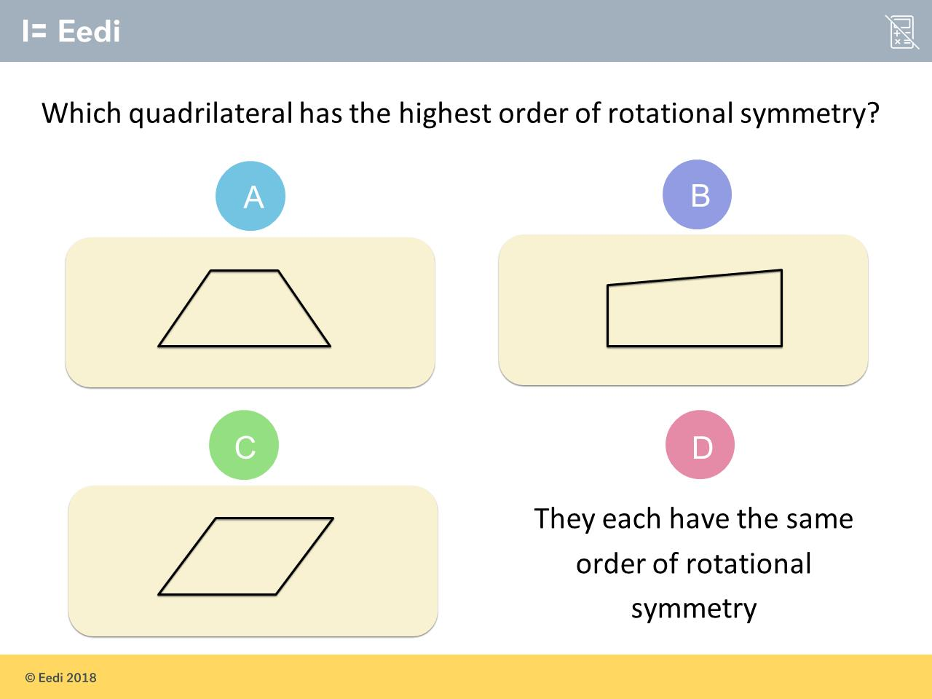
Question 5 – Rotational Symmetry

Slide 11
Answer 5 – Rotational Symmetry
CORRECT ANSWER | CORRECT EXPLANATION
C | Imagine the top-right vertex (corner) is marked in some way. When the shape is rotated through a half turn (180°), this vertex will match that on the bottom-left vertex. The whole shape will look the same as it did at its starting position. Another half a turn will return it to its starting position, meaning rotational symmetry of order 2. The other quadrilaterals have no rotational symmetry (so rotational symmetry of order 1) because in both cases it will take a complete turn before we get back to the picture we started with.
COMMON MISTAKES | WHAT MIGHT BE YOUR MISTAKE
A | The student may be confused with lines of symmetry.
B | The student may not understand rotational symmetry.
D | The student may think a parallelogram has no rotational symmetry.

Slide 12
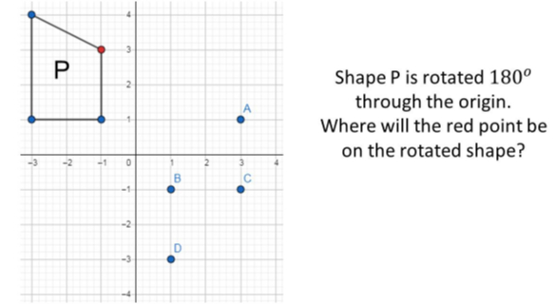
Question 6 – Rotations

Slide 13
Answer 6 – Rotations
CORRECT ANSWER | CORRECT EXPLANATION
D | When rotated 180 degrees, the shape P would rotate by a half turn. Point (-1,3) would rotate around to (1,-3).
COMMON MISTAKES | WHAT MIGHT BE YOUR MISTAKE
A | The student has rotated 90 degrees through the origin
B | The student has rotated correctly but may have rotated the wrong point.
C | The student has found the correct answer but has incorrectly written the coordinates the wrong around

Slide 14
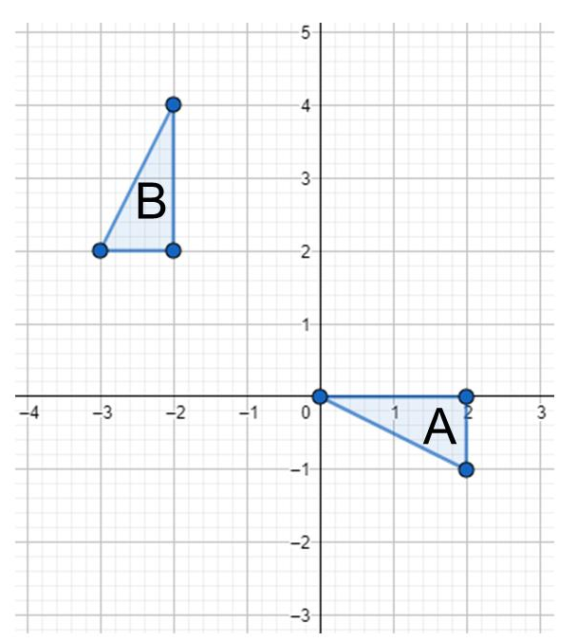
Question 7 – Rotations
What is the co-ordinate of the centre of rotation that
maps A onto B after a rotation of 270˚ ACW?

Slide 15
Answer 7 – Rotations
What is the co-ordinate of the centre of rotation that
maps A onto B after a rotation of 270˚ ACW?
CORRECT ANSWER | CORRECT EXPLANATION
(1,3) | Student has correctly identified using tracing paper that the centre of rotation can only be at (1,3).
COMMON MISTAKES | WHAT MIGHT BE YOUR MISTAKE
(0,0) | Student may think that the origin is always the centre of rotation in any question
(3,1) | The student may have identified the correct centre but has made an error when writing down the coordinates.
(-1,1) | The student may think that the closest point between the two shapes is the centre of rotation.

Slide 16
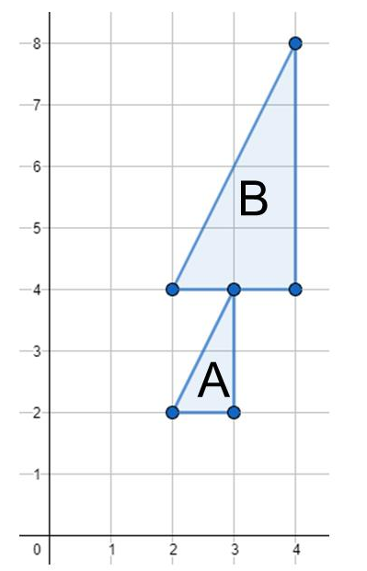
Question 8 – Enlargements
Describes how shape A
has been mapped
onto shape B

Slide 17
Answer 8 – Enlargements
Describes how shape A has been
mapped onto shape B
CORRECT ANSWER | CORRECT EXPLANATION
Enlargement Scale Factor 2 and (2,0) | Enlarging shape A by a scale factor 2 gives and image that is double the size and double the distance away from the centre of enlargement.
COMMON MISTAKES | WHAT MIGHT BE YOUR MISTAKE
Scale Factor 2 and (2,0) | The student has missed out a key bit of terminology
Enlargement Scale Factor 0.5 and (2,0) | The student has given the correct answer if it was shape B to shape A
Enlargement Scale Factor -2 and (2,0) | The student may think that because A is smaller it must be a -2 scale factor

Slide 18
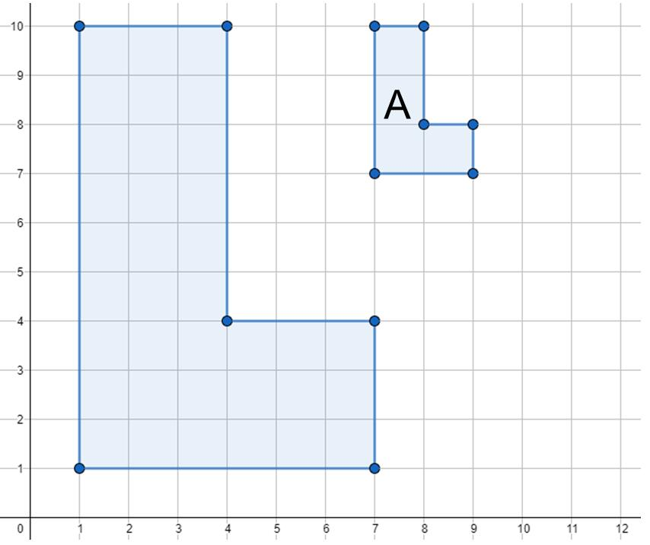
Question 9 – Enlargements
Shape A has been enlarged by a scale factor of 3.
What is the co-ordinate of the centre of enlargement?

Slide 19
Answer 9 – Enlargements
Shape A has been enlarged by a scale factor of 3.
What is the co-ordinate of the centre of enlargement?
CORRECT ANSWER | CORRECT EXPLANATION
(10,10) | When drawing on the construction lines through each point, all lines join up at (10,10).
COMMON MISTAKES | WHAT MIGHT BE YOUR MISTAKE
(7,10) | The student may have visualised that the centre is from the top left-hand corner of the shape
(1,1) | The student may think that the centre of enlargement comes from the furthest actual point from the actual centre
(11,10) | The student may have miscounted the number of squares to find the centre of enlargement

Slide 20
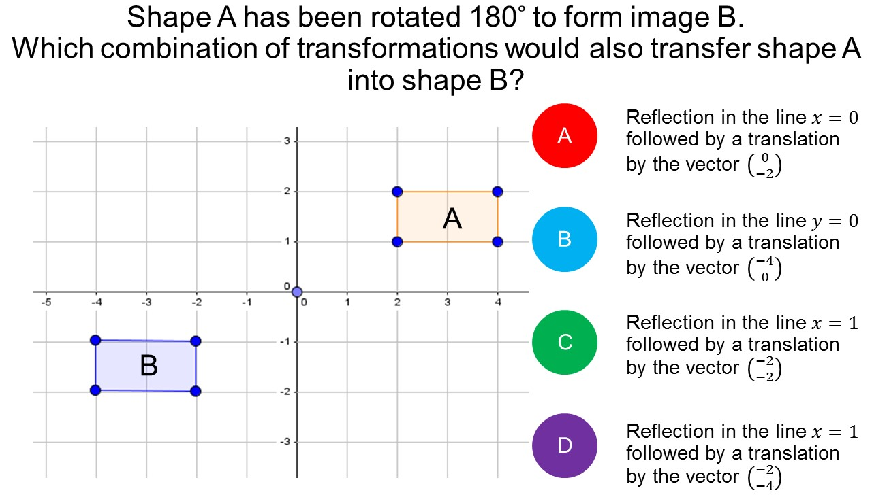
Question 10 – Combined Transformations

Slide 21
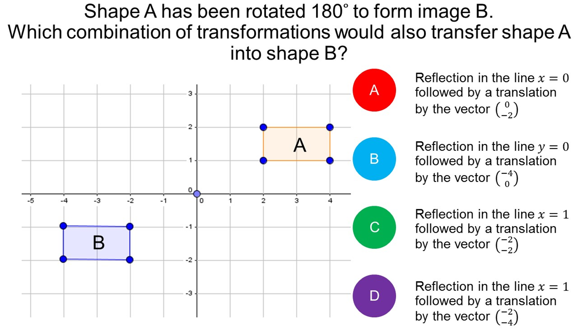
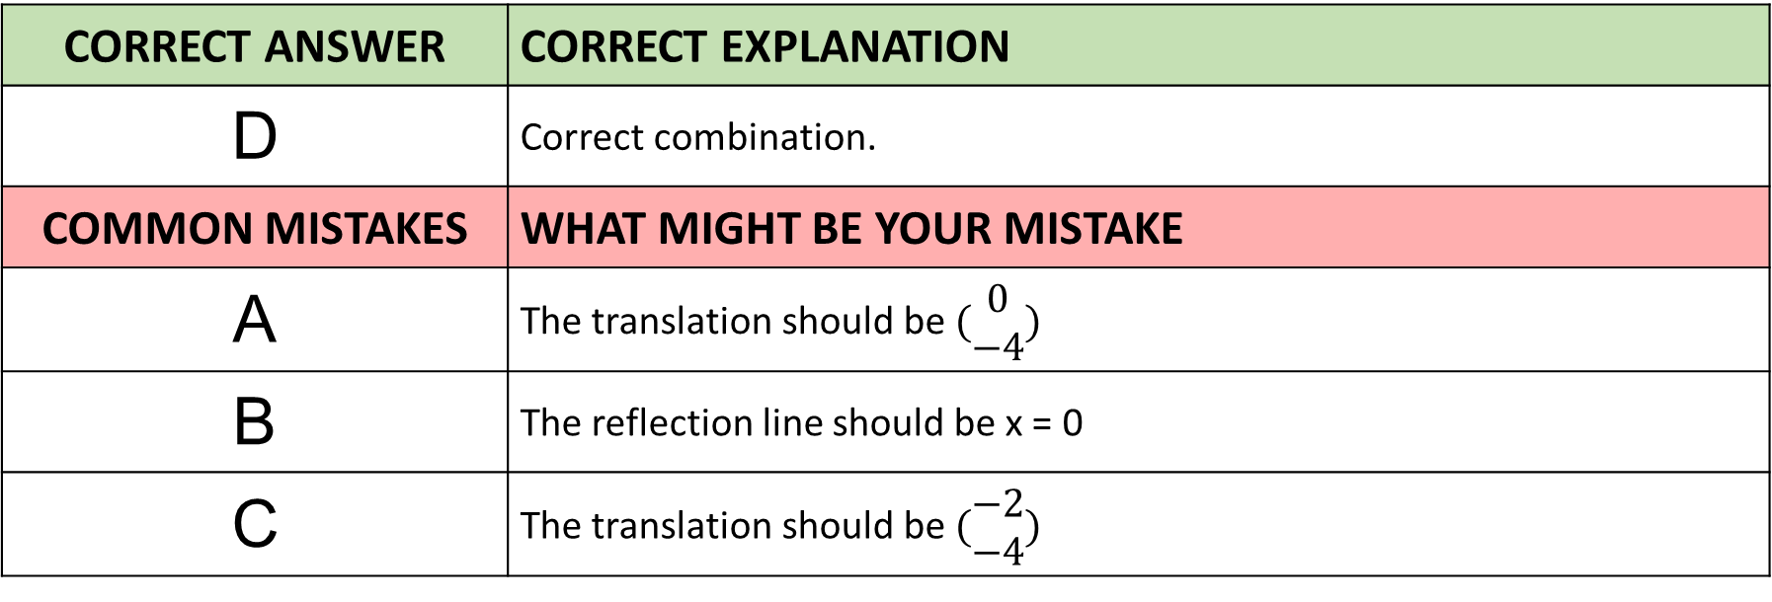
Answer 10 – Combined Transformations
CORRECT ANSWER | CORRECT EXPLANATION
D | Correct combination.
COMMON MISTAKES | WHAT MIGHT BE YOUR MISTAKE
A | The translation should be $(\begin{matrix}0 \\ −4\end{matrix})$
B | The reflection line should be x = 0
C | The translation should be $(\begin{matrix}−2 \\ −4\end{matrix})$

Slide 22
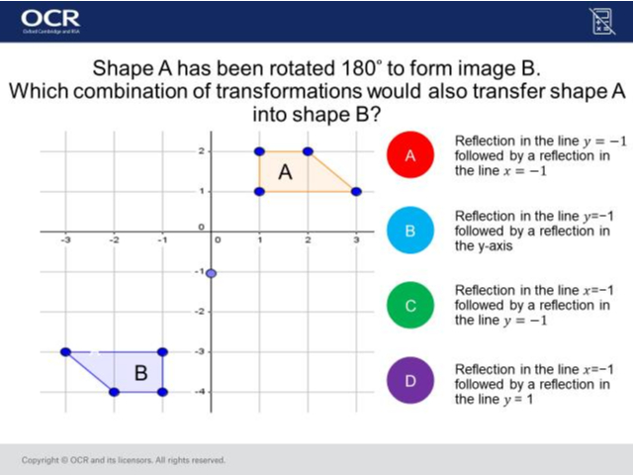
Question 11 – Combined Transformations

Slide 23
Answer 11 – Combined Transformations
CORRECT ANSWER | CORRECT EXPLANATION
B | Correct combination.
COMMON MISTAKES | WHAT MIGHT BE YOUR MISTAKE
A | The second transformation is incorrect.
B | They reflected too far to the left.
C | They reflected too far to the left.

Slide 24
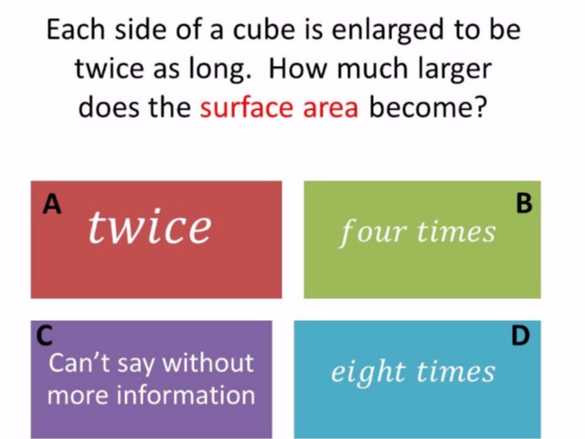
Question 12 – Enlargement of Area

Slide 25
Answer 12 – Enlargement of Area
CORRECT ANSWER | CORRECT EXPLANATION
4 times | Length Scale Factor = Area Scale Factor Squared.
COMMON MISTAKES | WHAT MIGHT BE YOUR MISTAKE
2 times | The student thought the scale factor is the same for length and area.
8 times | The student has found the scale factor for Volume.
More information needed | The student needs to review this topic.

Slide 26
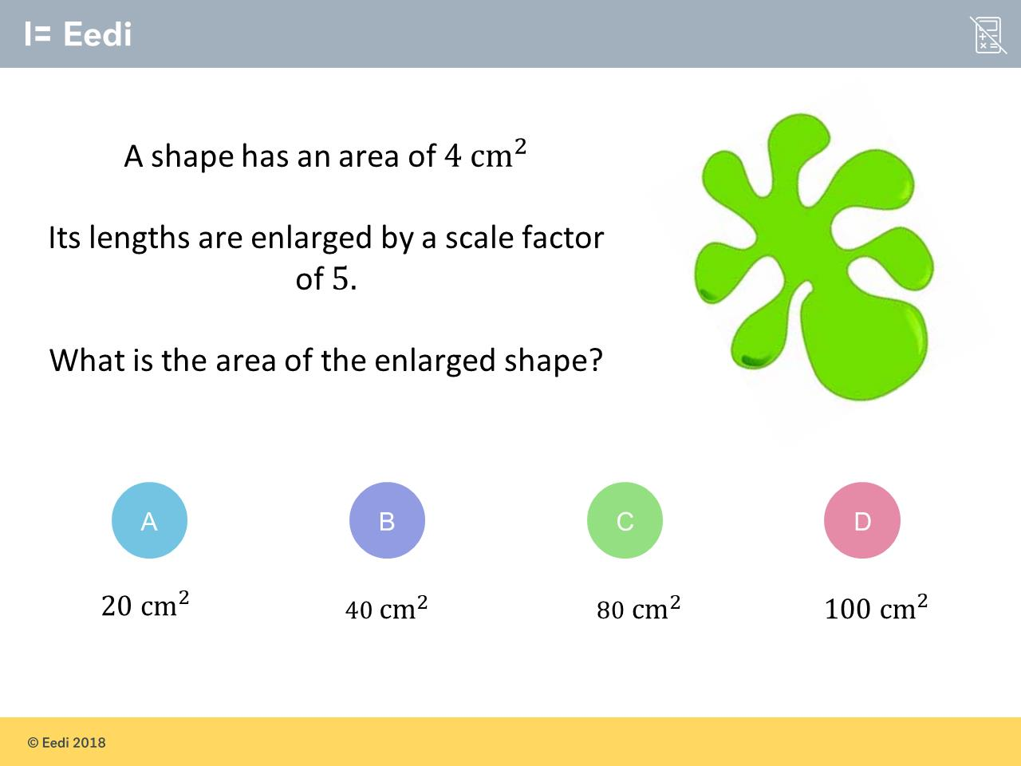
Question 13 – Enlargement of Area

Slide 27
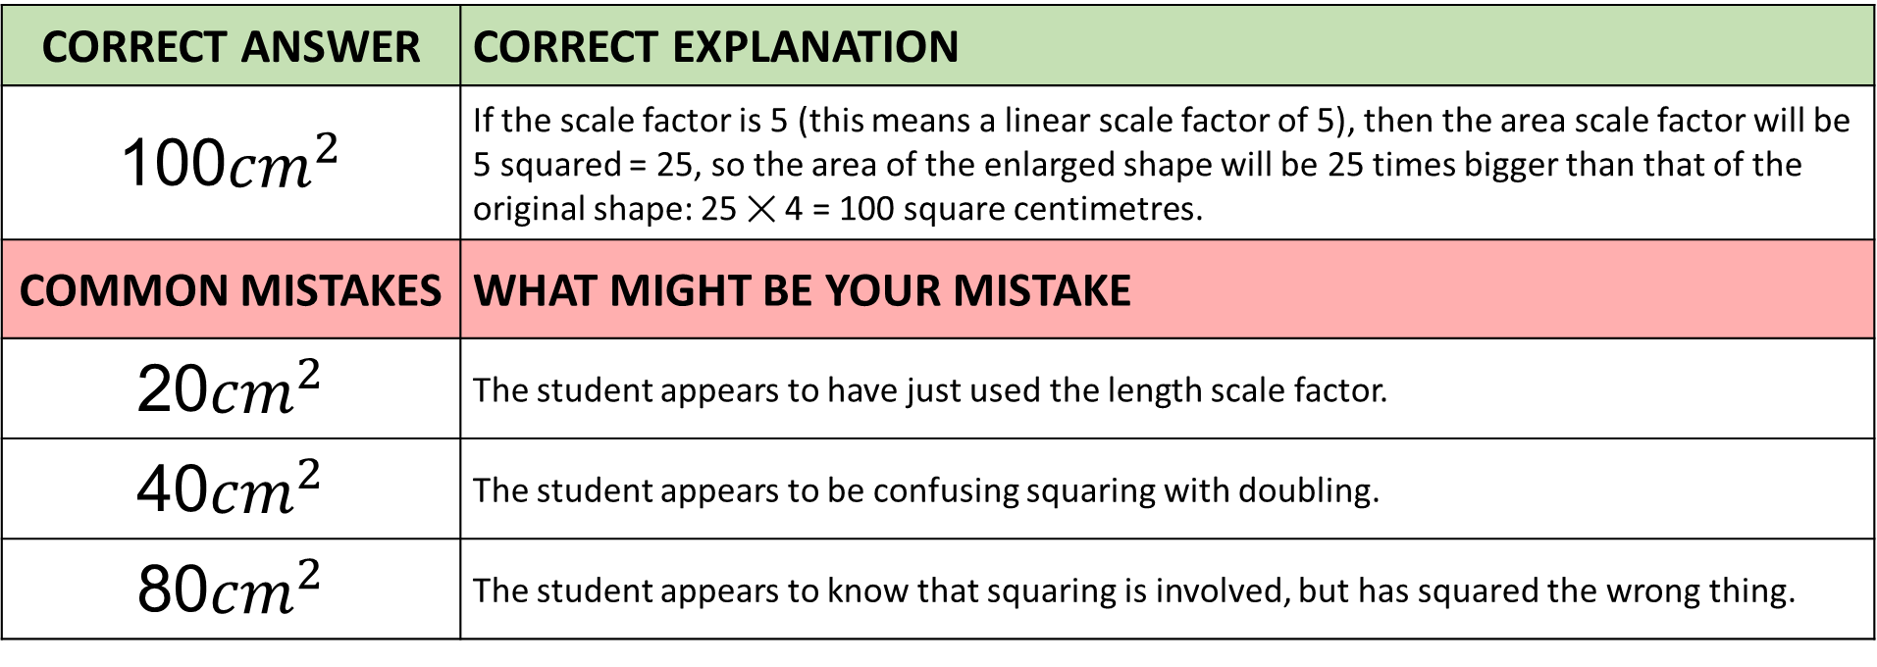
Answer 13 – Enlargement of Area
CORRECT ANSWER | CORRECT EXPLANATION
100${cm}^{2}$ | If the scale factor is 5 (this means a linear scale factor of 5), then the area scale factor will be 5 squared = 25, so the area of the enlarged shape will be 25 times bigger than that of the original shape: 25 ✕ 4 = 100 square centimetres.
COMMON MISTAKES | WHAT MIGHT BE YOUR MISTAKE
20${cm}^{2}$ | The student appears to have just used the length scale factor.
40${cm}^{2}$ | The student appears to be confusing squaring with doubling.
80${cm}^{2}$ | The student appears to know that squaring is involved, but has squared the wrong thing.

Slide 28
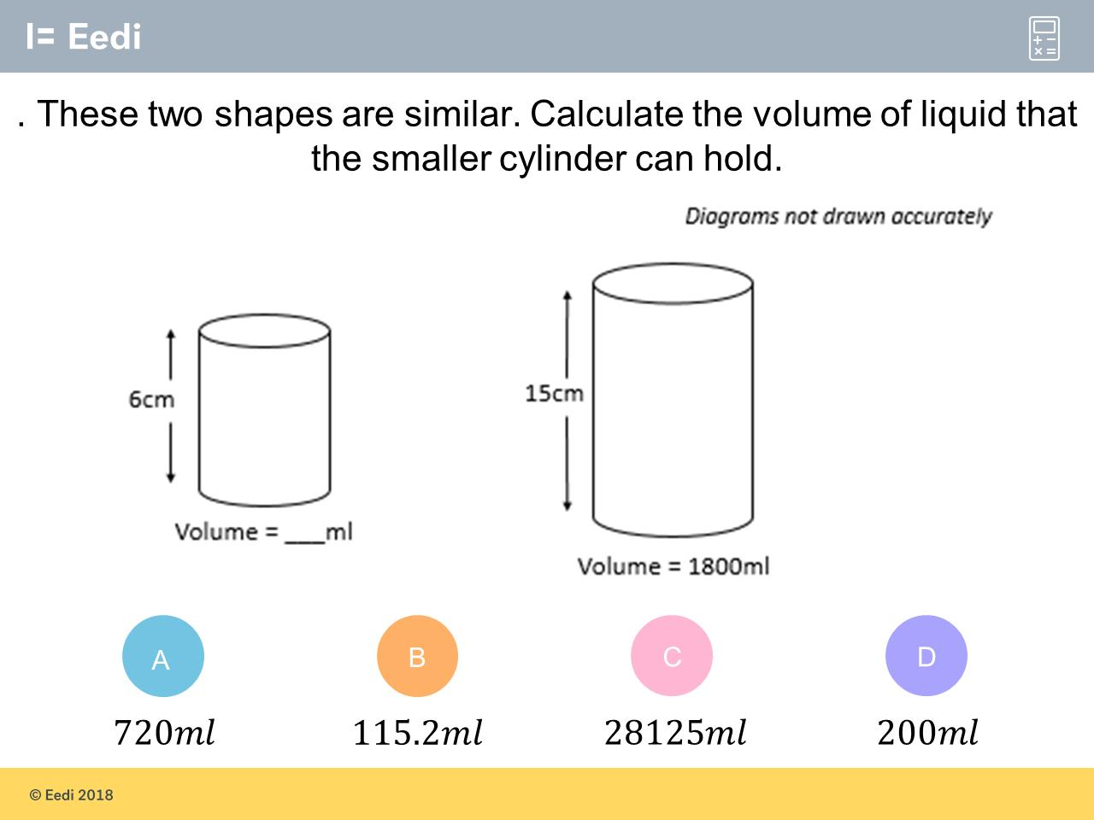
Question 14 – Enlargement of Volume

Slide 29
Answer 14 – Enlargement of Volume
CORRECT ANSWER | CORRECT EXPLANATION
115.2ml | First we need to work out the length scale factor, which is 15 ÷ 6 = 2.5. Now, we need the volume scale factor, which is 2.5³. So, to find the volume it is 1800 ÷ 2.5³
COMMON MISTAKES | WHAT MIGHT BE YOUR MISTAKE
720ml | The student may have found the length scale factor of 2.5 then divided 1800 by 2.5, ignoring that they need the volume scale factor
28125ml | The student may have multiply 1800 by 2.5³ instead of dividing
200ml | The student may have done 15 - 6 = 9 in an incorrect attempt to find the scale factor, and then done 1800 divided by 9

