Slide 1


7SGA
7G
South

Slide 2

Tuesday Schedule
7.45 Tutor Time (J103) – Expectations/Admin/Timetables/Planners/Ice Breakers
9.00 Lower School Assembly (AUD)
9.40 Break
10.00 Period 3
10.50 Period 4
11.40 Period 5
12.30 Lunch - (Bring a packed lunch)
13.30 Form Time
13.55 Period 6
14.45 Period 7
15.35 Home Time

Slide 3
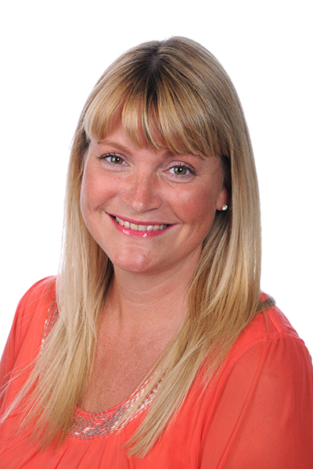
7SGA
5 Years as a form
We lookout for each other
Form Room J103
Head of Year - Mrs Greenlees

Slide 4
Personal Expectations
Be kind.
Make good decisions.
Treat other people as you want to be treated.
Think about other people's point of view.

Slide 5
Form Room Rules
It is a calm place.
No other students in the room.
Keep it tidy.
No use of devices if I am not in the room.

Slide 6
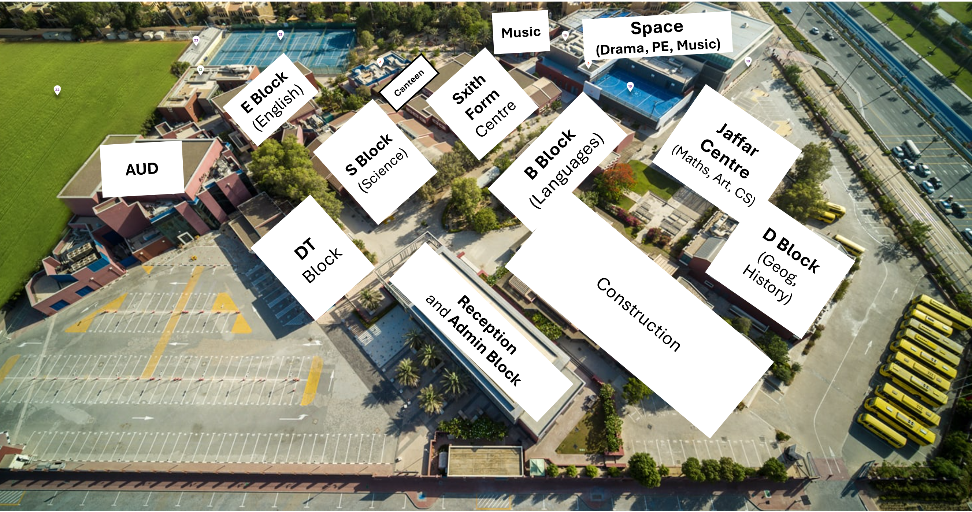
School Map

Slide 7
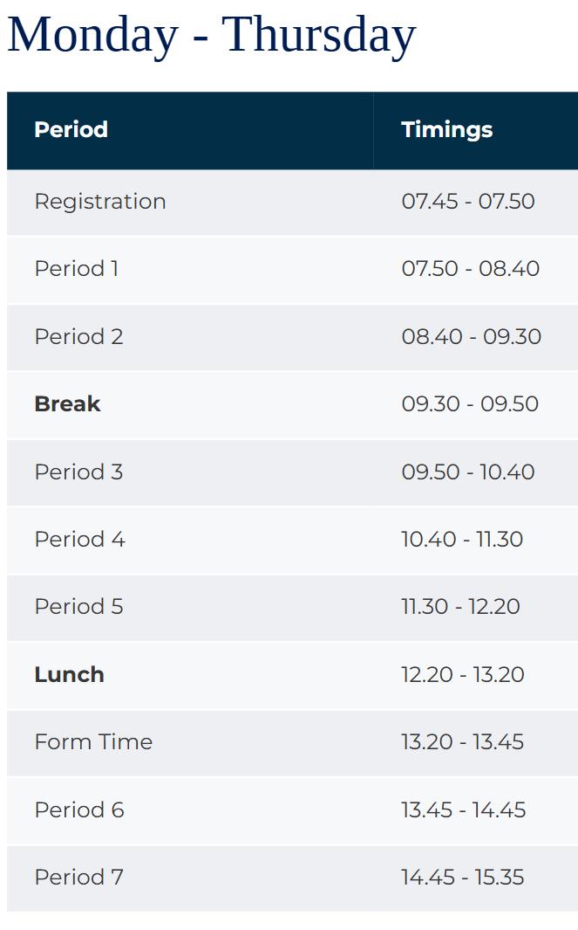
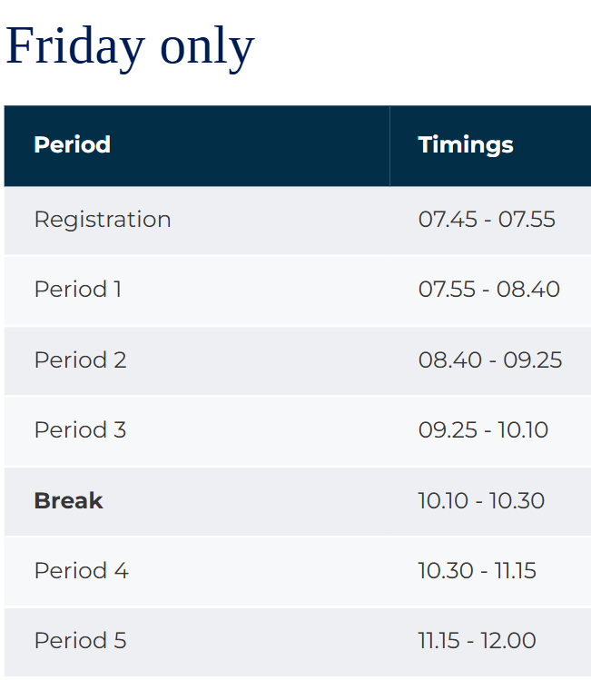
Timings of the Day

Slide 8
Weekly Form Overview
Monday | Tuesday | Wednesday | Thursday
Admin | Form Group Activity (Liaisons) | Tutor Time | Assembly (AUD)

Slide 9
7SGA Homework Timetable
Monday | Tuesday | Wednesday | Thursday | Friday
Arabic | Science | Maths | French/ Spanish | Arabic
History | English | MSC | Geog | Science
Maths |  | Art/CS/DT

Slide 10
Check List
Timetables
Planners
ID Cards
Lockers
DC Expectations – behaviour, attitude, uniform, mobiles, social media.
Colours
Student Parliament
Lates
Absent
Emails and Teams Chat
Nurse
Counsellors

Slide 11
Use of Buses
Designated Seats
No standing
No excessive noise
Treat bus drivers and conductors with respect.

Slide 12
Social Events
Friday 14th November
BBQ 12pm to 4pm
Friday 3rd April to Sunday 5th April
Residential Weekend Trip

Slide 13
Teaching Staff
Click on the badge below
to see the photos of all staff.

