Slide 1
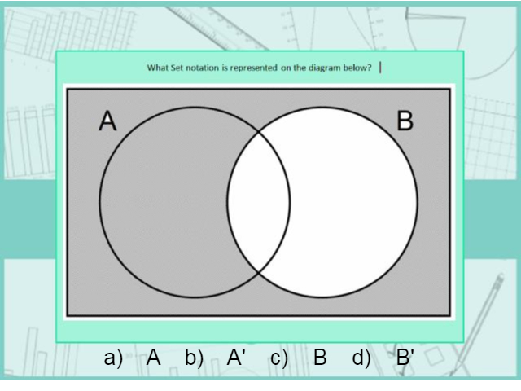
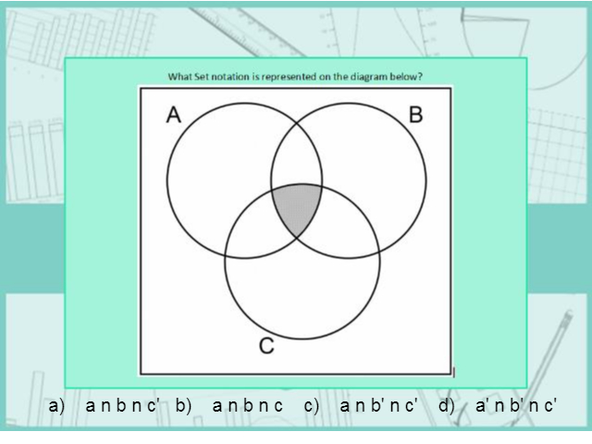
Worst answered question?
Most common wrong answer?

Slide 2
ANSWERS

Slide 3
Worst answered question?

Slide 4
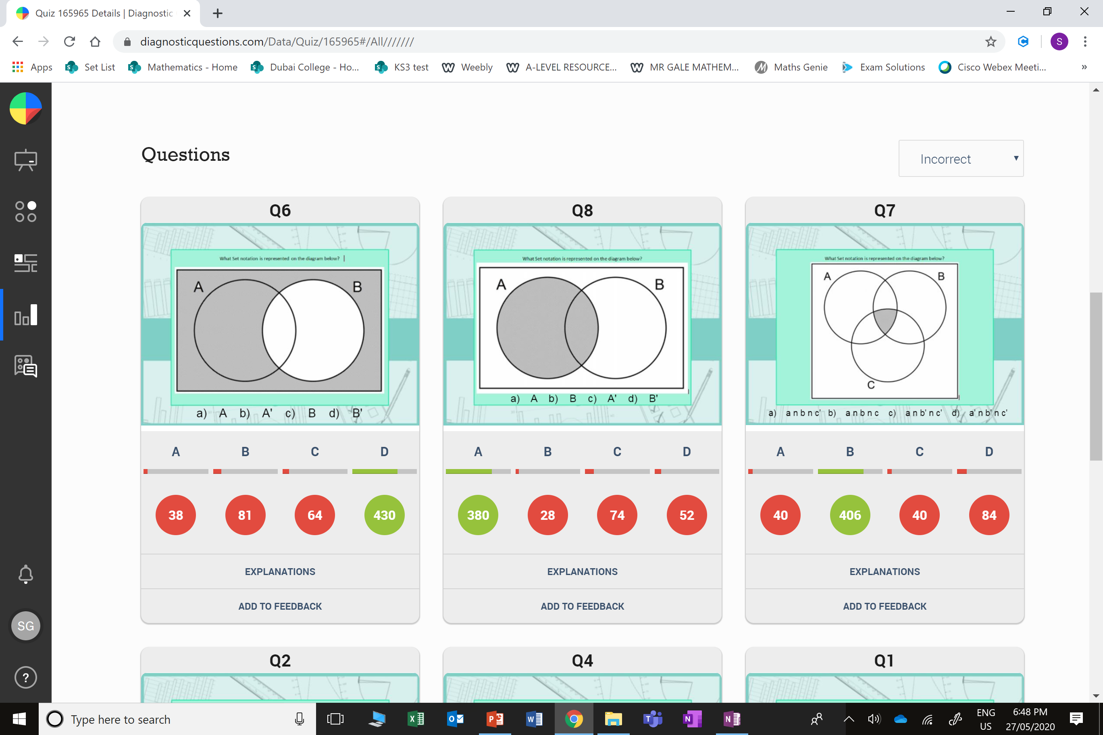
B
The student chose the
wrong letter.

Slide 5
C
The student thought it was
only in the A circle.

