Slide 1
Trig Functions
Inverse Graphs
Chapter 6
(Part 4 of 4)

Slide 2
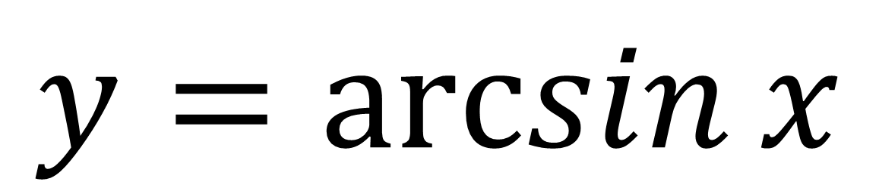
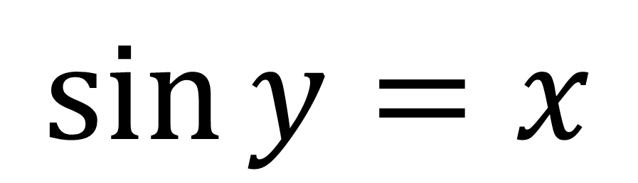
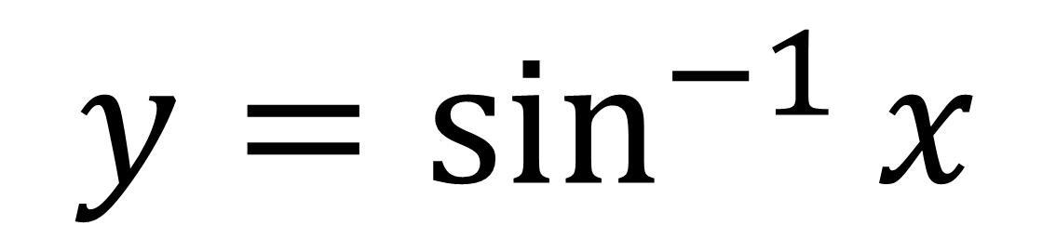
$$\sin{y}=x$$
$$y=\sin^{−1}{x}$$
$$y=\arcsin{x}$$

Slide 3
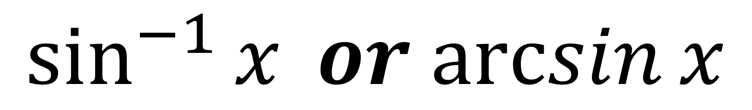
$$\sin^{−1}{x} or arcsin⁡x$$
Be careful:
the -1 here doesn’t mean a power of -1. This is an unfortunate historical accident.

Slide 4
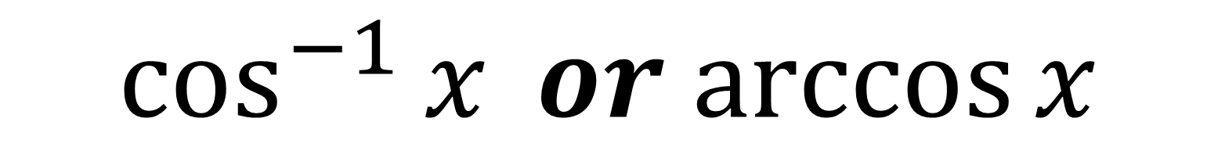

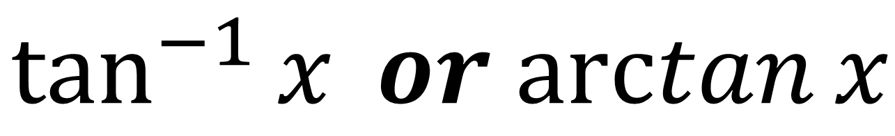
Inverse Trig Functions
$$\sin^{−1}{x} or arcsin⁡x$$
$$\cos^{−1}{x} or arccos⁡x$$
$$\tan^{−1}{x} or arctan⁡x$$

Slide 5

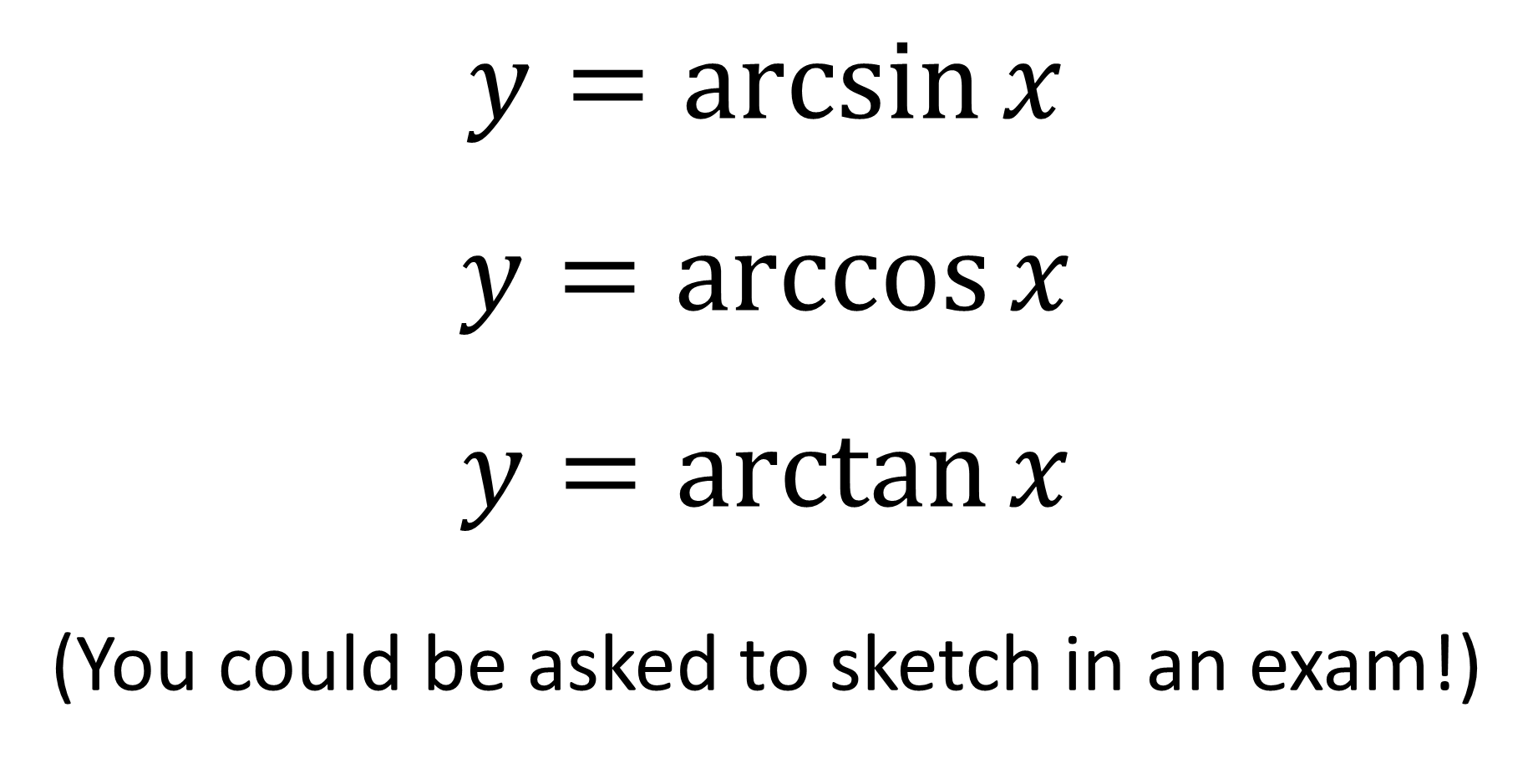
Graphing Inverse Trig Functions
$$y=\arcsin{x}$$
$y=\arccos{x}$
$$y=\arctan{x}$$
(You could be asked to sketch in an exam!)

Slide 6








Sketch $y=\arcsin{x}$
$$y$$
$$\frac{π}{2}$$
$$y=\sin{x}$$
$$x$$
$$−1$$
$$1$$
$$−\frac{π}{2}$$

Slide 7






Sketch $y=\arccos{x}$
$$y$$
$$π$$
$$\frac{π}{2}$$
$$x$$
$$−1$$
$$1$$

Slide 8





Sketch $y=\arctan{x}$
Note that this graph has asymptotes.
$$y$$
$$\frac{π}{2}$$
$$x$$
$$−\frac{π}{2}$$

