Slide 1
LO: Solving Quadratic Inequalities

Slide 2
Quadratic skills needed:
Factorising Quadratics
Solving Quadratics (by factorising)
Sketching Quadratics

Slide 3
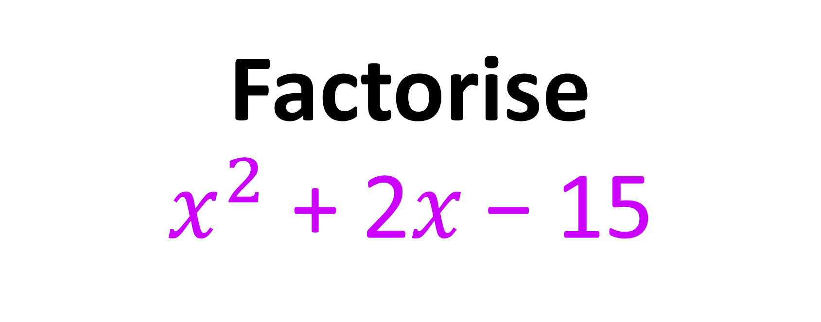
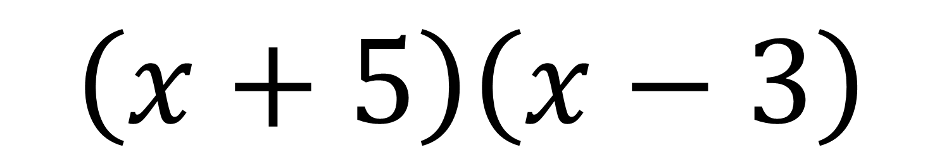
Factorise
$x^{2}$ + 2𝑥 − 15
$$\left(x+5\right)\left(x−3\right)$$

Slide 4
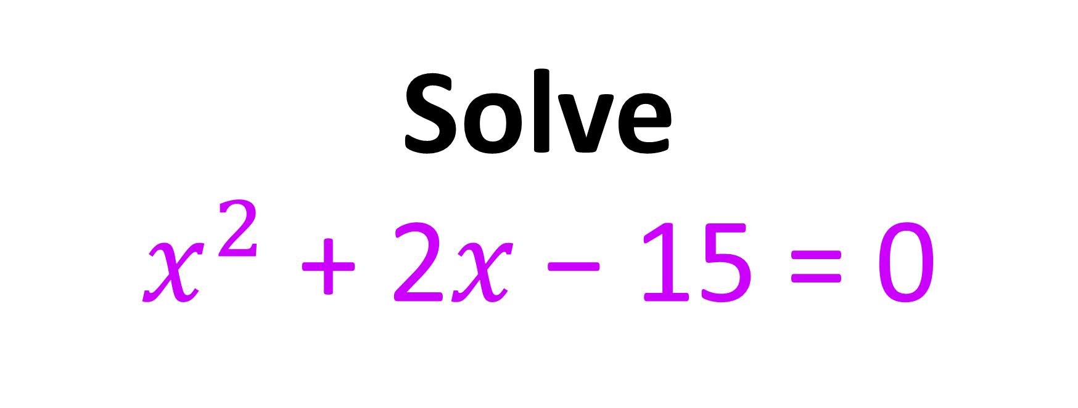
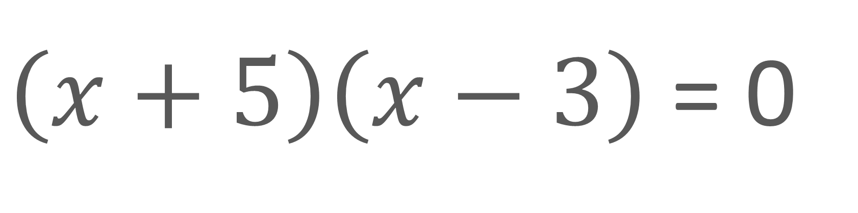
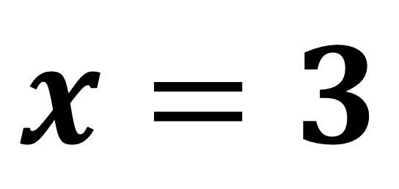
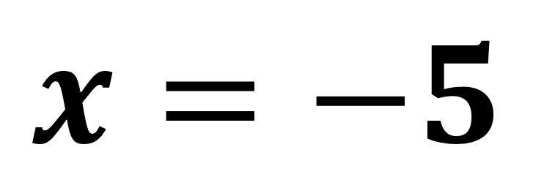
Solve
$x^{2}$ + 2𝑥 − 15 = 0
$\left(x+5\right)\left(x−3\right)$ = 0
$$x=−5$$
$$x=3$$

Slide 5
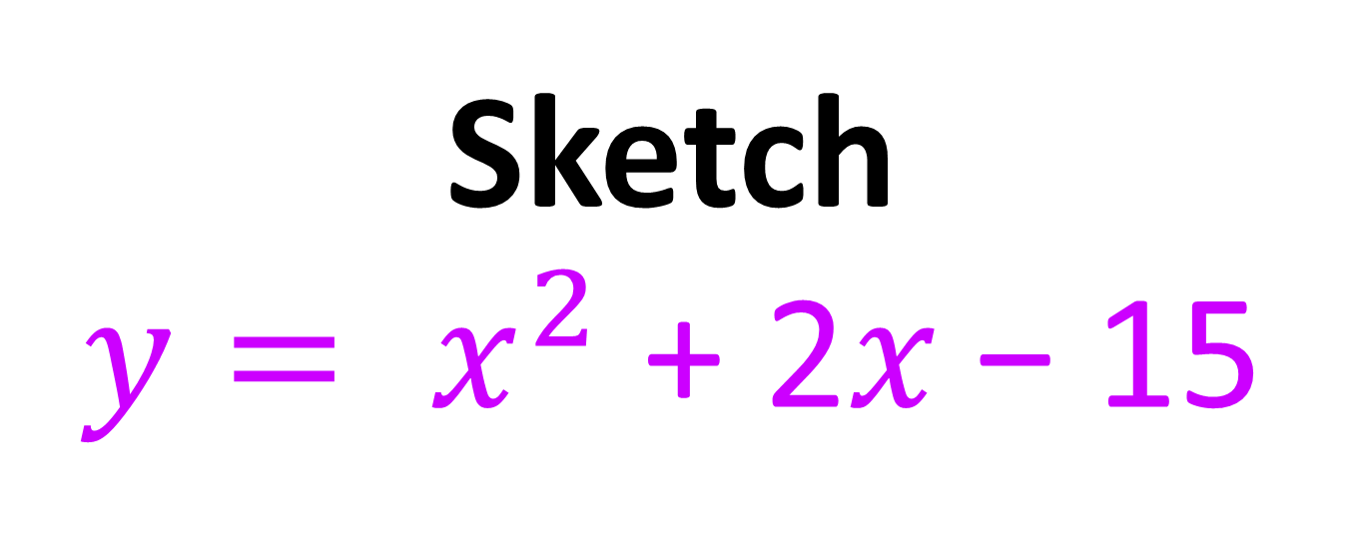

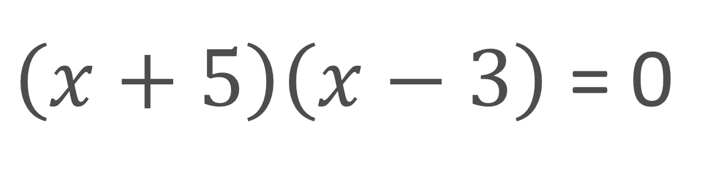



Sketch
${y= x}^{2}$ + 2𝑥 − 15
$\left(x+5\right)\left(x−3\right)$ = 0
$$y$$
$$−5$$
$$3$$
$$x$$

Slide 6
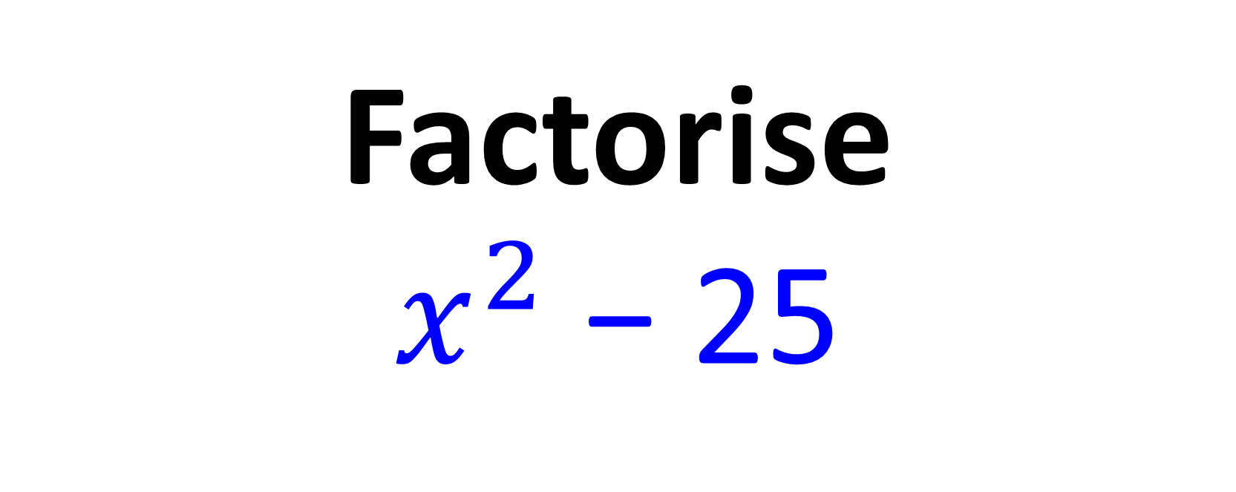
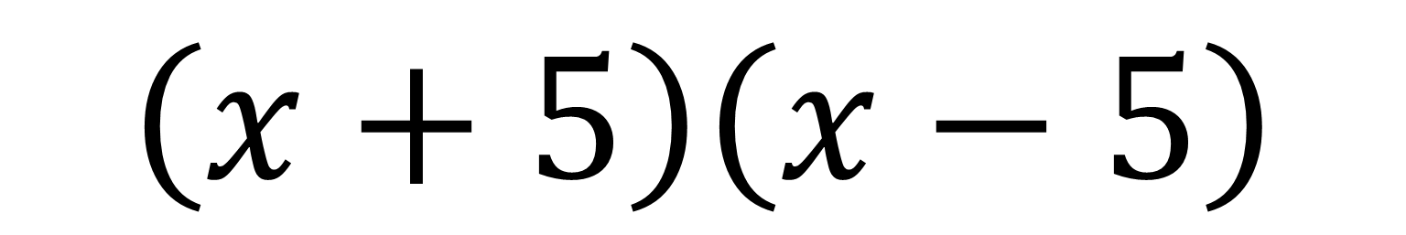
Factorise
$x^{2}$ − 25
$$\left(x+5\right)\left(x−5\right)$$

Slide 7
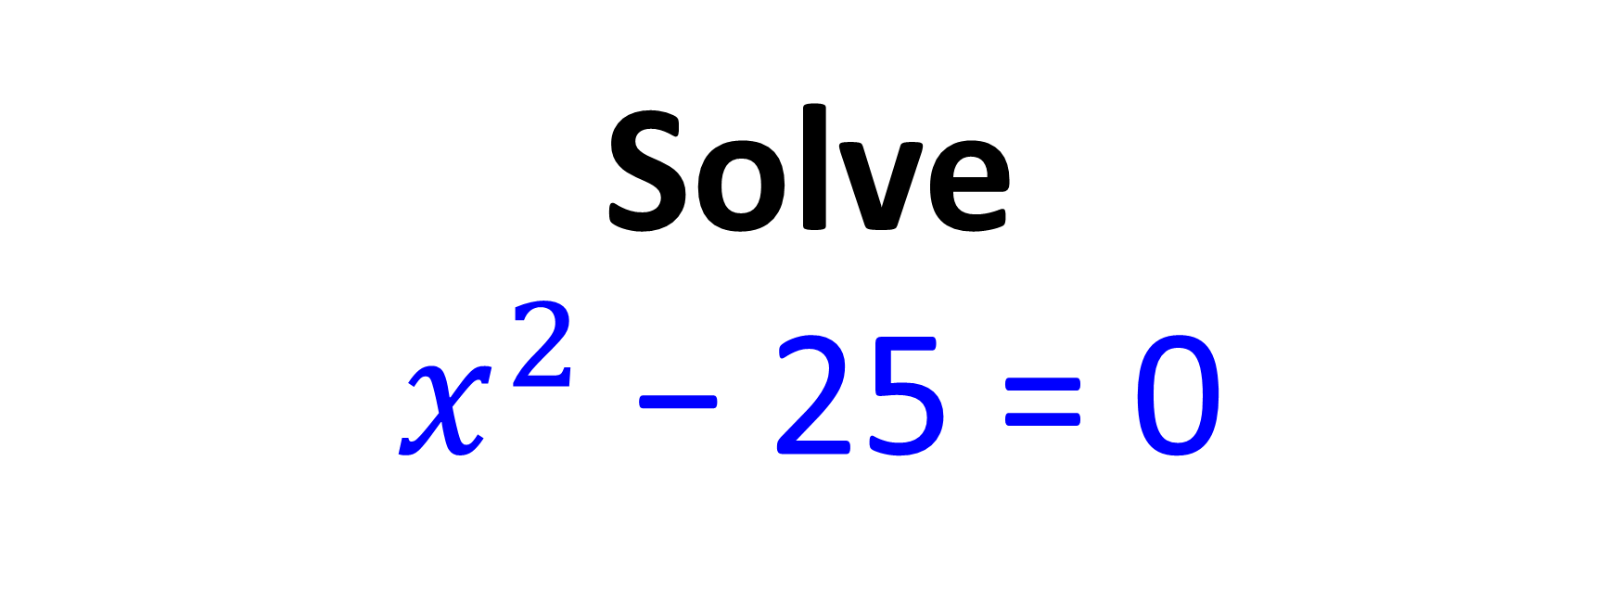

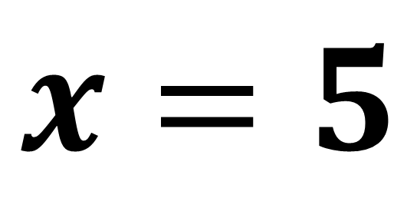
Solve
$x^{2}$ − 25 = 0
$\left(x+5\right)\left(x−5\right)$ = 0
$$x=−5$$
$$x=5$$

Slide 8
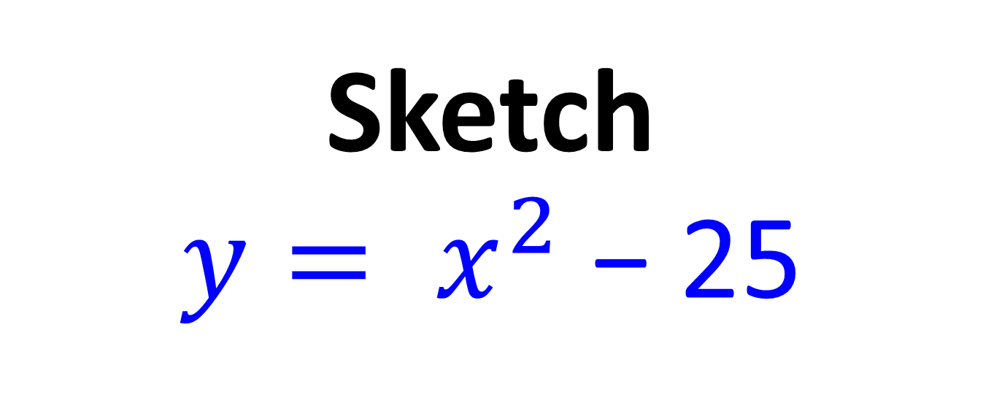

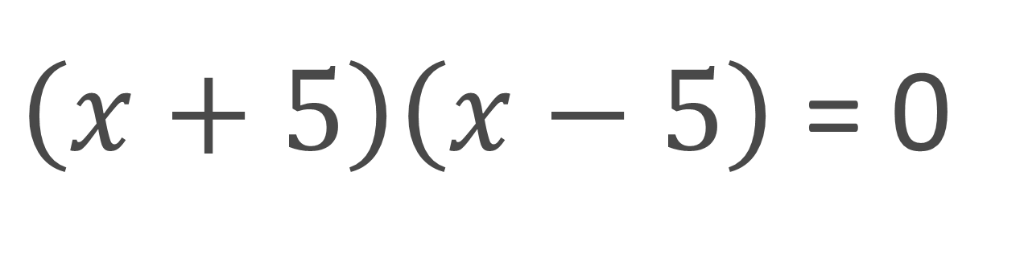
Sketch
${y= x}^{2}$ − 25
$\left(x+5\right)\left(x−5\right)$ = 0
$$y$$
$$−5$$
$$5$$
$$x$$

Slide 9
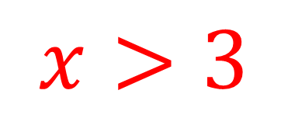


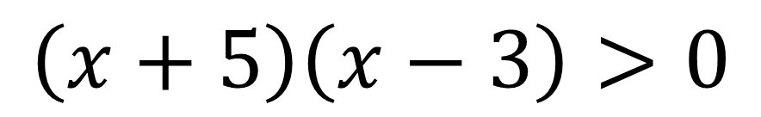



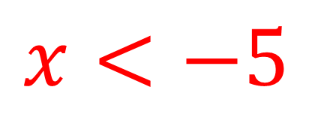

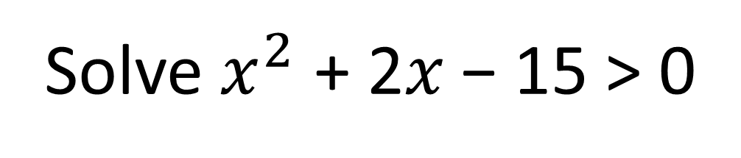
Solve $x^{2}$ + 2𝑥 − 15 > 0
$$>0$$
$$\left(x+5\right)\left(x−3\right)>0$$
$$y$$
greater than zero
=
graph above x axis
$$y=(x+5)(x−3)$$
$$x$$
$$−5$$
$$3$$
$$x<−5$$
and
$$x>3$$

Slide 10
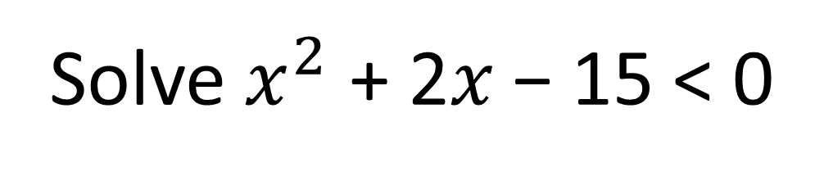
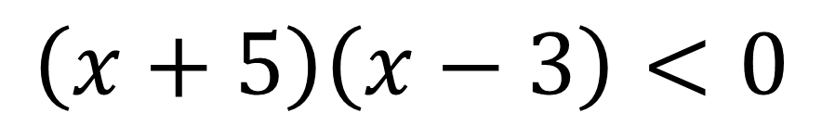

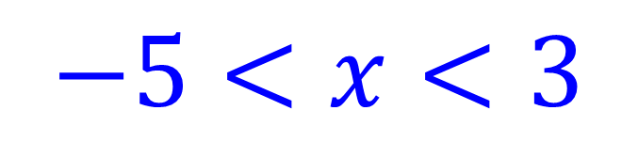
Solve $x^{2}$ + 2𝑥 − 15 < 0
$$<0$$
$$\left(x+5\right)\left(x−3\right)<0$$
$$y$$
less than zero
=
graph below x axis
$$y=(x+5)(x−3)$$
$$x$$
$$−5$$
$$3$$
$$−5<x<3$$

Slide 11
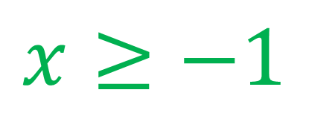

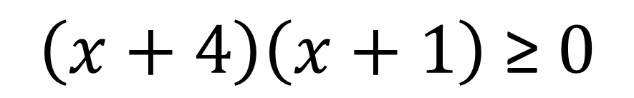


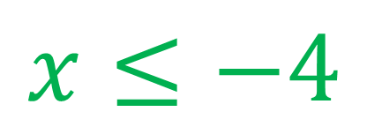

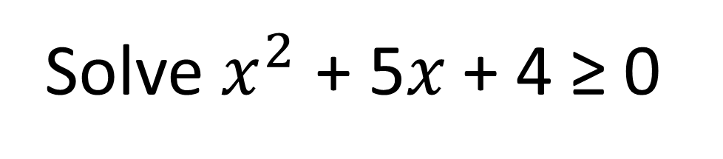
Solve $x^{2}$ + 5𝑥 + 4 ≥ 0
$$\left(x+4\right)\left(x+1\right) \text{≥} 0$$
$$y$$
$$y=(x+4)(x+1)$$
$$x$$
$$−4$$
$$−1$$
$$x≤−4$$
and
$$x≥−1$$

Slide 12
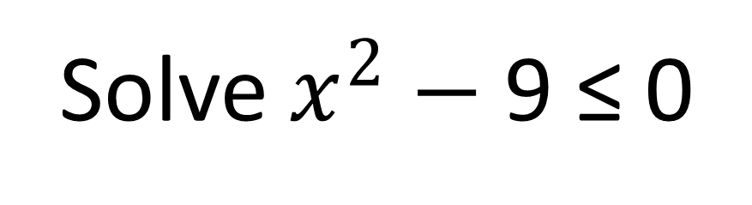

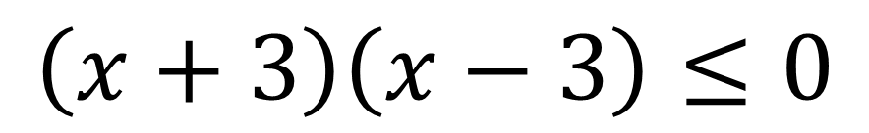



Solve $x^{2}$ $−$ 9 ≤ 0
$$\left(x+3\right)\left(x−3\right)≤0$$
$$y$$
$$y=(x+3)(x−3)$$
$$x$$
$$−3$$
$$3$$
$$−3≤x≤3$$

Slide 13
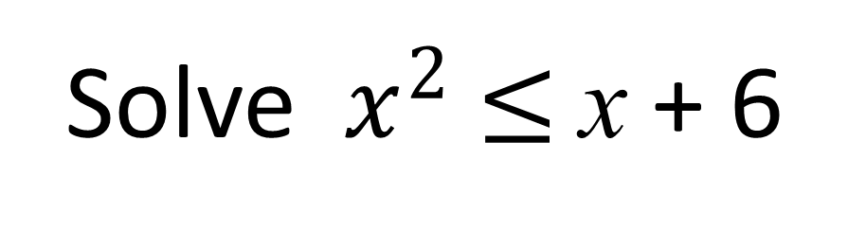


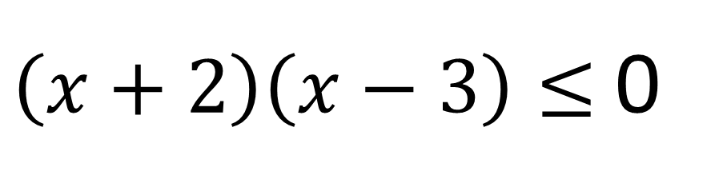


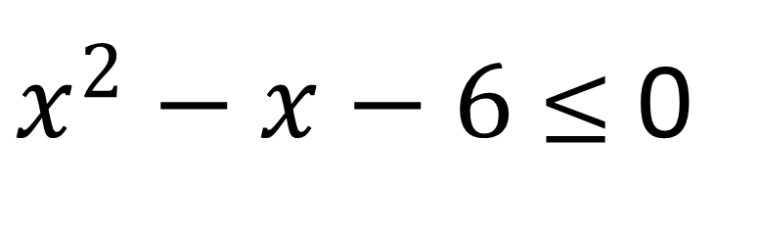

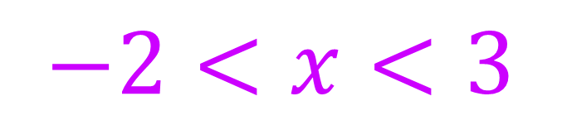
Solve $x^{2}$ $≤$x + 6
$x^{2}−x−6$ $≤$ 0
$\left(x+2\right)\left(x−3\right)≤$ 0
$$y$$
$$y=(x+2)(x−3)$$
$$x$$
$$−2$$
$$3$$
$$−2<x<3$$

