Slide 1
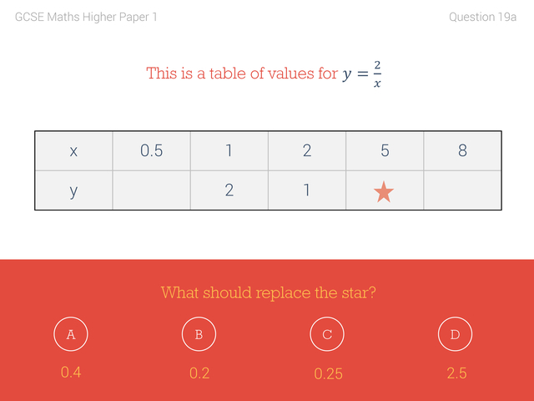
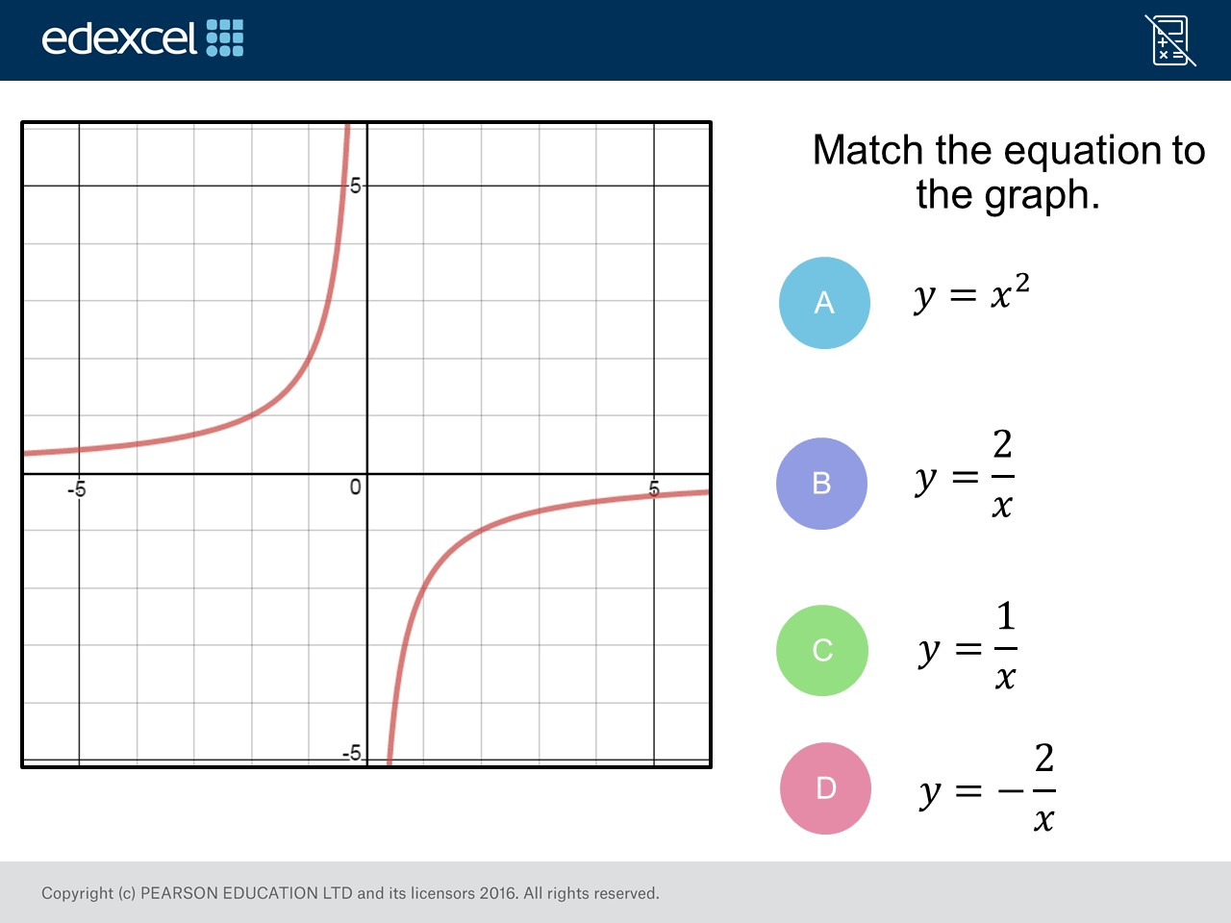
Worst answered question?
Most common wrong answer?

Slide 2
ANSWERS

Slide 3
Worst answered question?

Slide 4
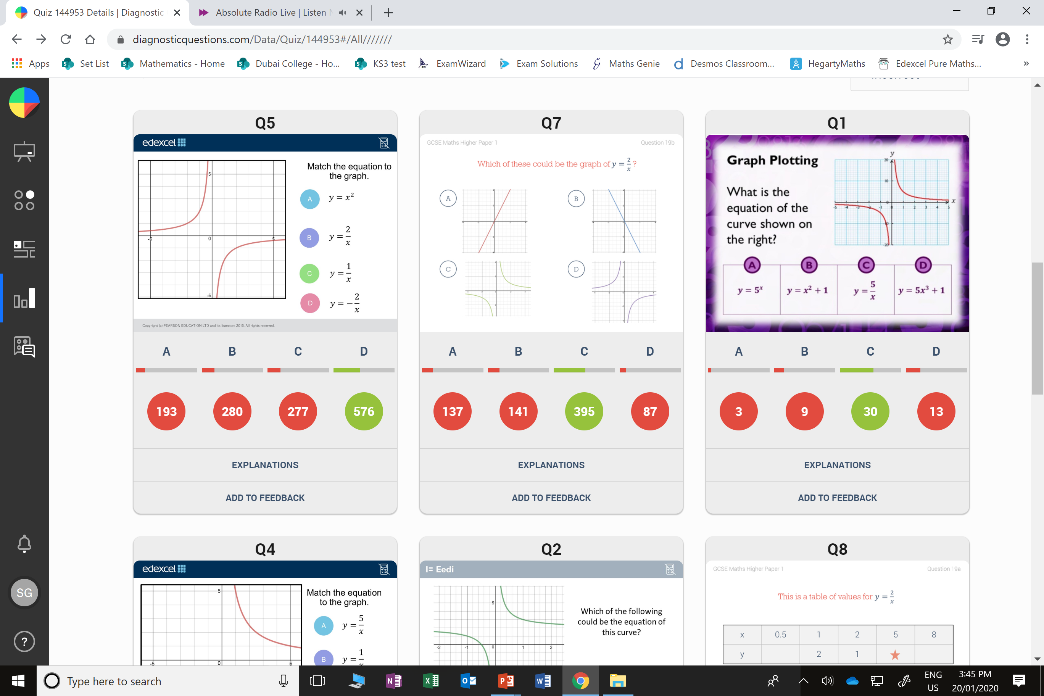
B
They did not recognise the graph has be reflected.

Slide 5
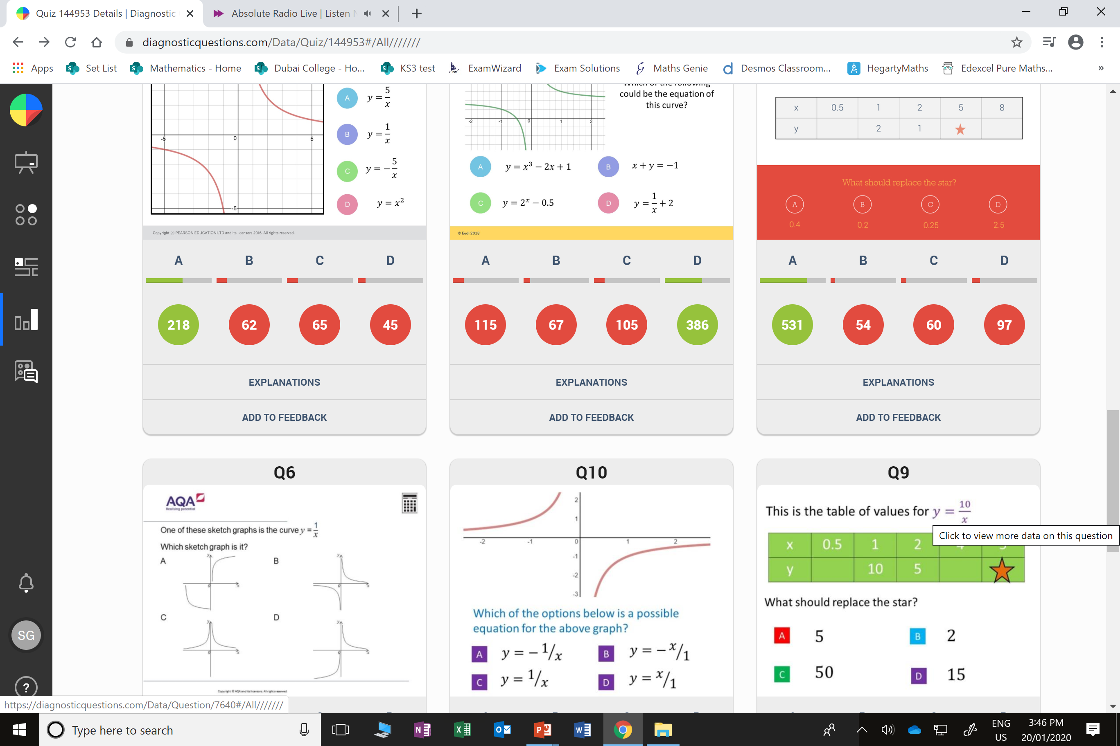
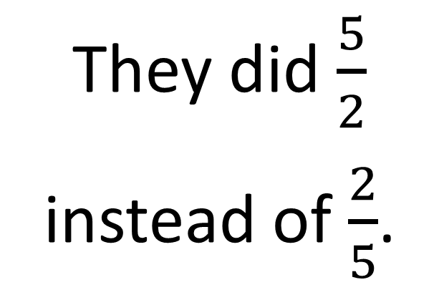
D
They did $\frac{5}{2}$
instead of $\frac{2}{5}$.

