Slide 1
LO: Area of Rectangles
and Triangles

Slide 2
What is the area of this rectangle?
?

Slide 3
What is the area of this rectangle?
20 square units.

Slide 4
What is the area of this rectangle?
4cm
5cm
20 cm²

Slide 5
What is the area of this rectangle?
40mm
50mm
2000 mm²

Slide 6
Are the two rectangles
the same size or different?
20 cm²
2000 mm²

Slide 7
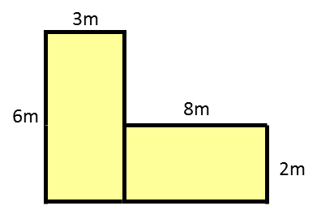
What is the total area?
State your units
34m²
18m²
16m²

Slide 8
What is the total area?
State your units
8 cm
2 cm
16 cm
24cm²
6 cm
8cm²
2 cm

Slide 9
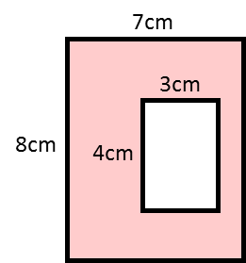
What is the area of the shape?
State your units
Large Rectangle = 56cm²
Small Rectangle = 12cm²
12cm²
Total Area =
44cm²

Slide 10
If you cut a rectangle along the diagonal
what 2 shapes do you get?

Slide 11

Height
Base
What is the formula for area of a triangle?
Area of a Triangle = $\frac{1}{2}$ x height x base

Slide 12

Area of a Triangle = $\frac{1}{2}$ x height x base
Base
Base
Base
Base

Slide 13
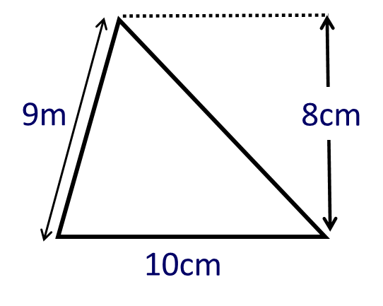
9cm
What is the area of a triangle?
40cm²

Slide 14
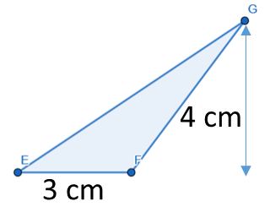
Is the area of triangle 6cm²?
Yes

Slide 15
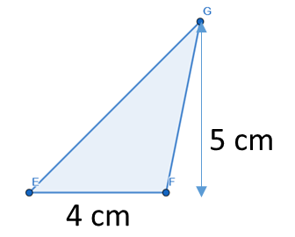
Is the area of triangle 10cm²?
Yes

Slide 16
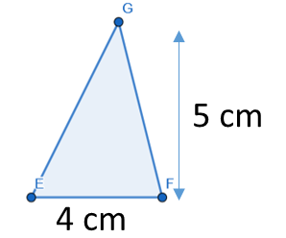
Is the area of triangle 10cm²?
Yes

Slide 17
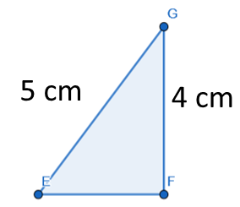
Is the area of triangle 10cm²?
No

Slide 18
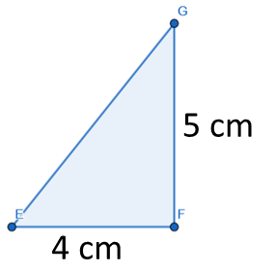
Is the area of triangle 10cm²?
Yes

Slide 19
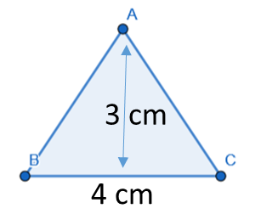
Is the area of triangle 12cm²?
No

Slide 20
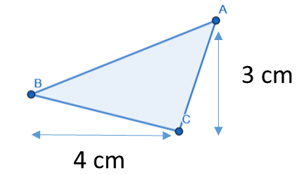
Is the area of triangle 6cm²?
No

Slide 21
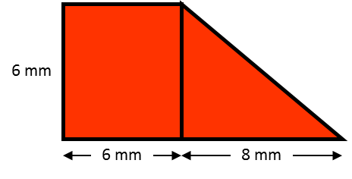
What is the area of the shape?
State your units
36mm²
24mm²
Total Area =
60mm²

Slide 22
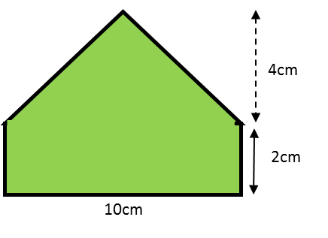
What is the area of the shape?
State your units
20cm²
20cm²
Total Area =
40cm²

