Slide 1



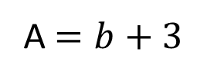
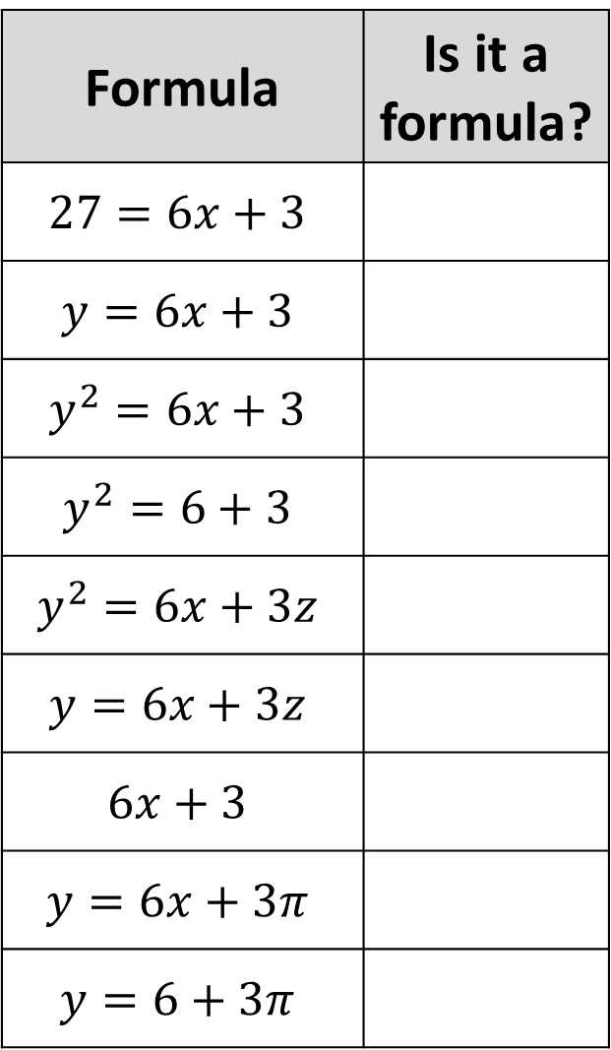











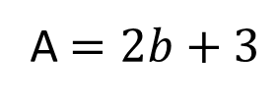


Formula | Is it a formula?
Formula | Is it a formula?
Formula | Is it a formula?
$$27=6x+3$$
$$y=6x+3$$
$$y^{2}=6x+3$$
$$y^{2}=6+3$$
$$y^{2}=6x+3z$$
$$y=6x+3z$$
$$6x+3$$
$$y=6x+3π$$
$$y=6+3π$$
A $=b+3$
$$y+x$$
A $=2b+3$
$$y+x=5$$
$$b+3=A$$
$$y+x=c$$
$$b+3=a$$
$$y+x=c^{2}$$
$$b+3$$
$$y+5=c^{2}$$
$$5= b+3$$
$$8+5=c^{2}$$
$$5A=b+3$$
$$c^{2}$$
$$5A=a+3$$
$$c^{2}−a+b=d$$
$$5A=A+3$$
$$c^{2}−5+8=d$$

Slide 2
ANSWERS

Slide 3

Formula | Is it a formula?
Formula | Is it a formula?
Formula | Is it a formula?
$$27=6x+3$$
$$y=6x+3$$
$$y^{2}=6x+3$$
$$y^{2}=6+3$$
$$y^{2}=6x+3z$$
$$y=6x+3z$$
$$6x+3$$
$$y=6x+3π$$
$$y=6+3π$$
A $=b+3$
Yes
$$y+x$$
No
No
A $=2b+3$
Yes
$$y+x=5$$
Yes
Yes
$$b+3=A$$
Yes
$$y+x=c$$
Yes
Yes
$$b+3=a$$
Yes
$$y+x=c^{2}$$
Yes
No
$$b+3$$
No
$$y+5=c^{2}$$
Yes
Yes
$$5= b+3$$
No
$$8+5=c^{2}$$
No
Yes
$$5A=b+3$$
Yes
$$c^{2}$$
No
No
$$5A=a+3$$
Yes
$$c^{2}−a+b=d$$
Yes
Yes
$$5A=A+3$$
No
$$c^{2}−5+8=d$$
Yes
No

