Slide 1
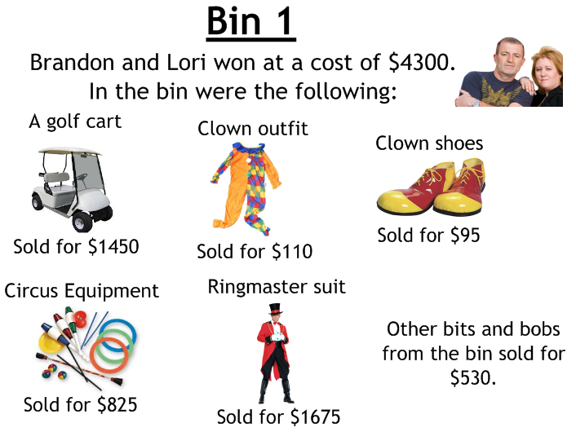
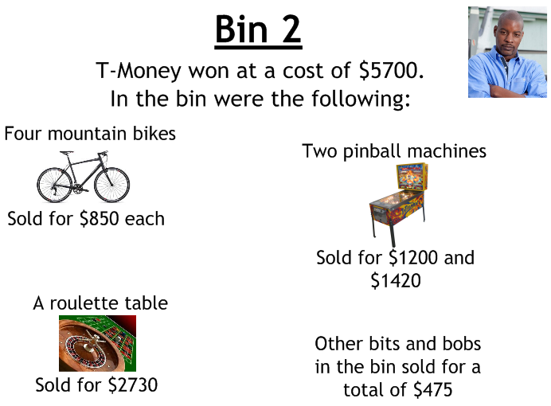
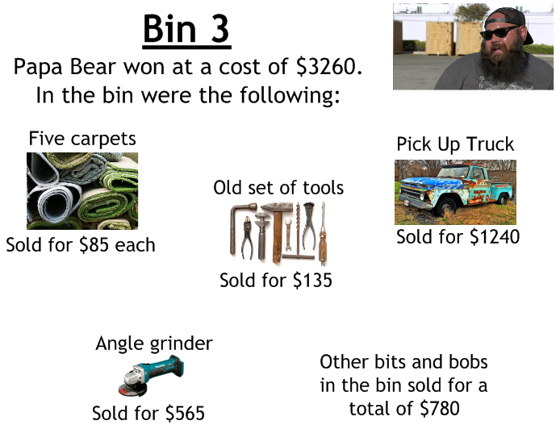
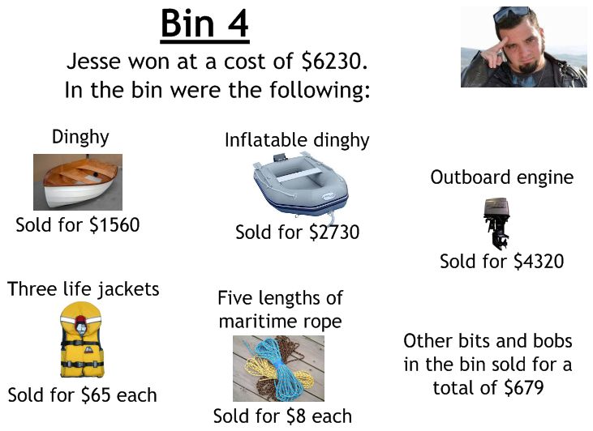

Slide 2
ANSWERS

Slide 3
Bin 1 Answer:
Total received: $4685
Profit: $385 (9%)
Bin 2 Answer:
Total received: $9225
Profit: $3525 (62%)

Slide 4
Bin 3 Answer:
Total received: $3145
Loss: $115 (4%)
Bin 4 Answer:
Total received: $9524
Profit: $3294 (53%)

