Slide 1
LO: Length of an Arc

Slide 2
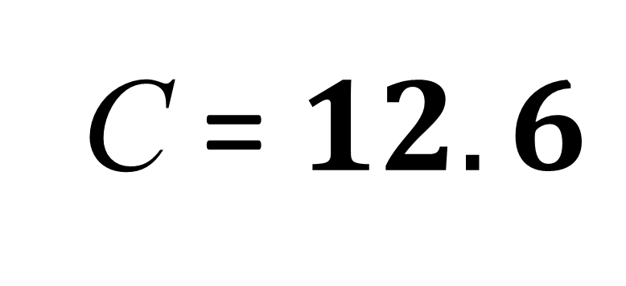
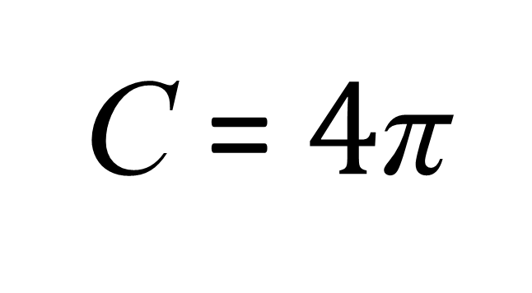
What is the circumference of the circle?
Give your answer to 1 d.p.
C = πd
4cm
C = $4\text{π}$
C = $12.6$

Slide 3
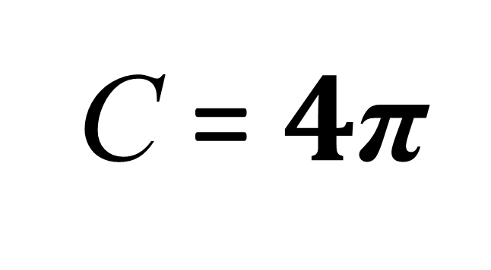
What is the circumference of the circle?
Give your answer in terms of π.
C = πd
4cm
C = $4\text{π}$

Slide 4
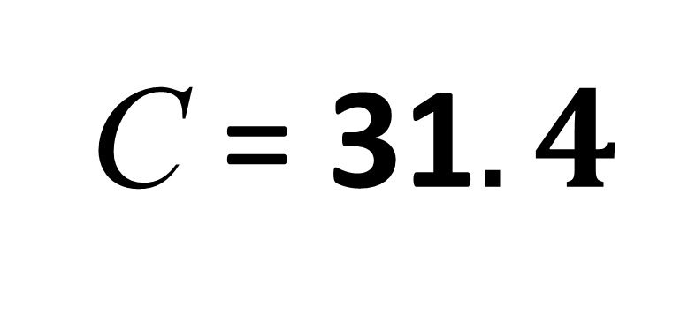
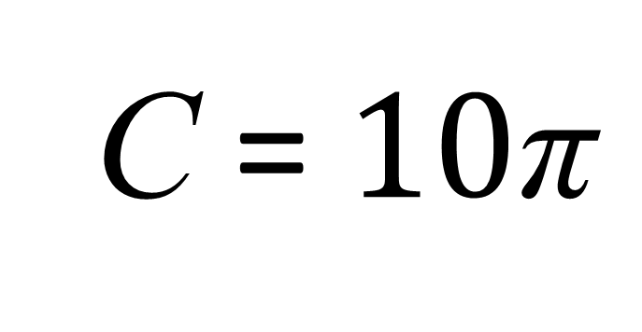
What is the circumference of the circle?
Give your answer to 1 d.p.
C = πd
5cm
C = $10\text{π}$
C = 31$.4$

Slide 5
What is the circumference of the circle?
Give your answer in terms of π.
C = πd
5cm
C = $10\text{π}$

Slide 6
The length of an arc is a fraction of the circumference .
circumference

Slide 7
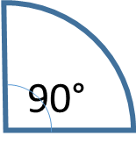
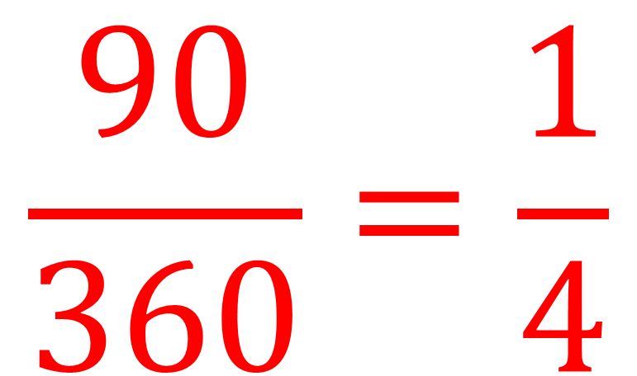
What is the fraction of the circle?
$$\frac{90}{360}=\frac{1}{4}$$

Slide 8
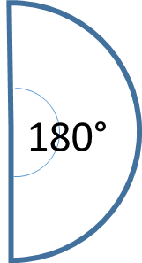
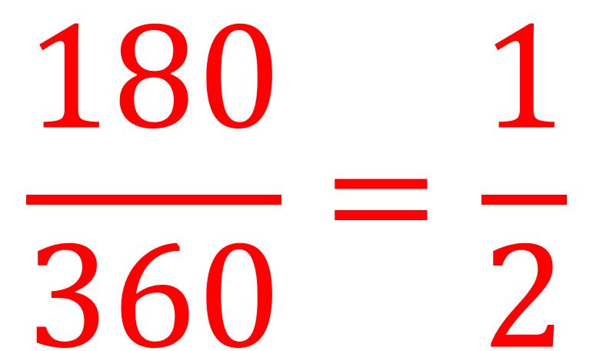
What is the fraction of the circle?
$$\frac{180}{360}=\frac{1}{2}$$

Slide 9
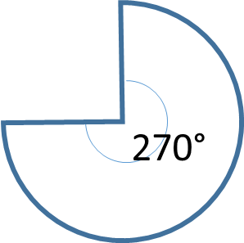
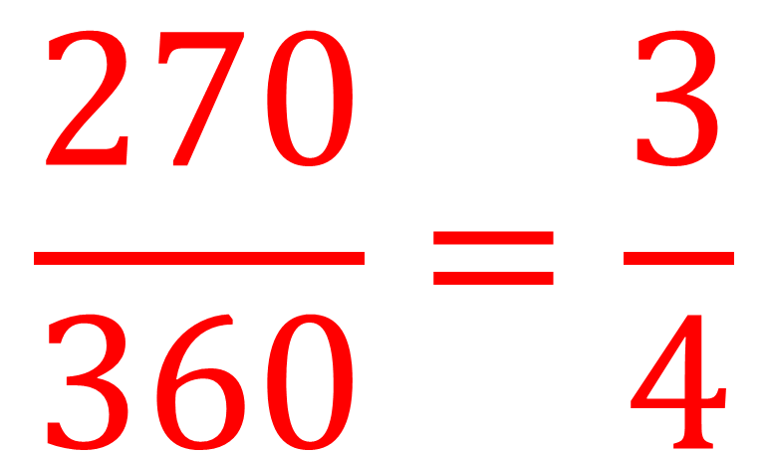
What is the fraction of the circle?
$$\frac{270}{360}=\frac{3}{4}$$

Slide 10
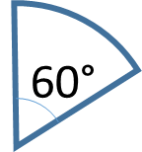
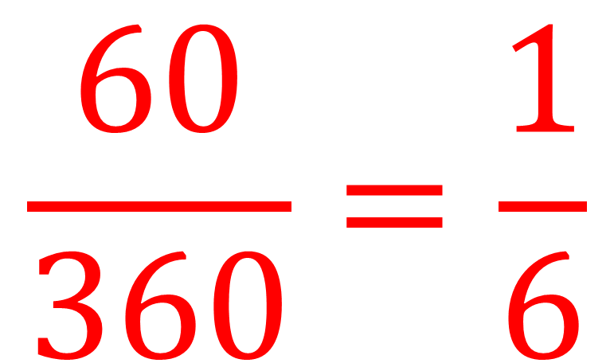
What is the fraction of the circle?
$$\frac{60}{360}=\frac{1}{6}$$

Slide 11
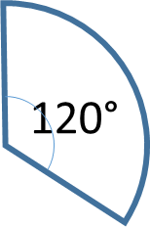
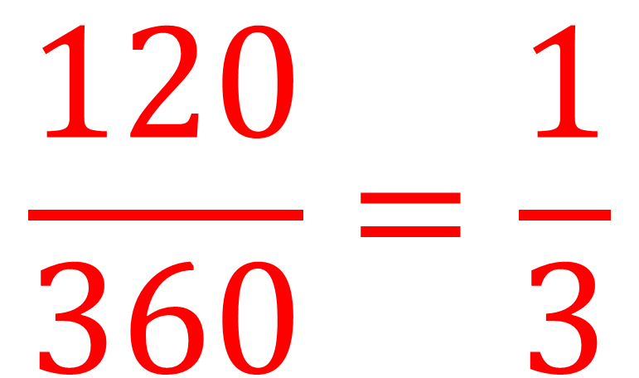
What is the fraction of the circle?
$$\frac{120}{360}=\frac{1}{3}$$

Slide 12
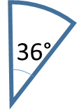
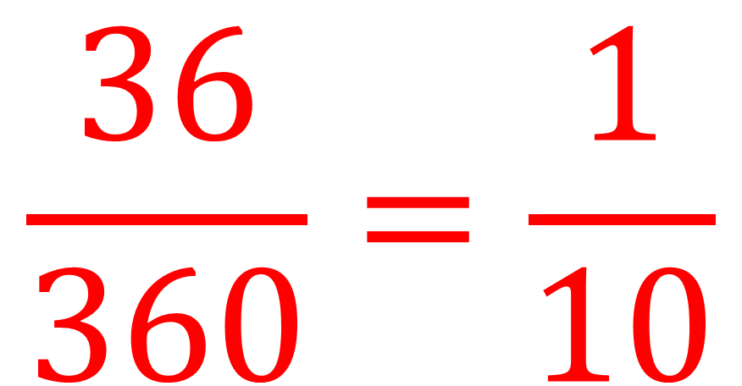
What is the fraction of the circle?
$$\frac{36}{360}=\frac{1}{10}$$

Slide 13

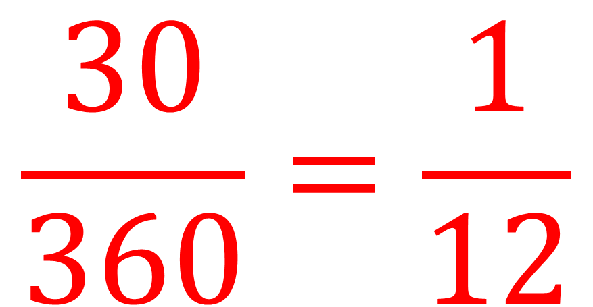
What is the fraction of the circle?
$$\frac{30}{360}=\frac{1}{12}$$

Slide 14

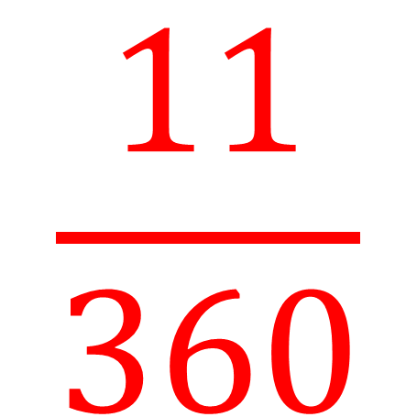
What is the fraction of the circle?
$$\frac{11}{360}$$
11°

Slide 15
What is the formula of calculating circumference?
C = πd

Slide 16
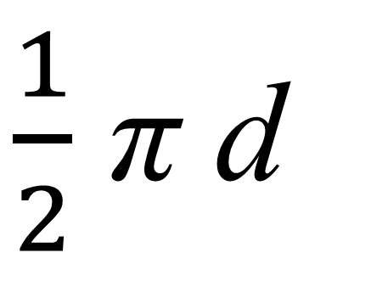
πd
180°
$\frac{1}{2}$ π d
Arc =

Slide 17
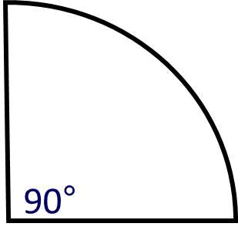
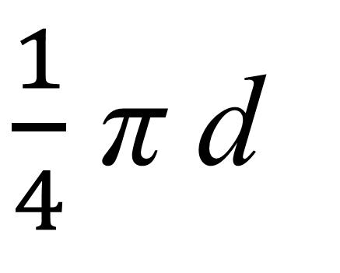
πd
$\frac{1}{4}$ π d
Arc =

Slide 18
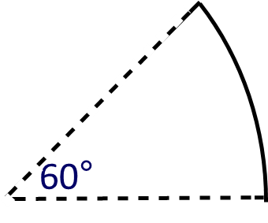
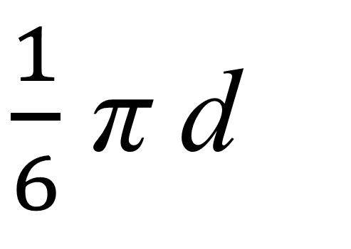
πd
$\frac{1}{6}$ π d
Arc =

Slide 19
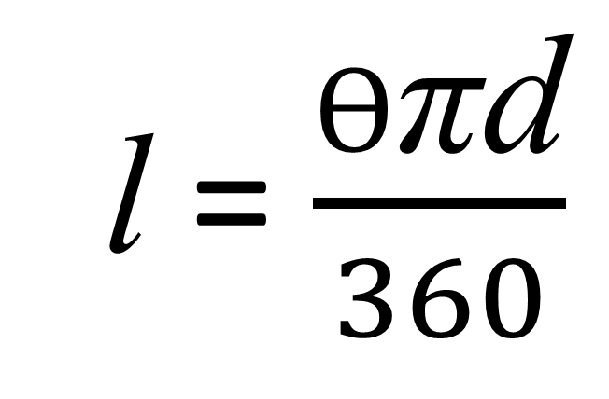
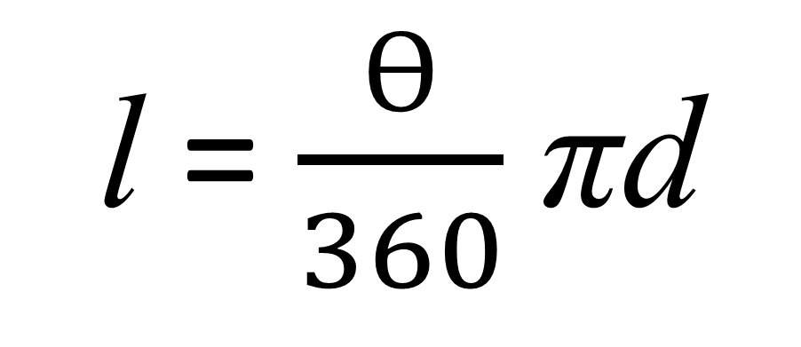
Write a formula for calculating the length of an arc.
l
l = $\frac{Ө}{360}$πd
r
θ
l = $\frac{Ө\text{π}\text{d}}{360}$

Slide 20
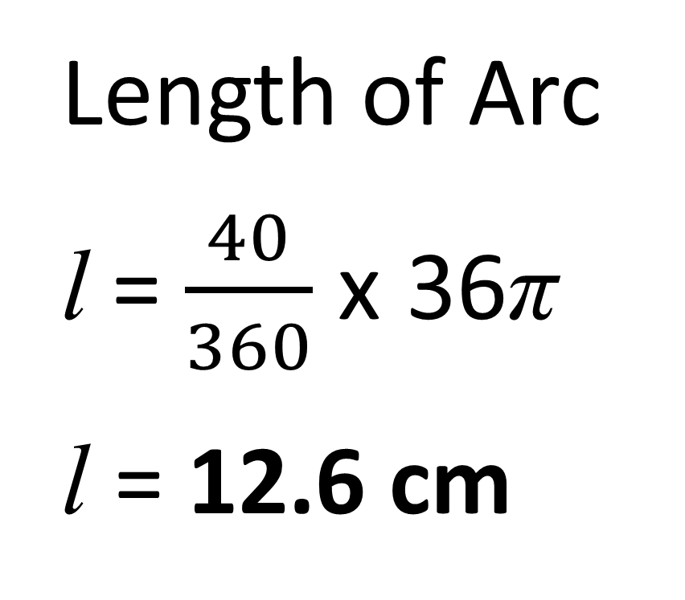
What is the length of the Arc?
Length of Arc
l = $\frac{40}{360}$ x 36π
l = 12.6 cm
18 cm
40°

Slide 21

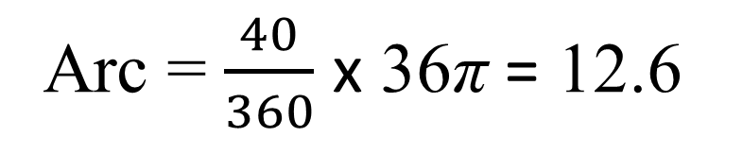
Find the perimeter of the shape.
(Give your answer to 1 d.p.)
Arc = $\frac{40}{360}$ x 36π = 12.6
18 cm
Radius = 18
40°
Radius = 18
Perimeter = 48.6 cm

Slide 22
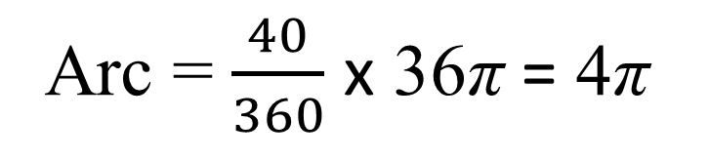
Find the perimeter of the shape.
Give you answer in terms of π
Arc = $\frac{40}{360}$ x 36π = 4π
18 cm
Radius = 18
40°
Radius = 18
Perimeter = 4π + 36

Slide 23
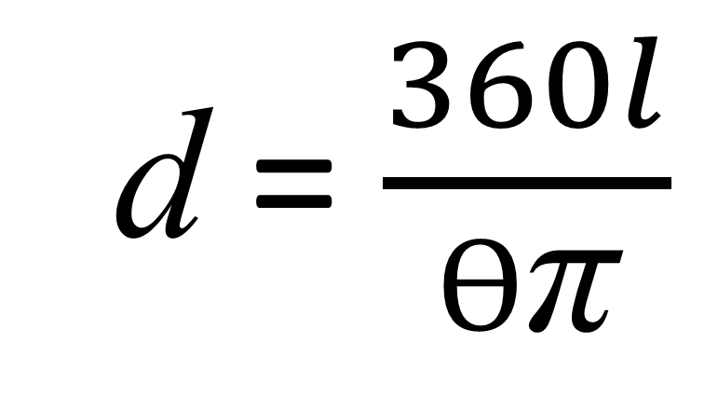
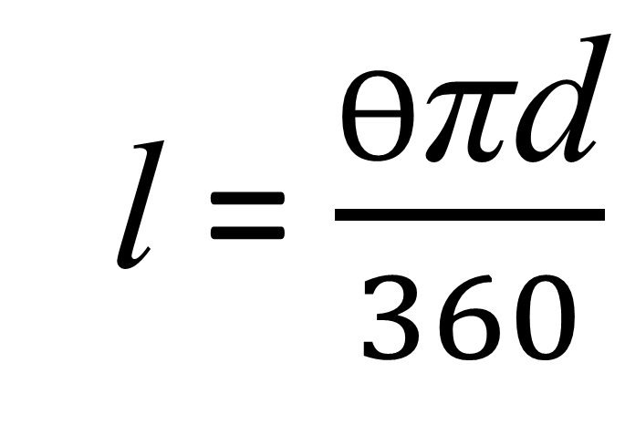
Rearrange the formula to make d the subject.
l = $\frac{Ө\text{π}\text{d}}{360}$
d = $\frac{360l}{Ө\text{π}}$

Slide 24
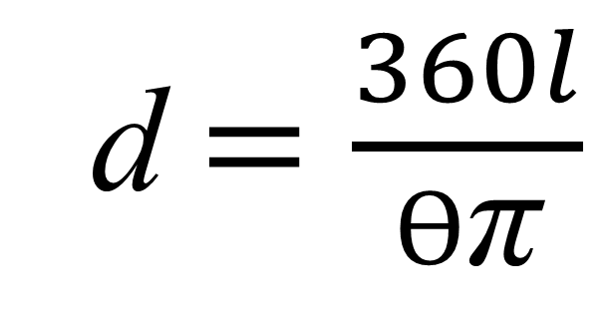
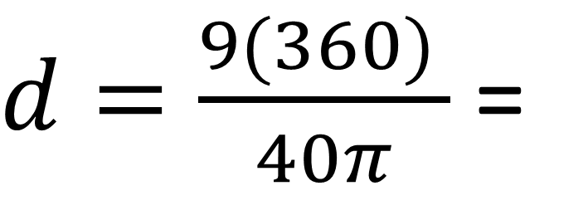
What is the diameter of the sector?
Give your answer to 1dp
d $=\frac{360l}{Ө\text{π}}$
9 cm
40°
$d=\frac{9(360) }{40π}$ =
25.7cm

