Slide 1
LO: Bounds and Calculations

Slide 2
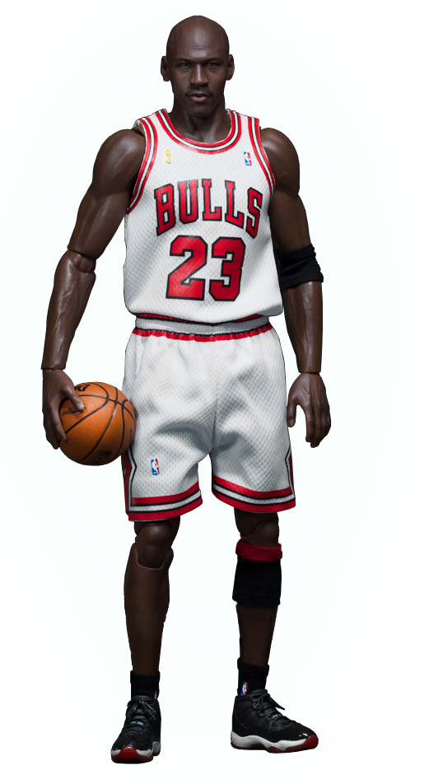
What is the upper and lower bounds of Michael Jordan's height?
Upper =
198.5
198 cm
to nearest cm
Lower =
197.5

Slide 3
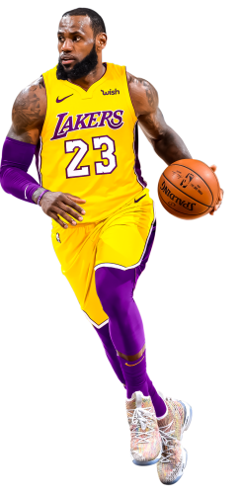
What is the upper and lower bounds of LeBron James height?
Upper =
2.165
2.16 m
to 2 decimal place
Lower =
2.155

Slide 4
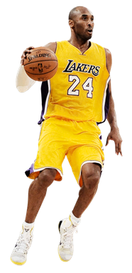
What is the upper and lower bounds of Kobe Byrant height?
Upper =
2.05
2.0 metres
to 2 significant level
Lower =
1.95

Slide 5
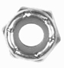
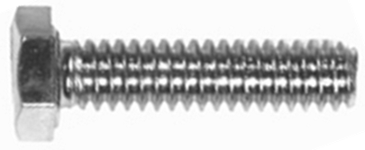
It is very important to take into consideration
lower and upper bounds when performing calculations.
In industry this could be the difference form
your product working or being useless!

Slide 6
 | Lower Bound (LB) | Upper Bound (UB)
A
B
A = 3.1 to nearest 1dp
B = 2 to nearest whole number
3.05
3.15
1.5
2.5
Possible calculations |  |  | Answer?
A |  | B
UB | + | UB
UB | + | LB
LB | + | UB
LB | + | LB
What combination gives you the biggest?
UB | + | UB
5.65
4.65
What combination gives you the smallest?
5.55
LB | + | LB
4.55

Slide 7
 | Lower Bound (LB) | Upper Bound (UB)
A
B
A = 50 to nearest 10
B = 2 to nearest whole number
45
55
1.5
2.5
Possible calculations |  |  | Answer?
A |  | B
UB | - | UB
UB | - | LB
LB | - | UB
LB | - | LB
What combination gives you the biggest?
UB | - | LB
52.5
What combination gives you the smallest?
53.5
42.5
LB | - | UB
43.5

Slide 8
 | Lower Bound (LB) | Upper Bound (UB)
A
B
A = 30 to nearest 10
B = 27 to nearest whole number
25
35
26.5
27.5
Possible calculations |  |  | Answer?
A |  | B
UB | X | UB
UB | X | LB
LB | X | UB
LB | X | LB
What combination gives you the biggest?
UB | x | UB
962.5
927.5
What combination gives you the smallest?
687.5
LB | x | LB
662.5

Slide 9
 | Lower Bound (LB) | Upper Bound (UB)
A
B
A = 50 to nearest 10
B = 11 to nearest whole number
45
55
10.5
11.5
Possible calculations |  |  | Answer?
A |  | B
UB | ÷ | UB
UB | ÷ | LB
LB | ÷ | UB
LB | ÷ | LB
What combination gives you the biggest?
UB | ÷ | LB
4.78
5.24
What combination gives you the smallest?
3.91
LB | ÷ | UB
4.29

Slide 10
t = 33 and k = 49
are rounded to the nearest whole number.
What is the lower bound for t + k ?
32.5 + 48.5 = 81

Slide 11
n = 2.2 and c = 1.6
are round to 1 decimal place.
What is the upper bound for n – c ?
2.25 – 1.55 = 0.7

Slide 12
h = 2.1 and f = 5.4
are round to 1 decimal place.
What is the lower bound for h x f ?
2.05 x 5.35 = 10.9675

Slide 13
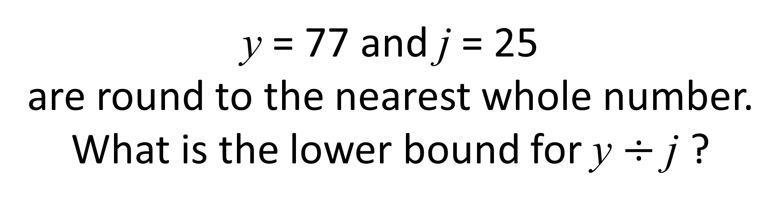
y = 77 and j = 25
are round to the nearest whole number.
What is the lower bound for y $÷$ j ?
76.5 ÷ 25.5 = 3

Slide 14
What is the upper bound
for the perimeter of the shape?
3.05
4.5
5.5
13.05
5cm (to 1 sf)
3.0cm (to 1 dp)
4cm
(nearest whole number)

Slide 15
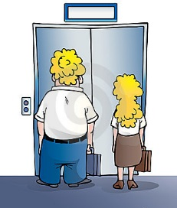
A elevator must not exceed 161kg.
All measurement have been taken
to the nearest kg.
Are they safe to get on the elevator?
60kg
No it is not safe!
Upper = 100.5
Upper = 60.5
Upper Total = 161kg
Lower Lift = 160.5
100kg

Slide 16
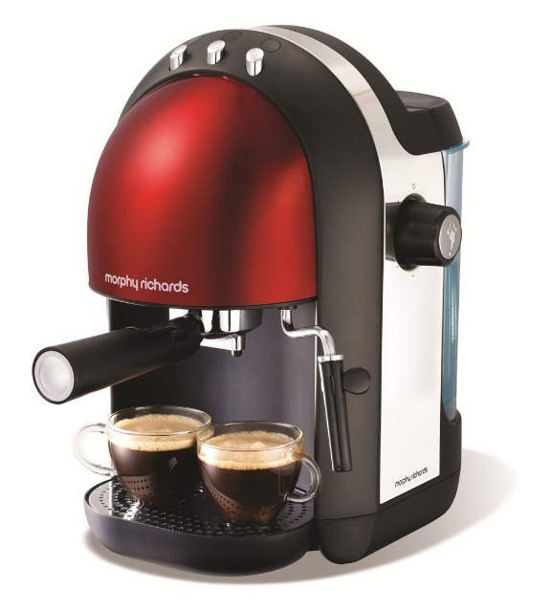


A coffee machine dispenses 130 millilitres of black coffee
into cups with a capacity of 175 millilitres.
These values are accurate to 3 significant figures.
Milk is supplied in small cartons which contain 21 millilitres,
accurate to the nearest millilitre.
Beryl likes milky coffee and always puts 2 cartons of milk in her coffee.
Will Beryl’s cup ever overflow?
No
Coffee (Upper) = 130.5
Milk (Upper) = 21.5 + 21.5 = 43
Cup (Lower) = 174.5

Slide 17
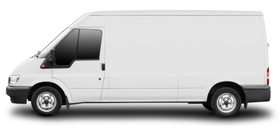

Peter transports metal bars in his van.
For safety reasons Peter assumes that:
1200 is rounded correct to 2 significant figures
60 is rounded correct to 1 significant figure.
What is the greatest number of bars
that Peter can safely put into the van?
Van (Lower) = 1150kg
Brick (Upper) = 65
1150 ÷ 65 = 17.6923…
17 is the greatest number of bars

