Slide 1
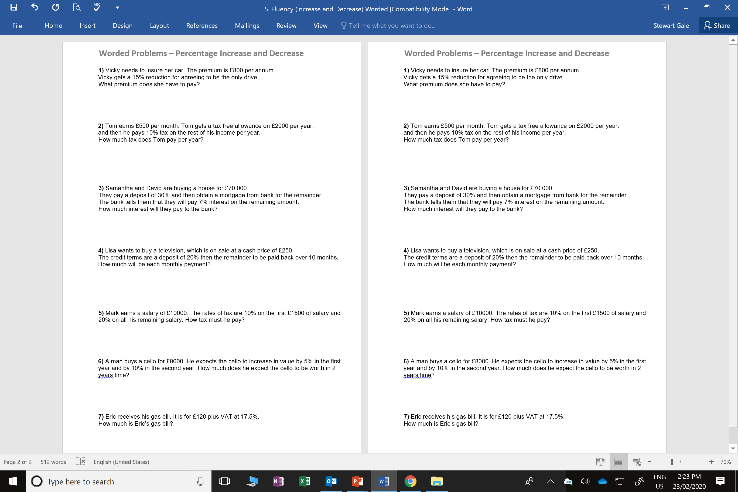

Slide 2
ANSWERS

Slide 3
150 + 1700 = 1850
800 – 120 = £680
8000 + 400 + 840 = 9240
6000 – 2000 = 4000
10% = 400
120 + 21 = 141
70000 – 21000 = 49000
7% = 3430
250 – 50 = 200
200 ÷ 10 = £20

