Slide 1
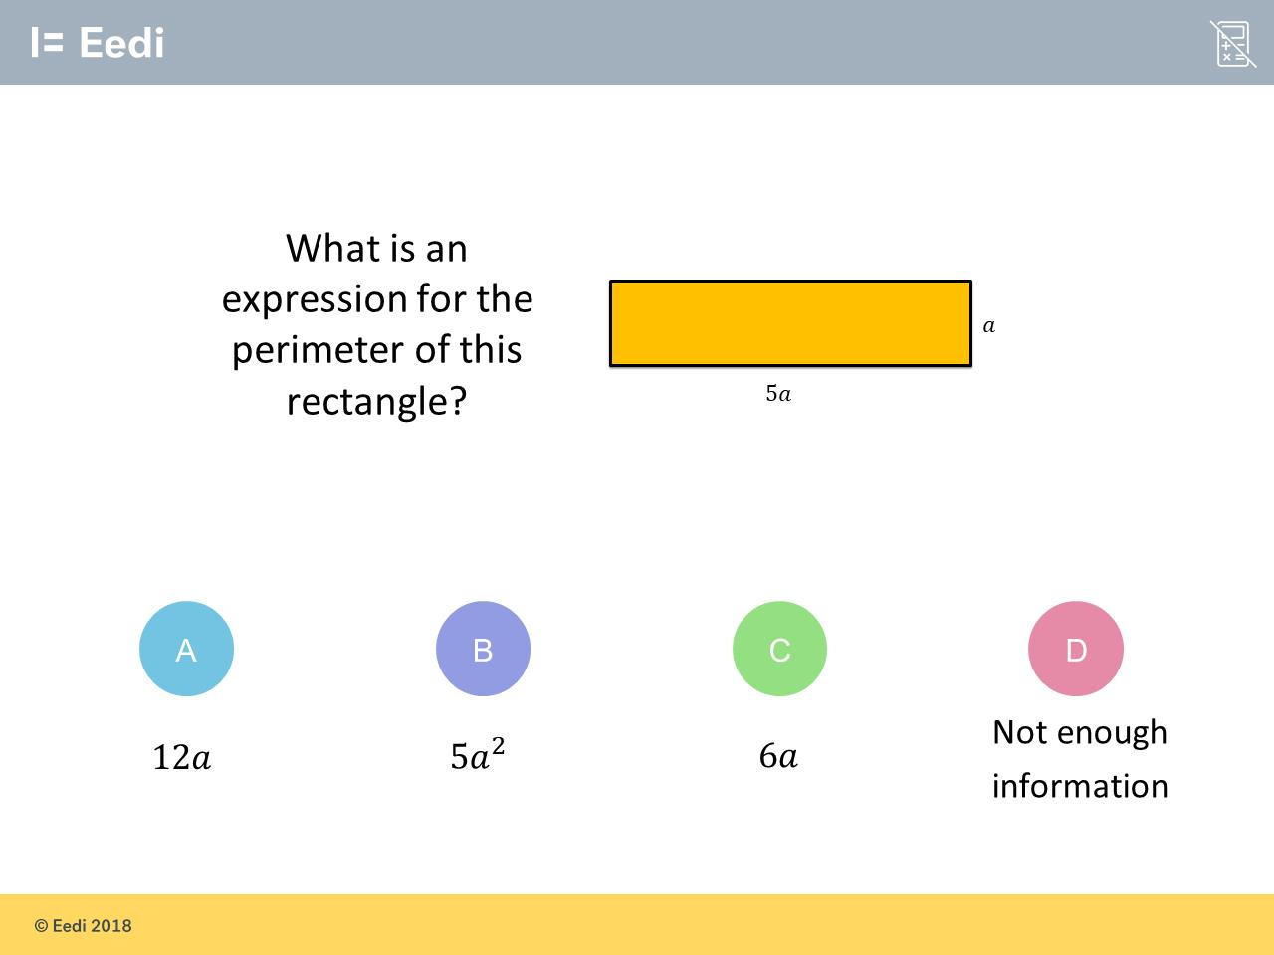
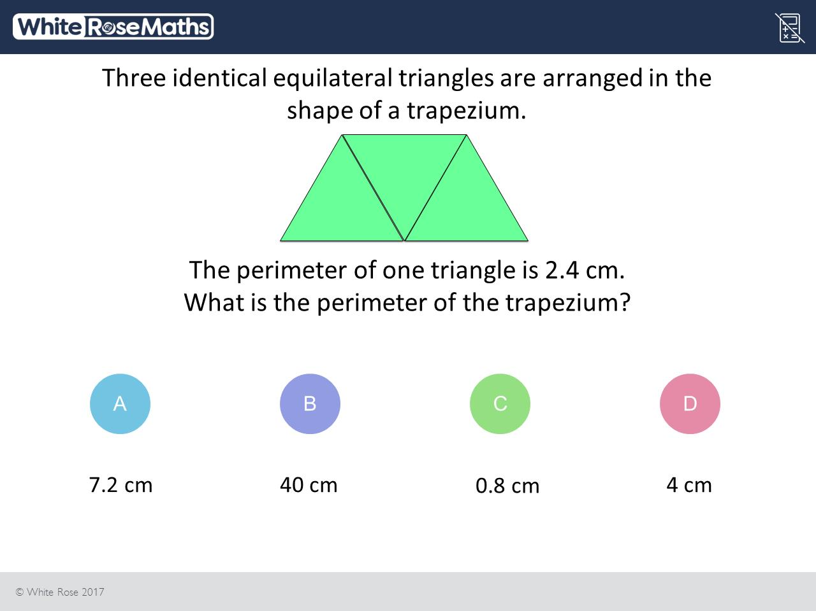
Worst answered question?
Most common wrong answer?

Slide 2
ANSWERS

Slide 3
Worst answered question?

Slide 4
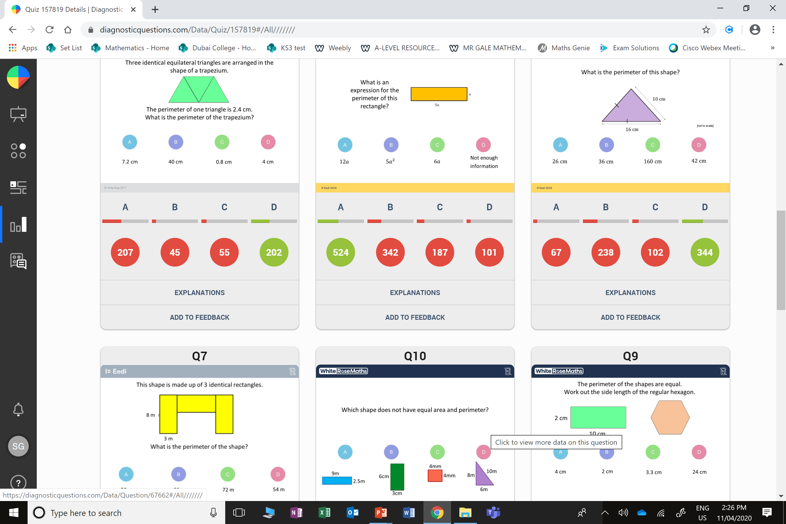
A
The student has multiplied
one triangle by 3, without considering that some sides
aren't visible.

Slide 5
B
They have found the area and not the perimeter.

