Slide 1
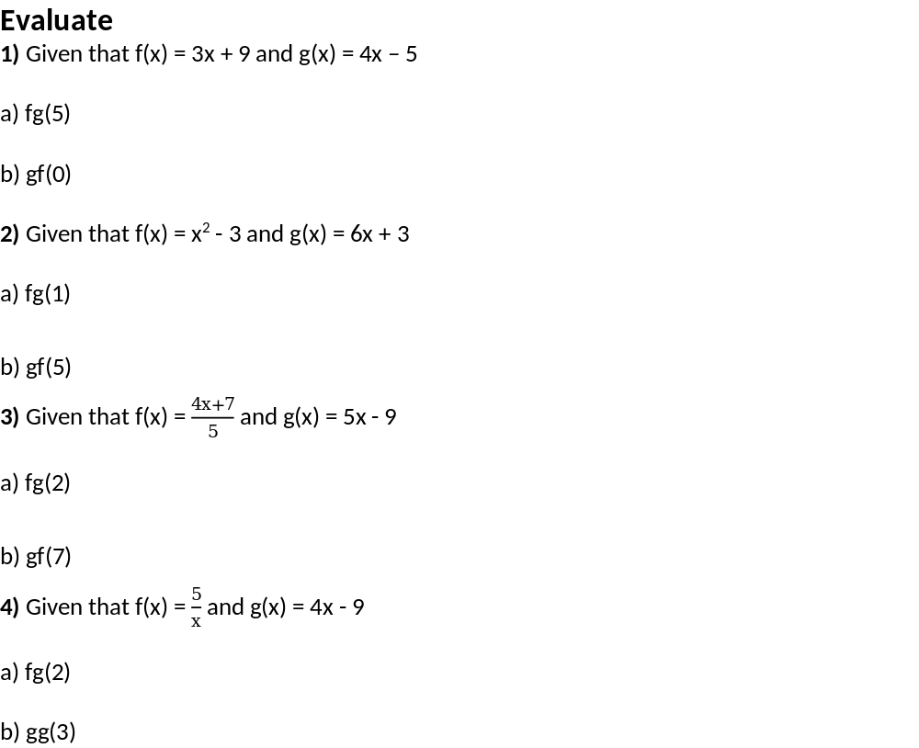
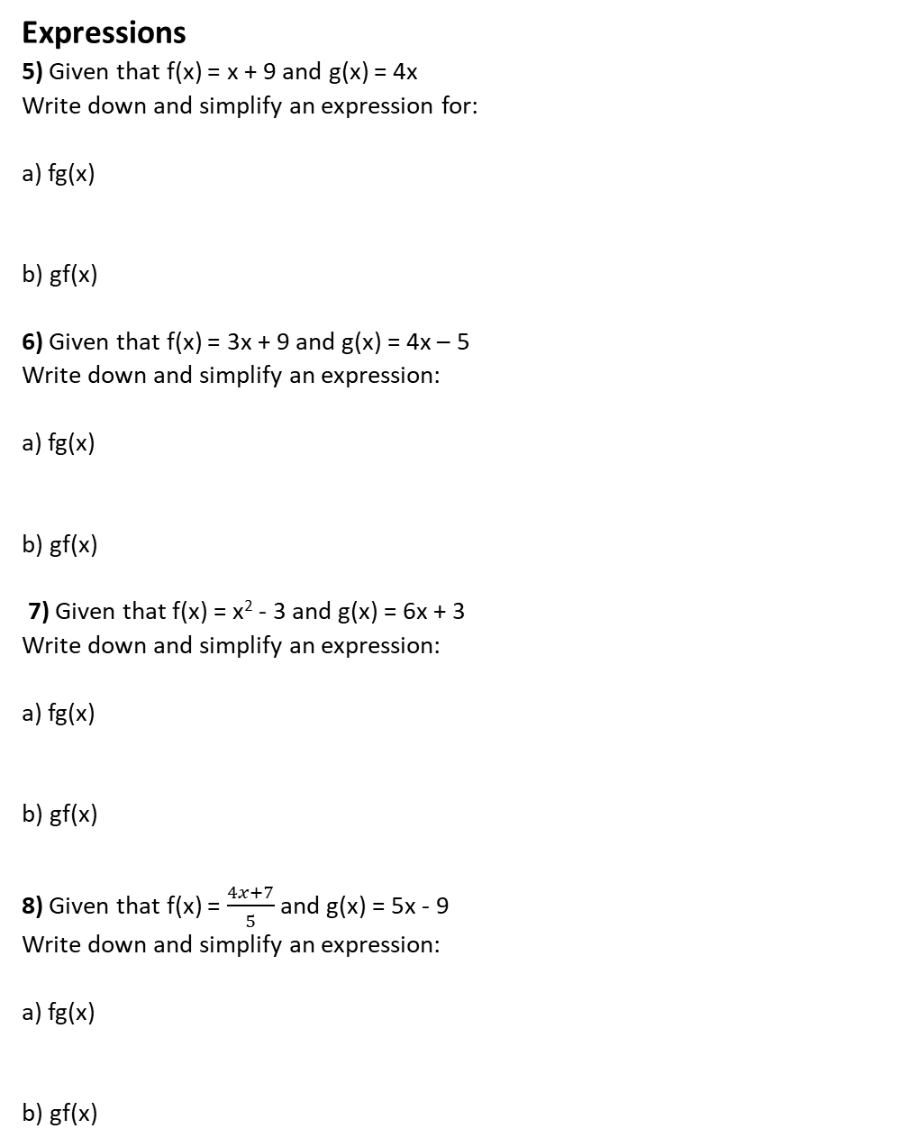
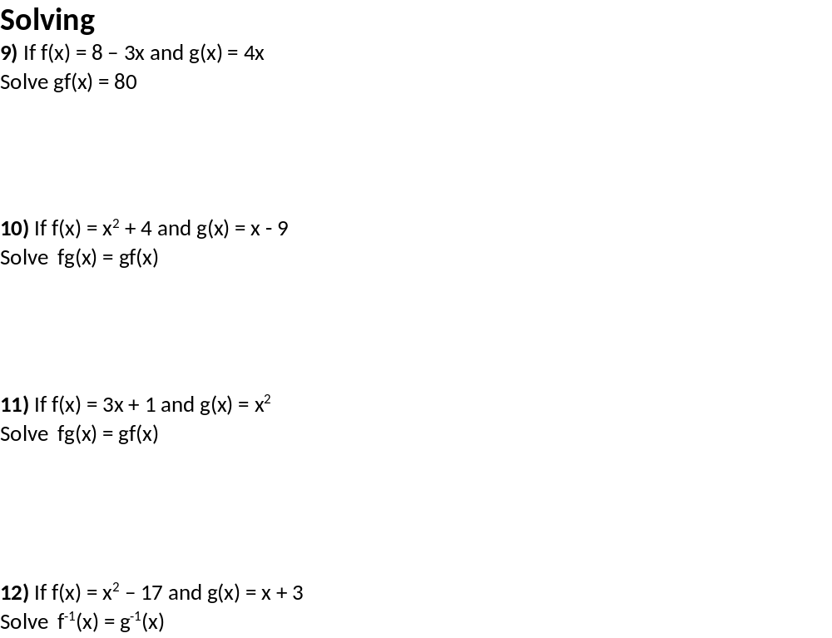

Slide 2
ANSWERS

Slide 3
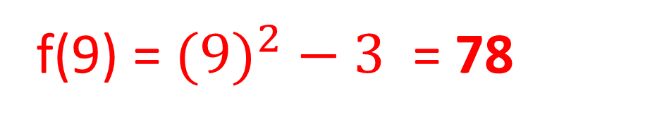
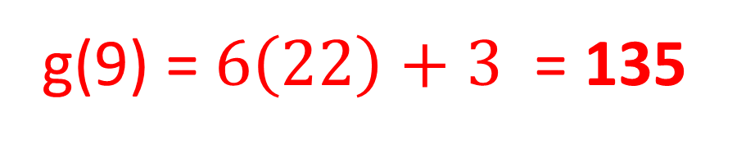
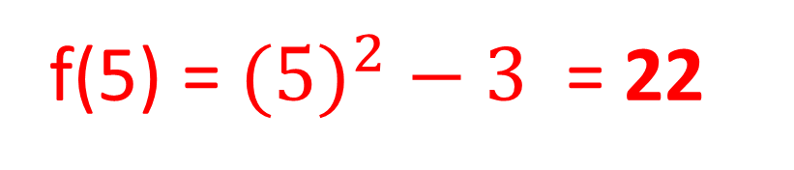
g(5) = 4(5) – 5 = 15
f(15) = (15) + 9 = 543
f(0) = 3(0) + 9 = 9
g(9) = 4(9) – 5 = 31
g(1) = 6(1) + 3 = 9
f(9) = $({9)}^{2}−3$ = 78
f(5) = $({5)}^{2}−3$ = 22
g(9) = $6\left(22\right)+3$ = 135

Slide 4
g(2) = 5(2) – 9 = 1
f(1) = (4(1) + 7)/5 = 2.2
f(7) = (4(7) + 7)/5 = 7
g(7) = 5(7) – 9 = 26
g(2) = 4(2) – 9 = -1
f(-1) = 5/-1 = -5
g(3) = 4(3) – 9 = 3
g(3) = 4(3) – 9 = 3

Slide 5
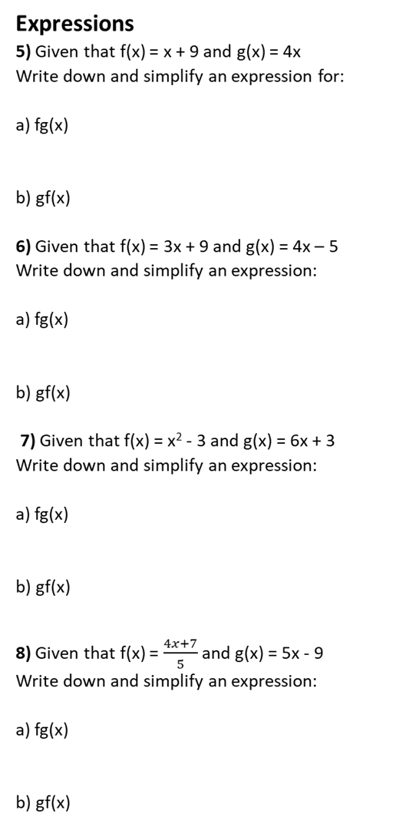
f(gx) = 4x + 9
g(fx) = 4(x + 9) = 4x + 36

Slide 6
f(gx) = 3(4x – 5) + 9
= 12x – 15 + 9 = 12x - 6
g(fx) = 4(3x + 9) – 5
= 12x + 36 – 5 = 12x + 31

Slide 7
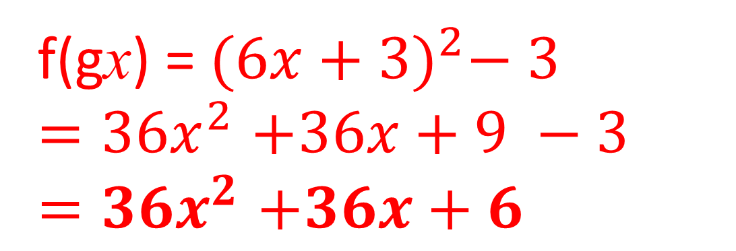
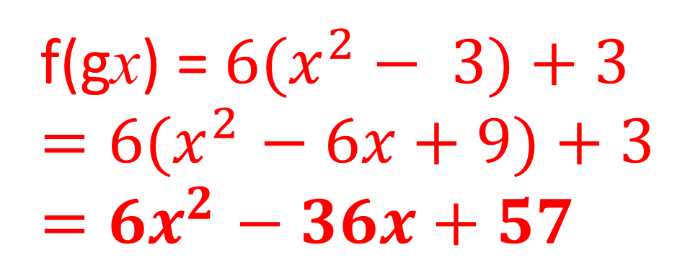
f(gx) = ${(6x+3)}^{2}− 3$
${=36x}^{2}+36x+9 −3$
$${=36x}^{2}+36x+6$$
f(gx) = ${6(x}^{2}− 3)+3$
${=6(x}^{2}− 6x+9)+3$
$${=6x}^{2}− 36x+57$$

Slide 8
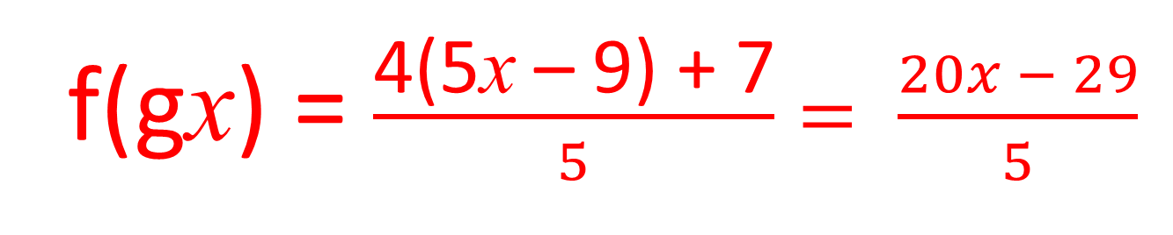
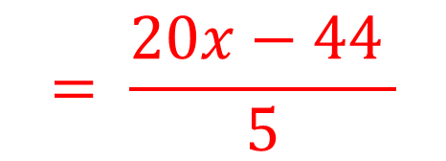
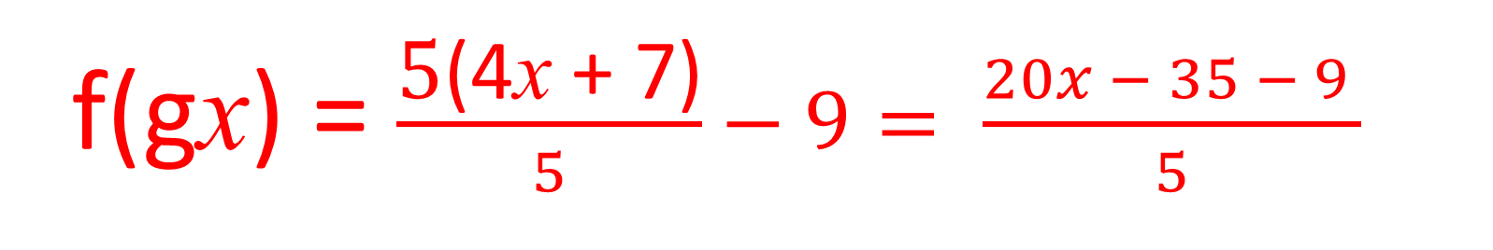
f(gx) = $\frac{\text{4(5}\text{x}\text{ – 9) + 7}}{5}= \frac{20x − 29}{5}$
f(gx) = $\frac{\text{5}\text{(}\text{4}\text{x} \text{+ 7}\text{)}}{5}−9= \frac{20x − 35 − 9 }{5}$
$$= \frac{20x−44 }{5}$$

Slide 9
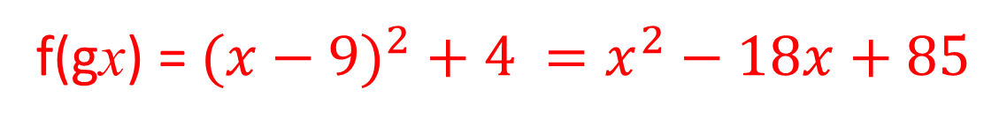
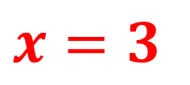
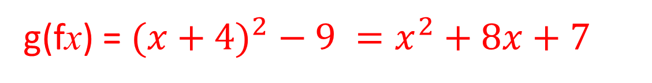
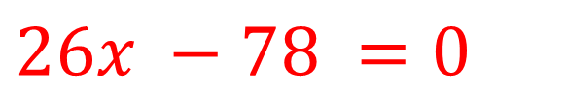
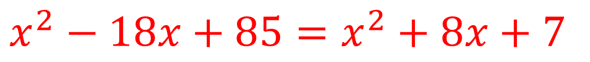
g(fx) = 4(8 – 3x) = 32 – 12x
32 – 12x = 80
x = – 4
f(gx) = ${(x−9)}^{2} + 4 =x^{2}−18x+85$
g(fx) = ${(x+4)}^{2} − 9 =x^{2}+8x+7$
$$x^{2}−18x+85=x^{2}+8x+7$$
$$26x −78 =0$$
$$x=3$$

Slide 10

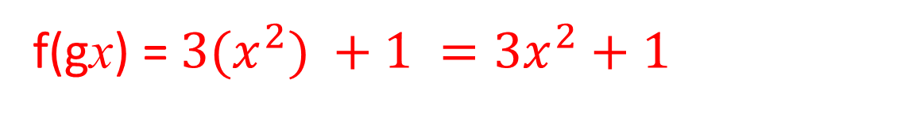
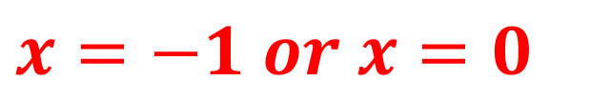

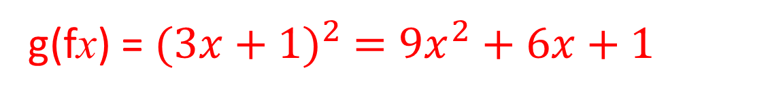

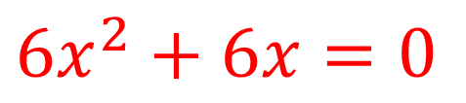

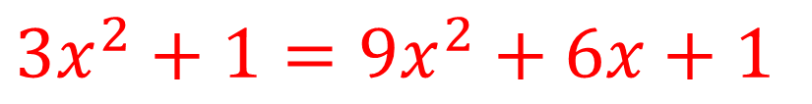

f(gx) = ${3(x}^{2}) +1 ={3x}^{2}+1$
g(fx) = ${(3x+1)}^{2} ={9x}^{2}+6x+1$
$${3x}^{2}+1={9x}^{2}+6x+1$$
$${6x}^{2}+6x=0$$
$$x=−1 or x=0$$
$$x+17=x −3$$
$$\sqrt{x+17}={\left(x−3\right)}^{2}$$
$$x+17=x^{2} −6x+9$$
$$0=x^{2} −7x−8$$
$$x=8 or x=−1$$

