Slide 1
LO: Exponential Graphs

Slide 2

Can you describe what an
exponential graph looks like?

Slide 3
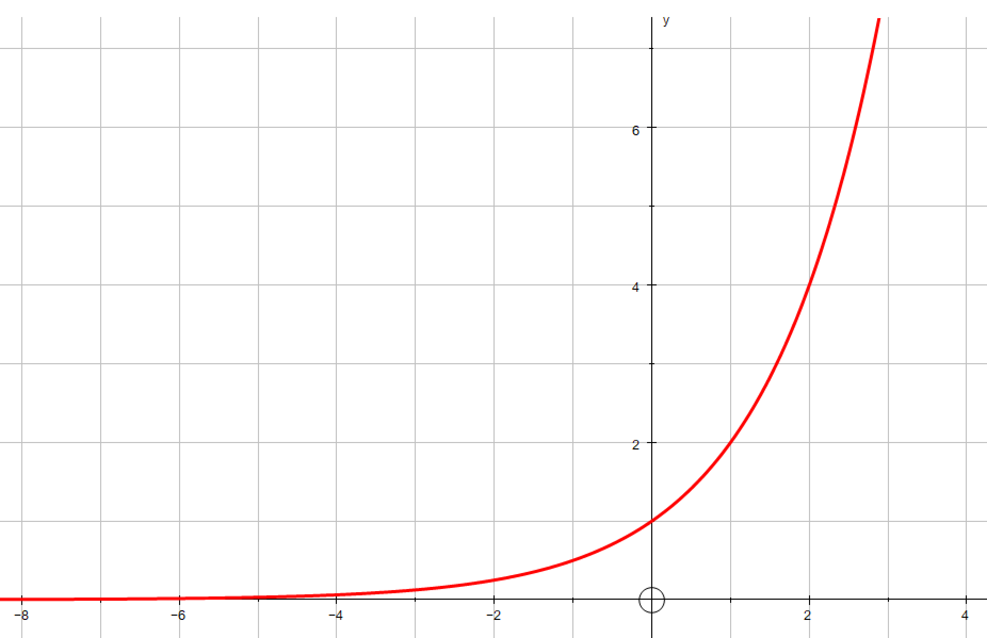

Exponential Graph or Not

Slide 4


Exponential Graph or Not

Slide 5
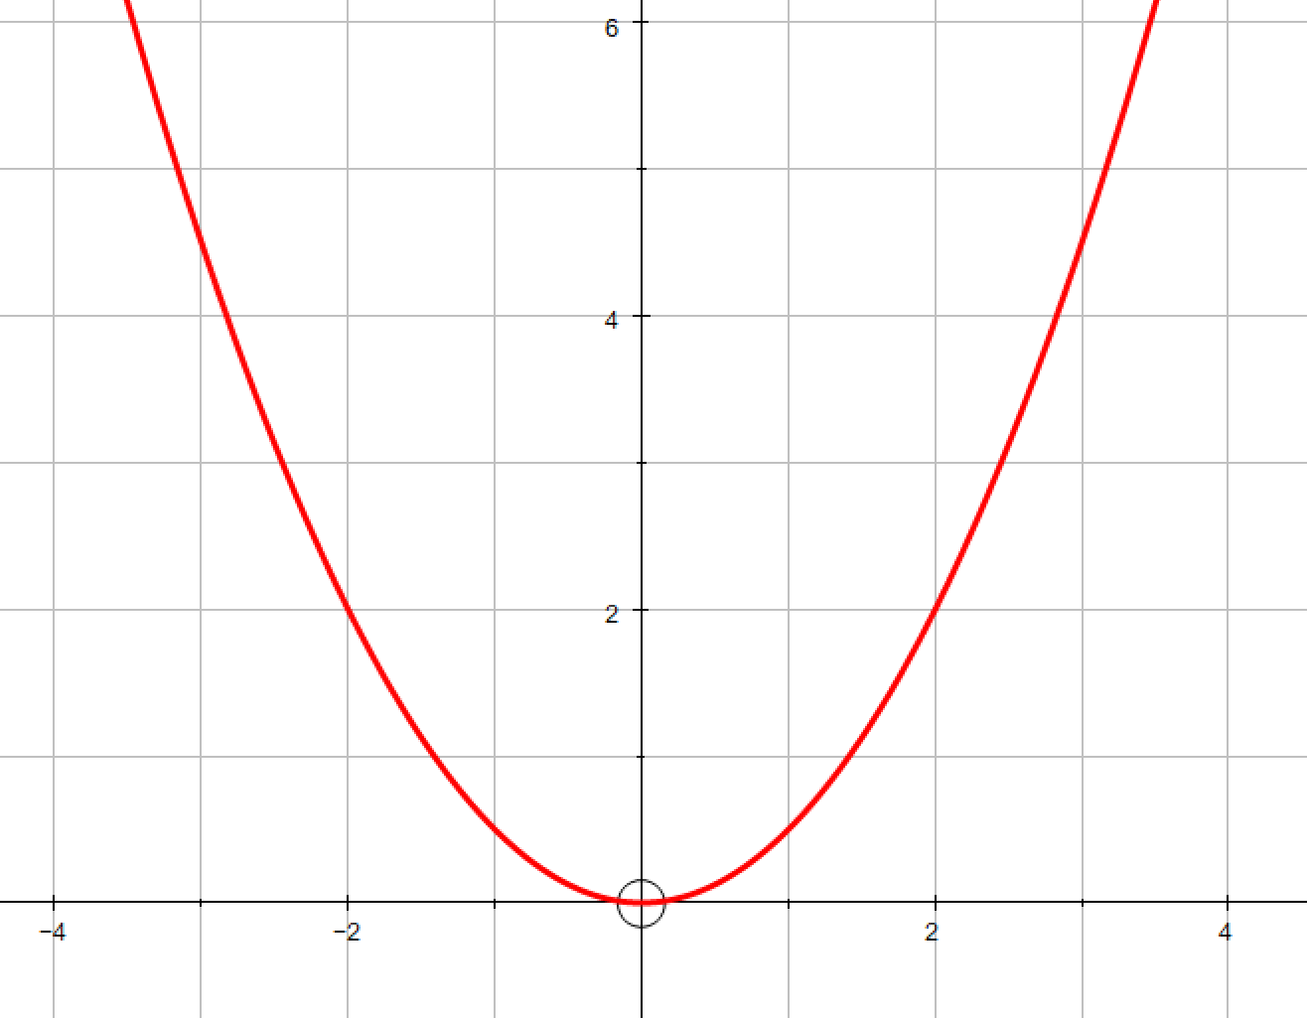
Exponential Graph or Not

Slide 6
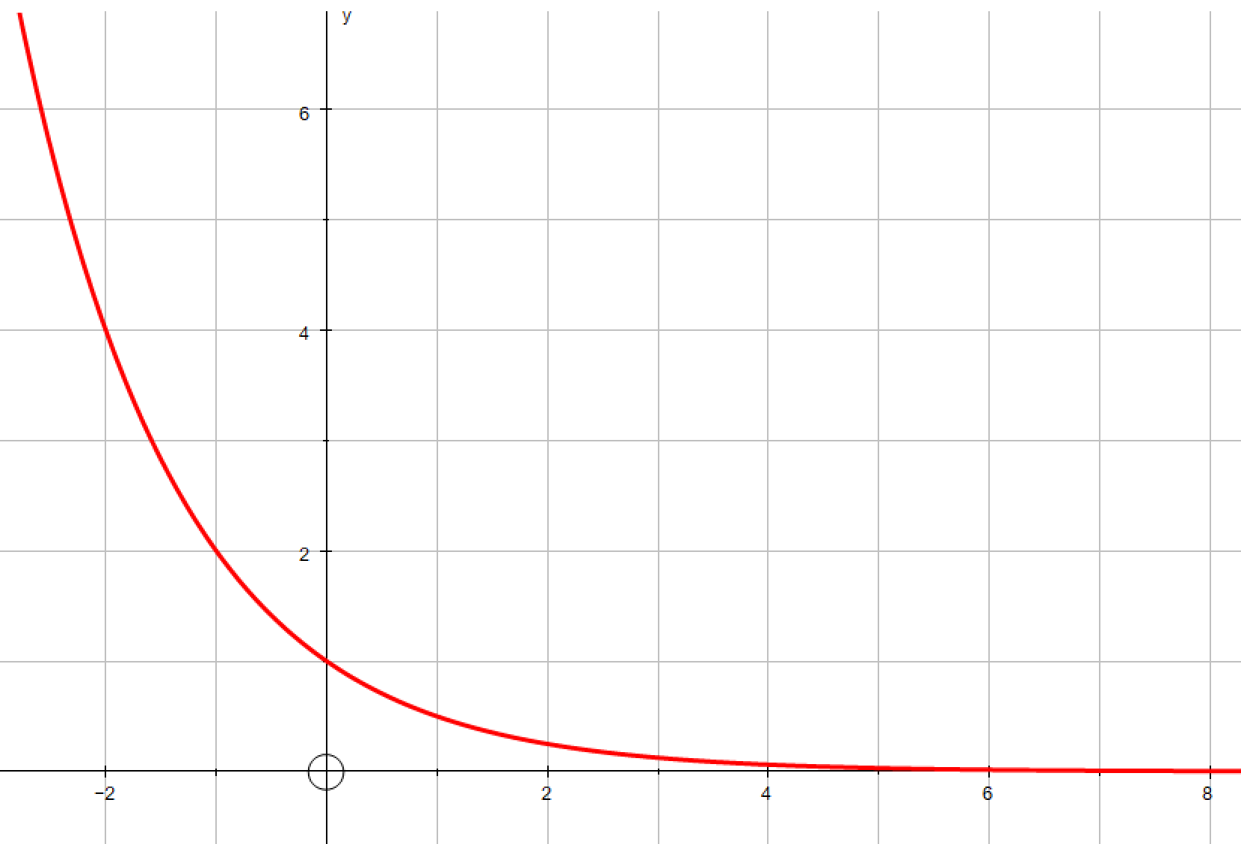
Exponential Graph or Not

Slide 7
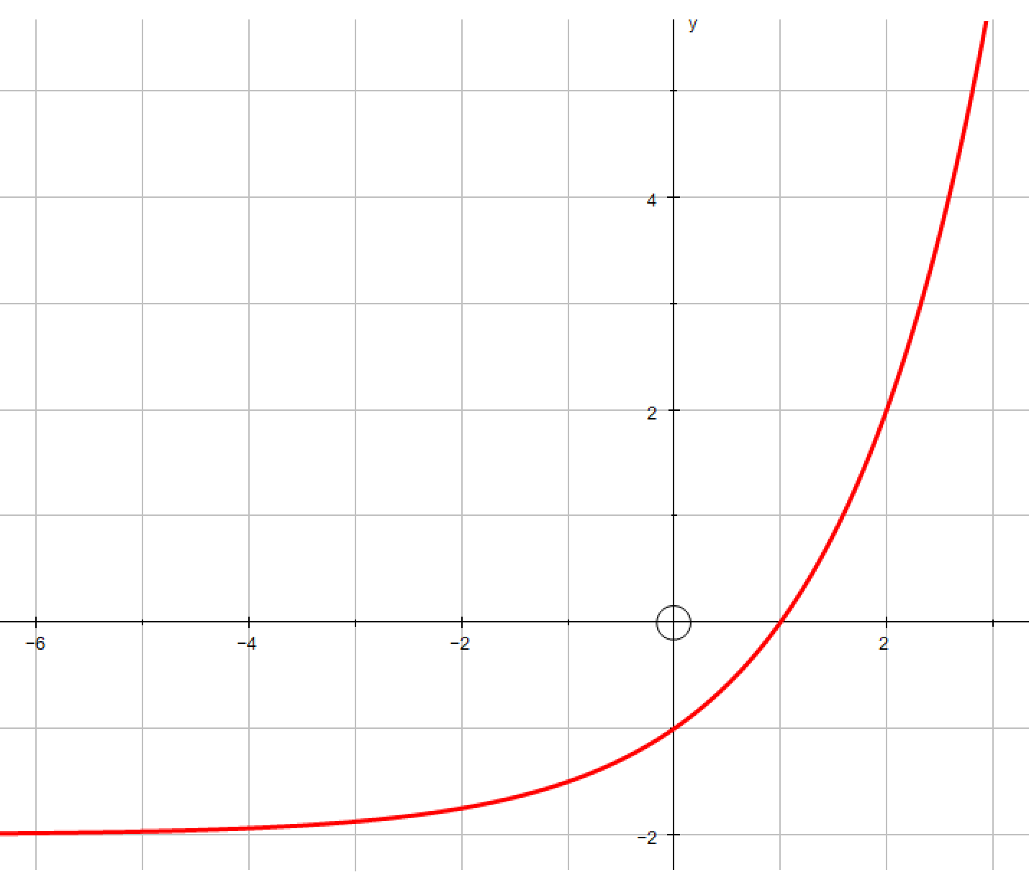
Exponential Graph or Not

Slide 8
Exponential Equation or Not
y = 3^{x}

Slide 9
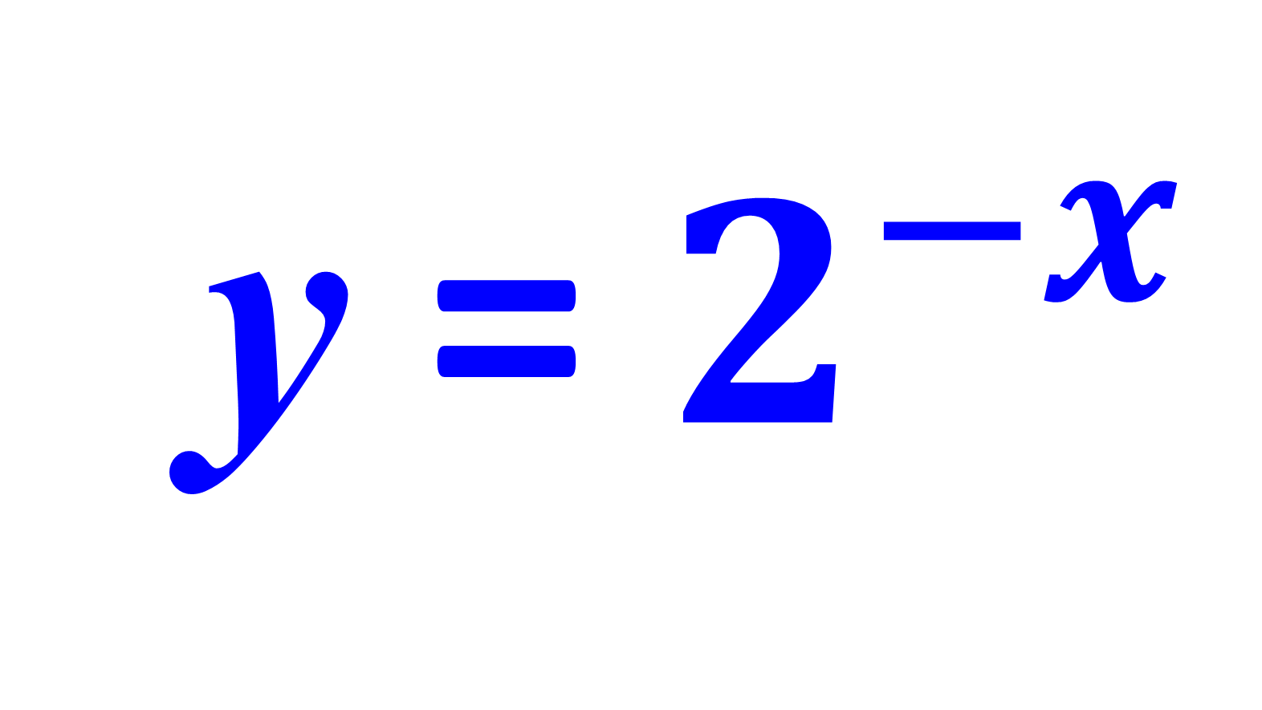
Exponential Equation or Not
y = $2^{−x}$

Slide 10
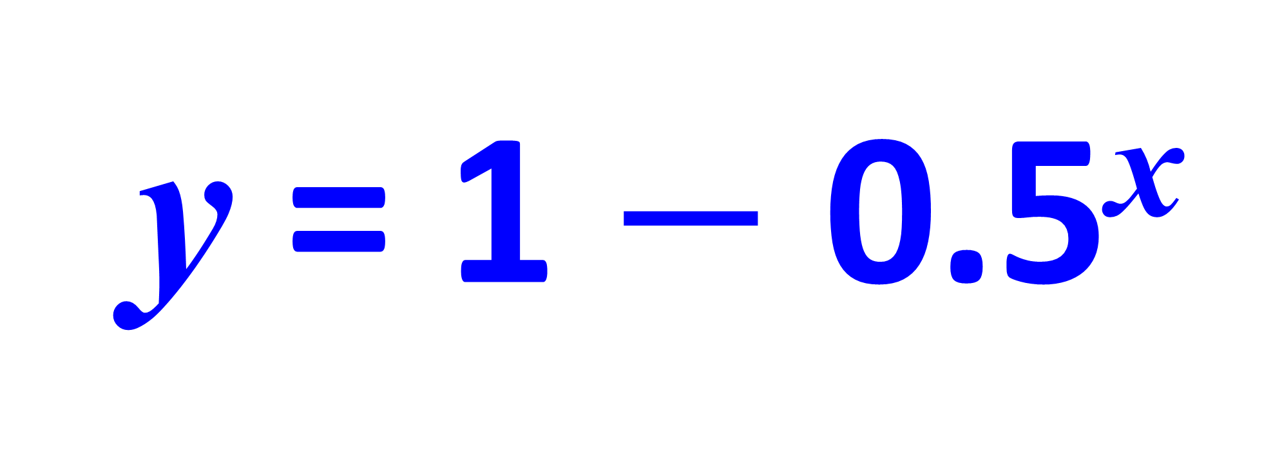
Exponential Equation or Not
y = 1 $−$ 0.5^{x}

Slide 11
Exponential Equation or Not
y = x²

Slide 12
Exponential Equation or Not
y = a^{x}

Slide 13
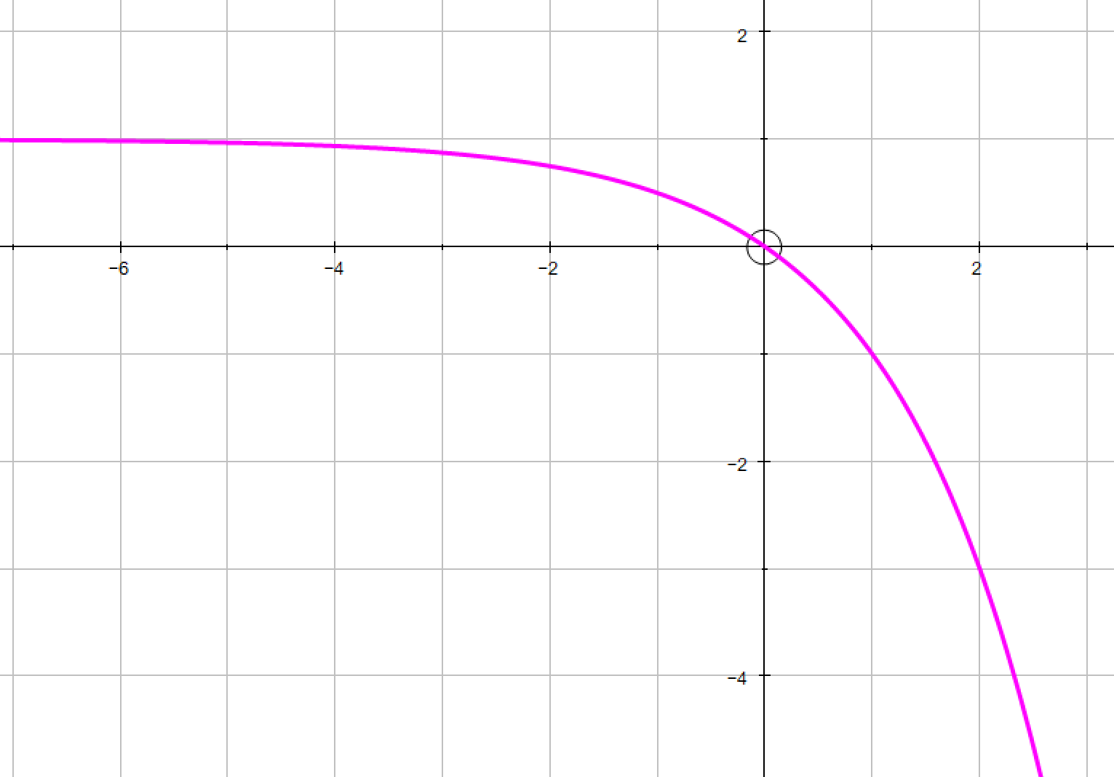
Growth or Decay
Decay

Slide 14
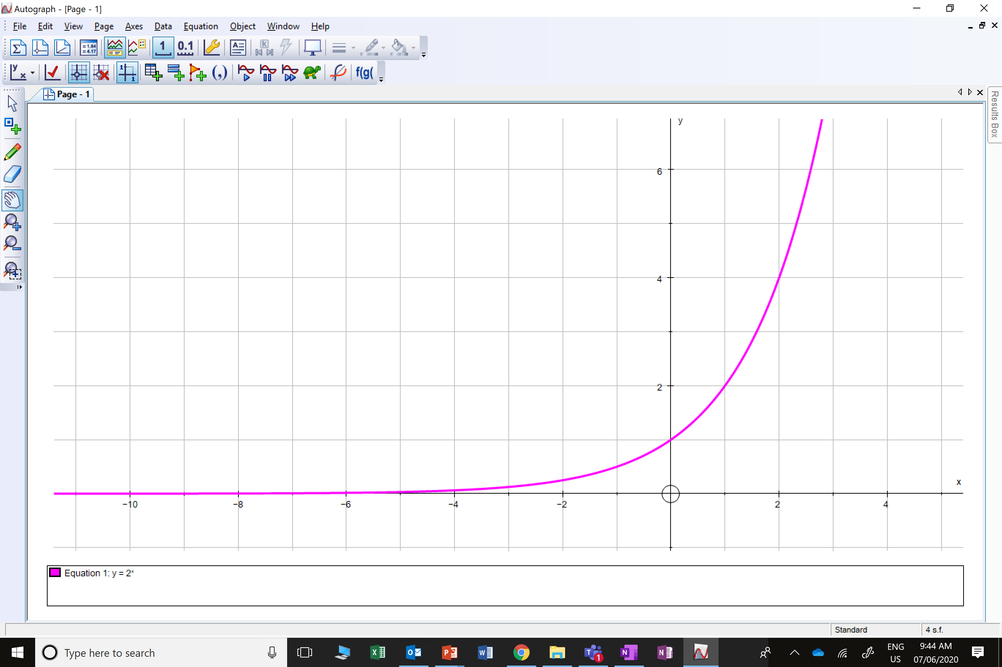
Growth or Decay
Growth

Slide 15
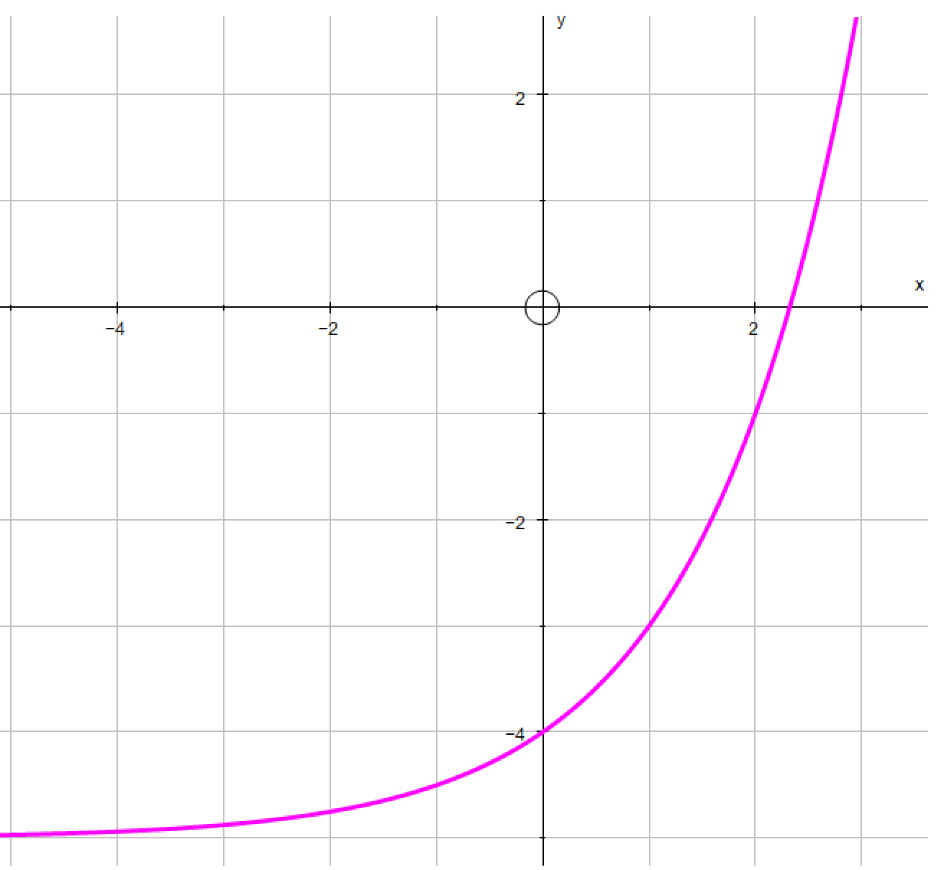
Growth or Decay
Growth

Slide 16
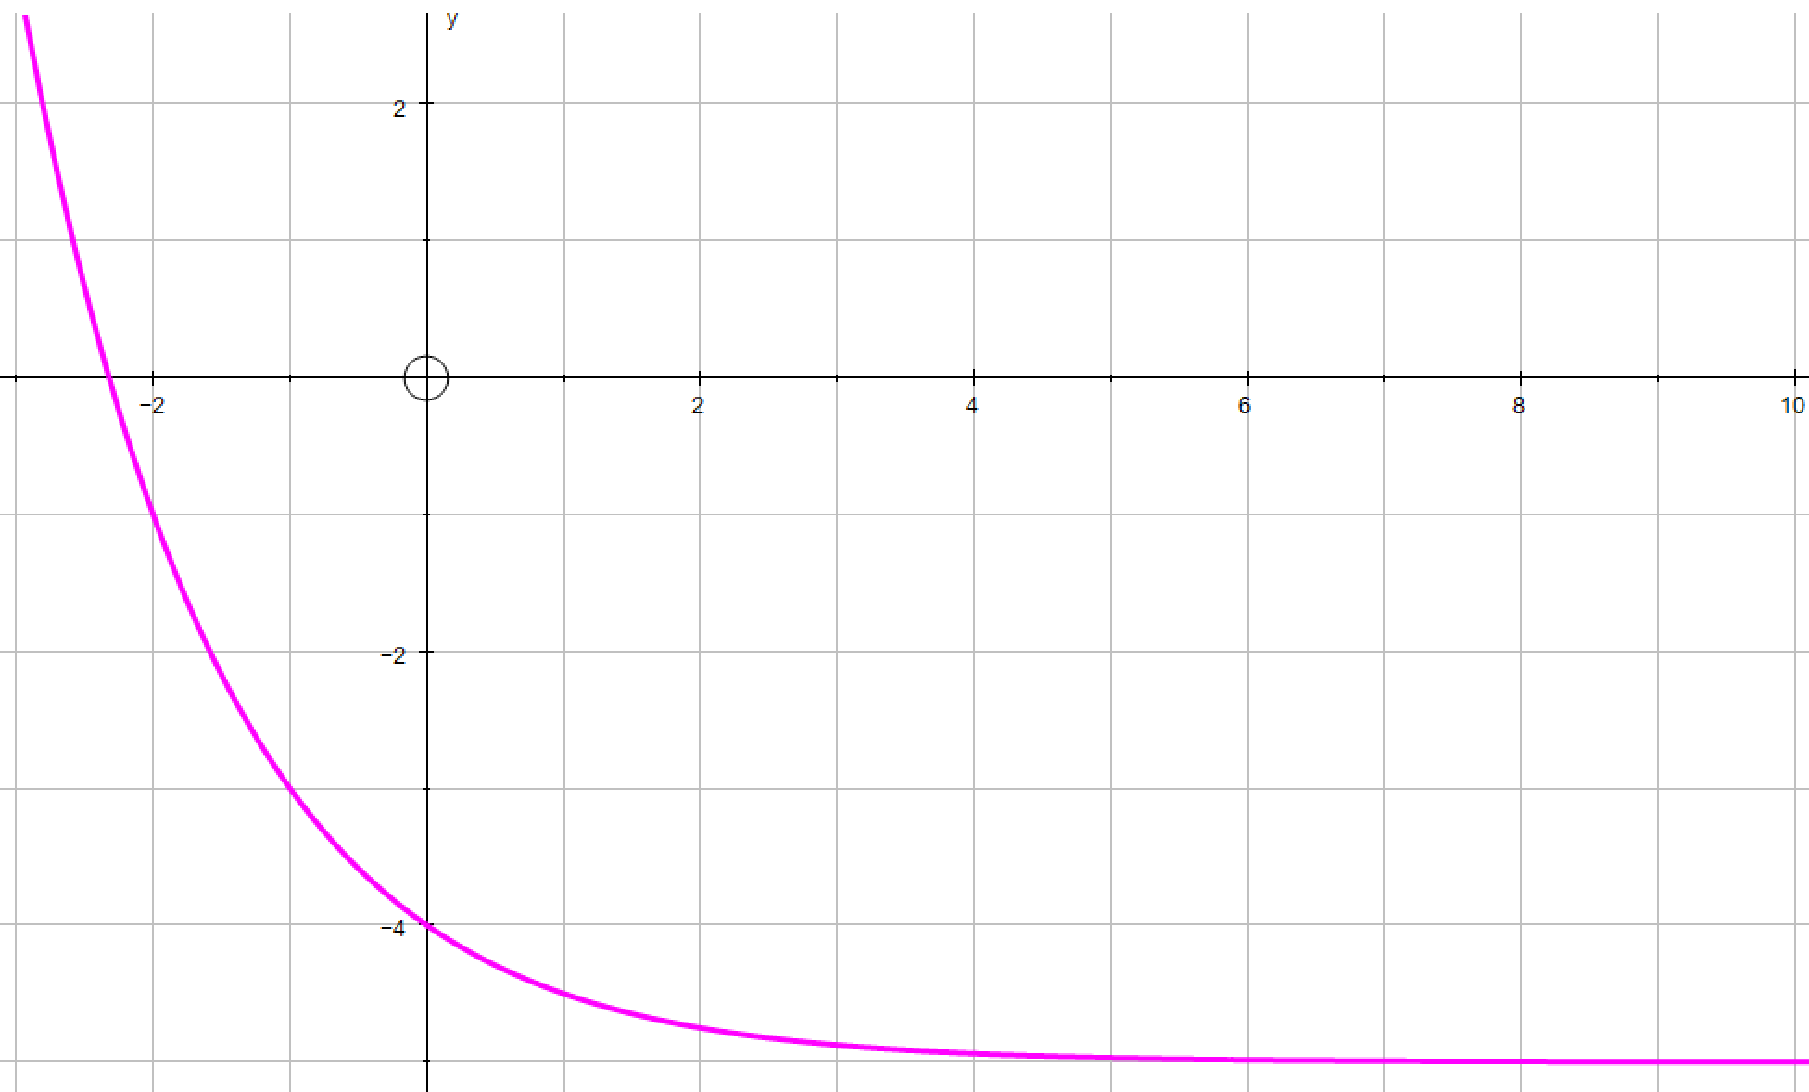
Growth or Decay
Decay

Slide 17

Can you think of possible situations that might produce a exponential growth and decay graph?

Slide 18
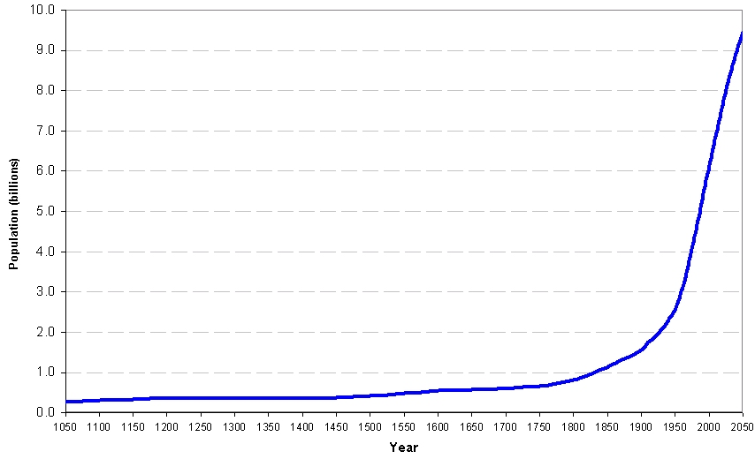
World Population Growth Rate

Slide 19
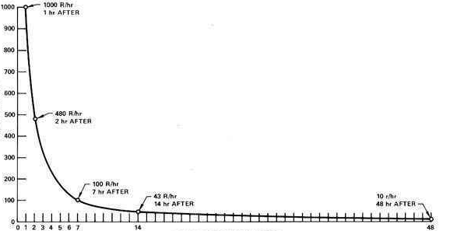
Decay of Radiation From Explosion of Chernobyl
Dose Rate (R/hr)
Hours After The Explosion

Slide 20
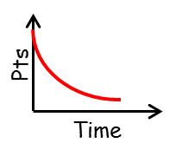
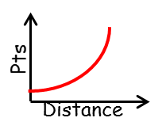
The heptathlon is an Olympic competition consisting of 7 events:
100m Hurdles, 200m, 800m, Javelin, Shot Put, Long Jump, High Jump
The points system for the heptathlon is based on the following two graphs.
Why do you think they use two different graphs?

Slide 21
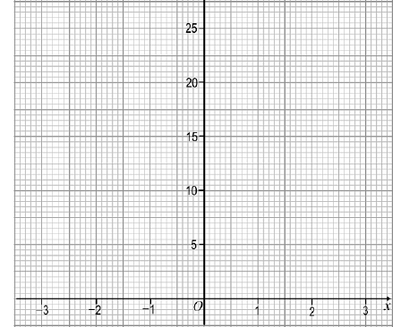
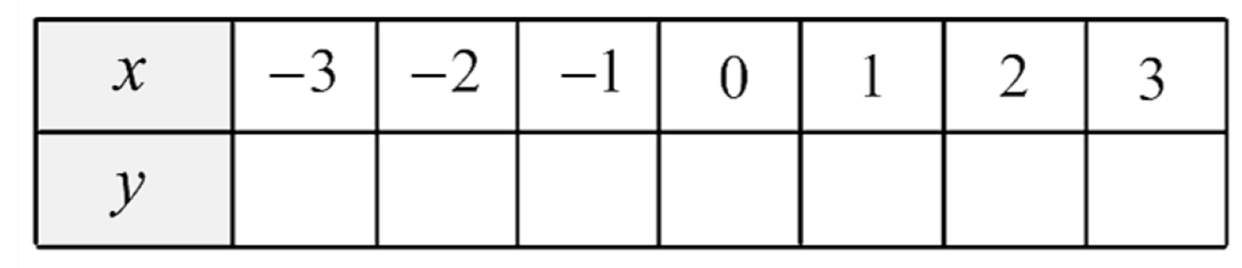
Plotting Exponential Graphs
y = 3^{x}
0.04
0.11
0.33
1
3
9
27

Slide 22
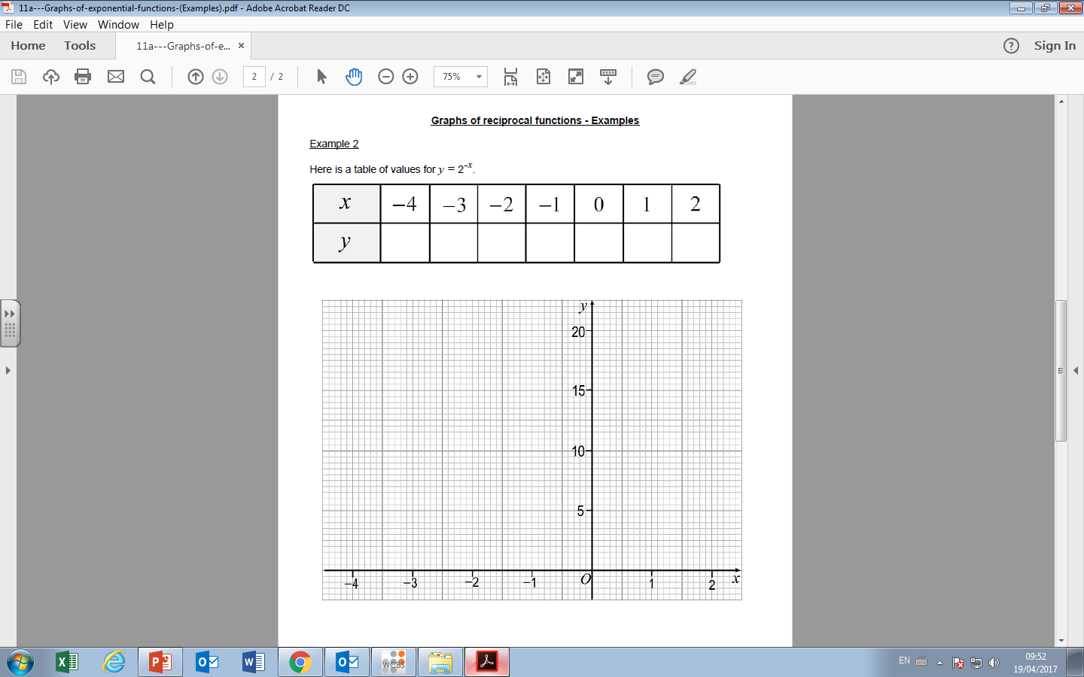
y = 2^{-x}
16
8
4
2
1
0.5
0.25

Slide 23
An exponential equation is
where the x value is an exponential.
y = a^{-x}
y = a^{x}
Decay
Growth

