Slide 1
LO: Pie Charts
(Drawing)

Slide 2
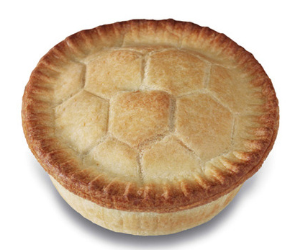

Hmmmmm
..Pie!

Slide 3
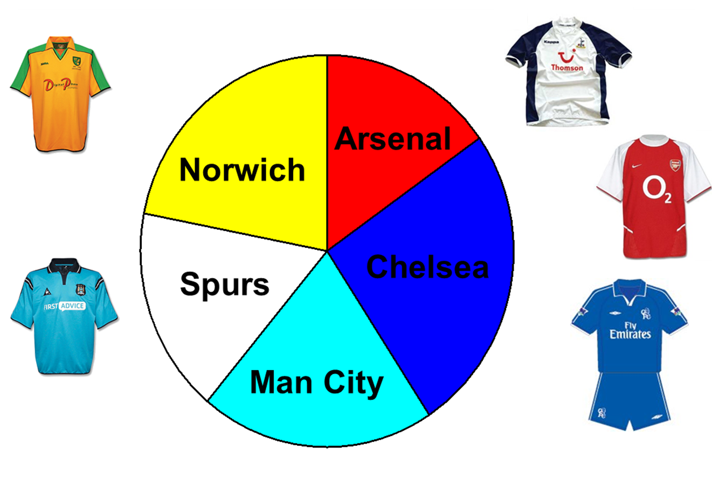

Slide 4




What percentage of the pie chart is coloured red?
A
20%
B
25%
C
50%
D
75%

Slide 5
What percentage of the pie chart is coloured blue?
A
33.33%
B
30%
C
25%
D
75%

Slide 6
What percentage of the pie chart is coloured purple?
A
25%
B
5%
C
75%
D
20%

Slide 7
What percentage of the pie chart is coloured orange?
A
12%
B
10%
C
15%
D
20%

Slide 8
What percentage of the pie chart is coloured blue?
A
40%
B
33%
C
75%
D
50%

Slide 9
What percentage of the pie chart is coloured purple?
A
15%
B
8%
C
12.5%
D
25%

Slide 10
What percentage of the pie chart is coloured purple?
A
15%
B
8%
C
12.5%
D
25%

Slide 11
A
E
C
B
D

Slide 12
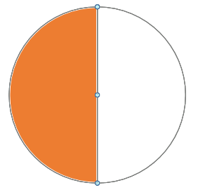
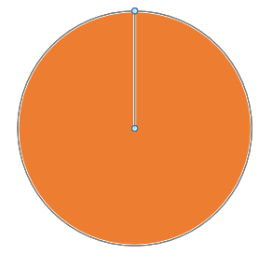
180 people take part in a survey. 1 person = 1° Would it fill out the pie chart? If No, What should each person equal?
1 person = 1°
1 person = 2°

Slide 13
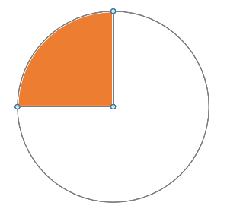
90 people take part in a survey. 1 person = 1° Would it fill out the pie chart? If No, What should each person equal?
1 person = 1°
1 person = 4°

Slide 14
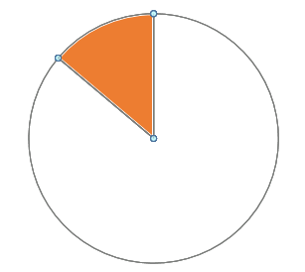
36 people take part in a survey. 1 person = 1° Would it fill out the pie chart? If No, What should each person equal?
1 person = 1°
1 person = 10°

Slide 15
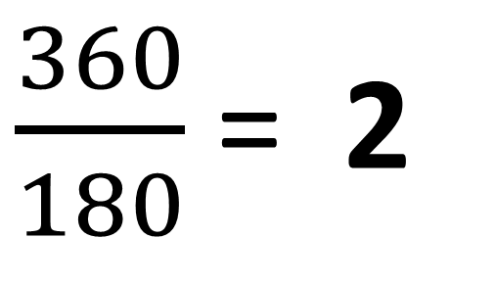
What are the angles needed
to draw a pie chart?
Colour | Number | Angle
Red | 15
Green | 45
Blue | 30
Purple | 90
 | 180 | 360
Multiplier
30
90
60
180
$\frac{360}{180}$ = 2

Slide 16
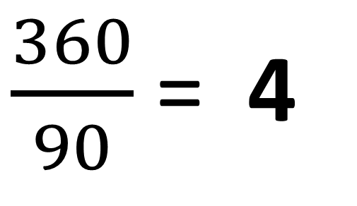
What are the angles needed
to draw a pie chart?
Colour | Frequency | Angle
Red | 10
Green | 10
Blue | 30
Purple | 40
 | 90 | 360
40
40
120
160
$\frac{360}{90}$ = 4

Slide 17
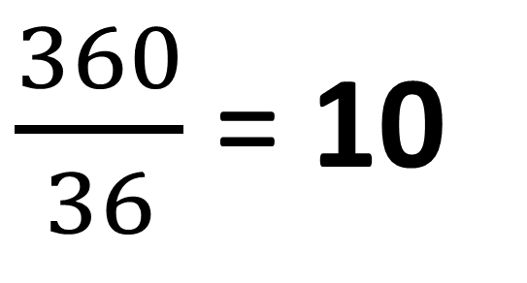
What are the angles needed
to draw a pie chart?
Colour | Frequency | Angle
Red | 8
Green | 6
Blue | 12
Purple | 10
 | 36 | 360
80
60
120
120
$\frac{360}{36}$ = 10

Slide 18
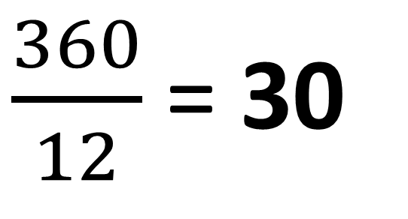
What are the angles needed
to draw a pie chart?
Colour | Frequency | Angle
Red | 2
Green | 4
Blue | 6
 | 12 | 360
60
120
180
$\frac{360}{12}$ = 30

Slide 19
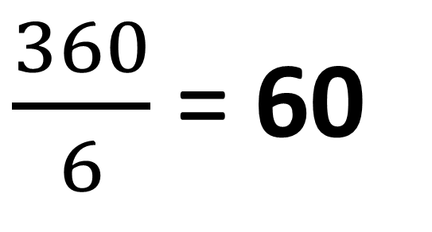
What are the angles needed
to draw a pie chart?
Colour | Frequency | Angle
Red | 1
Green | 3
Blue | 2
60
180
120
360
$\frac{360}{6}$ = 60
6

Slide 20

Angle =
Frequency x $\frac{360˚}{Total Frequency}$

Slide 21
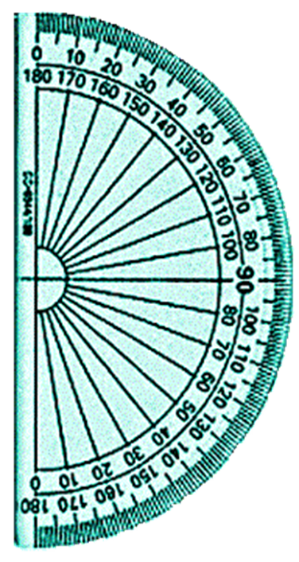
Using a Protractor

Slide 22
Using a Protractor

Slide 23
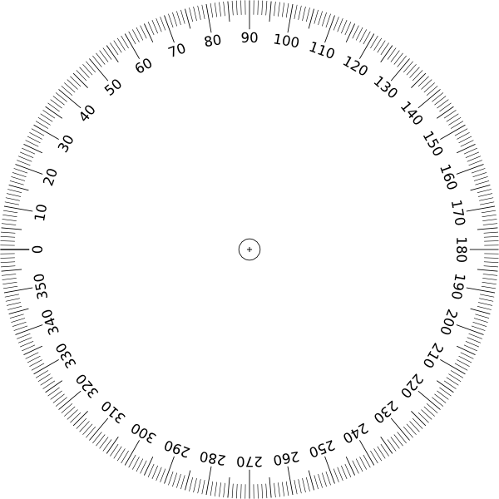
Using a Protractor

Slide 24
Using a Protractor

Slide 25
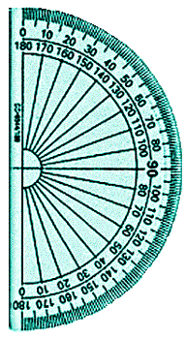
Favourite Takeaways
Fast Food | Frequency | Angle
KFC | 10 | 100
McDonalds | 6 | 60
Burger King | 2 | 20
Nando’s | 18 | 180
 | 36 | 360

Slide 26
Favourite Takeaways
Fast Food | Frequency | Angle
KFC | 10 | 100
McDonalds | 6 | 60
Burger King | 2 | 20
Nando’s | 18 | 180
 | 36 | 360
KFC

Slide 27
Favourite Takeaways
Fast Food | Frequency | Angle
KFC | 10 | 100
McDonalds | 6 | 60
Burger King | 2 | 20
Nando’s | 18 | 180
 | 36 | 360
KFC
McDonalds

Slide 28
Favourite Takeaways
Fast Food | Frequency | Angle
KFC | 10 | 100
McDonalds | 6 | 60
Burger King | 2 | 20
Nando’s | 18 | 180
 | 36 | 360
KFC
Nando’s
McDonalds
Burger King

