Slide 1

Senior Challenge 3
BRONZE

Slide 2
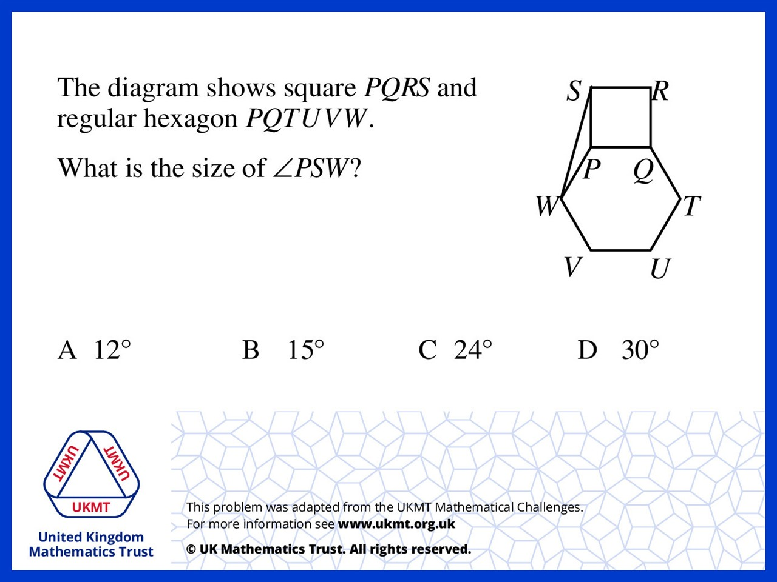
Q1.
120 + 90 = 210
360 – 210 = 150
180 – 150 = 30
30 ÷ 2 = 15

Slide 3
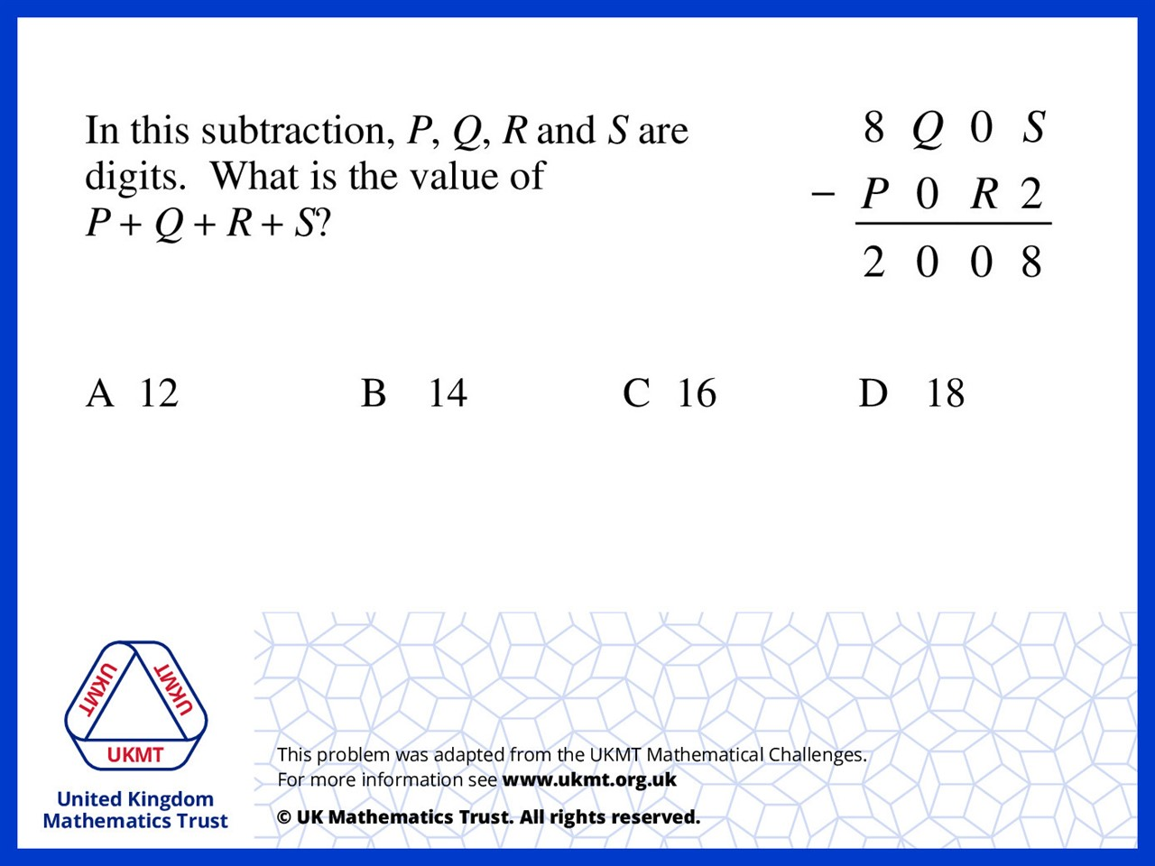
Q2.
S = 0 R = 9 Q = 1 P = 6
0 + 9 + 1 + 6 = 16

Slide 4
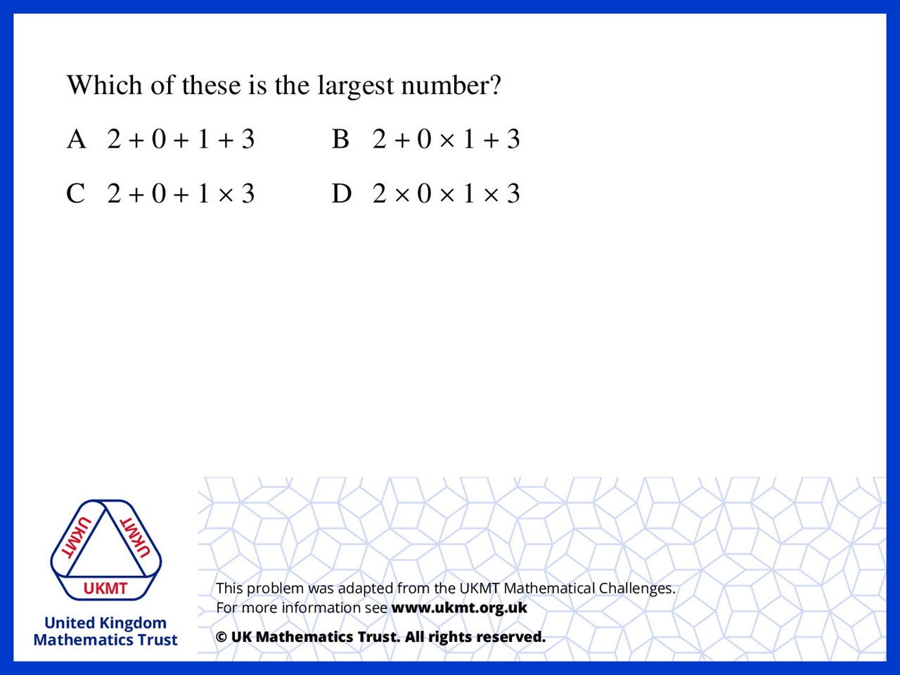
Q3.
A = 6 B = 5
C = 5 D = 0

Slide 5
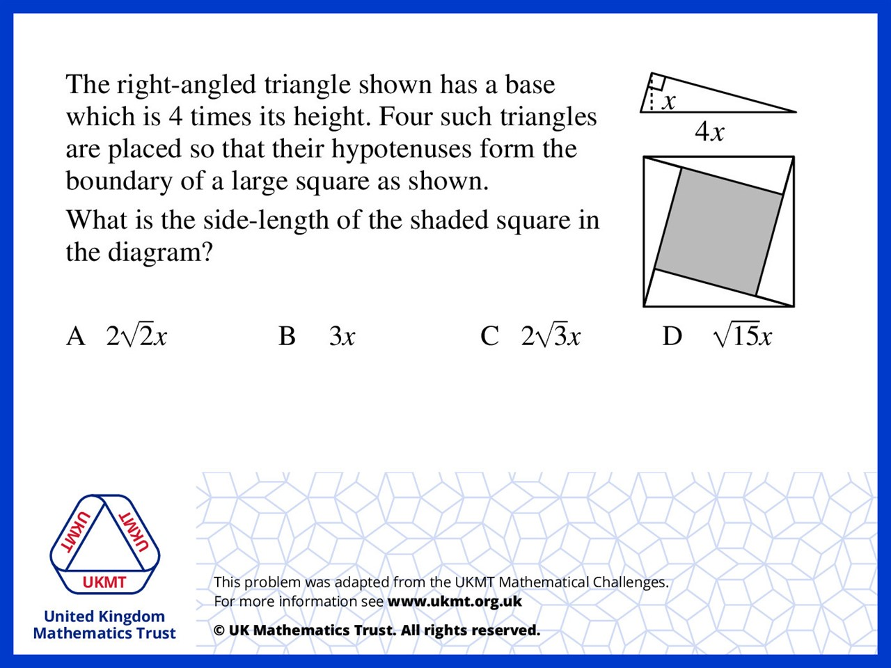
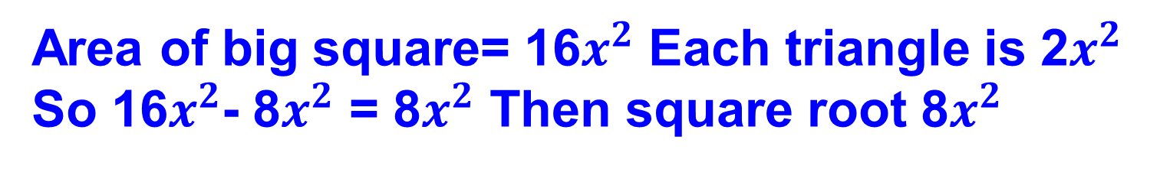
Q4.
Area of big square= 16$x^{2}$ Each triangle is 2$x^{2}$
So 16$x^{2}$- 8$x^{2}$ = 8$x^{2}$ Then square root 8$x^{2}$

Slide 6
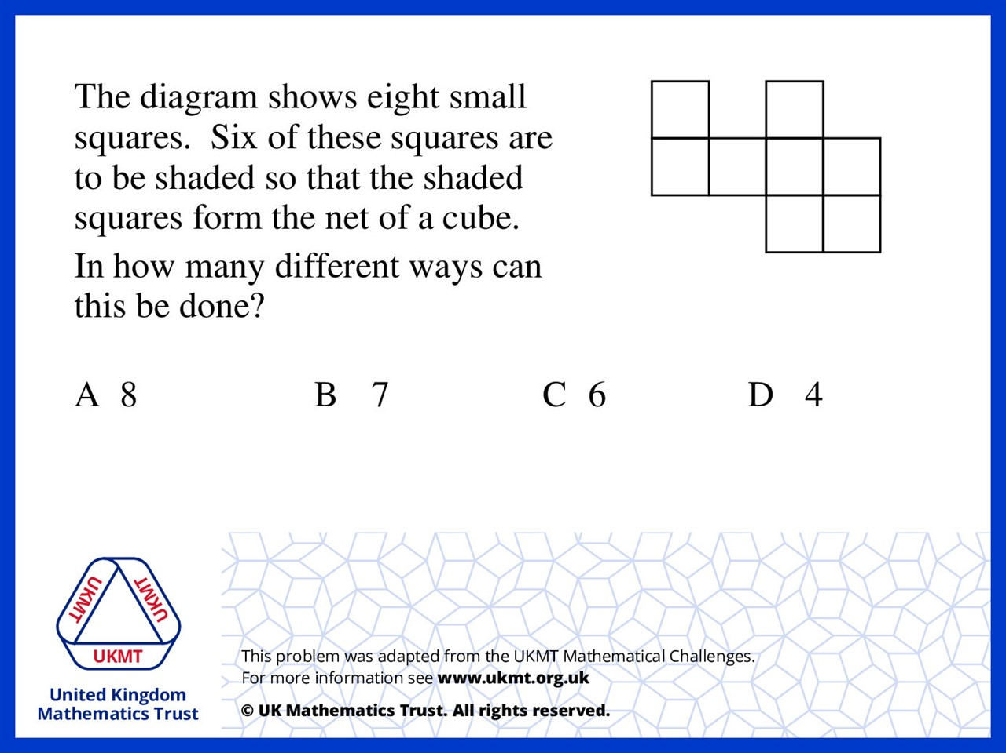
Q5.
The top two squares create the same face and the bottom two squares create the same face. The square on the far right in the centre row can be removed for two more nets. 2 x 3 = 6.

