Slide 1
Application of Forces
Connected Particles
and Friction
Chapter 7
(Part 6 of 6)

Slide 2
Connected particles
ϴ

Slide 3
Connected particles

Slide 4
What forces are acting parallel and perpendicular to the slope on each practical?
R
T
T
5
10
𝝁𝑹
5g sin ϴ
Rough Surface
ϴ
10g

Slide 5
Write an F = ma equation for each practical.
T
T
5
10
𝝁𝑹
5g sin ϴ
10g
F = ma
F = ma
F = T – (𝝁𝑹 + 5g sin ϴ)
F = 10g – T

Slide 6
Look at both particles individually
using the F = ma equation.
Then solve simultaneously.
5
10
ϴ

Slide 7
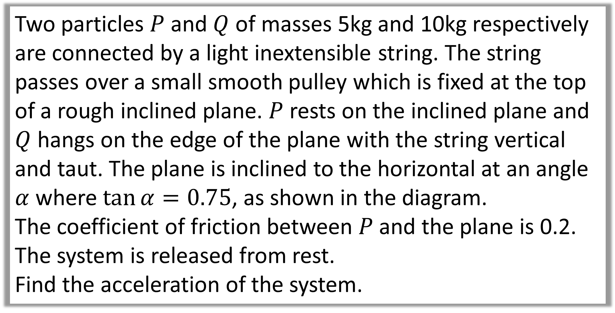
Two particles $P$ and $Q$ of masses 5kg and 10kg respectively are connected by a light inextensible string. The string passes over a small smooth pulley which is fixed at the top of a rough inclined plane. $P$ rests on the inclined plane and $Q$ hangs on the edge of the plane with the string vertical and taut. The plane is inclined to the horizontal at an angle $α$ where $\tan{α}=0.75$, as shown in the diagram.
The coefficient of friction between $P$ and the plane is 0.2.
The system is released from rest.
Find the acceleration of the system.

Slide 8
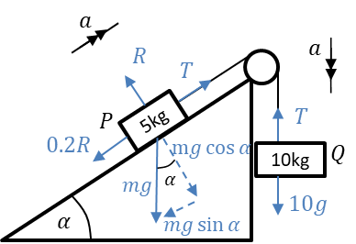
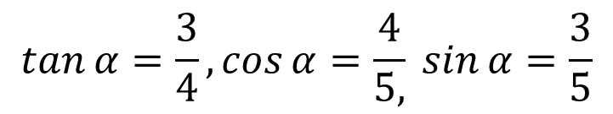
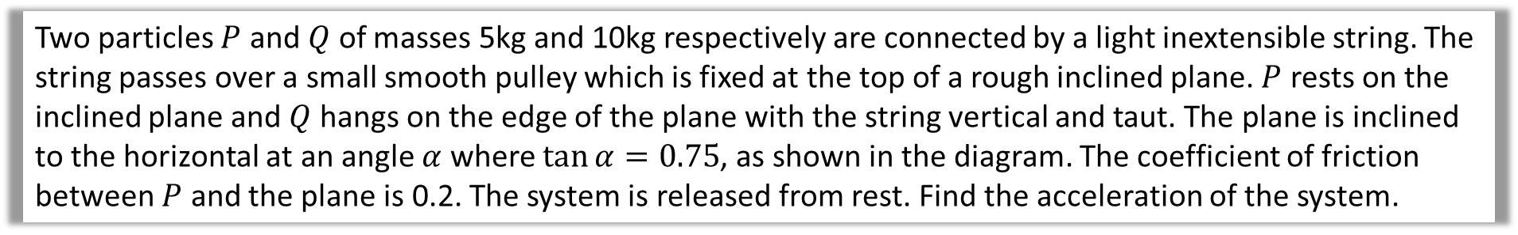
Two particles $P$ and $Q$ of masses 5kg and 10kg respectively are connected by a light inextensible string. The string passes over a small smooth pulley which is fixed at the top of a rough inclined plane. $P$ rests on the inclined plane and $Q$ hangs on the edge of the plane with the string vertical and taut. The plane is inclined to the horizontal at an angle $α$ where $\tan{α}=0.75$, as shown in the diagram. The coefficient of friction between $P$ and the plane is 0.2. The system is released from rest. Find the acceleration of the system.
Diagram
$$\tan{α}=\frac{3}{4}, \cos{α}=\frac{4}{5,}\sin{α}=\frac{3}{5}$$

Slide 9
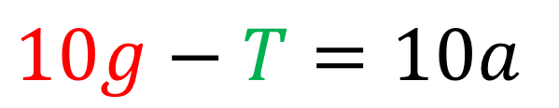
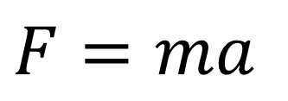
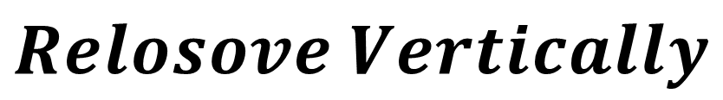

Find the acceleration of the system.
Particle $Q$
$Relosove Vertically$
$$F=ma$$
$$10g−T=10a$$

Slide 10

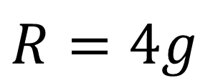
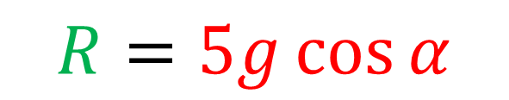
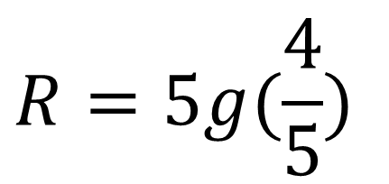
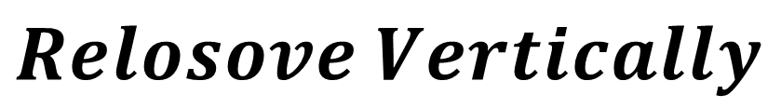
Find the acceleration of the system.
Particle $P$
$Relosove Vertically$
$$R=5g\cos{α}$$
$$R=5g(\frac{4}{5})$$
$$R=4g$$

Slide 11

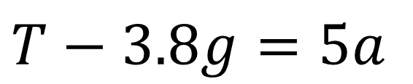
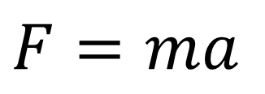
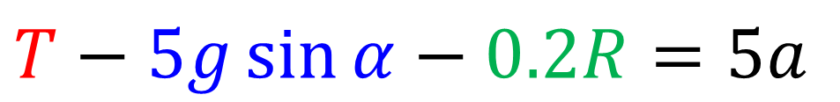
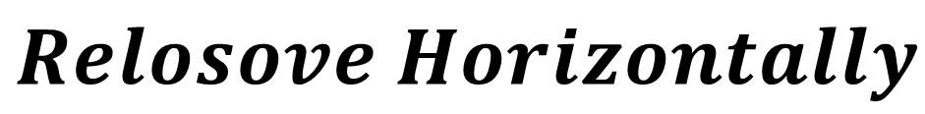
Find the acceleration of the system.
Particle $P$
$Relosove Horizontally$
$$F=ma$$
$$T−5g\sin{α}−0.2R=5a$$
$$T−3.8g=5a$$

Slide 12
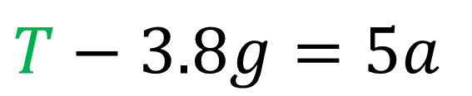
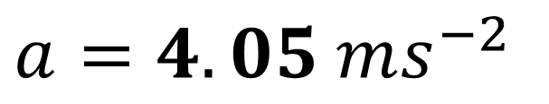
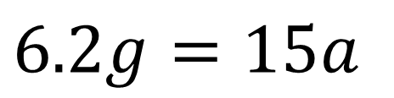
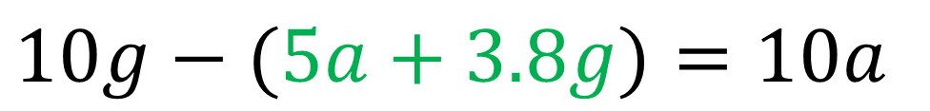
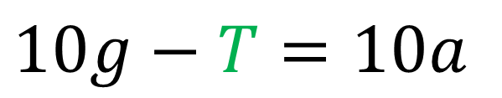
Find the acceleration of the system.
Solve Simultaneous
$$T−3.8g=5a$$
$$10g−T=10a$$
$$10g−(5a+3.8g)=10a$$
$$6.2g=15a$$
$$a=4.05 ms^{−2}$$

Slide 13

Force Exerted on the Pulley
Click Here
It is the resultant of the two tensions.

Slide 14
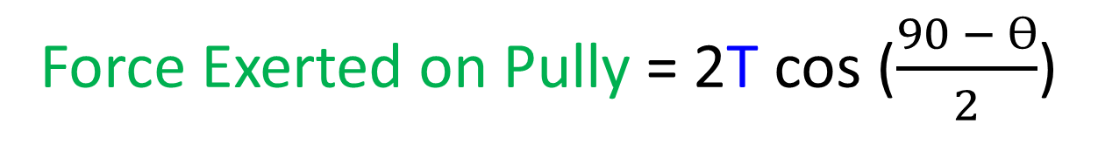
Resultant Force of the Tension
T
T
T
T
ϴ
Force Exerted on Pully = 2T cos ($\frac{90 − ϴ}{2}$)

Slide 15
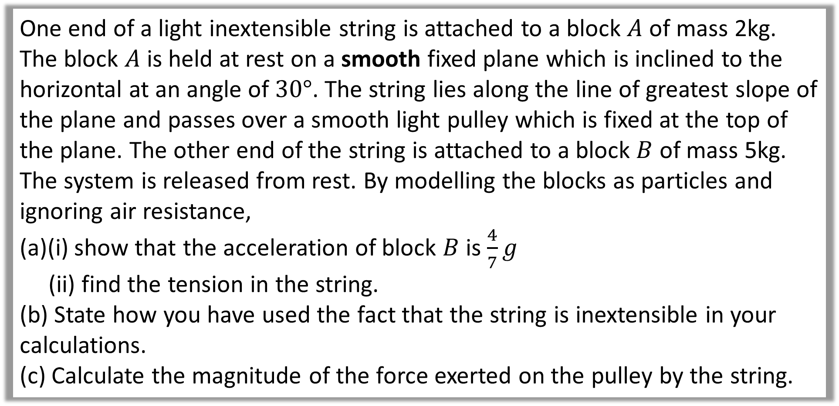
One end of a light inextensible string is attached to a block $A$ of mass 2kg. The block $A$ is held at rest on a smooth fixed plane which is inclined to the horizontal at an angle of $30°$. The string lies along the line of greatest slope of the plane and passes over a smooth light pulley which is fixed at the top of the plane. The other end of the string is attached to a block $B$ of mass 5kg. The system is released from rest. By modelling the blocks as particles and ignoring air resistance,
(a)(i) show that the acceleration of block $B$ is $\frac{4}{7}g$
(ii) find the tension in the string.
(b) State how you have used the fact that the string is inextensible in your calculations.
(c) Calculate the magnitude of the force exerted on the pulley by the string.

Slide 16
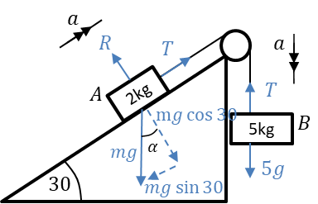
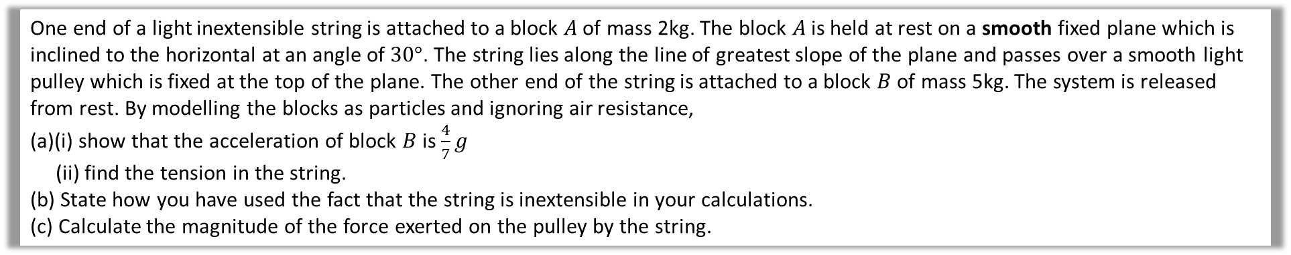
One end of a light inextensible string is attached to a block $A$ of mass 2kg. The block $A$ is held at rest on a smooth fixed plane which is inclined to the horizontal at an angle of $30°$. The string lies along the line of greatest slope of the plane and passes over a smooth light pulley which is fixed at the top of the plane. The other end of the string is attached to a block $B$ of mass 5kg. The system is released from rest. By modelling the blocks as particles and ignoring air resistance,
(a)(i) show that the acceleration of block $B$ is $\frac{4}{7}g$
(ii) find the tension in the string.
(b) State how you have used the fact that the string is inextensible in your calculations.
(c) Calculate the magnitude of the force exerted on the pulley by the string.
Diagram

Slide 17
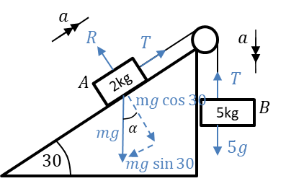
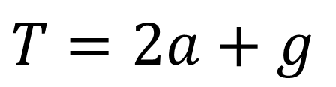
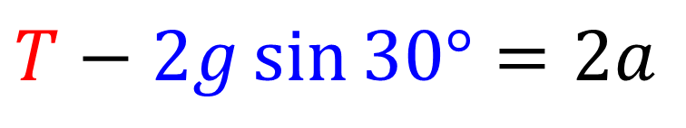


One end of a light inextensible string is attached to a block $A$ of mass 2kg. The block $A$ is held at rest on a smooth fixed plane which is inclined to the horizontal at an angle of $30°$. The string lies along the line of greatest slope of the plane and passes over a smooth light pulley which is fixed at the top of the plane. The other end of the string is attached to a block $B$ of mass 5kg. The system is released from rest. By modelling the blocks as particles and ignoring air resistance,
(a)(i) show that the acceleration of block $B$ is $\frac{4}{7}g$
(ii) find the tension in the string.
(b) State how you have used the fact that the string is inextensible in your calculations.
(c) Calculate the magnitude of the force exerted on the pulley by the string.
a
Particle $A$
$$Relsove Horiontially$$
$$T−2g\sin{30°}=2a$$
$$T=2a+g$$

Slide 18
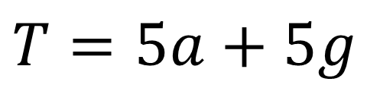
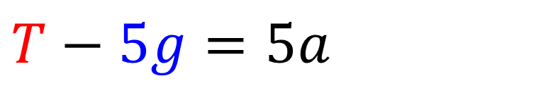


One end of a light inextensible string is attached to a block $A$ of mass 2kg. The block $A$ is held at rest on a smooth fixed plane which is inclined to the horizontal at an angle of $30°$. The string lies along the line of greatest slope of the plane and passes over a smooth light pulley which is fixed at the top of the plane. The other end of the string is attached to a block $B$ of mass 5kg. The system is released from rest. By modelling the blocks as particles and ignoring air resistance,
(a)(i) show that the acceleration of block $B$ is $\frac{4}{7}g$
(ii) find the tension in the string.
(b) State how you have used the fact that the string is inextensible in your calculations.
(c) Calculate the magnitude of the force exerted on the pulley by the string.
a
Particle $B$
$$Relsove Vertically$$
$$T−5g=5a$$
$$T=5a+5g$$

Slide 19
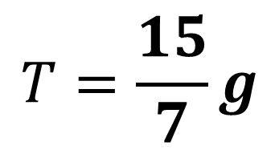
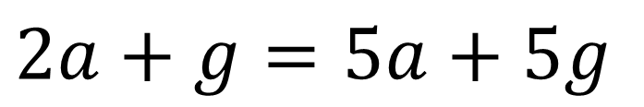
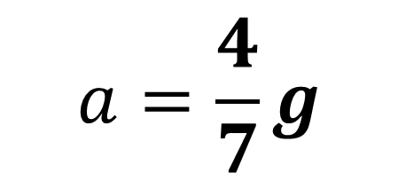
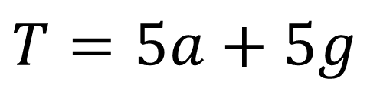
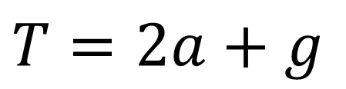
One end of a light inextensible string is attached to a block $A$ of mass 2kg. The block $A$ is held at rest on a smooth fixed plane which is inclined to the horizontal at an angle of $30°$. The string lies along the line of greatest slope of the plane and passes over a smooth light pulley which is fixed at the top of the plane. The other end of the string is attached to a block $B$ of mass 5kg. The system is released from rest. By modelling the blocks as particles and ignoring air resistance,
(a)(i) show that the acceleration of block $B$ is $\frac{4}{7}g$
(ii) find the tension in the string.
(b) State how you have used the fact that the string is inextensible in your calculations.
(c) Calculate the magnitude of the force exerted on the pulley by the string.
a
Solve Simultaneously
$$2a+g=5a+5g$$
$$T=2a+g$$
$$a=\frac{4}{7}g$$
$$T=5a+5g$$
$$T=\frac{15}{7}g$$

Slide 20
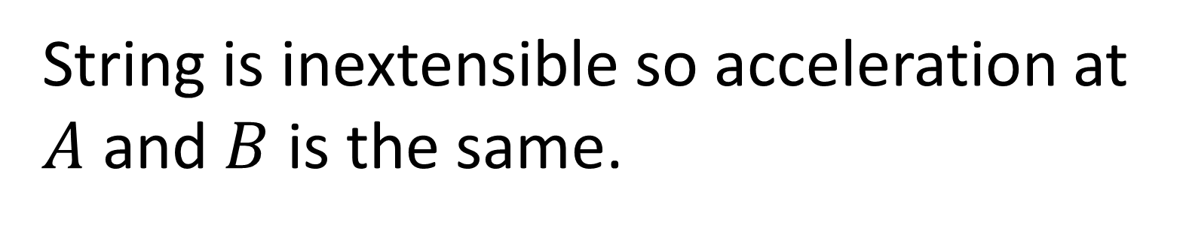
One end of a light inextensible string is attached to a block $A$ of mass 2kg. The block $A$ is held at rest on a smooth fixed plane which is inclined to the horizontal at an angle of $30°$. The string lies along the line of greatest slope of the plane and passes over a smooth light pulley which is fixed at the top of the plane. The other end of the string is attached to a block $B$ of mass 5kg. The system is released from rest. By modelling the blocks as particles and ignoring air resistance,
(a)(i) show that the acceleration of block $B$ is $\frac{4}{7}g$
(ii) find the tension in the string.
(b) State how you have used the fact that the string is inextensible in your calculations.
(c) Calculate the magnitude of the force exerted on the pulley by the string.
String is inextensible so acceleration at $A$ and $B$ is the same.
b

Slide 21
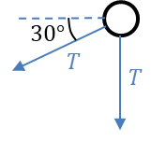
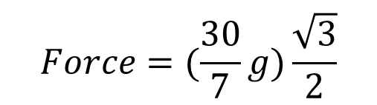
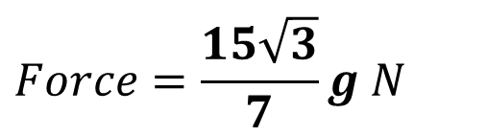
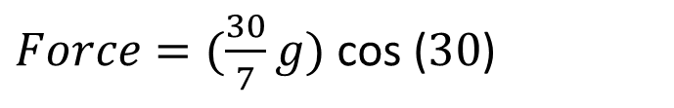
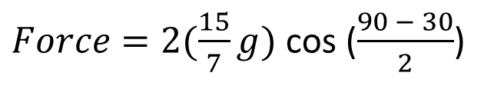
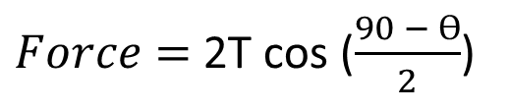

One end of a light inextensible string is attached to a block $A$ of mass 2kg. The block $A$ is held at rest on a smooth fixed plane which is inclined to the horizontal at an angle of $30°$. The string lies along the line of greatest slope of the plane and passes over a smooth light pulley which is fixed at the top of the plane. The other end of the string is attached to a block $B$ of mass 5kg. The system is released from rest. By modelling the blocks as particles and ignoring air resistance,
(a)(i) show that the acceleration of block $B$ is $\frac{4}{7}g$
(ii) find the tension in the string.
(b) State how you have used the fact that the string is inextensible in your calculations.
(c) Calculate the magnitude of the force exerted on the pulley by the string.
$Force=$2T cos ($\frac{90 − ϴ}{2}$)
c
$Force=2(\frac{15}{7}g)$ cos ($\frac{90 − 30}{2}$)
$Force=(\frac{30}{7}g)$ cos ($30$)
$$Force=(\frac{30}{7}g)\frac{\sqrt{3}}{2}$$
$$Force=\frac{15\sqrt{3}}{7}g N$$
$$=36.4N (3sf)$$

