Slide 1
Variable Acceleration
Understanding an Equation
Chapter 11
(Part 1 of 3)

Slide 2
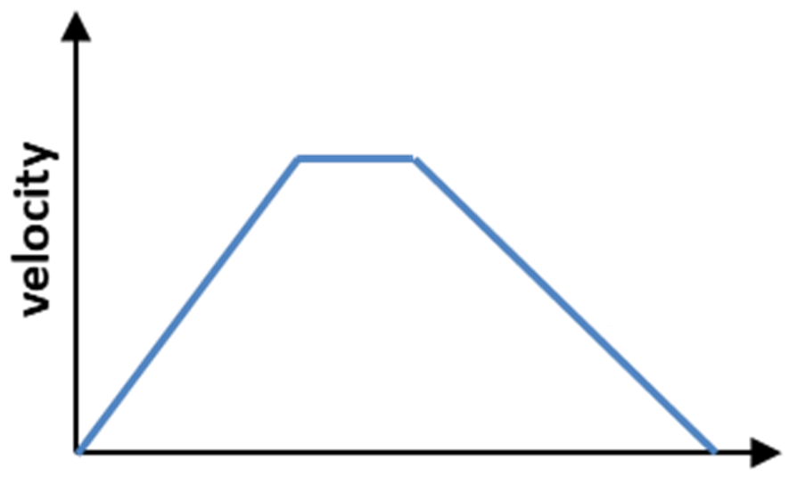

From the graph, what can you say about the acceleration?
$$suvat$$
time
Constant Acceleration

Slide 3


From the graph, what can you say about the acceleration?
$$suvat$$
$$suvat$$
time
Constant Acceleration

Slide 4



From the graph, what can you say about the acceleration?
$$suvat$$
The equation of the curve will be given
each time.
time
Variable Acceleration

Slide 5
Accelerating or Decelerating?
time
Accelerating

Slide 6
Accelerating or Decelerating?
time
Decelerating

Slide 7
Accelerating or Decelerating?
Velocity
0
Time
Accelerating

Slide 8
Accelerating or Decelerating?
Velocity
0
Time
Decelerating

Slide 9
Accelerating or Decelerating?
Velocity
0
Time
Accelerating and then Decelerating

Slide 10
Accelerating or Decelerating?
Velocity
0
Time
Decelerating and then Accelerating

Slide 11
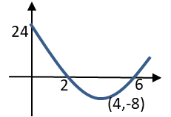
Between 0 and 2 seconds
v
t = 0
t = 2
Between 2 and 6 seconds
t = 6
T
From 6 seconds and beyond
t = 6

Slide 12
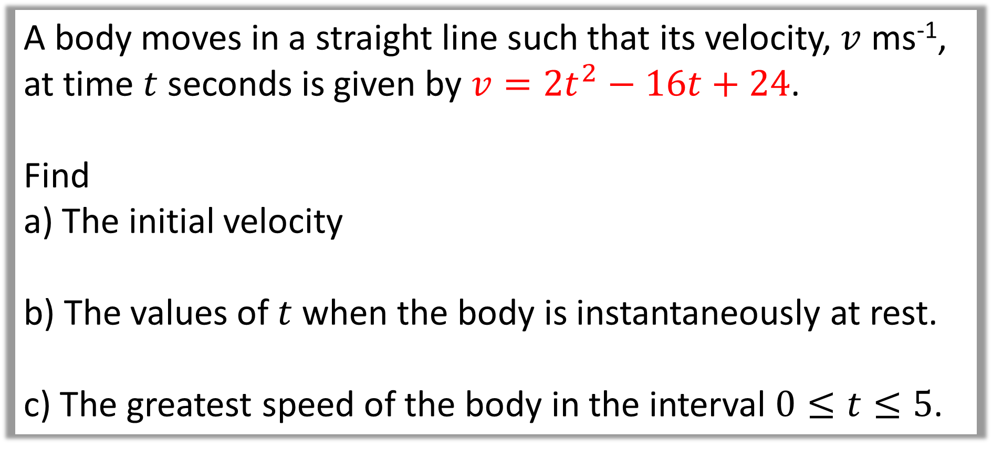
Question A
A body moves in a straight line such that its velocity, $v$ ms⁻¹,
at time $t$ seconds is given by $v=2t^{2}−16t+24$.
Find
a) The initial velocity
b) The values of $t$ when the body is instantaneously at rest.
c) The greatest speed of the body in the interval $0≤t≤5$.

Slide 13
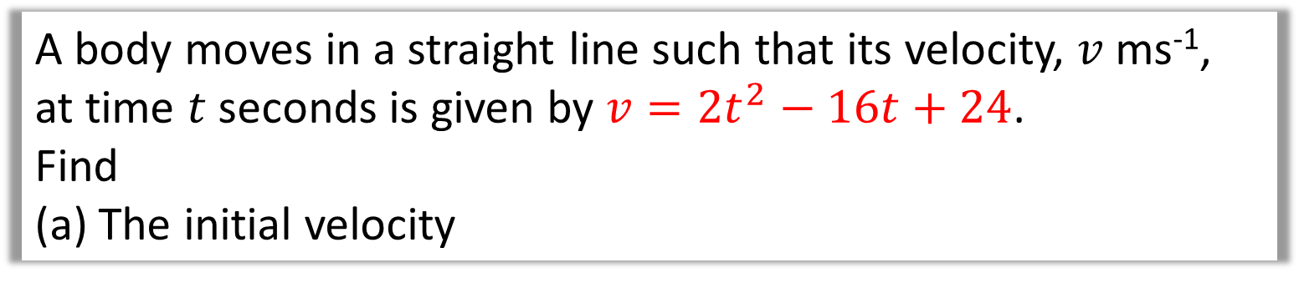
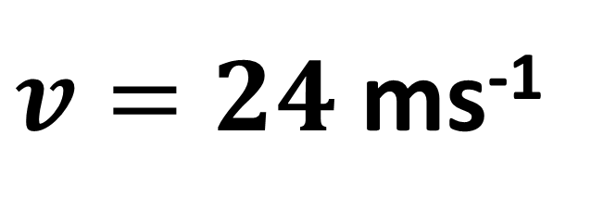
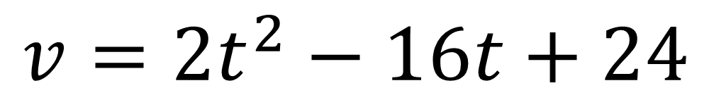
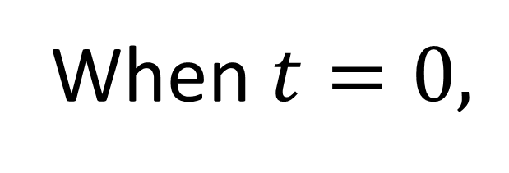
A body moves in a straight line such that its velocity, $v$ ms⁻¹,
at time $t$ seconds is given by $v=2t^{2}−16t+24$.
Find
The initial velocity
When $t=0,$
a.
$$v=2t^{2}−16t+24$$
$v=24$ ms⁻¹

Slide 14
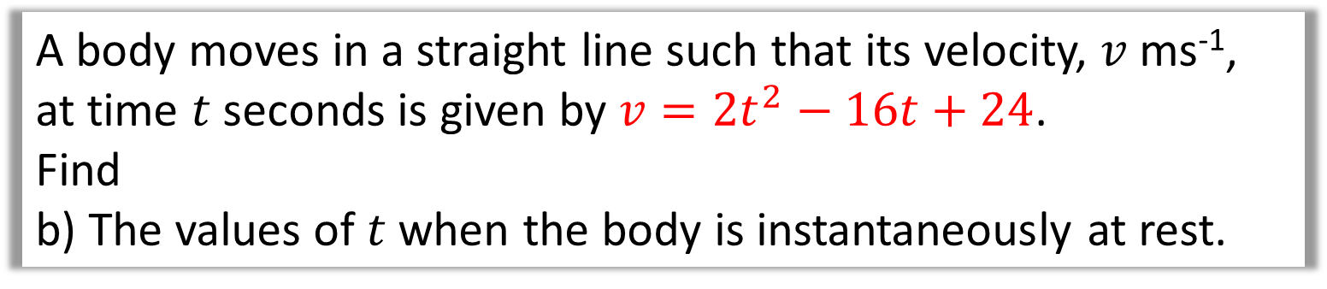
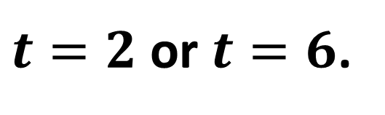
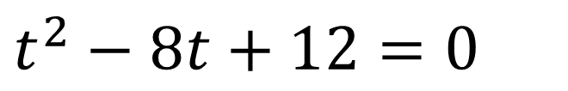
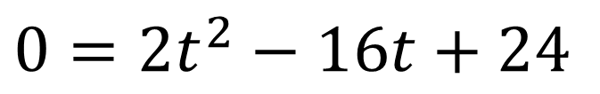
A body moves in a straight line such that its velocity, $v$ ms⁻¹,
at time $t$ seconds is given by $v=2t^{2}−16t+24$.
Find
b) The values of $t$ when the body is instantaneously at rest.
b.
$$0=2t^{2}−16t+24$$
$$t^{2}−8t+12=0$$
$t=2$ or $t=6$.
It stops on two occasions.
When it comes to rest it could mean the particle is changing direction.

Slide 15
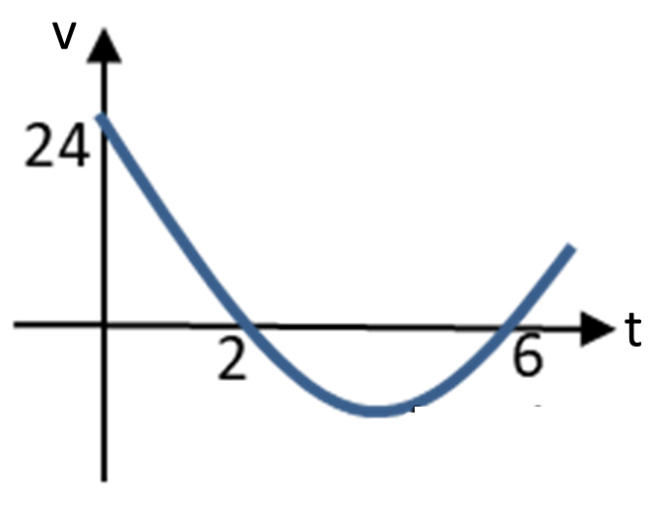
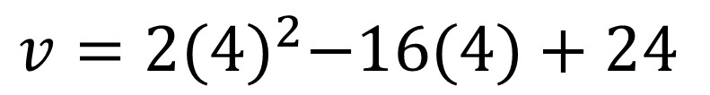

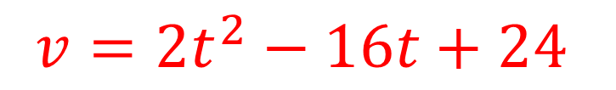
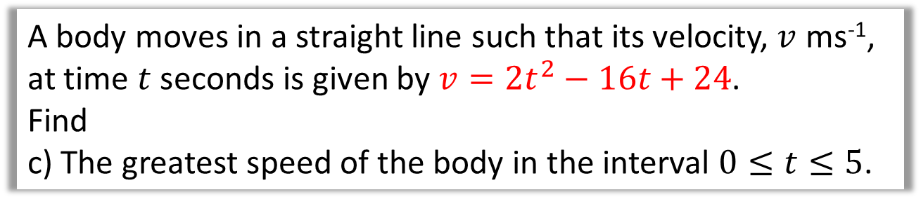
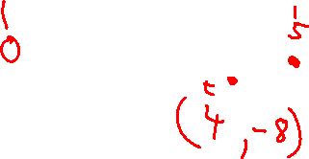
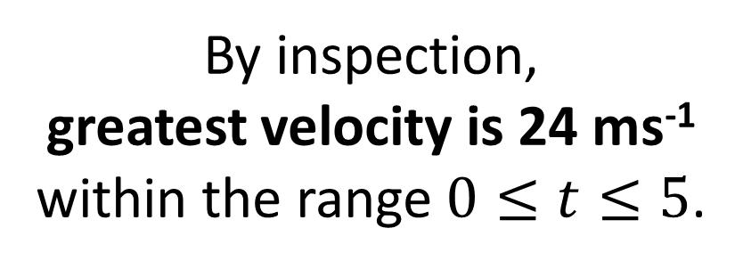
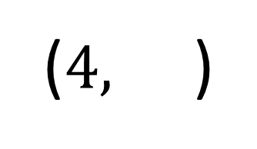
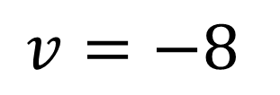
A body moves in a straight line such that its velocity, $v$ ms⁻¹,
at time $t$ seconds is given by $v=2t^{2}−16t+24$.
Find
c) The greatest speed of the body in the interval $0≤t≤5$.
Note: Speed is a magnitude. Therefore, the greatest speed could be a negative velocity.
c.
$$v=2t^{2}−16t+24$$
$$v=2{(4)}^{2}−16(4)+24$$
$$v=−8$$
By inspection,
greatest velocity is 24 ms⁻¹
within the range $0≤t≤5$.
($4,$ )
$$−8$$

