Slide 1
LO: Inverse Functions

Slide 2
You need to know the inverse operations:
÷
x
–
+

Slide 3
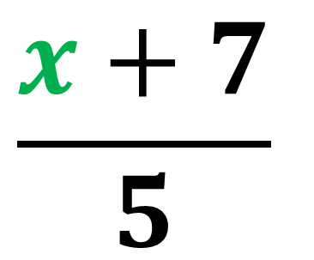
Function
x
x5
-7
5x - 7
Inverse Function
$$\frac{x+7}{5}$$
x
÷5
+7

Slide 4
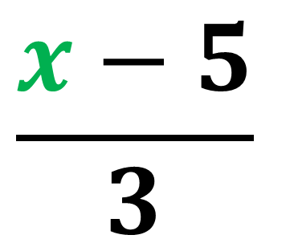
Function
x
x 3
+ 5
3x + 5
Inverse Function
$$\frac{x−5}{3}$$
x
÷ 3
- 5

Slide 5
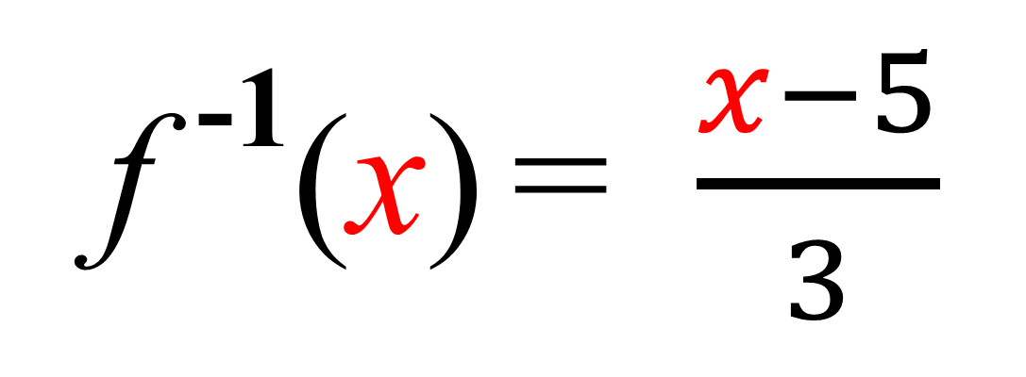
Inverse Function Notation
f (x) = 3x + 5
f ⁻¹(x) = $\frac{x−5}{3}$

Slide 6
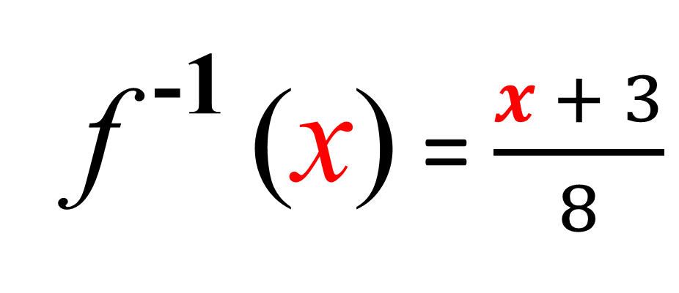
Finding the inverse of f(x)
f (x) = 8x – 3
f ⁻¹ (x) = $\frac{x + 3}{8}$

Slide 7
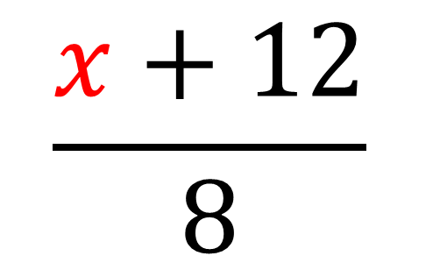
Finding the inverse of f (x)
f (x) = 4(2x – 3)
f (x) = 8x – 12
$$\frac{x+12}{8}$$
f ⁻¹(x) =

Slide 8
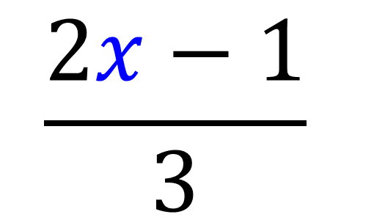
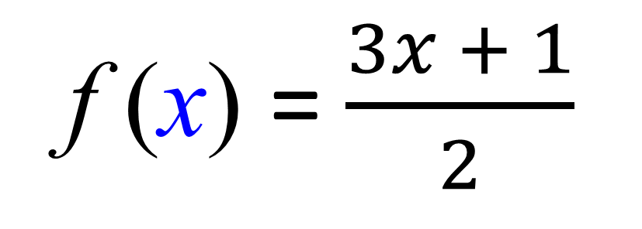
Finding the inverse of f (x)
f (x) = $\frac{3x + 1}{2}$
$$\frac{2x−1}{3}$$
f ⁻¹(x) =

