Slide 1
Functions and Graphs
Composite Functions
Chapter 2
(Part 3 of 6)

Slide 2
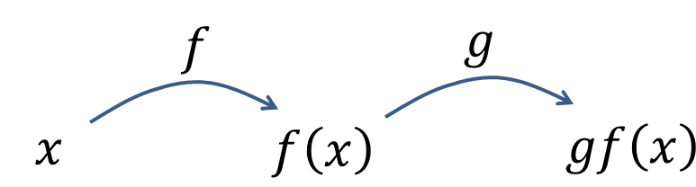
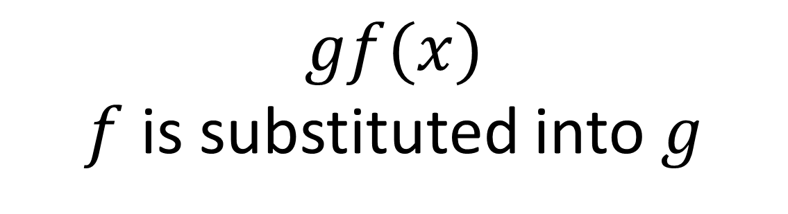
Multiple functions in succession
are known as a composite function.
$$gf(x)$$
$f$ is substituted into $g$

Slide 3
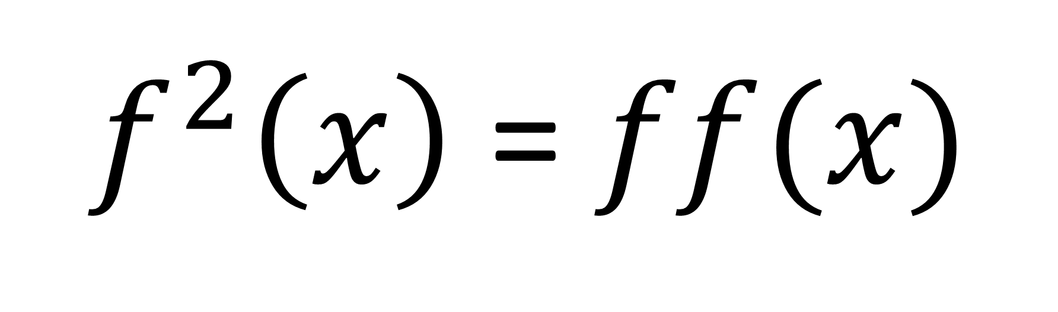

$f^{2}\left(x\right)$ = $ff(x)$
$f$ is substituted into $f$

Slide 4
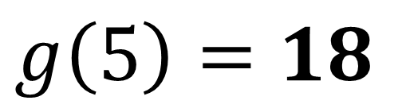
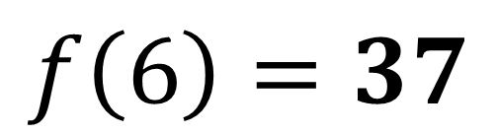
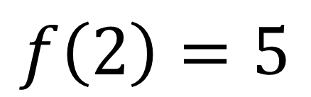
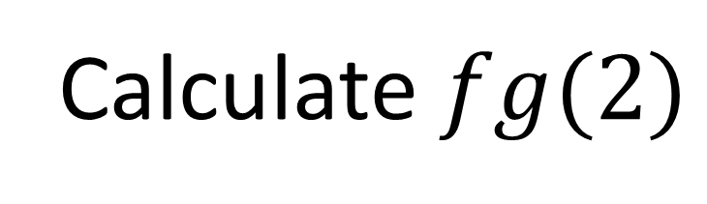
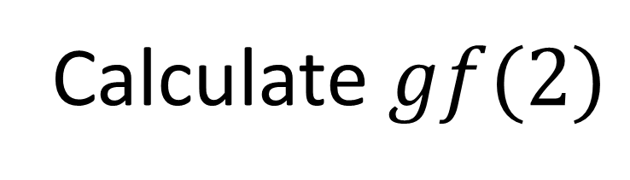
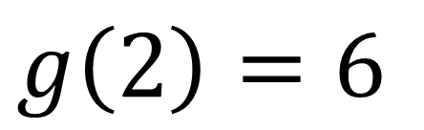
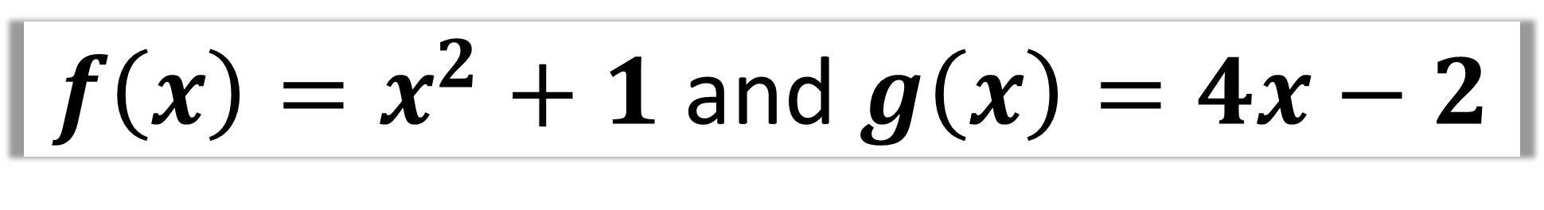
$f\left(x\right)=x^{2}+1$ and $g\left(x\right)=4x−2$
Calculate $fg(2)$
Calculate $gf(2)$
$$g\left(2\right)=6$$
$$f\left(2\right)=5$$
$$f\left(6\right)=37$$
$$g\left(5\right)=18$$

Slide 5

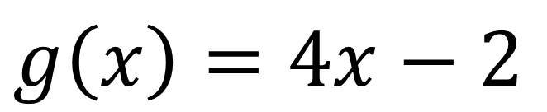
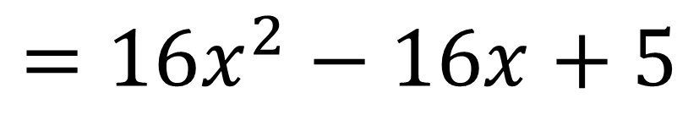
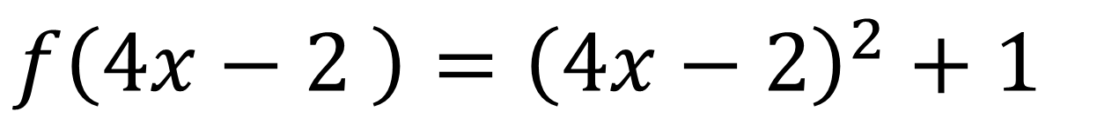
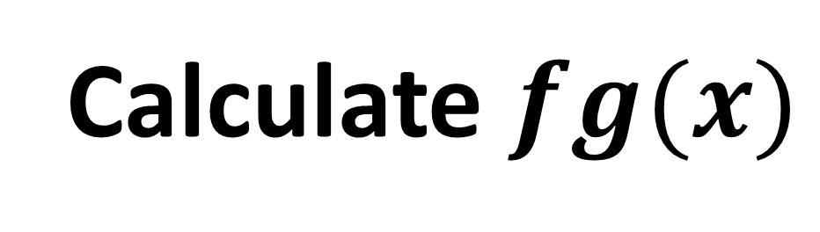
$f\left(x\right)=x^{2}+1$ and $g\left(x\right)=4x−2$
Calculate $fg(x)$
$$g\left(x\right)=4x−2$$
$$f\left(4x−2 \right)={\left(4x−2\right)}^{2}+1$$
$$=16x^{2}−16x+5$$

Slide 6
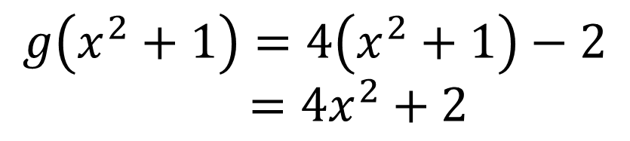
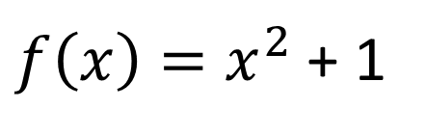
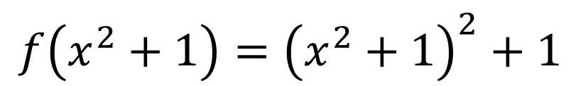
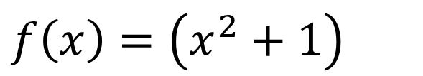
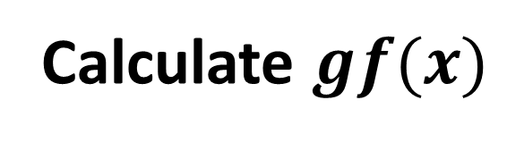
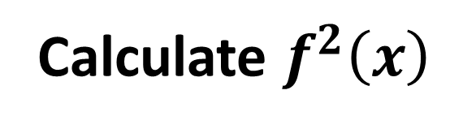

$f\left(x\right)=x^{2}+1$ and $g\left(x\right)=4x−2$
Calculate $gf(x)$
Calculate $f^{2}\left(x\right)$
$$f\left(x\right)=\left(x^{2}+1\right)$$
$f\left(x\right)=x^{2}$ + 1
$${f\left(x^{2}+1\right)=\left(x^{2}+1\right)}^{2}+1$$
$$g\left(x^{2}+1\right)=4\left(x^{2}+1\right)−2$$
$=4x^{2}+2$

Slide 7

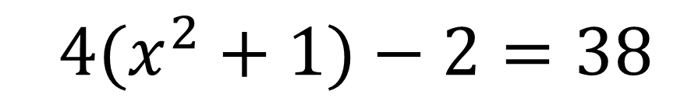
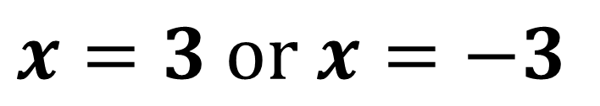
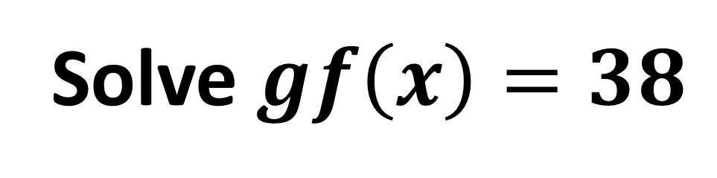
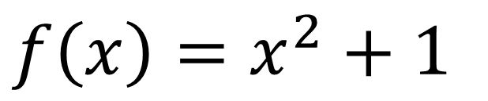
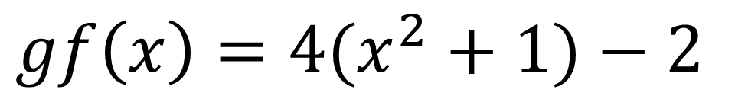
$f\left(x\right)=x^{2}+1$ and $g\left(x\right)=4x−2$
Solve $gf\left(x\right)=38$
$f\left(x\right)=x^{2}+1$
$$gf\left(x\right)=4(x^{2}+1)−2$$
$$4(x^{2}+1)−2=38$$
$$x=3 or x=−3$$

Slide 8
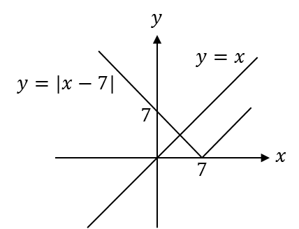
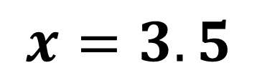
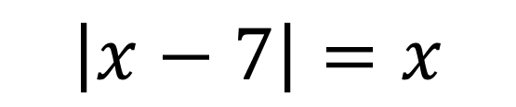
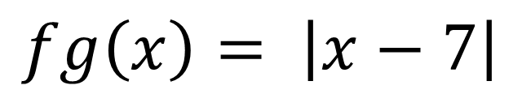
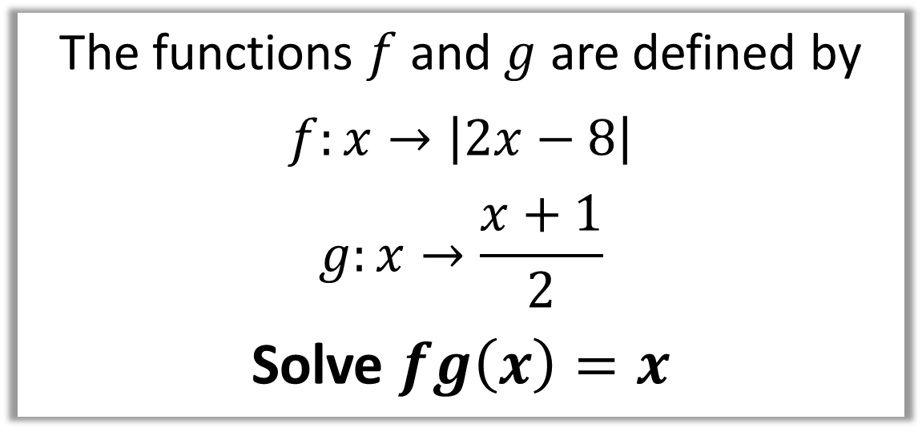
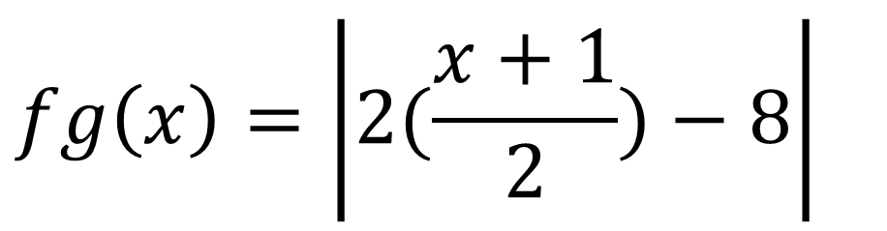
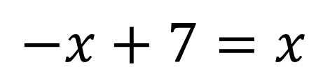
The functions $f$ and $g$ are defined by
$$f:x→\left|2x−8\right|$$
$$g:x→\frac{x+1}{2}$$
Solve $fg\left(x\right)=x$
$$\left|x−7\right|=x$$
$$fg\left(x\right)=\left|2(\frac{x+1}{2})−8\right|$$
$$−x+7=x$$
$$fg\left(x\right)= \left|x−7\right|$$
$$x=3.5$$

Slide 9
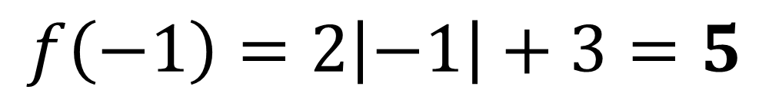
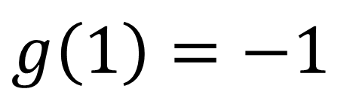
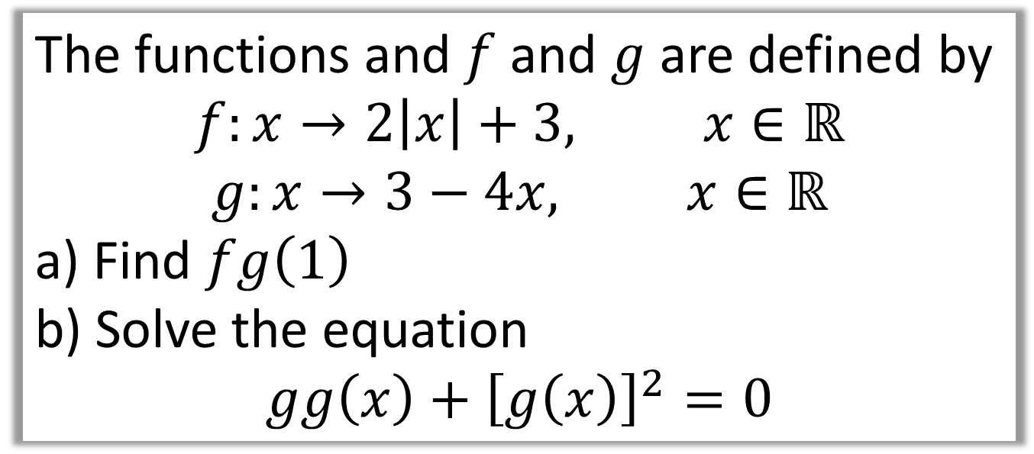
The functions and $f$ and $g$ are defined by
$$f:x→2\left|x\right|+3, x∈ℝ$$
$$g:x→3−4x, x∈ℝ$$
a) Find $fg\left(1\right)$
b) Solve the equation
$$gg\left(x\right)+{\left[g\left(x\right)\right]}^{2}=0$$
a)
$$g\left(1\right)=−1$$
$$f\left(−1\right)=2\left|−1\right|+3=5$$

Slide 10

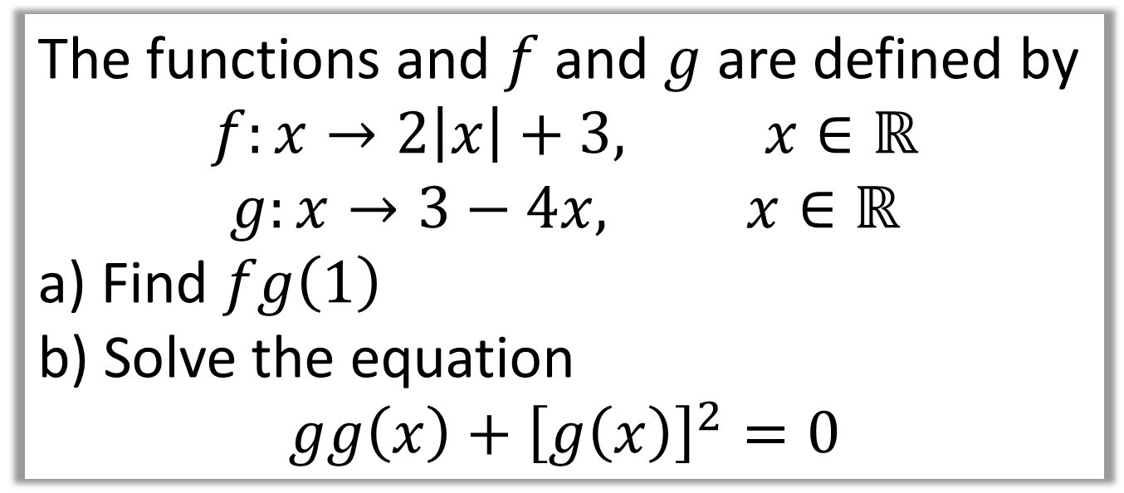

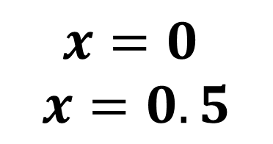
The functions and $f$ and $g$ are defined by
$$f:x→2\left|x\right|+3, x∈ℝ$$
$$g:x→3−4x, x∈ℝ$$
a) Find $fg\left(1\right)$
b) Solve the equation
$$gg\left(x\right)+{\left[g\left(x\right)\right]}^{2}=0$$
b)
$$3−4\left(3−4x\right)+{\left(3−4x\right)}^{2}=0$$
$$3−12+16x+9−24x+16x^{2}=0$$
$$16x^{2}−8x=0$$
$$x=0$$
$$x=0.5$$
$$8x\left(2x−1\right)=0$$

Slide 11
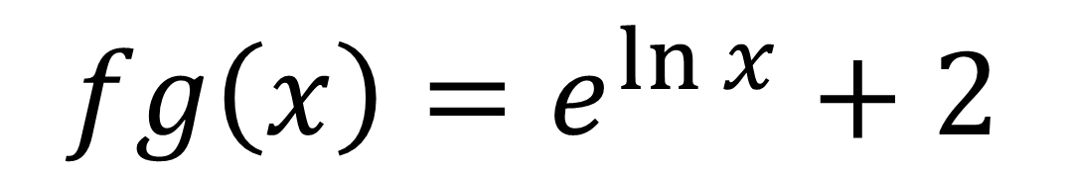
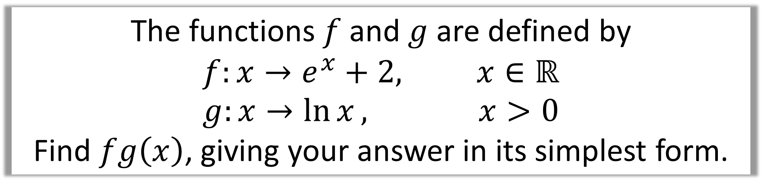
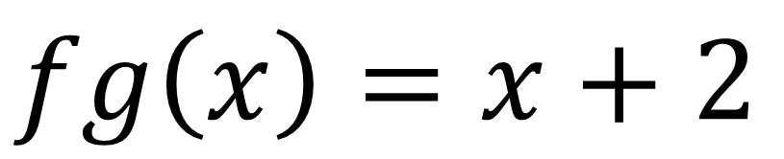
The functions $f$ and $g$ are defined by
$$f:x→e^{x}+2, x∈ℝ \\ g:x→\ln{x}, x>0$$
Find $fg\left(x\right)$, giving your answer in its simplest form.
$$fg\left(x\right)=e^{\ln{x}}+2$$
$$fg\left(x\right)=x+2$$

