Slide 1
Data Collection
Large Data Set
Chapter 1
(Part 4 of 4)

Slide 2
Large Data Set
All A Level exam boards are obligated
to provide a ‘large data set’.
Data in exam questions will often be from this set, and you are encouraged to explore this data.

Slide 3
Large Data Set
It is important to note that you are expected
to be familiar with this data set
before you go into your exam,
including some basic geographic knowledge!

Slide 4
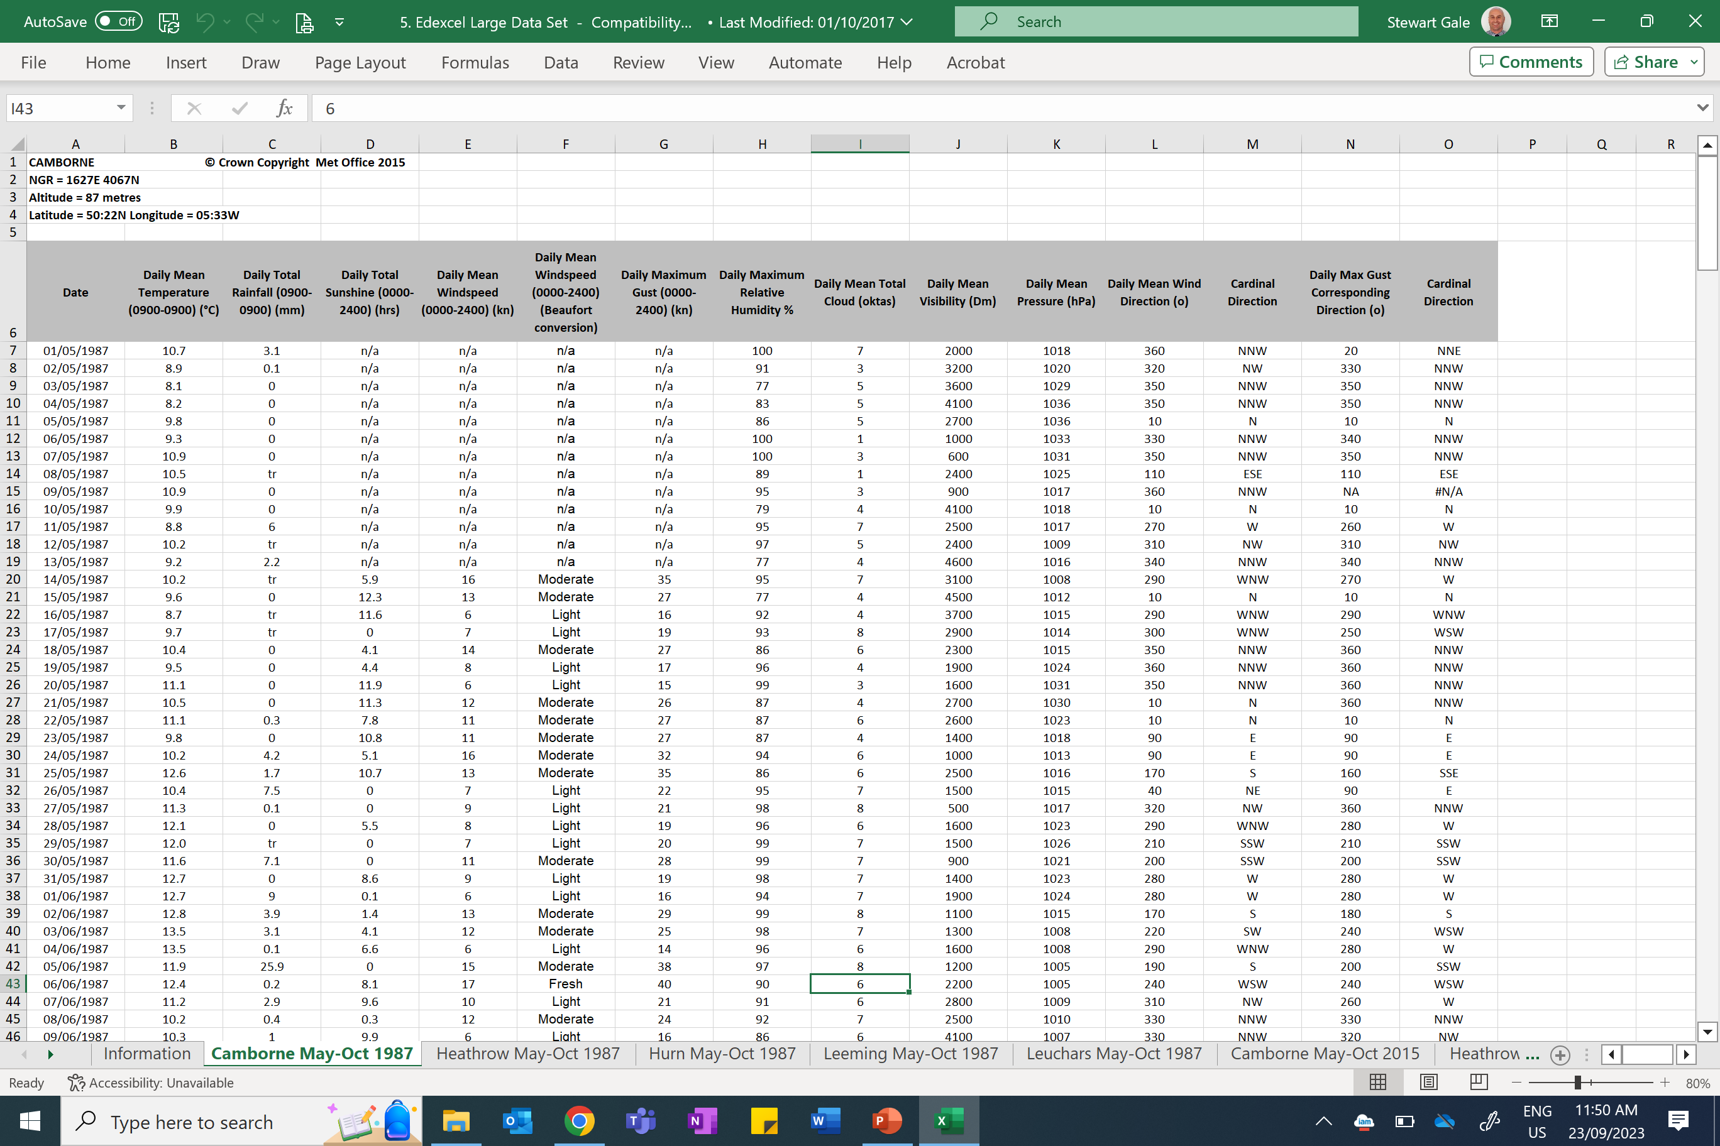

Slide 5
Data Set Source
The data set consists of weather data samples provided by
the Met Office for five UK weather stations
and three overseas weather stations
in the time periods May to October 1987 and May to October 2015.
The weather stations are:
in the UK - Camborne, Heathrow, Hurn, Leeming and Leuchars
overseas - Beijing, Jacksonville and Perth Further

Slide 6
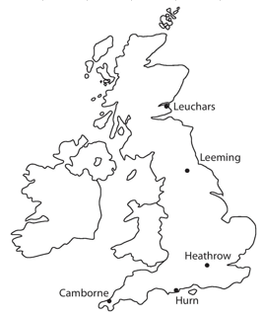
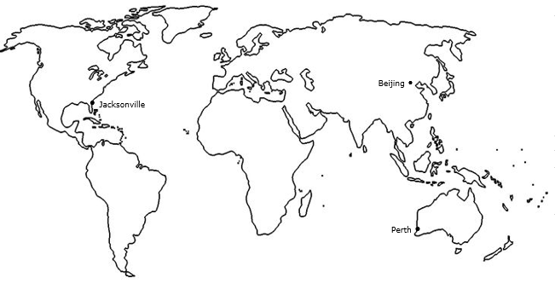
What You Need To Be Familiar With…
Locations

Slide 7
What You Need To Be Familiar With…
Dates
The data was recorded for:
May-Oct 1987
May-Oct 2015

Slide 8
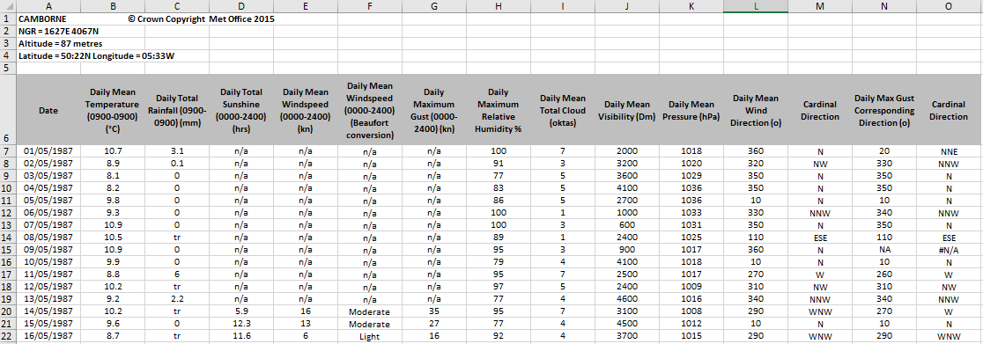
What You Need To Be Familiar With…
Variables involved and their respective units

Slide 9
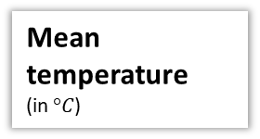
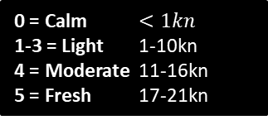
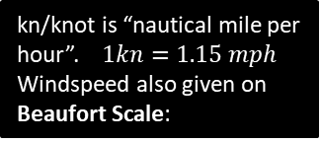
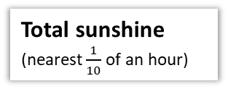
What You Need To Be Familiar With…
Variables involved and their respective units
Mean temperature
(in $°C$)
Total rainfall
(in mm)
Total sunshine
(nearest $\frac{1}{10}$ of an hour)
Mean Windspeed
Maximum Gust (in kn) is highest instantaneous wind speed.
kn/knot is “nautical mile per hour”. $1kn=1.15 mph$
Windspeed also given on Beaufort Scale:
0 = Calm $<1kn$
1-3 = Light 1-10kn
4 = Moderate 11-16kn
5 = Fresh 17-21kn
tr/trace means less than 0.05mm

Slide 10
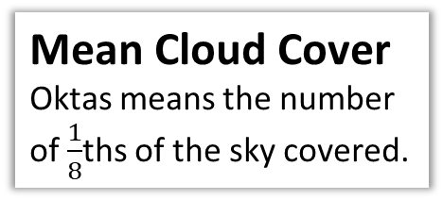
What You Need To Be Familiar With…
Variables involved and their respective units
Humidity
is the % of air saturation with water vapour. 100% is the maximum % water content air can contain.
Mean Visibility
How far (in metres) can be seen into the horizon during daylight hours.
Mean Cloud Cover
Oktas means the number of $\frac{1}{8}$ths of the sky covered.
Mean Pressure
In hectopascals (hPa)

Slide 11
What You Need To Be Familiar With…
Variables involved and their respective units
Wind Direction
Bearings or Compass

Slide 12
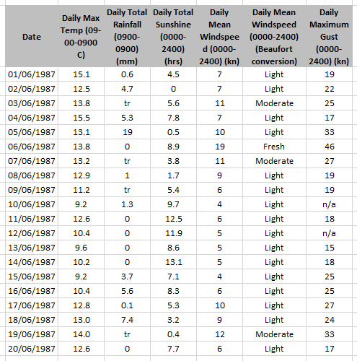
(a) Describe the type of data represented by daily total rainfall.
Alison is investigating daily maximum gust. She wants to select a sample of size 5 from the first 20 days in Hurn in June 1987. She uses the first two digits of the date as a sampling frame and generates five random numbers between 1 and 20.
b) State the type of sample selected by Alison.
c) Explain why Alison’s process might not generate a sample of size 5.
a
Continuous quantitate data.
b
Simple random sample.
c
Some of the data values are not available (n/a).

Slide 13
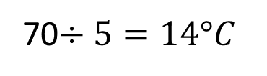
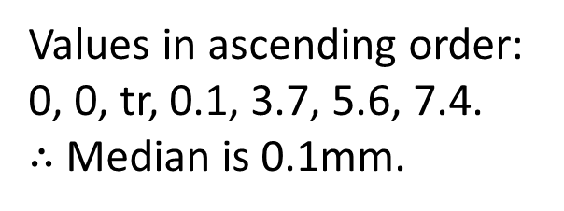
Calculate:
The mean daily maximum temperature for the first five days of June in Hurn in 1987.
The median daily total rainfall for the week of 14th June to 20th June inclusive.
The median daily total rainfall for the same week in Perth was 19.00mm. Karl states that more southerly countries experience higher rainfall during June. State with a reason whether your answer to part (b) supports this statement.
a
70$÷5=14°C$
b
Values in ascending order:
0, 0, tr, 0.1, 3.7, 5.6, 7.4.
$∴$ Median is 0.1mm.
c
This is a very small sample from a single location in each country so does not provide enough evidence to support Karl’s statement.

