Slide 1
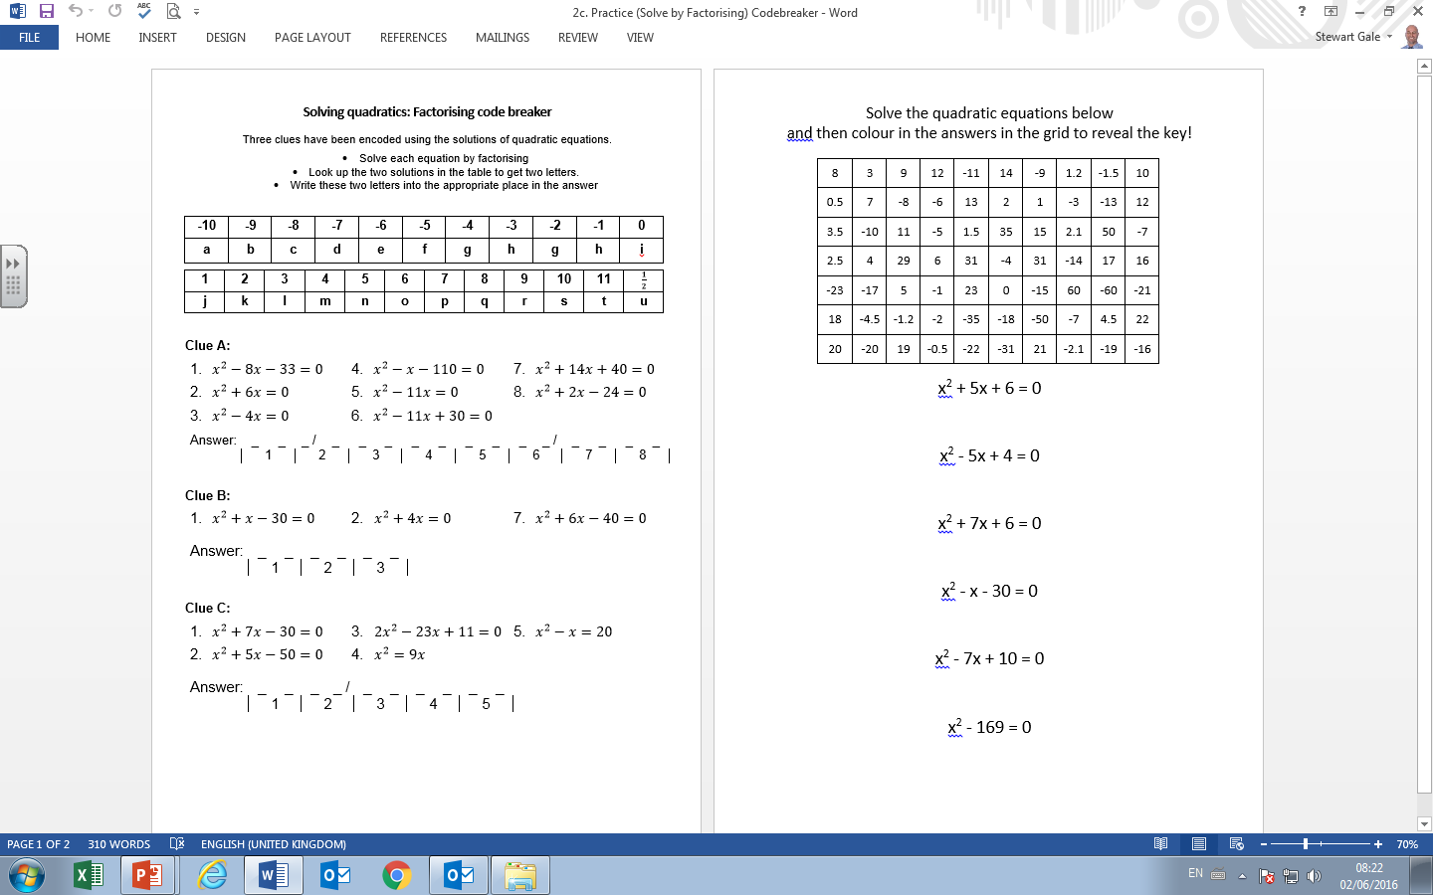

Slide 2
ANSWERS

Slide 3
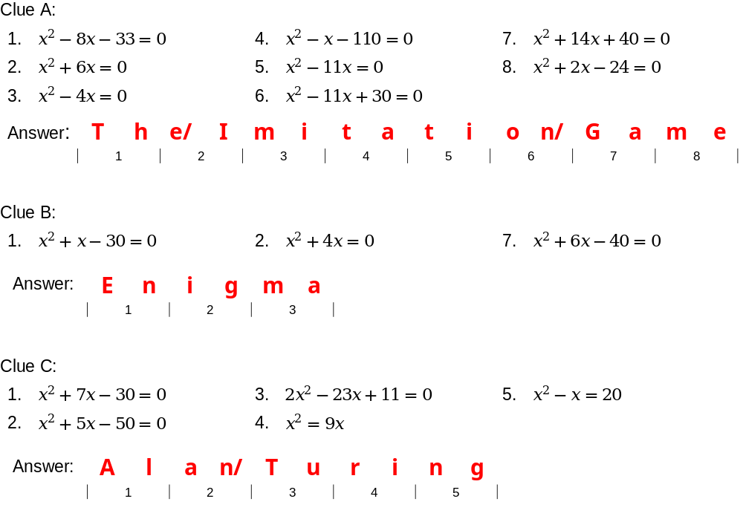

Slide 4
