Slide 1
LO: Describing
Parabolas

Slide 2
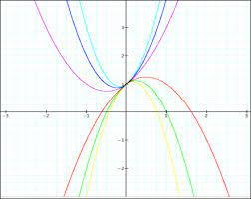
Sketch a parabola.

Slide 3
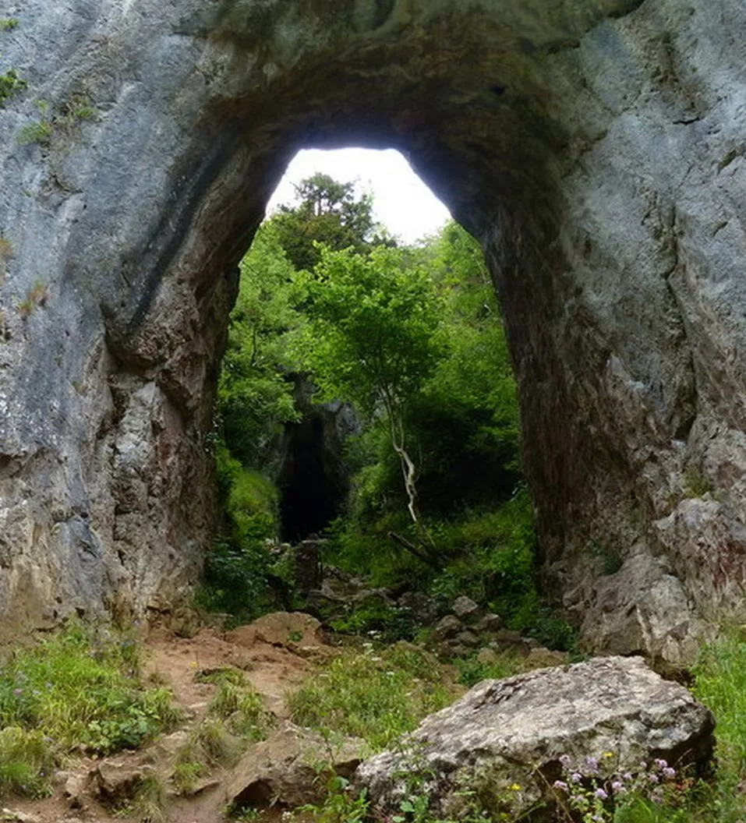
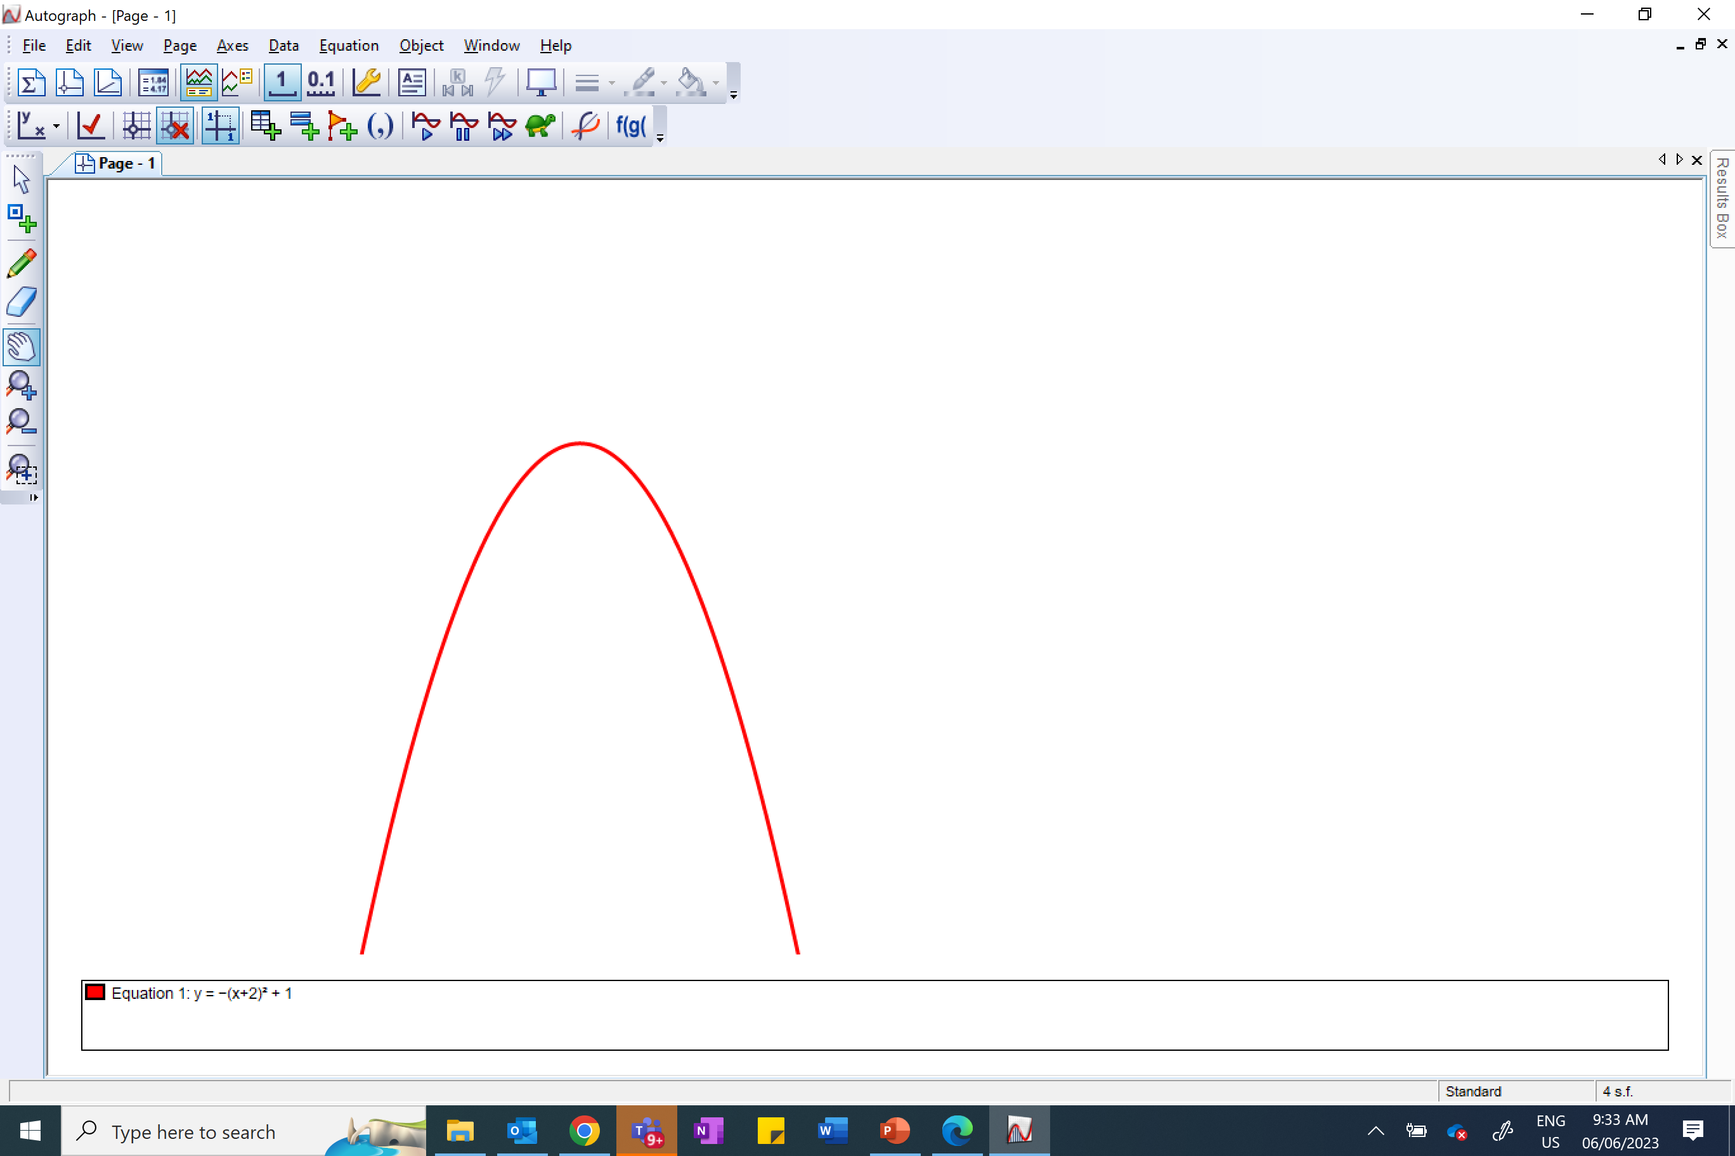
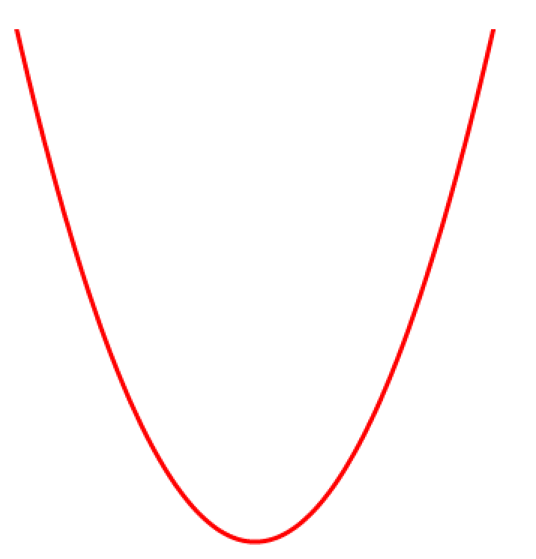
Which is concave and which is convex?
convex
concave

Slide 4
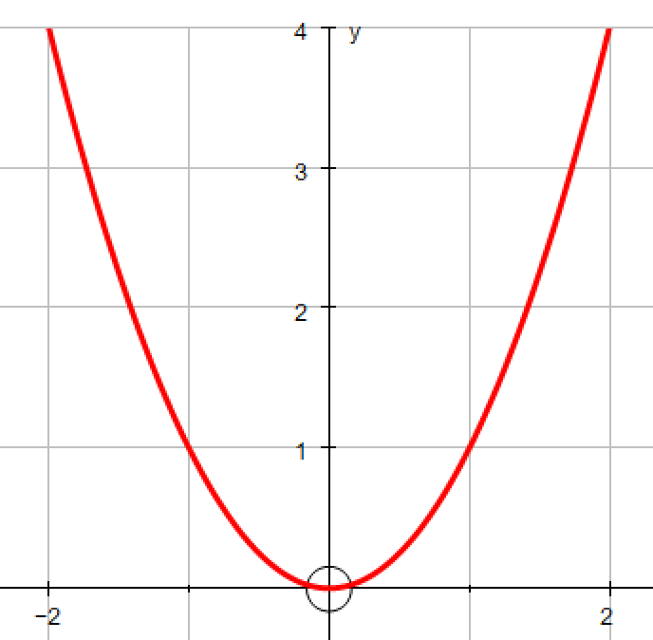
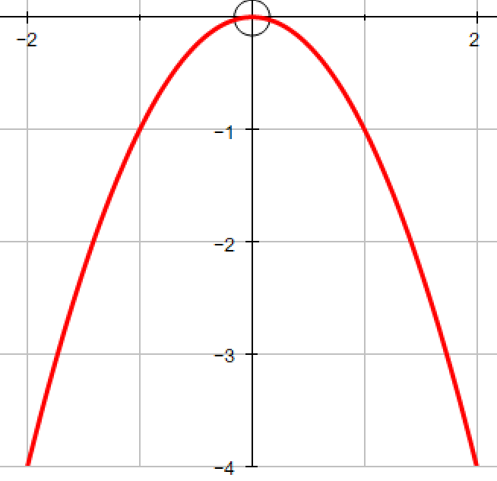
What is the main difference between these two graphs?
Happy
Positive gradient
Sad
Negative gradient

Slide 5
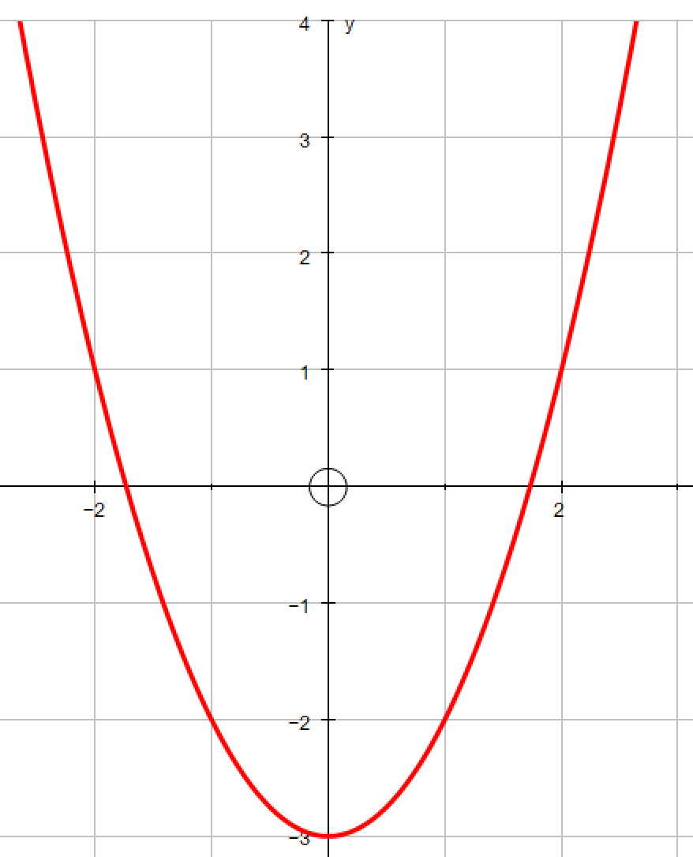
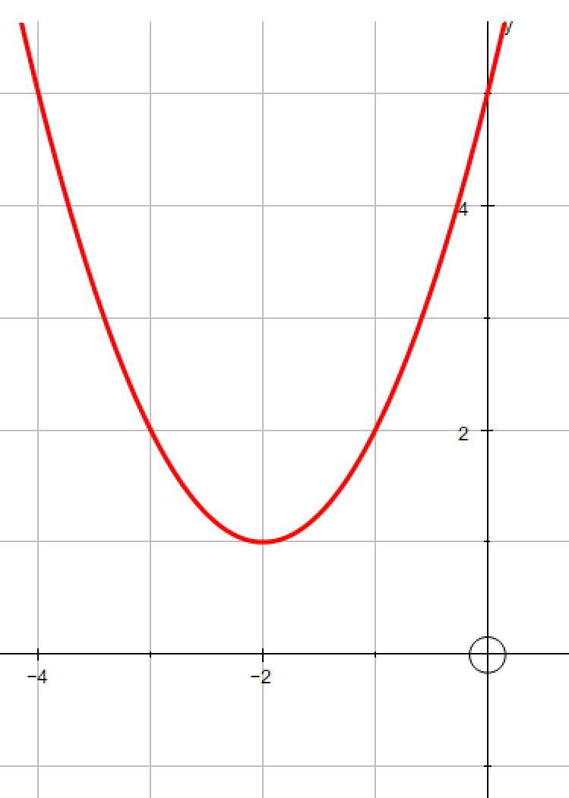
How many times does each graph cross the x axis?
One
Two
None

Slide 6
Where does each graph cross the y axis?
0
-3
5

Slide 7
What name can be given to this co-ordinate?
Vertex
Turning Point
Minimum Point
Possible Names?

