Slide 1
LO: Rates of Change
(Real Life Graphs)

Slide 2
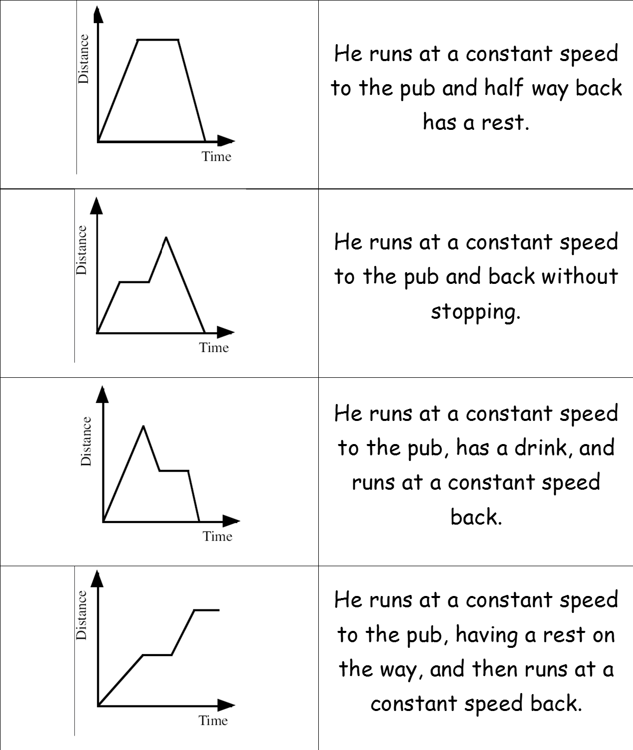
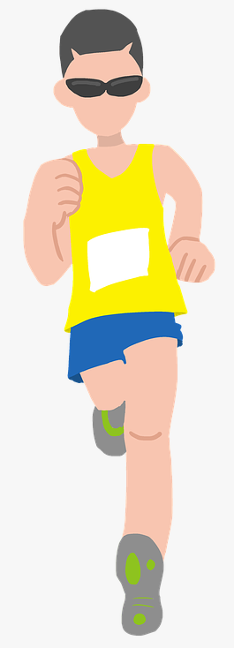
1
3
4
2
A
C
B
D

Slide 3
Relaxes in bath.
Cold tap turned off.
Hot and cold taps turned on.
Gets out of bath.
Gets into bath.
Pulls the plug.
Turns off hot tap.
5
Depth of Water
4
6
2
3
7
1
Time

Slide 4
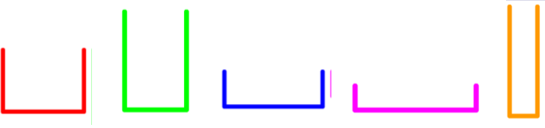
Can you predict the graph for each beaker?
Notes:
Start by explaining that the we are going to produce a graph of the depth of water in a flask as it fills with water. Note that the water flows out of the tap at a constant rate.
As the first flask fills up the graph of depth against time will be drawn. Ask pupils to tell you how many cm are filled each second for the flask.
Ask pupils to predict the slope of the graph for the new flask compared to the previous flask. Ask pupils to justify why they think the graph will be steeper or less steep than before.
Continue for each flask in turn. Establish the depth in the narrowest flask will increase the fastest and therefore produce the steepest graph. The depth in the widest flask will increase the slowest.
Ask pupils to explain why all the lines pass through the origin.
Ask pupils to explain why the lines are straight.
Ask pupils to explain what would happen if the water from the tap did not flow out at a constant rate. For example, in real life the rate of the water coming out of the tap would speed up as the tap is turned on. How would this affect the shape of the graph?

Slide 5
Discuss the difference between
the two graphs.
Speed
Speed
Time
Time

Slide 6
Notes:
Establish that if something is rising rapidly over time it will have a steeper and steeper gradient. If something is falling rapidly it will have a steeper negative (or downward) gradient. If something is rising or falling steadily then the graph will be straight.
Ask pupils what a horizontal section of graph would represent.
Each of the graphs in this example illustrates trends rather than accurate information.

Slide 7
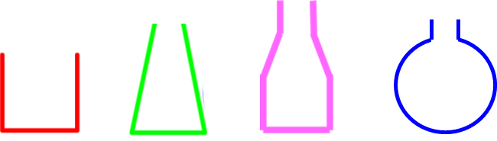
Can you predict the graph for each beaker?
Notes:
Start by explaining that the we are going to produce a graph of the depth of water in a flask as it fills with water. Note that the water flows out of the tap at a constant rate.
As the first flask fills up the graph of depth against time will be drawn.
Ask pupils to predict the shape of the next graph before it is drawn, justifying their explanations. Establish that the wider the flask is at a given point the loner it will take for the water to increase in depth.
Continue for each flask in turn.
Ask pupils if we can use the graph to work out the capacity of each flask.

Slide 8
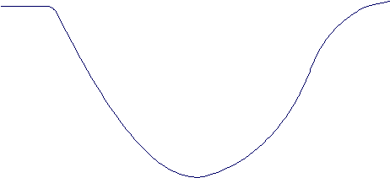
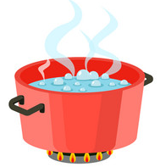

This graphs shows how the temperature of the water
in a pan changes when
frozen peas are added.
Temperature of water
Time
Locate the point on the graph that shows when the peas are added to the water.
What is happening in the portion of the graph that slopes downwards?
What is happening in the portion of the graph that slopes upwards?

