Slide 1
FM: Equation of a Circle

Slide 2
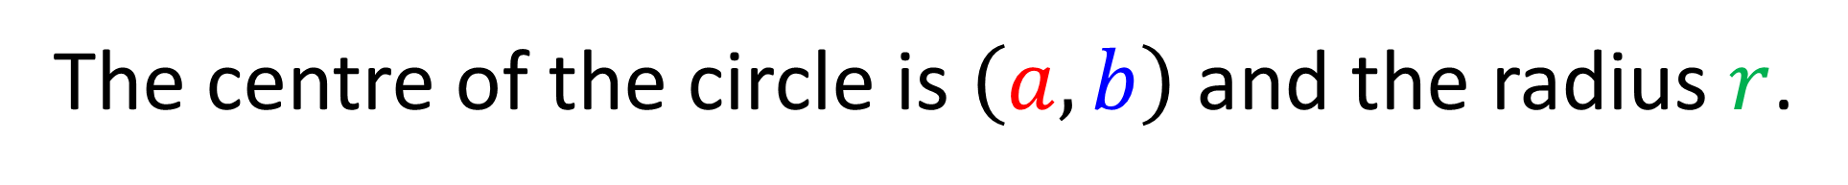


The equation of a circle can be given as
$${\left(x−a\right)}^{2}+{\left(y−b\right)}^{2}=r^{2}$$
$$y$$
(a, b)
$$x$$
The centre of the circle is $\left(a,b\right)$ and the radius $r$.

Slide 3
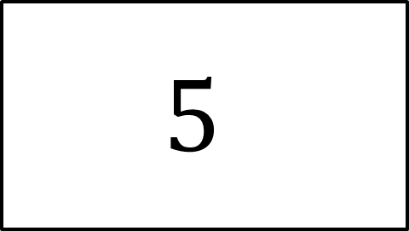
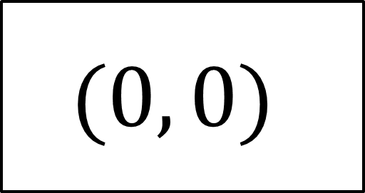
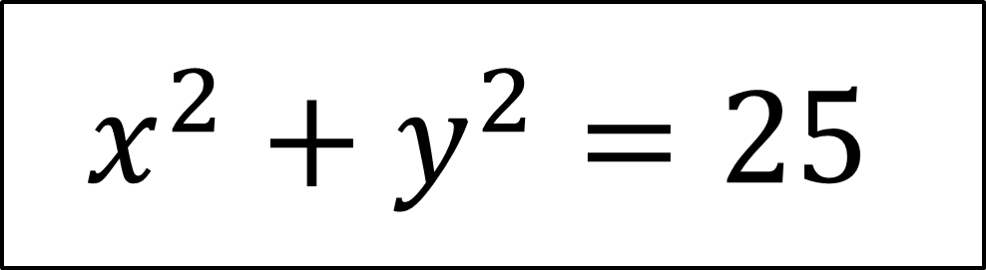
Centre
Radius
$$(0, 0)$$
$$5$$
Equation
$$x^{2}+y^{2}=25$$

Slide 4
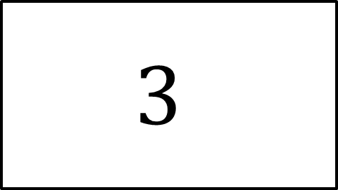
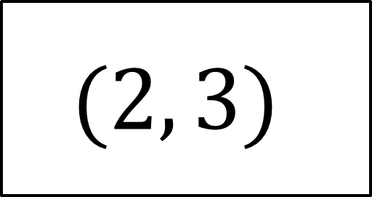
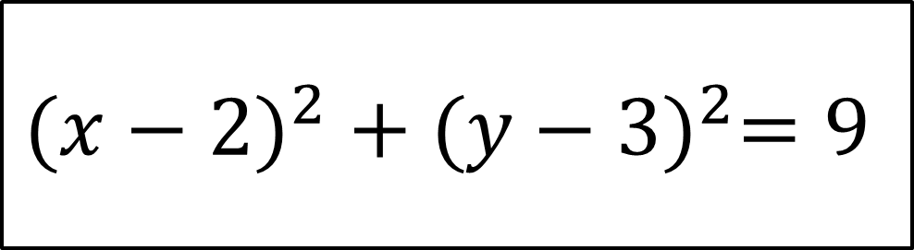
Centre
Radius
$$(2, 3)$$
$$3$$
Equation
$${(x−2)}^{2} + {(y−3)}^{2}=9$$

Slide 5
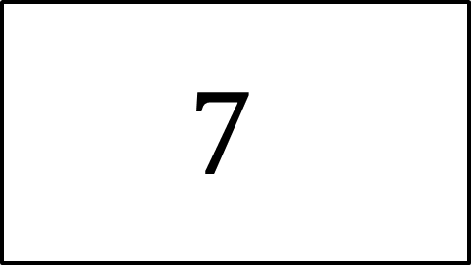
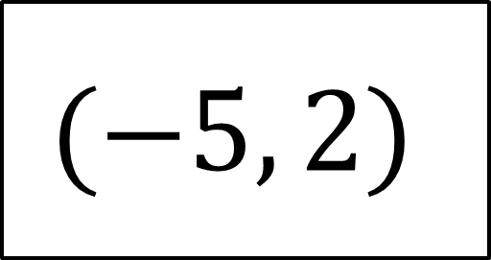
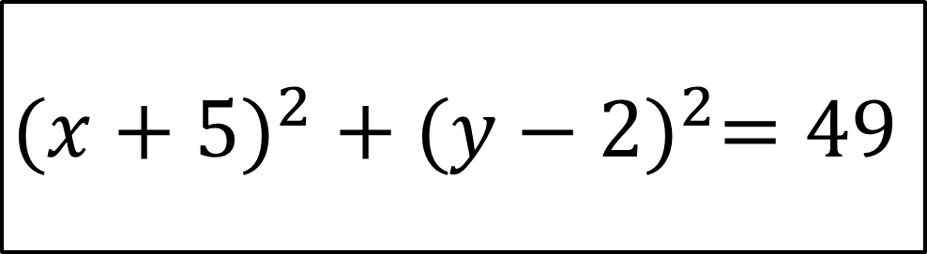
Centre
Radius
$$(−5, 2)$$
$$7$$
Equation
$${(x+5)}^{2} +{ (y−2)}^{2}=49$$

Slide 6
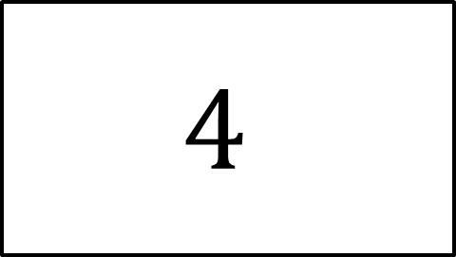
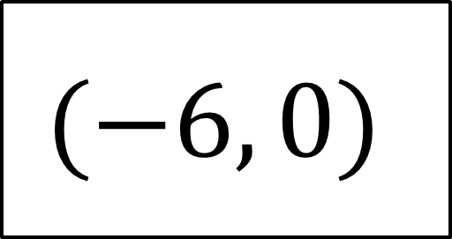
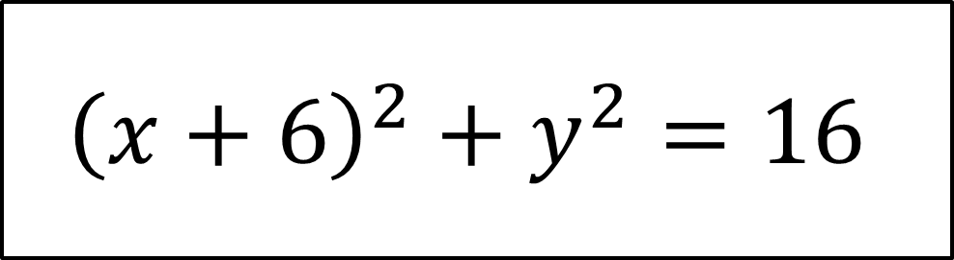
Equation
$${\left(x+6\right)}^{2}+y^{2}=16$$
Centre
Radius
$$(−6, 0)$$
$$4$$

Slide 7
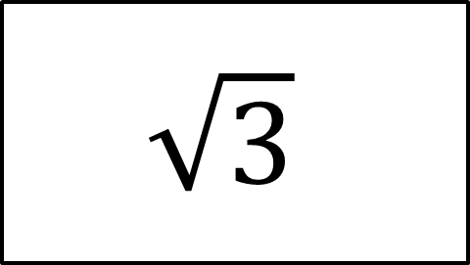
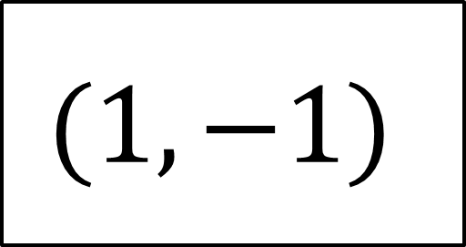
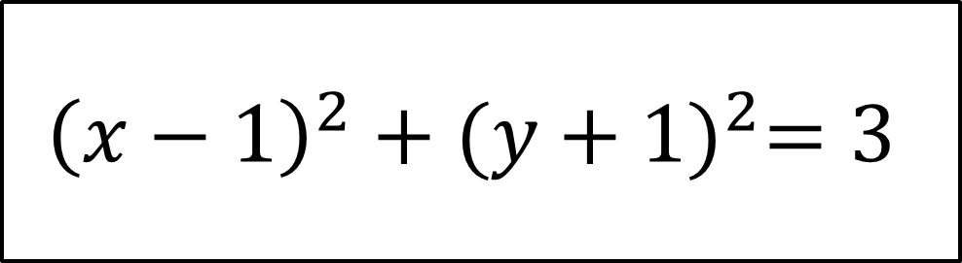
Equation
$${\left(x−1\right)}^{2}+{(y+1)}^{2}=3$$
Centre
Radius
$$(1, −1)$$
$$\sqrt{3}$$

Slide 8
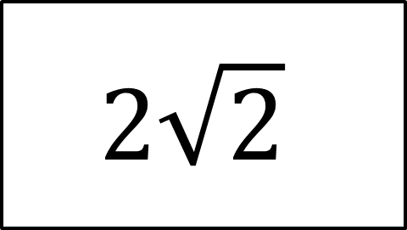
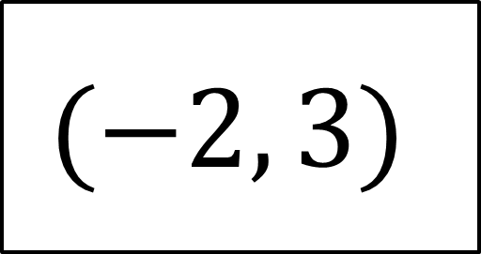
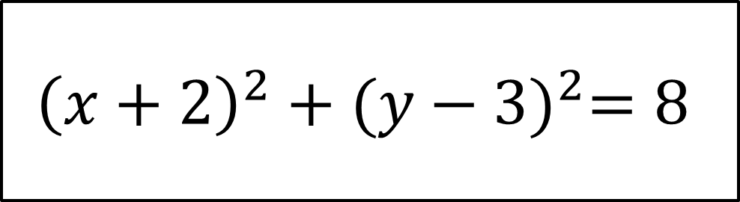
Circles – Equation of a Circle
Equation
$${\left(x+2\right)}^{2}+{(y−3)}^{2}=8$$
Centre
Radius
$$(−2, 3)$$
$$2\sqrt{2}$$

Slide 9
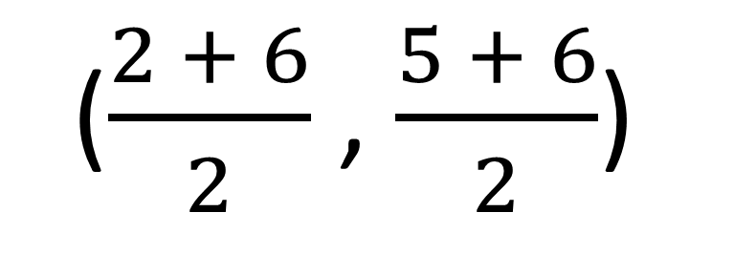


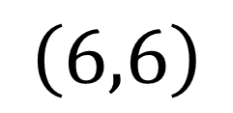
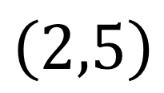
Mid points
$$\left(6,6\right)$$
$$M$$
$\left(2,5\right)$
What is the co-ordinate of M?
($\frac{2 + 6}{2}$ , $\frac{5 + 6}{2}$)
$$M=\left(4, 5.5\right)$$

Slide 10
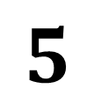
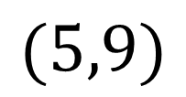
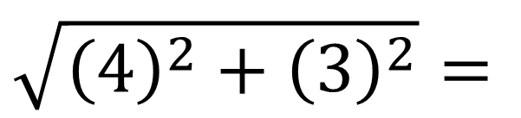
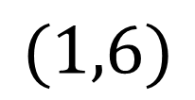
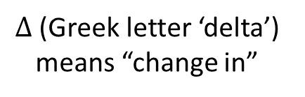


Distance between two points
What is the distance between these two points?
$$(5,9)$$
$$Δy=3$$
$Δ$ (Greek letter ‘delta’)
means “change in”
$$(1,6)$$
$$Δx=4$$
$$\sqrt{{\left(4\right)}^{2}+{\left(3\right)}^{2}}=$$
$$5$$

Slide 11
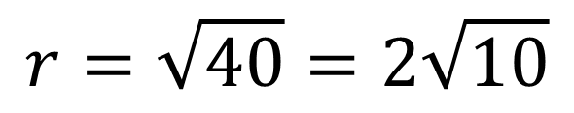

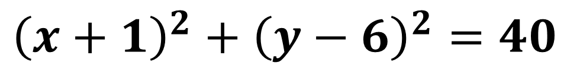

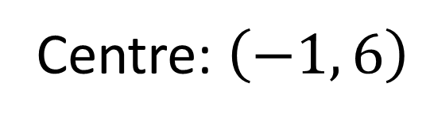
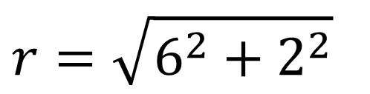
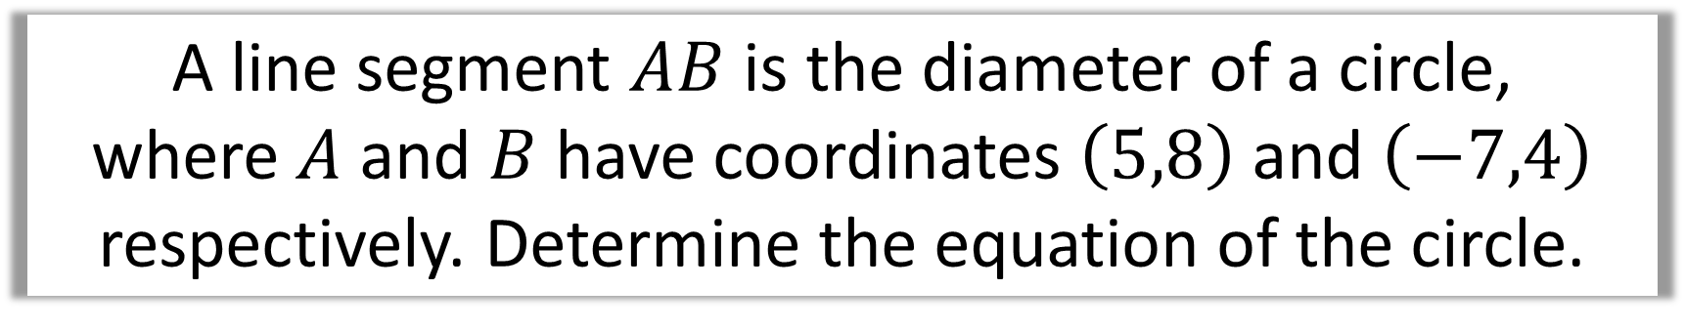
A line segment $AB$ is the diameter of a circle,
where $A$ and $B$ have coordinates $\left(5,8\right)$ and $\left(−7,4\right)$ respectively. Determine the equation of the circle.
Centre: $\left(−1, 6\right)$
$$A\left(5,8\right)$$
$$B\left(−7,4\right)$$
$$r=\sqrt{6^{2}+2^{2}}$$
$$r=\sqrt{40}=2\sqrt{10}$$
$${\left(x+1\right)}^{2}+{\left(y−6\right)}^{2}=40$$

Slide 12
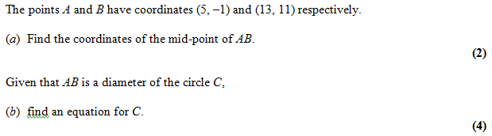
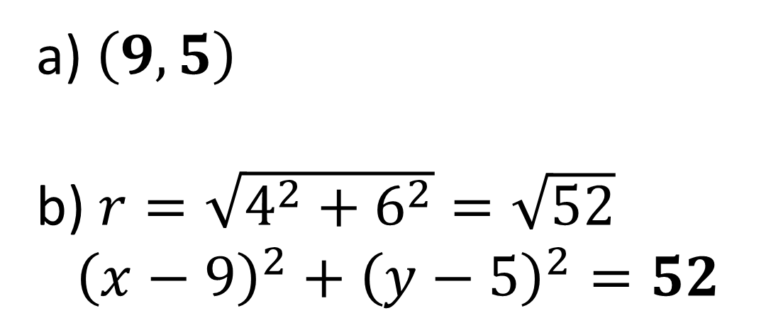
$\left(9, 5\right)$
$r=\sqrt{4^{2}+6^{2}}=\sqrt{52}$
${\left(x−9\right)}^{2}+{\left(y−5\right)}^{2}=52$

Slide 13
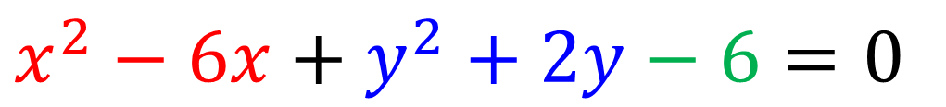
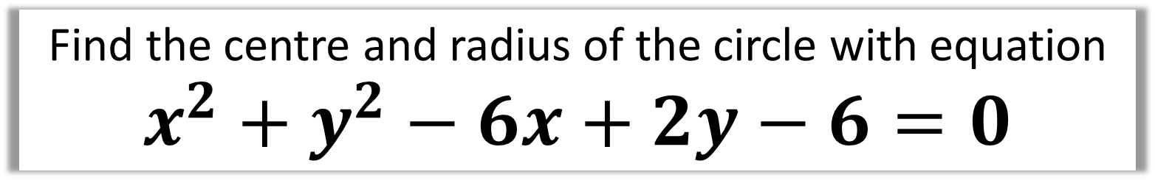
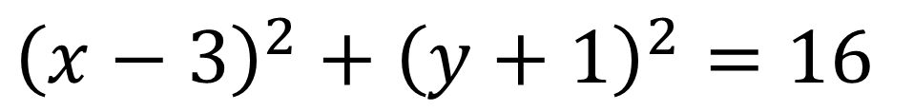
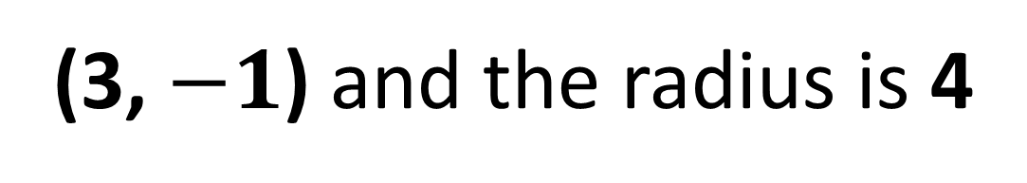
Find the centre and radius of the circle with equation
$$x^{2}+y^{2}−6x+2y−6=0$$
$$x^{2}−6x+y^{2}+2y−6=0$$
$${\left(x−3\right)}^{2}−9+{\left(y+1\right)}^{2}−1−6=0$$
$${\left(x−3\right)}^{2}+{\left(y+1\right)}^{2}=16$$
(3, $−1$) and the radius is 4

Slide 14
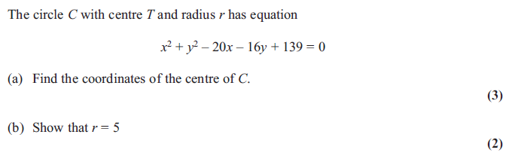

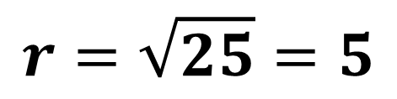


$$x^{2}−20x+y^{2}−16y+139=0$$
$${\left(x−10\right)}^{2}−100+{\left(y−8\right)}^{2}−64+139=0$$
$${\left(x−10\right)}^{2}+{\left(y−8\right)}^{2}=25$$
$$C\left(10,8\right)$$
$$r=\sqrt{25}=5$$

