Slide 1
FM: 3D Trigonometry and Pythagoras

Slide 2

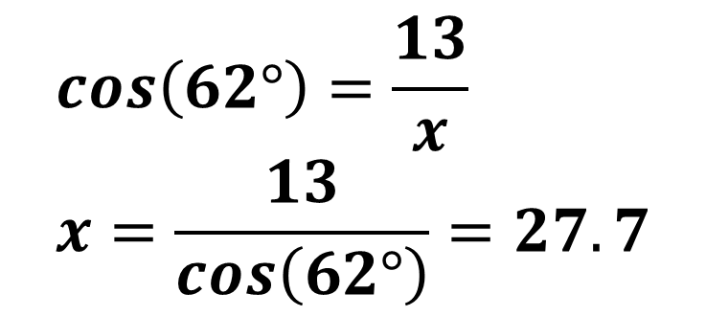



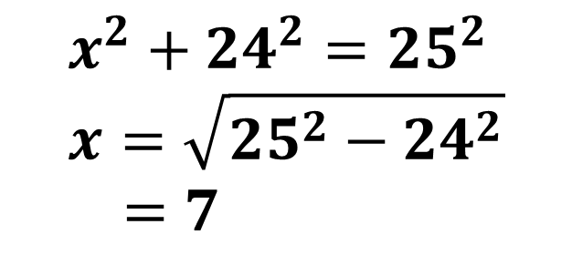
Find x
$$25$$
$$x^{2}+24^{2}=25^{2} \\ x=\sqrt{25^{2}−24^{2}} \\ =7$$
$$x$$
$$24$$
$$cos\left(62°\right)=\frac{13}{x} \\ x=\frac{13}{cos\left(62°\right)}=27.7$$
$$x$$
62 °
13

Slide 3
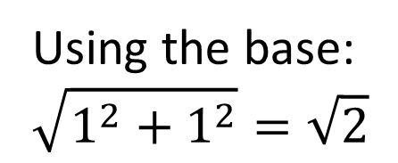


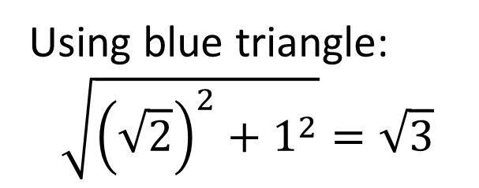



3D Pythagoras
Find the length of diagonal connecting two opposite corners of a unit cube.
Using blue triangle:
$$\sqrt{{\left(\sqrt{2}\right)}^{2}+1^{2}}=\sqrt{3}$$
$$1$$
$$\sqrt{3}$$
$$\sqrt{2}$$
$$1$$
$$1$$
Using the base:
$$\sqrt{1^{2}+1^{2}}=\sqrt{2}$$

Slide 4
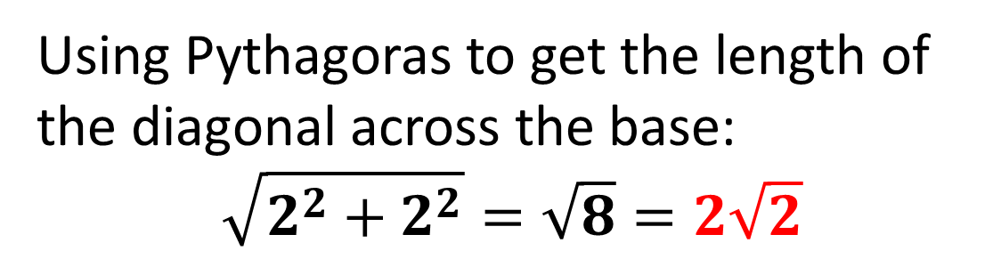


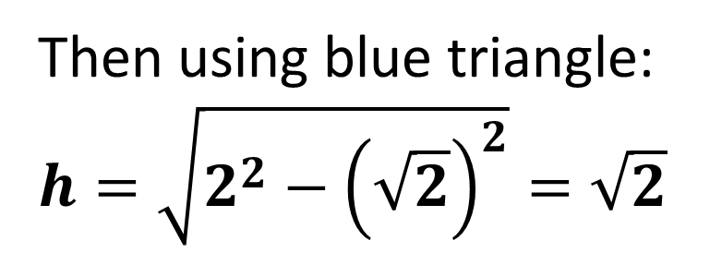
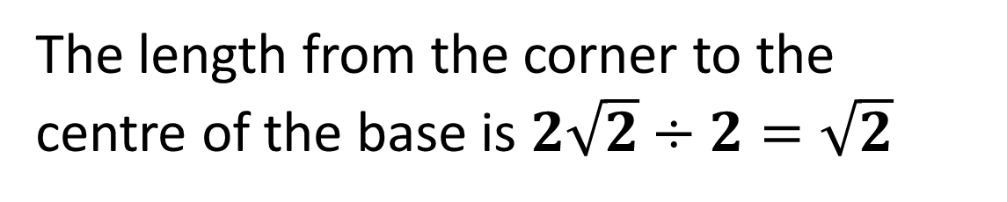
Determine the height of this pyramid.
Using Pythagoras to get the length of the diagonal across the base:
$$\sqrt{2^{2}+2^{2}}=\sqrt{8}=2\sqrt{2}$$
2
$$\sqrt{2}$$
$$\sqrt{2}$$
The length from the corner to the centre of the base is $2\sqrt{2}÷2=\sqrt{2}$
2
2
Then using blue triangle:
$$h=\sqrt{2^{2}−{\left(\sqrt{2}\right)}^{2}}=\sqrt{2}$$

Slide 5


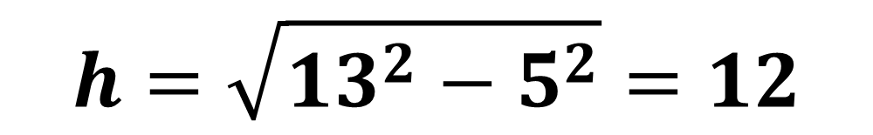
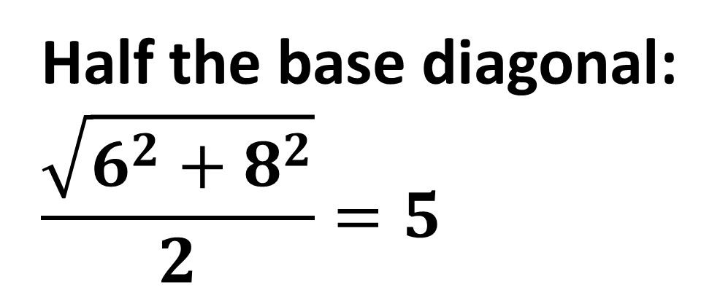
Determine the height of this pyramid.
13
Half the base diagonal:
$$\frac{\sqrt{6^{2}+8^{2}}}{2}=5$$
$$12$$
$$5$$
8
6
$$h=\sqrt{{13}^{2}−5^{2}}=12$$

Slide 6
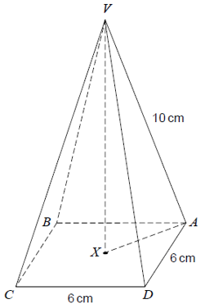
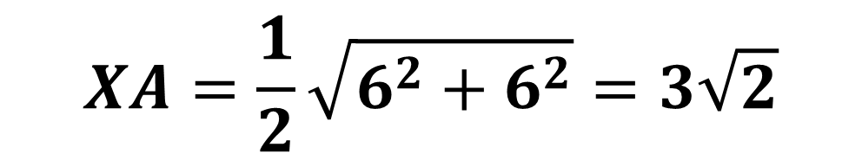
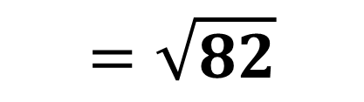

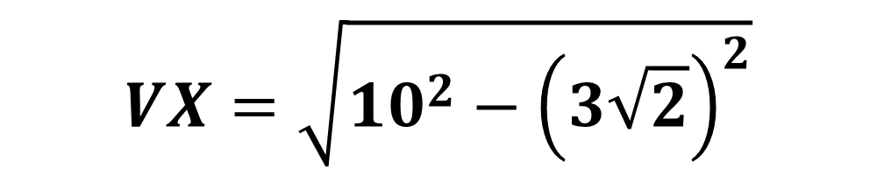
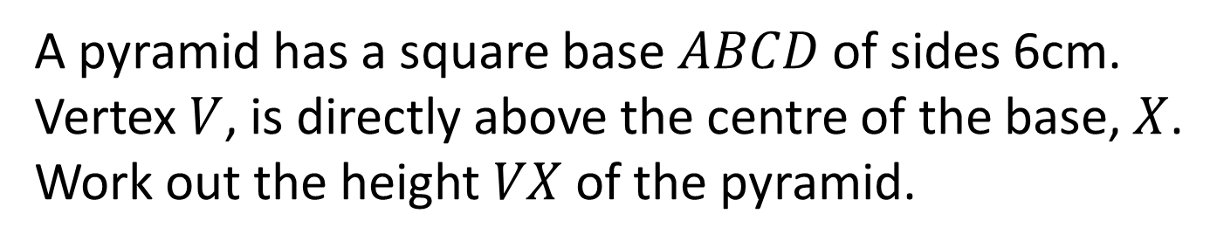
A pyramid has a square base $ABCD$ of sides 6cm.
Vertex $V$, is directly above the centre of the base, $X$.
Work out the height $VX$ of the pyramid.
$$XA=\frac{1}{2}\sqrt{6^{2}+6^{2}}=3\sqrt{2}$$
$$VX=\sqrt{{10}^{2}−{\left(3\sqrt{2}\right)}^{2}}$$
$$=\sqrt{100−18}$$
$$=\sqrt{82}$$

Slide 7

Angles between lines and planes
A plane is a
flat 2D surface.
When we want to find the angle between a line and a plane,
use the “drop method” –
imagine the line is a pen which you drop onto the plane.
The angle you want is between the original and dropped lines.
$$θ$$

Slide 8
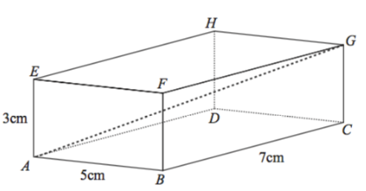
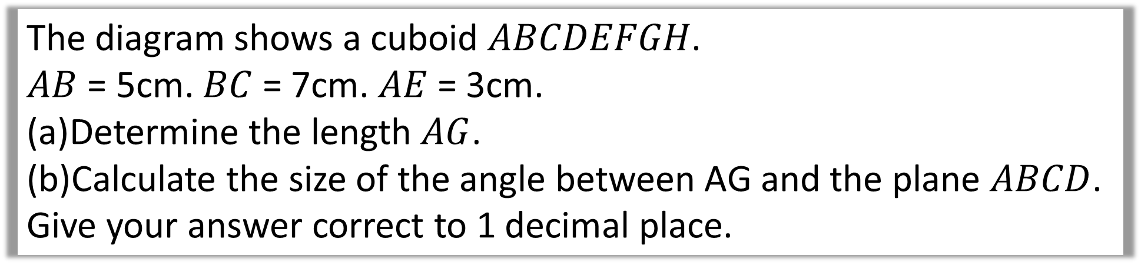
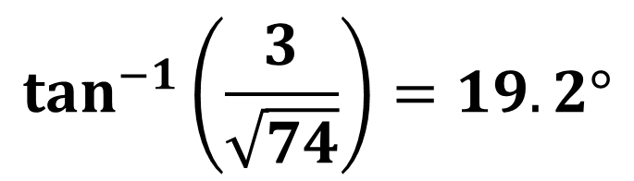
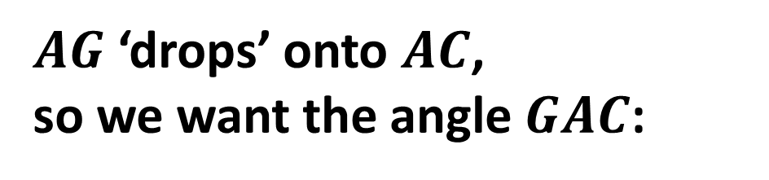
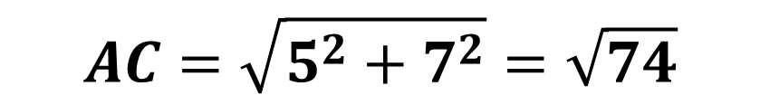
The diagram shows a cuboid $ABCDEFGH$.
$AB$ = 5cm. $BC$ = 7cm. $AE$ = 3cm.
Determine the length $AG$.
Calculate the size of the angle between AG and the plane $ABCD$.
Give your answer correct to 1 decimal place.
$$AC=\sqrt{5^{2}+7^{2}}=\sqrt{74}$$
$AG$ ‘drops’ onto $AC$,
so we want the angle $GAC$:
$$\tan^{−1}\left(\frac{3}{\sqrt{74}}\right)=19.2°$$

Slide 9
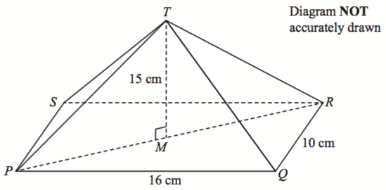
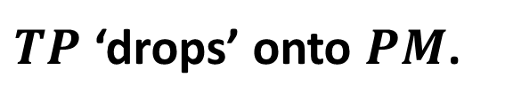
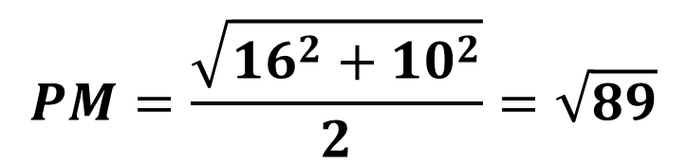
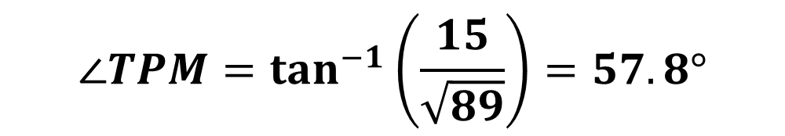
The diagram shows a pyramid with a horizontal rectangular base PQRS.
PQ = 16 cm. QR = 10 cm. M is the midpoint of the line PR.
The vertex, T, is vertically above M. MT = 15 cm.
Calculate the size of the angle between TP and the base PQRS.
Give your answer correct to 1 decimal place.
$TP$ ‘drops’ onto $PM$.
$$PM=\frac{\sqrt{{16}^{2}+{10}^{2}}}{2}=\sqrt{89}$$
$$∠TPM=\tan^{−1}\left(\frac{15}{\sqrt{89}}\right)=57.8°$$

Slide 10





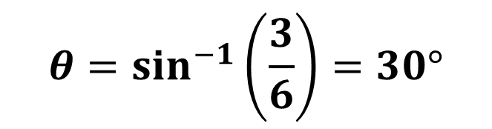



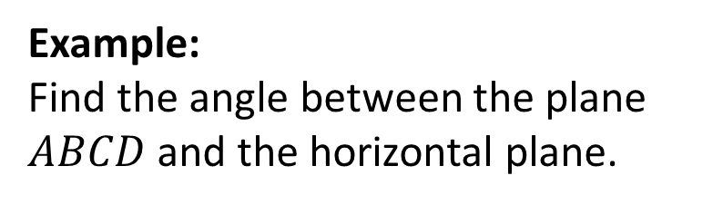
Angles between two planes
To find angle between two planes:
Use ‘line of greatest slope’
on one plane, before again ‘dropping’ down.
line of greatest slope
$$θ$$
$$B$$
Example:
Find the angle between the plane $ABCD$ and the horizontal plane.
$$6cm$$
$$C$$
$$3cm$$
line of greatest slope
$$θ=\sin^{−1}\left(\frac{3}{6}\right)=30°$$
$$A$$
$$θ$$
$$D$$

Slide 11



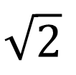






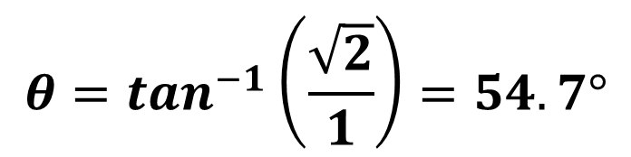




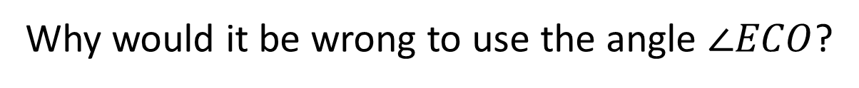


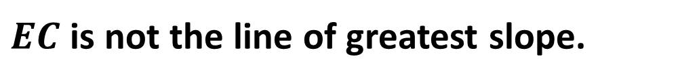
Find the angle between the planes $BCE$ and $ABCD$.
$$E$$
2
Why would it be wrong to use the angle $∠ECO$?
$$\sqrt{2}$$
$EC$ is not the line of greatest slope.
$$D$$
$$C$$
$$\sqrt{2}$$
$$O$$
2
$$A$$
2
$$B$$
$$E$$
$$\sqrt{2}$$
From $E$ a ball would roll down to the midpoint of $BC$.
$$D$$
$$C$$
$$θ$$
$$θ=\tan^{−1}\left(\frac{\sqrt{2}}{1}\right)=54.7°$$
$$O$$
1
$$A$$
$$B$$

Slide 12



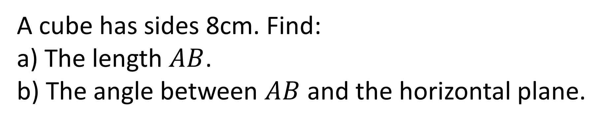


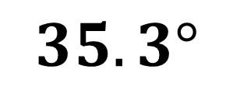


A cube has sides 8cm. Find:
a) The length $AB$.
b) The angle between $AB$ and the horizontal plane.
$$8\sqrt{3}$$
$$35.3°$$
$$B$$
$$8$$
$$C$$
$$8$$
$$A$$
$$8$$

Slide 13
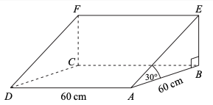
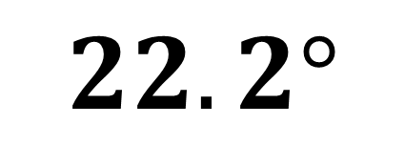
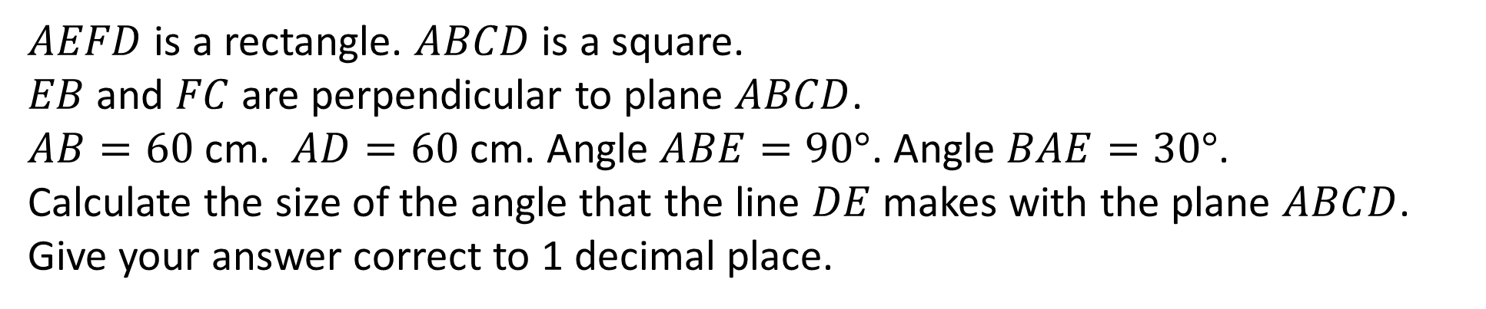
(on provided worksheet)
$AEFD$ is a rectangle. $ABCD$ is a square.
$EB$ and $FC$ are perpendicular to plane $ABCD$.
$AB=60$ cm. $AD=60$ cm. Angle $ABE=90°$. Angle $BAE=30°$.
Calculate the size of the angle that the line $DE$ makes with the plane $ABCD$.
Give your answer correct to 1 decimal place.
$$22.2°$$

