Slide 1
Exponentials and Logs
Linear Equations
Chapter 14
(Part 3 of 9)

Slide 2
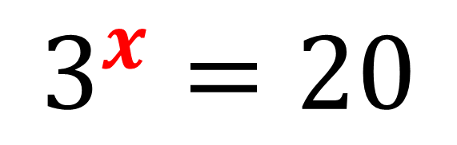
Solving Exponentials Equations
You will find that the unknow
will be the exponent.
$$3^{x}=20$$
The key to solve these equations is to
use the power law to turn the unknown into a coefficient rather than an exponent.

Slide 3
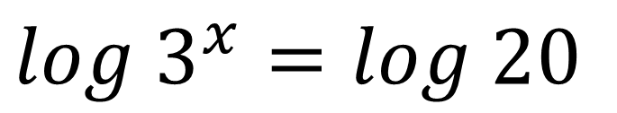
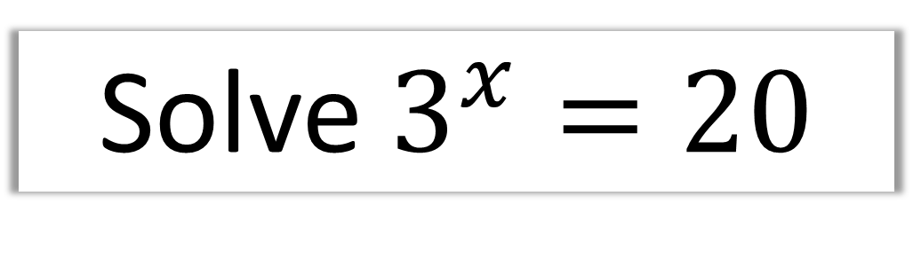
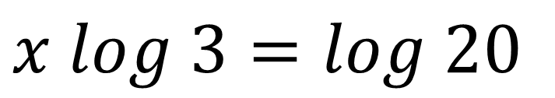
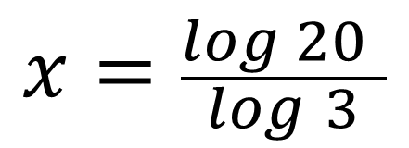
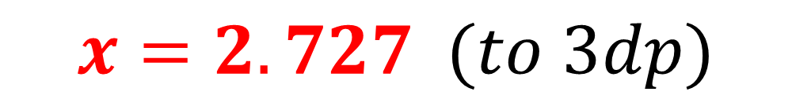
Solve $3^{x}=20$
$log$ $3^{x}=log 20$
logs of both sides
Power law
$x log$ $3=log 20$
$$x=\frac{log 20 }{log 3}$$
$$x=2.727 (to 3dp)$$

Slide 4
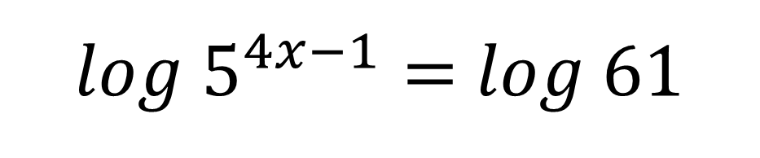
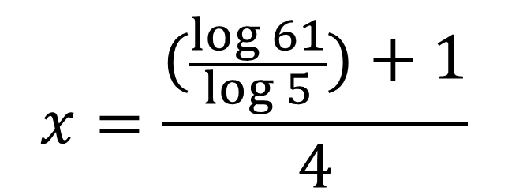
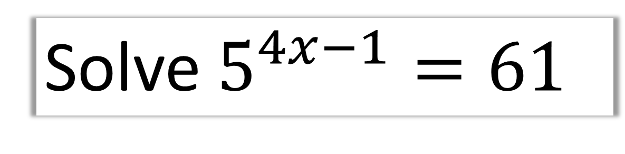
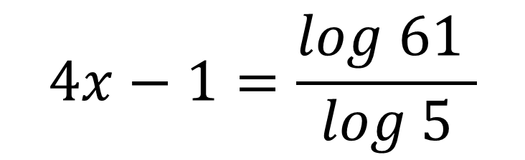
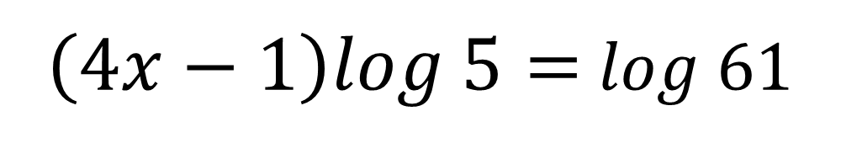
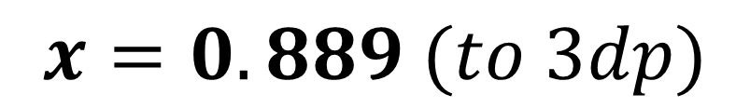
Solve $5^{4x−1}=61$
logs of both sides
$log{ 5}^{4x−1}=$ $log$ 61
Power law
$\left(4x−1\right)log \text{5}=$ $log$ 61
$$4x−1=\frac{log \text{61} }{log 5}$$
$$x=\frac{(\frac{\log{61}}{\log{5}})+1}{4}$$
$$x=0.889 (to 3dp)$$

Slide 5
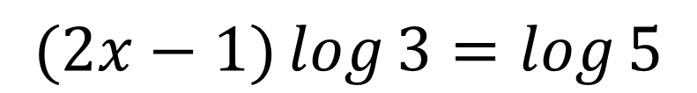
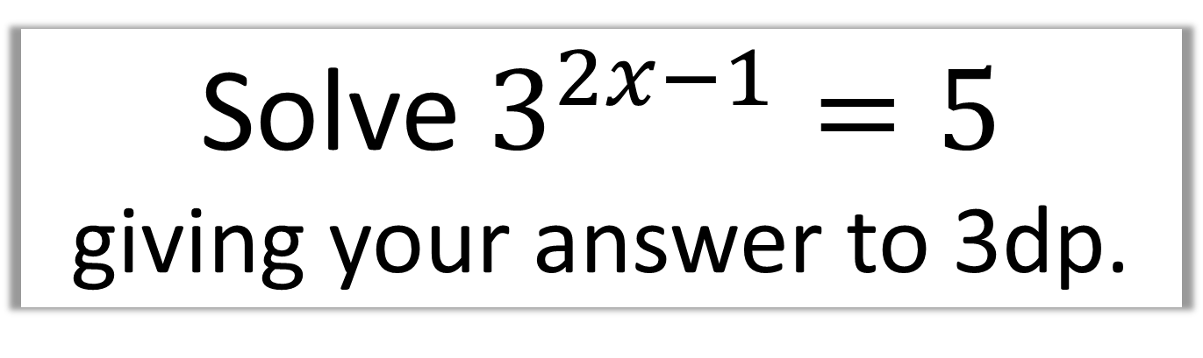
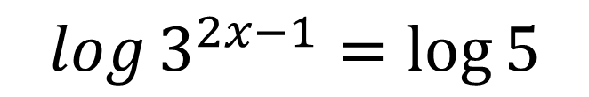
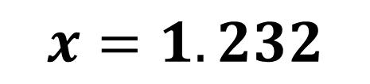
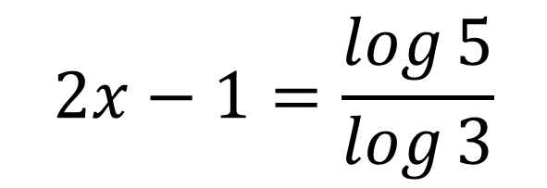
Solve $3^{2x−1}=5$
giving your answer to 3dp.
$$\log{3^{2x−1}}=\log{5}$$
$$(2x−1)\log{3}=\log{5}$$
$$2x−1=\frac{\log{5}}{\log{3}}$$
$$x=1.232$$

Slide 6
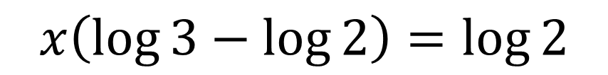
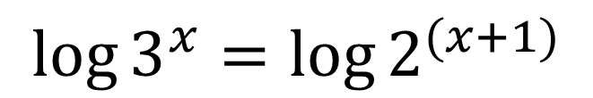
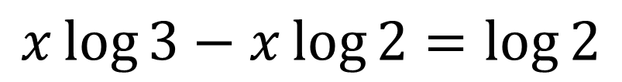
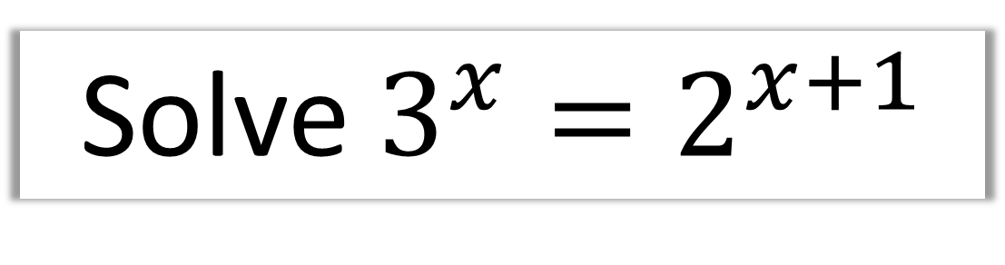
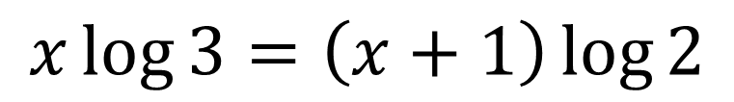
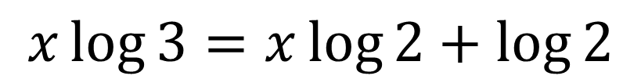
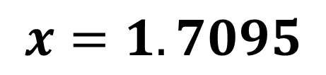
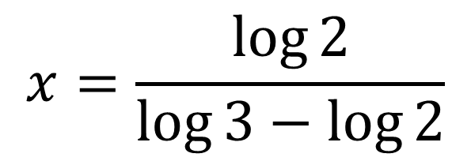
Solve $3^{x}=2^{x+1}$
$$\log{3^{x}}=\log{2^{(x+1)}}$$
$$x\left(\log{3}−\log{2}\right)=\log{2}$$
$$x\log{3}=\left(x+1\right)\log{2}$$
$$x=\frac{\log{2}}{\log{3}−\log{2}}$$
$$x\log{3}=x\log{2}+\log{2}$$
$$x=1.7095$$
$$x\log{3}−x\log{2}=\log{2}$$

Slide 7
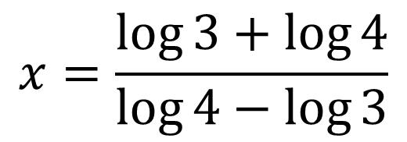


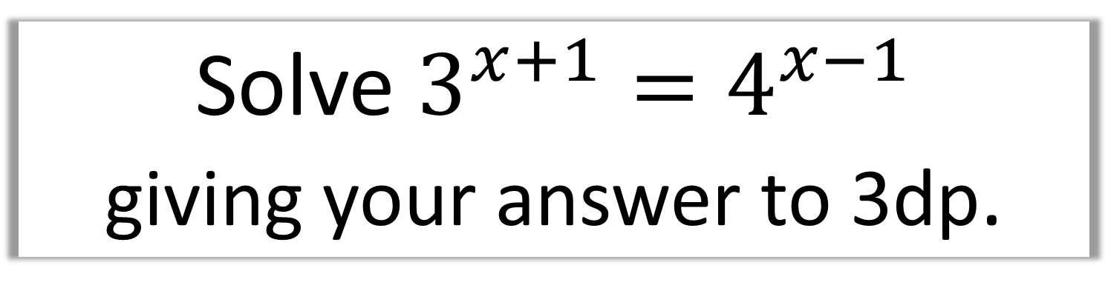



Solve $3^{x+1}=4^{x−1}$
giving your answer to 3dp.
$$\log{3^{x+1}}=\log{4^{x−1}}$$
$$x\left(\log{4}−\log{3}\right)=\log{3}+\log{4}$$
$$\left(x+1\right)\log{3}=\left(x−1\right)\log{4}$$
$$x=\frac{\log{3}+\log{4}}{\log{4}−\log{3}}$$
$$x\log{3}+\log{3}=x\log{4}−\log{4}$$
$$x=8.638$$
$$x\log{4}−x\log{3}=\log{3}+\log{4}$$

Slide 8
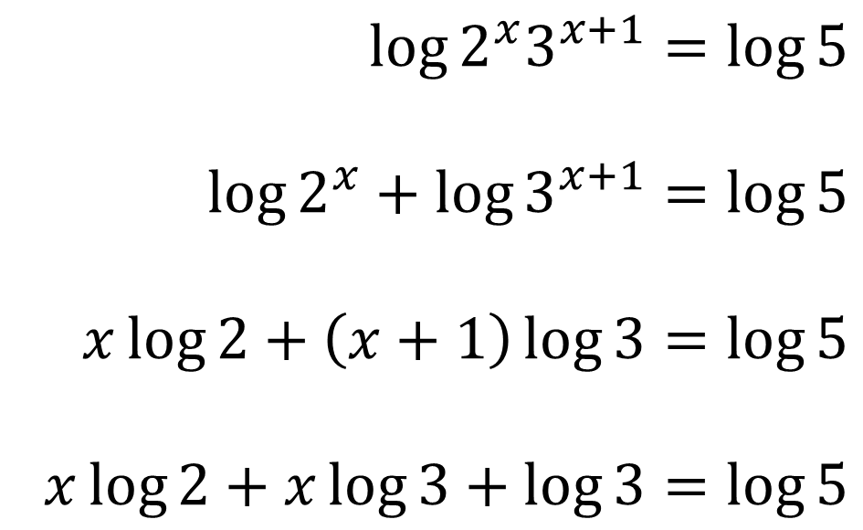

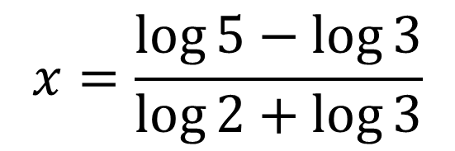
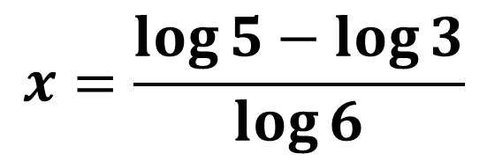

Solve $2^{x}3^{x+1}=5$
giving your answer in exact form.
$$\log{2^{x}3^{x+1}}=\log{5}$$
$$\log{2^{x}}+\log{3^{x+1}}=\log{5}$$
$$x\log{2}+\left(x+1\right)\log{3}=\log{5}$$
$$x\log{2}+x\log{3}+\log{3}=\log{5}$$
$$x \left(\log{2}+\log{3}\right)=\log{5}−\log{3}$$
$$x=\frac{\log{5}−\log{3}}{\log{2}+\log{3}}$$
$$x=\frac{\log{5}−\log{3}}{\log{6}}$$

