Slide 1
LO: Multiple and
Independent Events

Slide 2

True or False
When you roll a fair six sided dice,
it is harder to roll a six than a four.

Slide 3

True or False
In a lottery (1 to 49),
the six numbers 3, 12, 26, 37, 44, 45
are more likely to come up than
the six numbers 1, 2, 3, 4, 5, 6

Slide 4

True or False
In a ‘true or false’ quiz with ten questions,
you are certain to get five right if
you just guess.

Slide 5

True or False
After getting a head five times in a row,
the next coin is more likely to be
a tail than a head.
?

Slide 6
True or False
Peter rolls a dice ten times and gets tens sixes. The dice must be biased.

Slide 7


6 rolls of a dice were made twice.
Which set of rolls are more likely to happen?
Results A
Results B

Slide 8


Independent Events
?
If the probability of a previous event
has no effect on
the probability of another event,
then these events are independent.

Slide 9
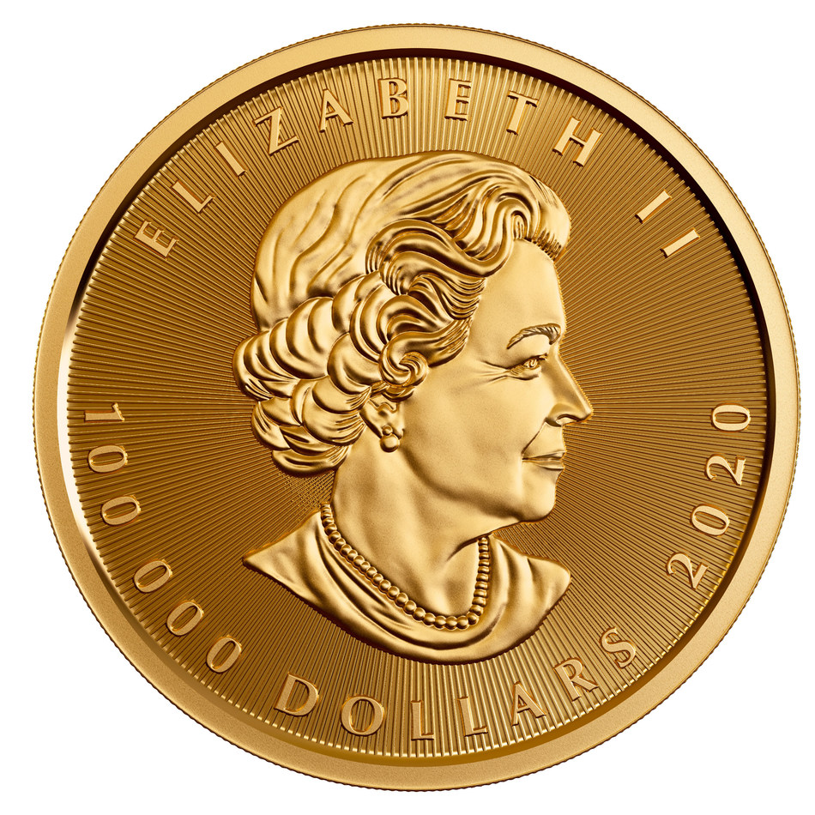

?
Throw 1
Throw 2
What is the probability of getting
a head on the second throw?
$$\frac{1}{2}$$

Slide 10

Throw 1
Throw 2
What is the probability
of throwing two heads?
$$\frac{1}{4}$$

Slide 11
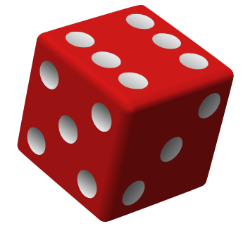

What is the probability of rolling
a 6 on your second roll?
$$\frac{1}{6}$$
Roll 1
Roll 2

Slide 12
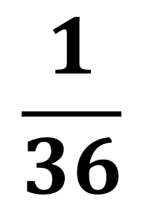
What is the probability of rolling two sixes consecutively?
$$\frac{1}{36}$$
Roll 1
Roll 2

Slide 13
When calculating probability
with multiple events
you need to lookout for the word
AND

Slide 14
When you see the word
AND
you should multiply the probabilities.

Slide 15
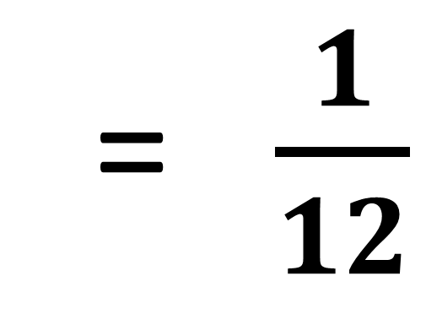
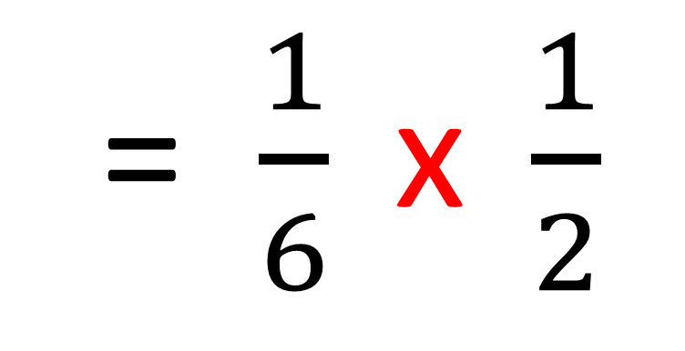
What is the probability
of rolling a 6 and throwing a head?
P(6 and H) = P(6) x P(H)
= $\frac{1}{6} \text{x} \frac{1}{2}$
= $\frac{1}{12}$

Slide 16
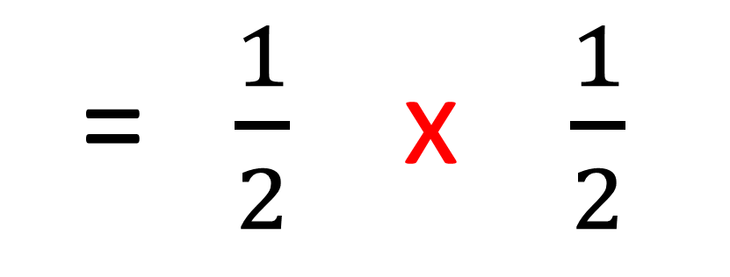
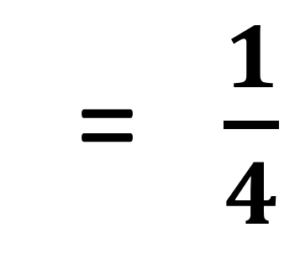
What is the probability
of throwing two consecutive tails?
P(T and T) = P(T) x P(T)
= $\frac{1}{2} \text{x} \frac{1}{2}$
= $\frac{1}{4}$

Slide 17
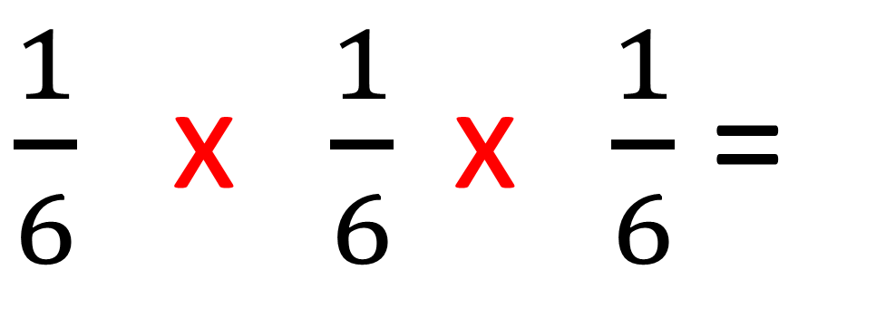
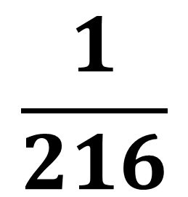
What is the probability of rolling
3 consecutive fives on a dice?
P(5 and 5) = P(5) x P(5) x P(5)
$\frac{1}{6} \text{x} \frac{1}{6} \text{x} \frac{1}{6}$ =
$$\frac{1}{216}$$

Slide 18
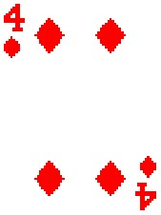

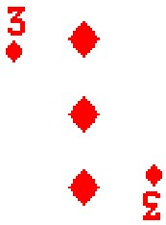
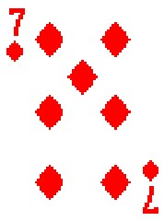
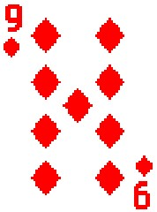
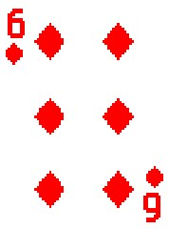
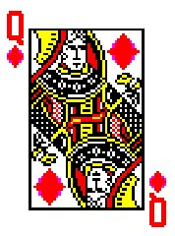


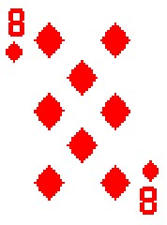
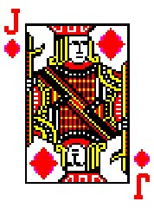
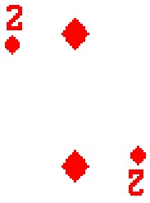
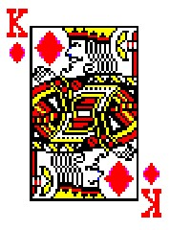
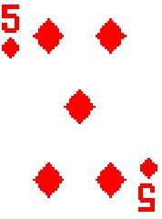
Higher or Lower
A
2
3
4
5
6
7
8
9
10
J
Q
K

Slide 19



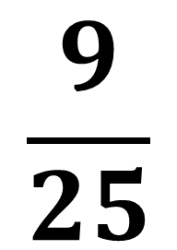
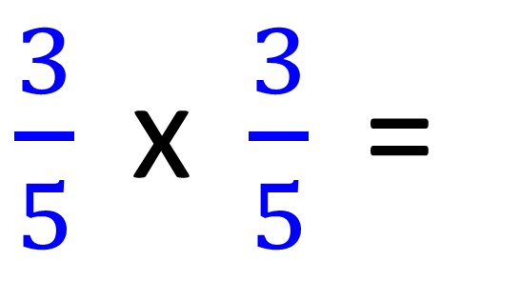
Two counters picked from the bag.
After each counter is taken it is replaced.
What is the probability of getting Blue and Blue?
$\frac{3}{5} \text{x} \frac{3}{5}$=
$$\frac{9}{25}$$

Slide 20

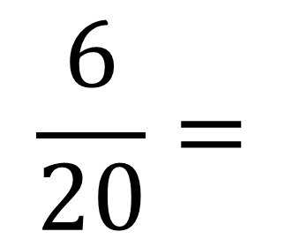
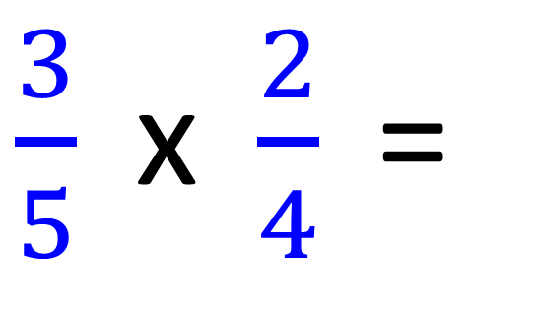
Two counters picked from the bag.
After each counter is taken it is not replaced.
What is the probability of getting Blue and Blue?
$\frac{3}{5} \text{x} \frac{2}{4}$=
$$\frac{6}{20}=$$
$$\frac{3}{10}$$

Slide 21
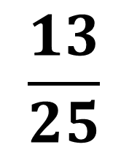
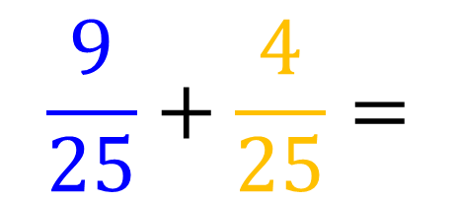
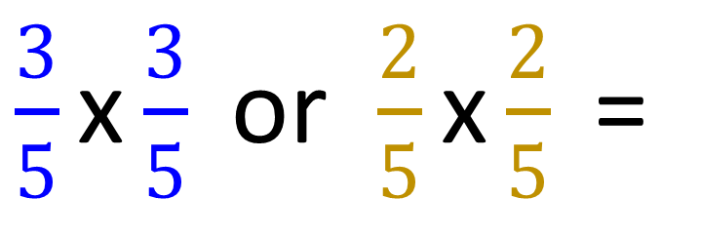
Two counters picked from the bag.
After each counter is taken it is replaced.
What is the probability of getting the same colour?
$\frac{3}{5}\text{x}\frac{3}{5}$or $\frac{2}{5}\text{x}\frac{2}{5} \text{=}$
$$\frac{9}{25}+\frac{4}{25}=$$
$$\frac{13}{25}$$

Slide 22
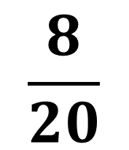
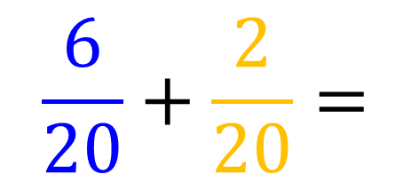
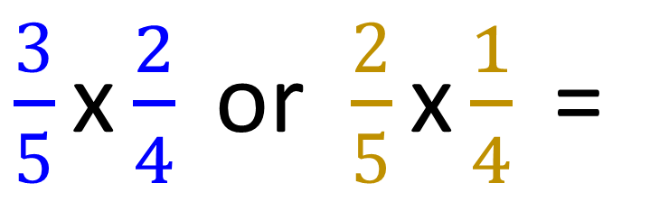
Two counters picked from the bag.
After each counter is taken it is not replaced.
What is the probability of getting the same colour?
$\frac{3}{5}\text{x}\frac{2}{4}$or $\frac{2}{5}\text{x}\frac{1}{4} \text{=}$
$$\frac{6}{20}+\frac{2}{20}=$$
$$\frac{8}{20}$$

Slide 23
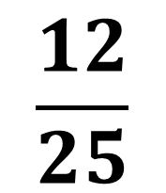
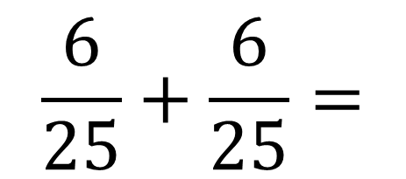
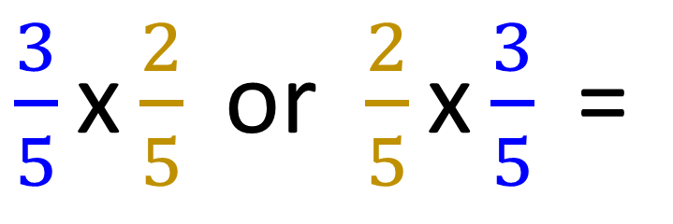
Two counters picked from the bag.
After each counter is taken it is replaced.
What is the probability of getting different colours?
$\frac{3}{5}\text{x}\frac{2}{5}$or $\frac{2}{5}\text{x}\frac{3}{5} \text{=}$
$$\frac{6}{25}+\frac{6}{25}=$$
$$\frac{12}{25}$$

