Slide 1
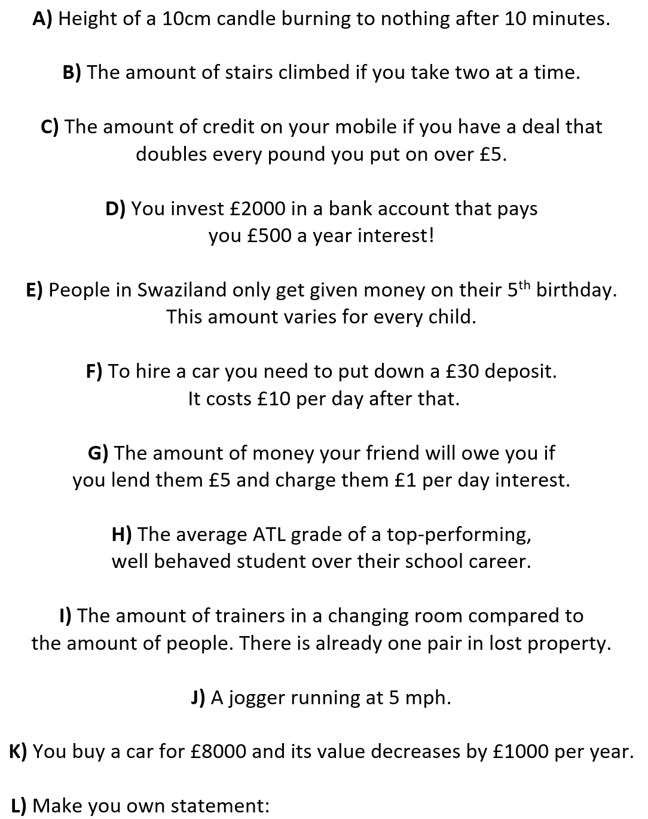
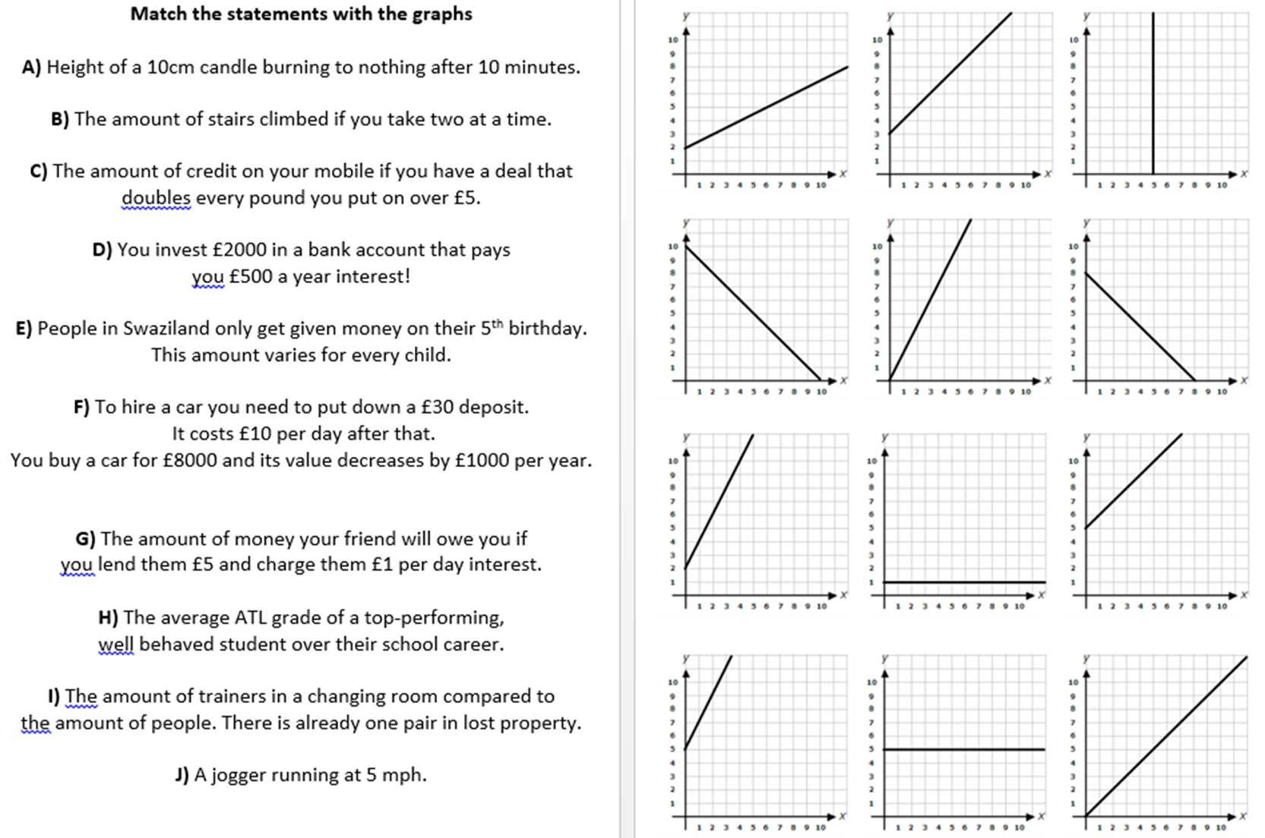
D
F
E
A
K
B
I
L
G
J
C
H

