Slide 1
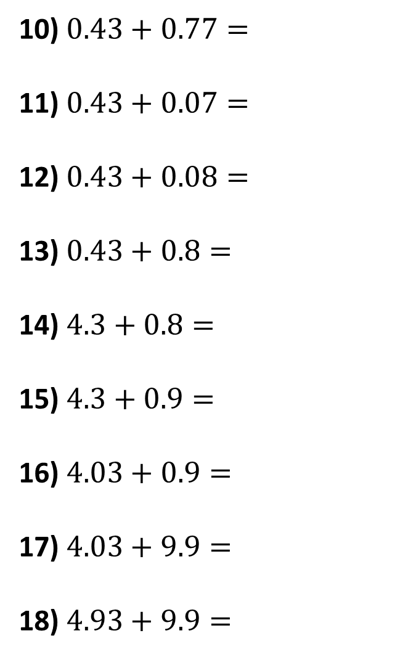
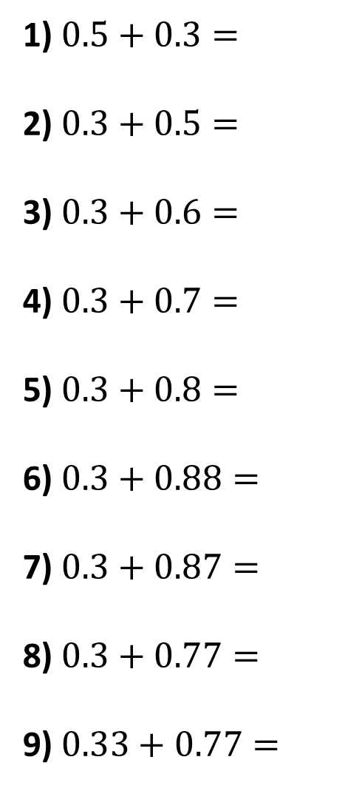
1) $0.5+0.3=$
2) $0.3+0.5=$
3) $0.3+0.6=$
4) $0.3+0.7=$
5) $0.3+0.8=$
6) $0.3+0.88=$
7) $0.3+0.87=$
8) $0.3+0.77=$
9) $0.33+0.77=$
10) $0.43+0.77=$
11) $0.43+0.07=$
12) $0.43+0.08=$
13) $0.43+0.8=$
14) $4.3+0.8=$
15) $4.3+0.9=$
16) $4.03+0.9=$
17) $4.03+9.9=$
18) $4.93+9.9=$

Slide 2
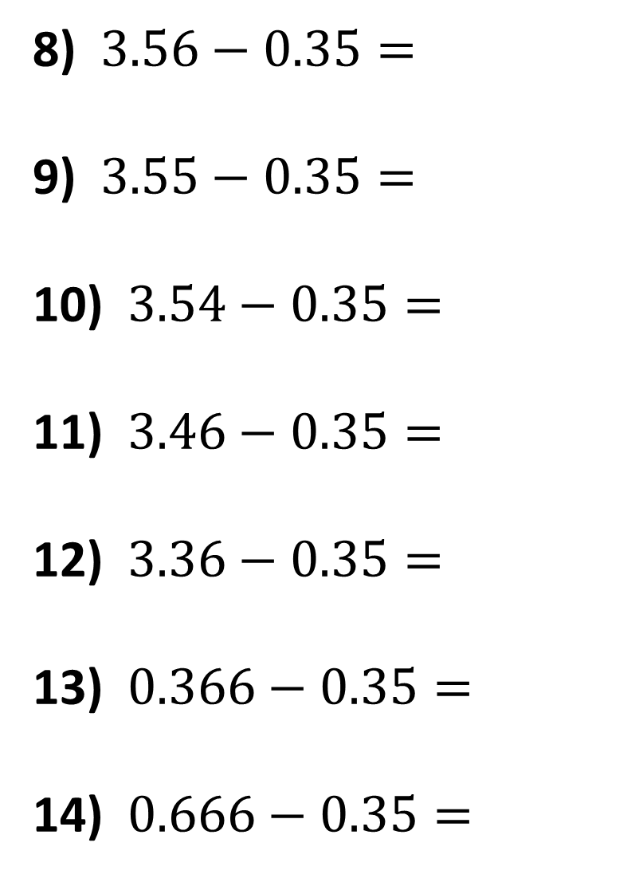
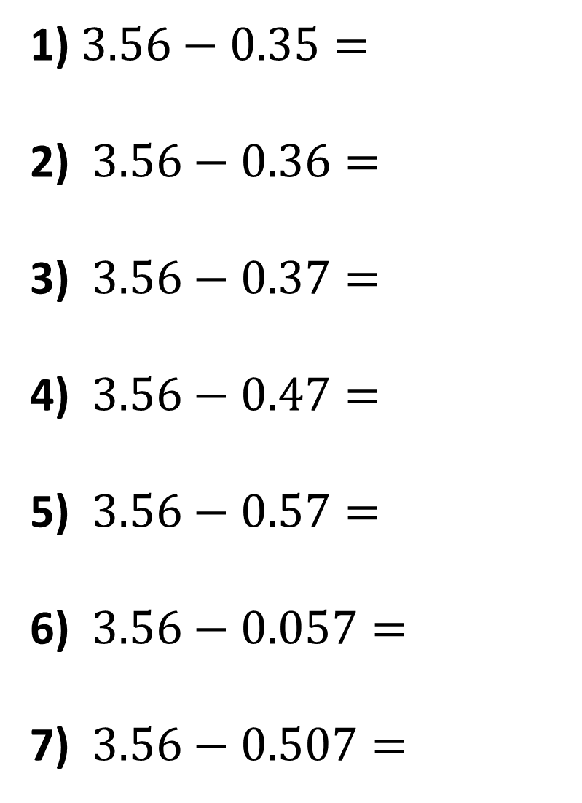
1) $3.56−0.35=$
2) $3.56−0.36=$
3) $3.56−0.37=$
4) $3.56−0.47=$
5) $3.56−0.57=$
6) $3.56−0.057=$
7) $3.56−0.507=$
8) $3.56−0.35=$
9) $3.55−0.35=$
10) $3.54−0.35=$
11) $3.46−0.35=$
12) $3.36−0.35=$
13) $0.366−0.35=$
14) $0.666−0.35=$

Slide 3
ANSWERS

Slide 4


















$$0.8$$
$$1.2$$
1) $0.5+0.3=$
2) $0.3+0.5=$
3) $0.3+0.6=$
4) $0.3+0.7=$
5) $0.3+0.8=$
6) $0.3+0.88=$
7) $0.3+0.87=$
8) $0.3+0.77=$
9) $0.33+0.77=$
10) $0.43+0.77=$
11) $0.43+0.07=$
12) $0.43+0.08=$
13) $0.43+0.8=$
14) $4.3+0.8=$
15) $4.3+0.9=$
16) $4.03+0.9=$
17) $4.03+9.9=$
18) $4.93+9.9=$
$$0.8$$
$$0.5$$
$$0.9$$
$$0.51$$
$$1$$
$$1.23$$
$$1.1$$
$$5.1$$
$$1.18$$
$$5.2$$
$$1.17$$
$$4.93$$
$$1.07$$
$$13.93$$
$$1.1$$
$$14.83$$

Slide 5














1) $3.56−0.35=$
2) $3.56−0.36=$
3) $3.56−0.37=$
4) $3.56−0.47=$
5) $3.56−0.57=$
6) $3.56−0.057=$
7) $3.56−0.507=$
$$3.21$$
8) $3.56−0.35=$
9) $3.55−0.35=$
10) $3.54−0.35=$
11) $3.46−0.35=$
12) $3.36−0.35=$
13) $0.366−0.35=$
14) $0.666−0.35=$
$$3.21$$
$$3.2$$
$$3.2$$
$$3.19$$
$$3.19$$
$$3.09$$
$$3.11$$
$$2.99$$
$$3.01$$
$$3.503$$
$$0.016$$
$$3.053$$
$$0.316$$

